Slide 1
Year 3 Knowledge Organisers Autumn 1 2023

Slide 2
DT

Slide 3
Computing

Slide 4
French

Slide 5
History

Slide 6
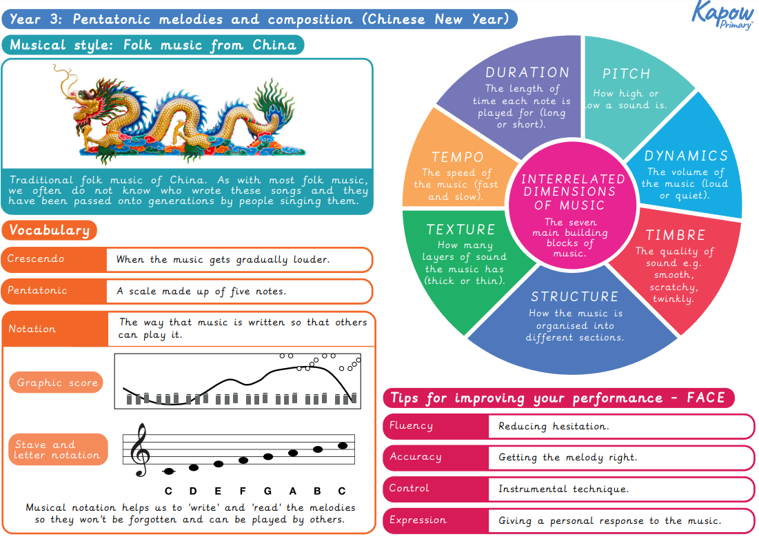
Music

Slide 7
PE Organiser – Y3
Autumn 1

Slide 8
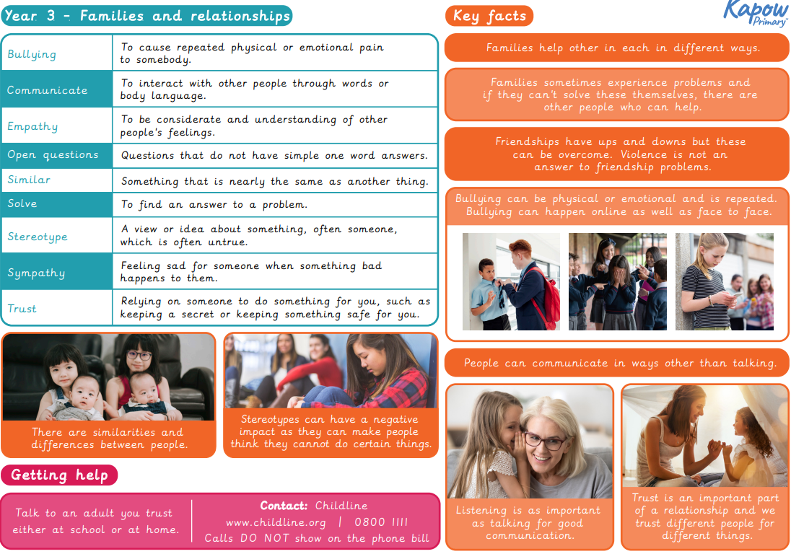
PSHE

Slide 9
RE

Slide 10
Science

