Slide 1

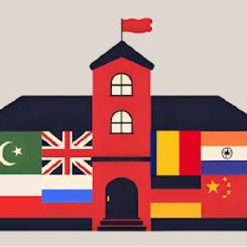
NO OUTSIDERS: EVERYONE BELONGS
Celebrating Diversity and Inclusion in Our School

Slide 2

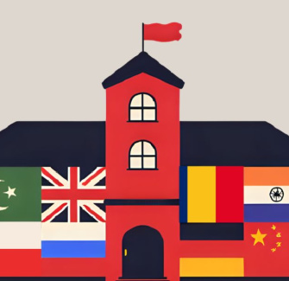
LOOKING AT THE PICTURE
What do you see?
Look closely at the picture. What stands out to you?
Can you spot different shapes, colours, or patterns?
What do you think this picture is about?
This artwork was made by an artist called Fliss.

Slide 3
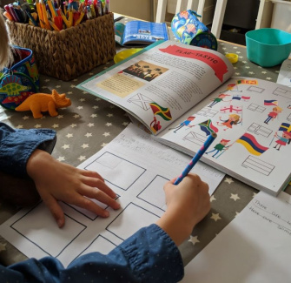
PATTERNS AND FLAGS
Patterns on the School
The walls and windows are made from lots of different flags.
Some flags might look familiar to you!
Can you recognise any of the flags? Which ones do you see?

Slide 4
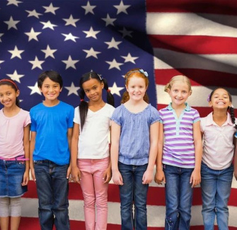
WHAT IS A FLAG?
Flags Around the World
A flag is a special piece of cloth with colours and shapes that stands for a country or group.
People use flags to show where they are from or what they believe in.
Where have you seen flags before?

Slide 5
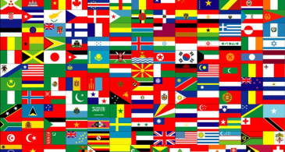
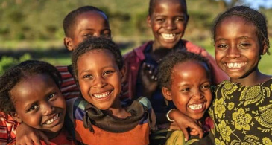
WHY SO MANY FLAGS?
Fliss used many flags to show lots of different countries in her art.
She wanted to celebrate all the colours and cultures.
One flag limits representation; more flags show diverse people uniting.

Slide 6

LIVING LIFE IN COLOUR
Fliss Says:
“I live my life in colour, and this image is a celebration of that spirit.”
What do you think it means to live your life in colour? How do colours make you feel?

Slide 7
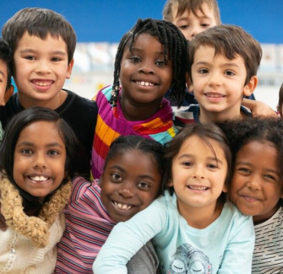
WHAT DOES IT MEAN?
Every Colour and Culture Has a Place
This picture shows that everyone is welcome, no matter where they come from.
Different flags mean different people, but together, they make something beautiful.
What do you think it means when we say, "Where every colour and culture has a place"?

Slide 8



FLAGS IN THE PICTURE
1
2
3
Pakistan
The green and white flag with a crescent and star.
Poland
The red and white flag, simple and bright.
United Kingdom
The Union Jack, with red, white, and blue.

Slide 9


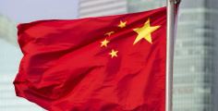
MORE FLAGS SHOWN
4
5
6
Romania
Blue, yellow, and red stripes standing tall.
India
Orange, white, and green with a blue wheel.
China
Red with yellow stars shining bright.

Slide 10
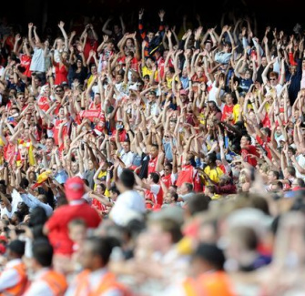
ARE FLAGS IMPORTANT?
What Do Flags Show?
Flags can show where people are from and what they are proud of.
During the Women's World Cup, lots of people waved flags to cheer for their teams.
Did you see any flags during the football matches?

Slide 11
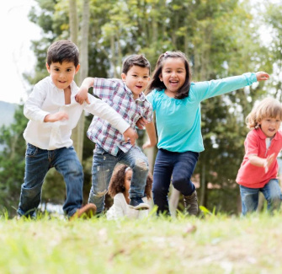
WHAT DO WE SAY?
Our School Says:
Everyone is welcome here.
We are kind to people from every country.
We learn together and help each other.
Why do you think this is important for our school?

Slide 12
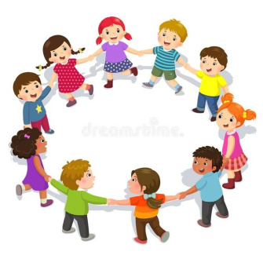
WHAT IS NO OUTSIDERS?
No Outsiders Means:
No one is left out.
Everyone belongs, no matter where they come from.
We celebrate differences and work together.
Which British value do you think this shows?

