Slide 1

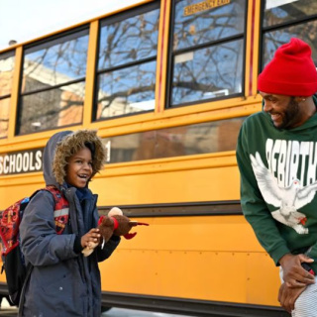
NO OUTSIDERS: THE STORY OF LARRY AND LEVI
Learning About Kindness and Belonging

Slide 2

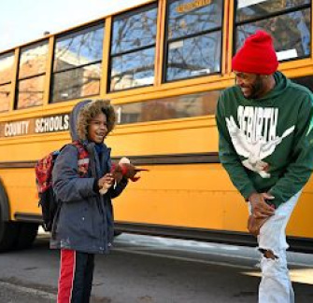
WHO ARE THEY?
Looking at the Picture
Who do you see in this picture?
Where do you think they are going or coming from?
What is behind them?
Let's think about what their roles might be in a story.

Slide 3
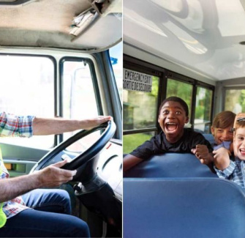
MEET LARRY FARRISH JNR
Larry's Job
Larry is a school bus driver in Louisville, Kentucky, USA. Every day, he drives children to school and gets to know them as they ride the bus together.

Slide 4
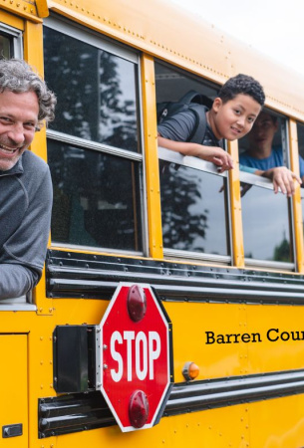
GETTING TO KNOW THE CHILDREN
Why Does Larry Know the Children?
Larry sees the same children every day. He notices their smiles, their moods, and when something is different. He cares about how they feel.

Slide 5
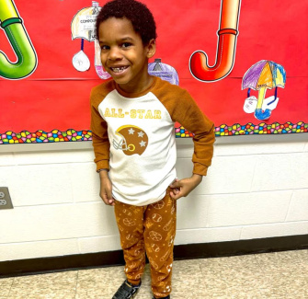
LEVI’S SAD DAY
What Happened to Levi?
One morning, Larry saw Levi looking upset. Levi was sitting on the ground with a jacket over his head, instead of smiling and waiting for the bus.

Slide 6



HOW MIGHT LEVI FEEL?
Upset
He could be feeling sad or left out.
Shy
Levi might feel shy because he doesn't want anyone to see him.
Worried
Maybe Levi is worried about something at school.

Slide 7
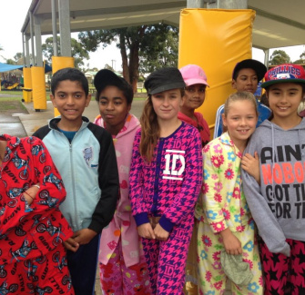
PYJAMA DAY SURPRISE
What is Pyjama Day?
Pyjama Day is a fun school event where everyone wears their pyjamas instead of normal clothes. But Levi was upset because he didn't have any pyjamas to wear.

Slide 8
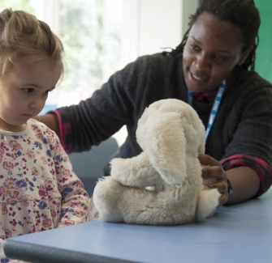
LARRY WANTS TO HELP
Larry’s Big Heart
Larry saw Levi was sad. He wanted to help Levi feel included and happy, so he decided to do something kind after dropping the children at school.

Slide 9

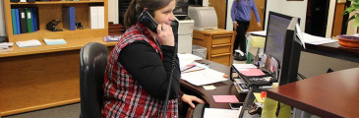
HOW LARRY HELPED
Went Shopping
Larry drove to a shop and bought two pairs of pyjamas for Levi.
Back to School
He took the pyjamas to the school office for Levi.

Slide 10
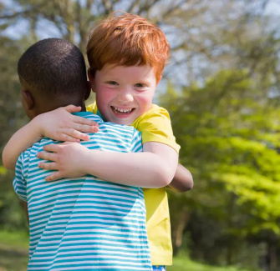
LEVI’S HAPPY CRY
A Special Moment
When Levi got the pyjamas, he hugged them and did a happy cry. He said Larry was nice and his heart was filled with joy.

Slide 11


WHAT DID LEVI LEARN?
People Care
He found out that people want to help and care about him.
Speak Up
Levi learned it's okay to tell someone when you feel upset.

Slide 12


WHAT CAN WE LEARN?
No Outsiders
Everyone should feel like they belong, no matter what.
Be Kind
We can help others feel included, just like Larry did.

Slide 13

KINDNESS AND INCLUSION
▶

Slide 14

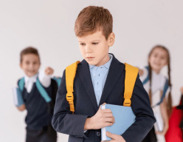
DISCUSS! ​🤷‍♀️​ ​💁‍♂️​ ​💬​
Being a Friend
Imagine you see someone in our class feeling left out or sad, just like Levi. What could you do or say to help them feel included and happy?

Slide 15
DISCUSS! ​🤷‍♀️​ ​💁‍♂️​ ​💬​
​✅​
You might have said...
I would ask them to come and play with me.
I could tell a teacher if I wasn't sure what to do.
I would smile at them and say hello.

Slide 16
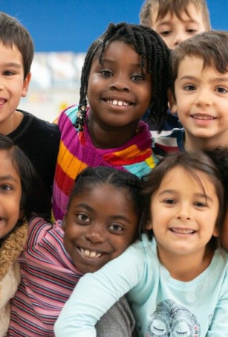
SUMMARY: NO OUTSIDERS
What Did We Learn?
Larry showed kindness and made sure Levi felt included.
Levi learned it’s okay to speak up when you need help.
We can all help make sure there are no outsiders in our school.
Let’s remember to be kind and help everyone belong!

