Slide 1

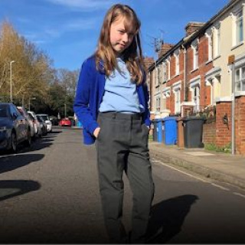
Why Do Girls' Trousers Have Fake Pockets?
Exploring Clothes, Fairness, and Speaking Up

Slide 2
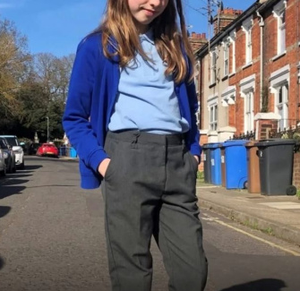
What Do You Notice?
Look at this picture
What is the girl doing?
Where are her hands?
Why might this be important for our story?
Think about how you use your pockets every day.

Slide 3
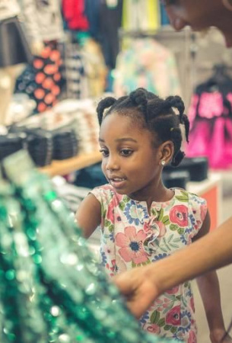
Meet Georgia from Ipswich
Georgia is a young girl from Ipswich, UK. She went shopping for new trousers at Sainsbury's. She was surprised when she tried to use the pockets on girls' trousers—they were fake!
But when Georgia looked in the boys' section, their trousers had real pockets.

Slide 4
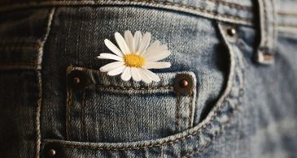
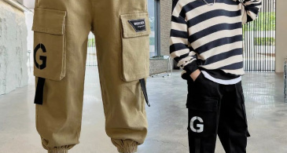
Girls' vs Boys' Trousers
Girls' trousers at the shop had pockets that weren't real. Georgia couldn't put her hands or anything else in them.
Boys' trousers had real pockets you could use. Georgia decided to buy boys' trousers instead.

Slide 5
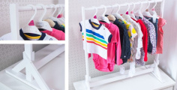

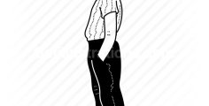
Are Clothes for Boys and Girls?
Are Clothes Gendered?
Do you think it's okay for Georgia to wear boys' clothes? What makes clothes for boys or girls?
Georgia's Choice
She chose boys' trousers because she wanted real pockets.
What Do You Think?
Everyone should wear what they want and have useful pockets.

Slide 6
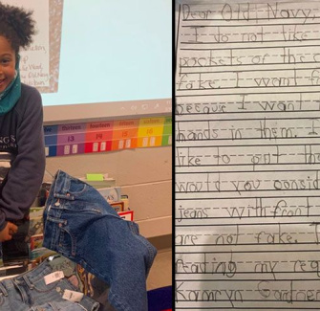
Another Girl's Story
Kamryn Gardner, a girl from America, noticed her jeans also had fake pockets. Her brother’s jeans had real pockets.
Kamryn wanted to do something about it. What do you think she did?

Slide 7
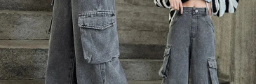

Kamryn Takes Action
1
2
Noticed Problem
Kamryn saw her jeans for girls had fake pockets, but her brother's didn't.
Wrote a Letter
She wrote to the shop, Old Navy, asking for real pockets in girls' jeans.

Slide 8
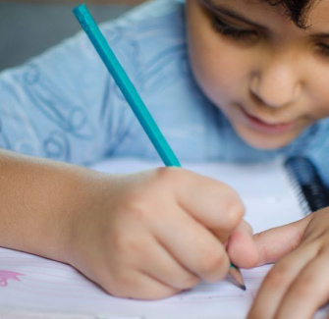
What is Persuasive Writing?
Persuasive writing is when you try to change someone’s mind or get them to do something.
Kamryn used persuasive writing in her letter. She explained why she wanted real pockets and asked the shop to make a change.

Slide 9
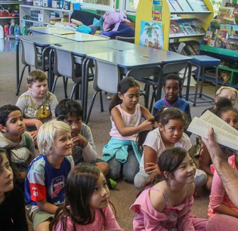
Kamryn's Letter
Dear Old Navy,
I do not like that the front pockets of the girls’ jeans are fake. I want front pockets because I want to put my hands in them. I also would like to put things in them. Would you consider making girls’ jeans with front pockets that are not fake?
Thank you for considering my request.
Kamryn Gardner

Slide 10

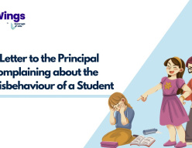
Discuss! ​🤷‍♀️​ ​💁‍♂️​ ​💬​
Making a Change
Kamryn wrote a persuasive letter to Old Navy. Do you think her letter was good at trying to change their mind? Why or why not? What would you write if you wanted to change something you thought was unfair?

Slide 11
Discuss! ​🤷‍♀️​ ​💁‍♂️​ ​💬​
​✅​
You might have said...
Yes, because she explained why she wanted real pockets, not just that she wanted them.
No, because she only asked for one thing. Maybe she should have given more reasons.
I would write about why it's not fair and what I think should happen instead.

Slide 12
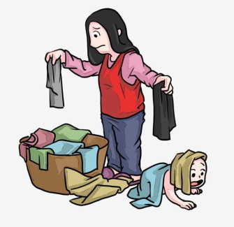
Did the Shops Change?
Old Navy replied to Kamryn, saying thank you for the feedback, but they didn’t promise to change anything.
Georgia in the UK also got a reply from Sainsbury's that didn’t promise to change their trousers.

Slide 13


Georgia Makes a Difference
1
2
Started Petition
Georgia made a petition at her school and sent it to Sainsbury’s.
Real Change
The next year, Sainsbury’s trousers for girls had real pockets!

Slide 14

What Can We Learn?
Speaking Up Matters
Georgia and Kamryn showed that even young people can ask for change.
Sometimes, if you speak up, things can get better for everyone.
This story is about fairness, equality, and British Values like respect and having a voice.

Slide 15

Summary: You Can Make a Difference!
Today we learned about Georgia and Kamryn, who noticed something unfair and spoke up. We explored why pockets matter, how to use persuasive writing, and how anyone can help make things fairer. Remember: your voice matters!
What would you change if you could?

