Slide 1

Welcome to Foundation Stage
A wonderful start to your child’s learning journey

Slide 2
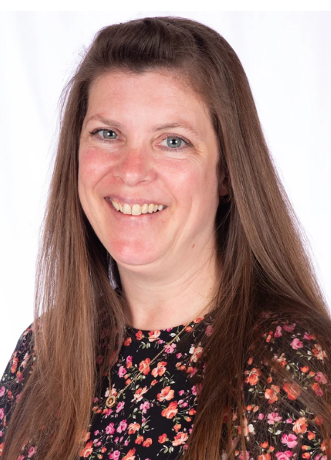
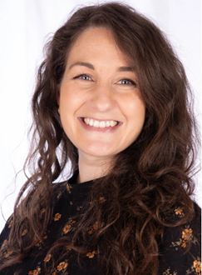
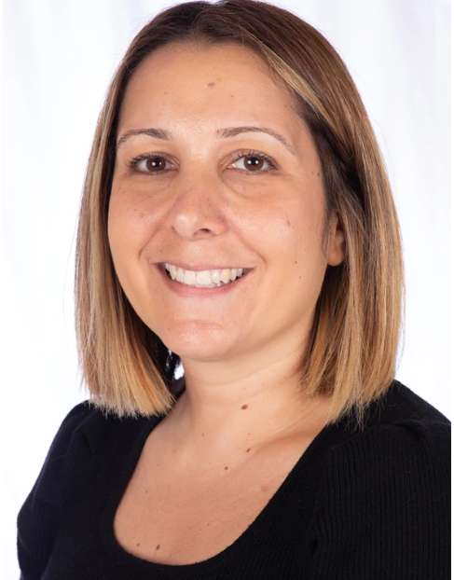
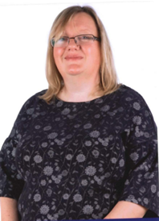
Meet the team
Miss Piacquadio
Maple Class Teacher
Mrs Byott
Holly Class Teacher
Mrs Hillier
Teaching Assistant
Mrs Archer
Higher Level Teaching Assistant (HLTA)

Slide 3
Our Vision
What is foundation stage all about?
❤️ Happy children
🎨 Learning through play
📚 Building confidence
🤝 Developing friendships
🌱 Growing independence
Every child develops at their own pace. We value curiosity, kindness and confidence just as much as reading and maths.

Slide 4
What will my Child Learn?
Communication and Language
Personal, Social and Emotional Development (PSED)
Physical Development
Literacy
Maths
Understanding of the World
Expressive Art and Design
Children learn through play, exploration and practical experiences.

Slide 5
A Typical Day in Reception
8:40 – 8:50 | Classroom jobs Morning work
8:50 – 9:00 | Register and time to share any news
9:00 – 10:00 | Phonics Exploring Time
10:00 – 10:15 | Break time
10:15 – 10:30 | Snack and Story
10:30 – 12:00 | English Exploring Time Handwriting
12:00 – 1:00 | Lunchtime
1:00 – 1:30 | Maths
1:30 – 2:50 | Topic Exploring
2:50 – 3:00 | Golden Time
3:00 – 3:10 | Songs/rhyme time Get ready for home time
Everyday always includes:
Continuous provision
Outdoor learning every day
Balance of adult-led and child-led activities

Slide 6
Learning to Read
Daily Phonics lessons.
We follow Twinkl Phonics Scheme
Your child will initially bring a reading book home with no words. This is to practice story telling and develop comprehension skills. E.g.: What do you think will happen next? Why is he/she feeling sad/happy etc. Once we have learnt our first phonics sounds, children will bring home a reading book with words matched to the sounds they are learning in class. Please try to share the book daily with your child. Five minutes is plenty!
Children will bring home a pencil case that contains the sounds we have learnt that week and any tricky words.
Daily story times.
We will visit the school library once a week. This is usually on a Friday.
You will be invited to a phonics workshop within the first few weeks.

Slide 7
School Ready - What does this mean?
Many people think that being school ready means:
Knowing the alphabet
Counting to 10 or 20
Writing their name
Recognising colours and shapes
Reading simple words
Holding a pencil correctly
While these skills can be helpful, they're not the most important indicators of school readiness.
The following skills are just as important as learning letters and numbers.

Slide 8


Slide 9
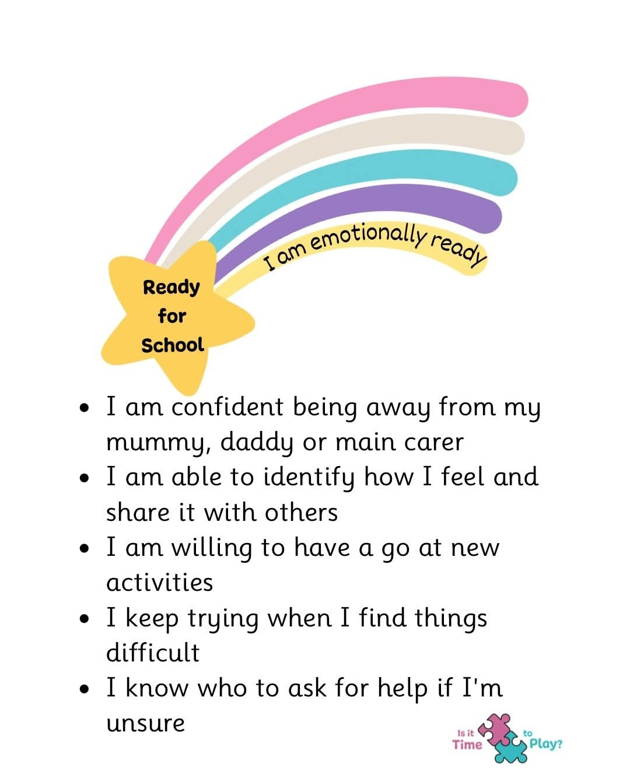

Slide 10
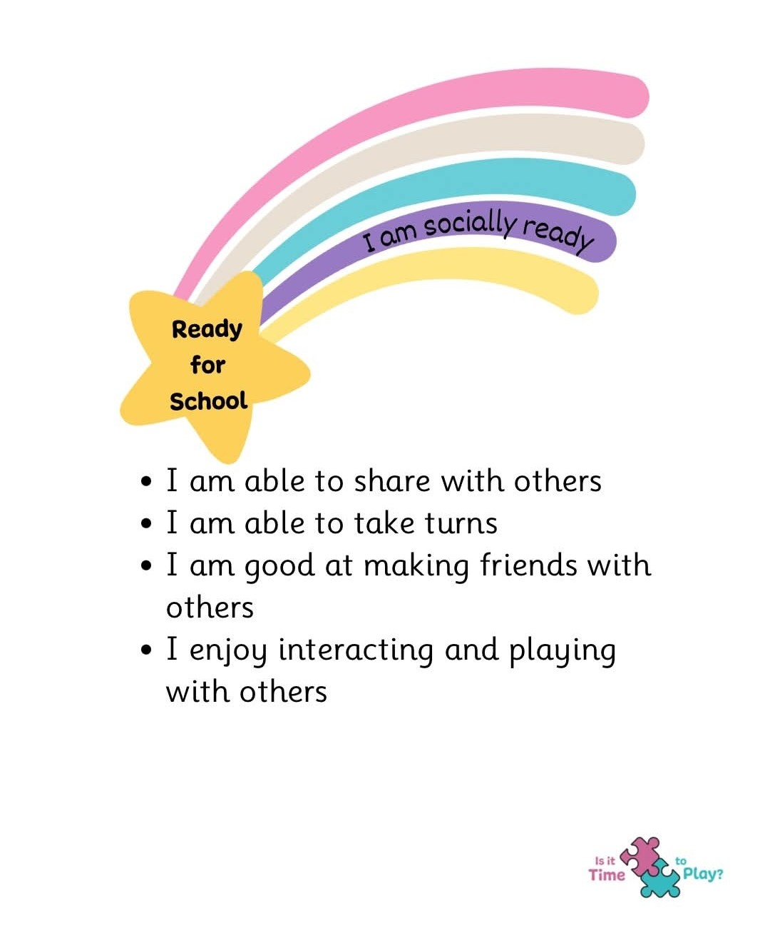

Slide 11
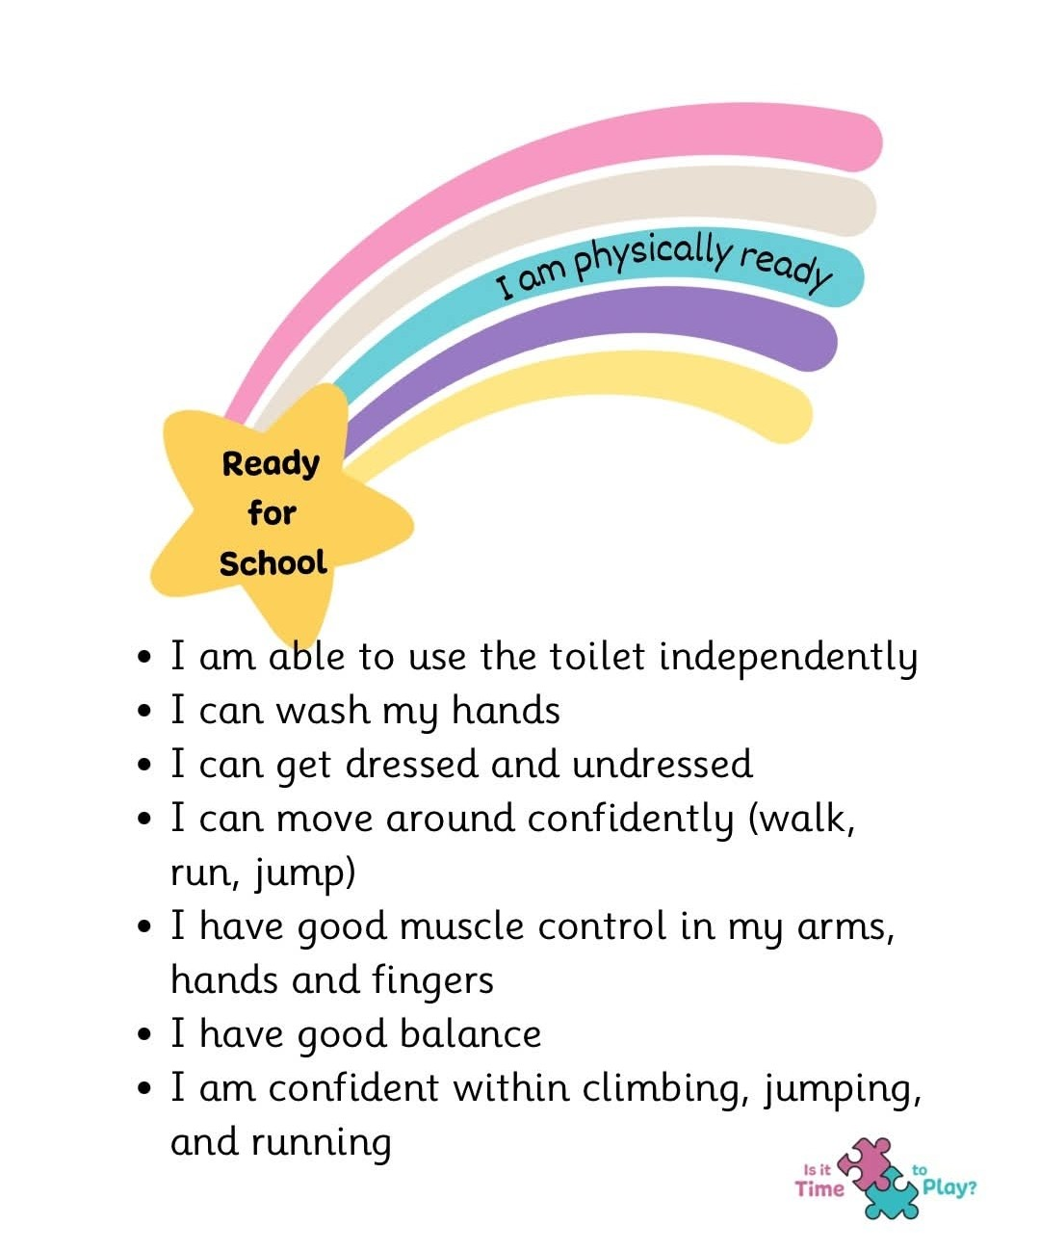

Slide 12
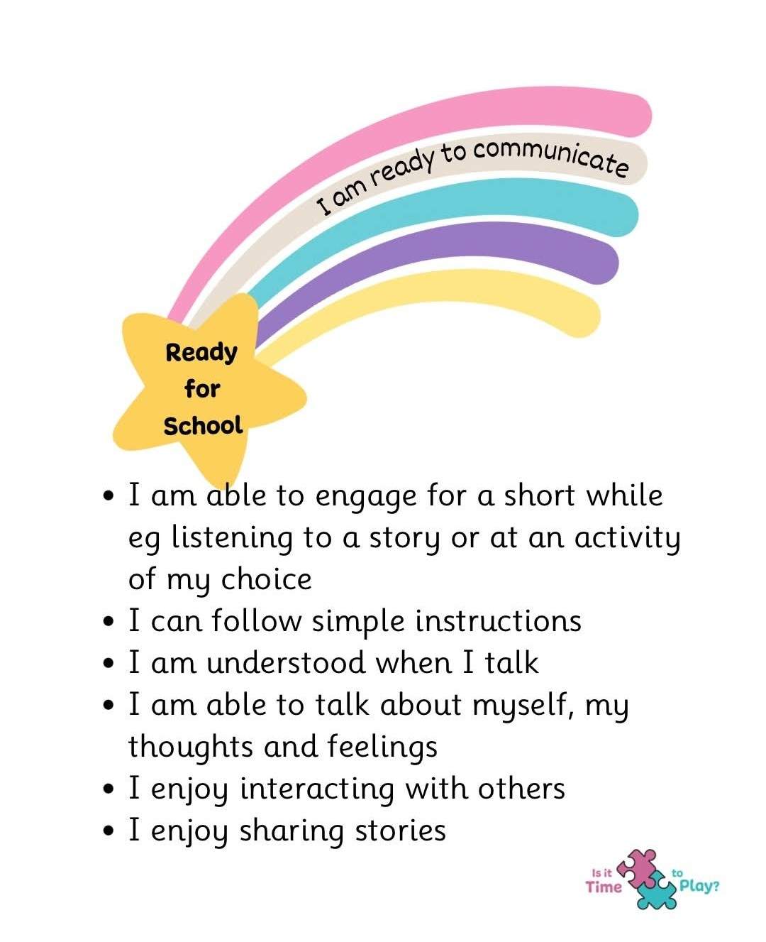

Slide 13
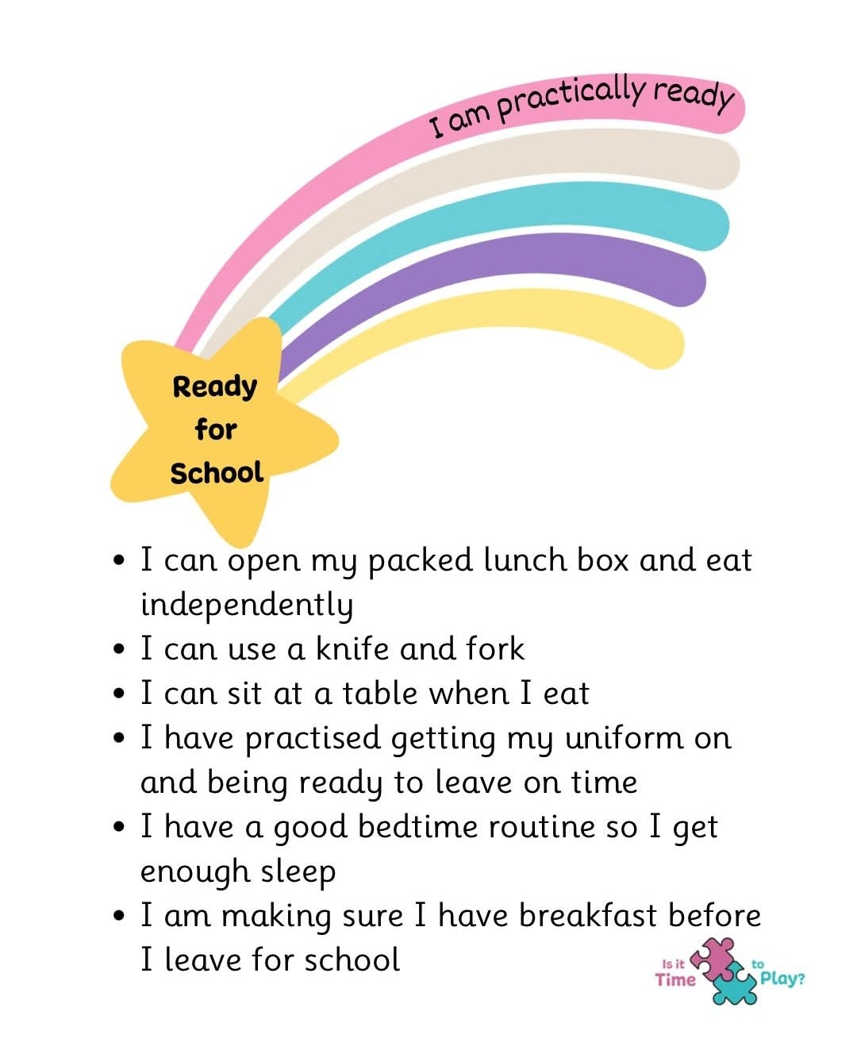

Slide 14
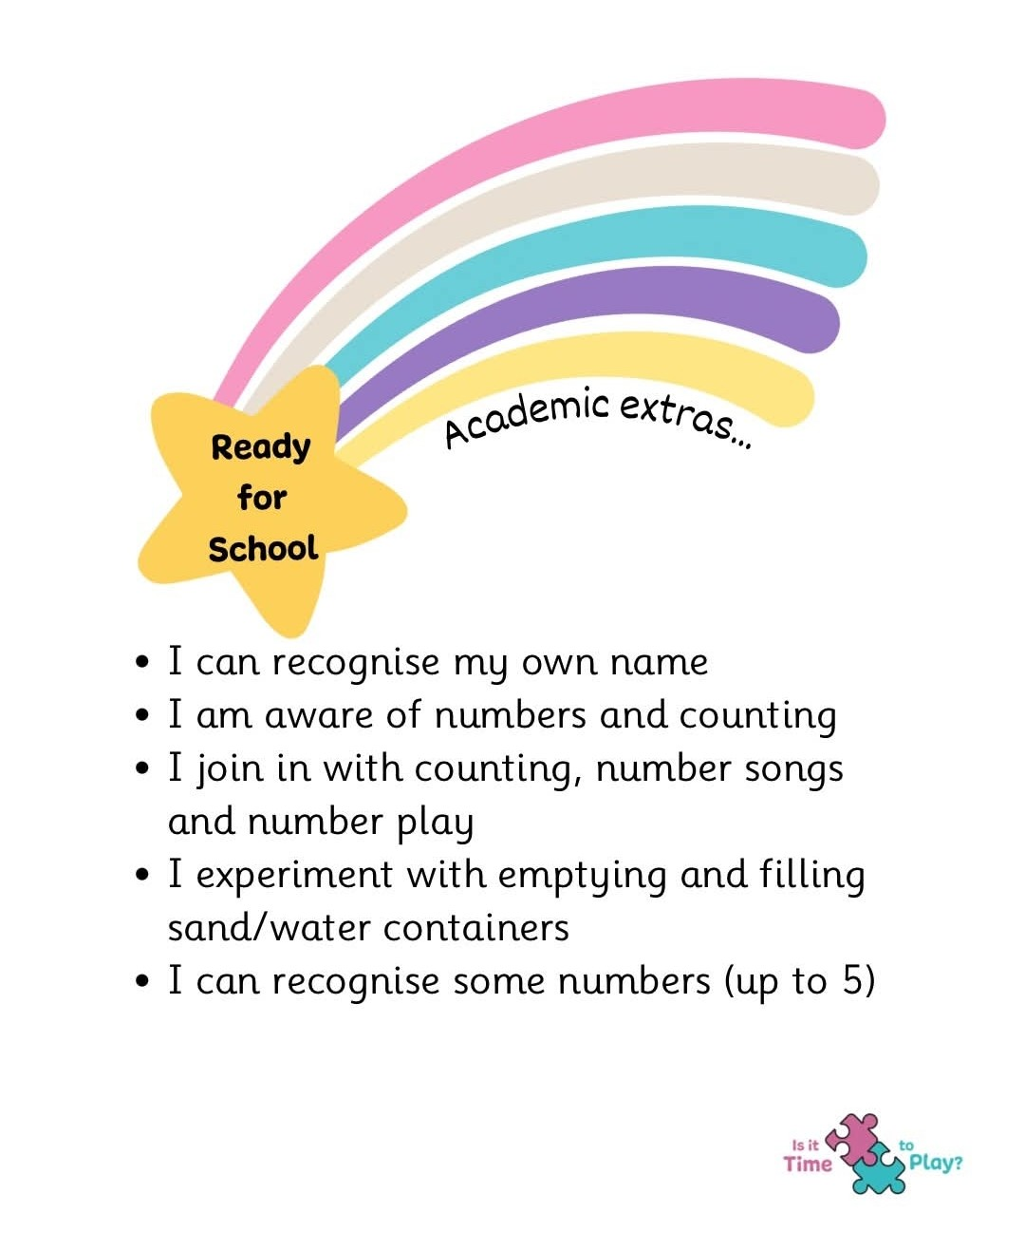

Slide 15
How Can Parents Help?
Keep it positive.
You don't need worksheets!
Instead:
📖 Read together
💬 Talk lots
🔢 Count everyday objects
🎵 Sing nursery rhymes
🎨 Play together
😴 Good sleep routine
Encourage independence
Your child will come home with a home/school communication book. This will contain any important messages, so please check it daily.
It is also for you to let us know any messages. They are checked daily.
When you read at home with your child, please sign to let us know.

Slide 16
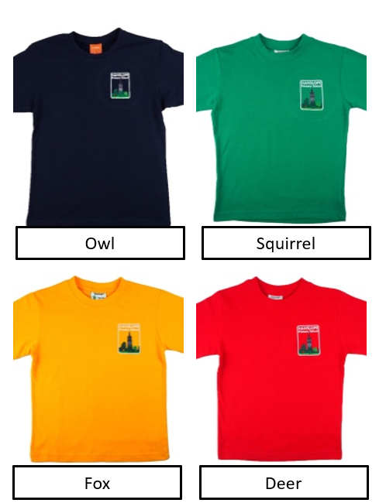
Uniform – Please clearly label EVERYTHING!
Uniform Items:
School bookbag (no rucksacks please as we store these in the children’s tray)
Joggers or leggings: plain black
Polo Shirt: White or light blue with collar
Pullover, Cardigan, or School Sweatshirt/Cardigan: Navy
Shoes: Plain black (no boots) No laces please. Velcro only
Socks: Black, white, or grey
Hair to be tied up everyday
PE Kit – Please send in a bag to keep on peg
Plain black or navy shorts
PE t-shirt in house colour
Plimsolls/trainers in neutral colour (black)
Plain navy or black tracksuit (winter only)
Most items are available from Maisies in Wolverton.
Home – Maisies

Slide 17
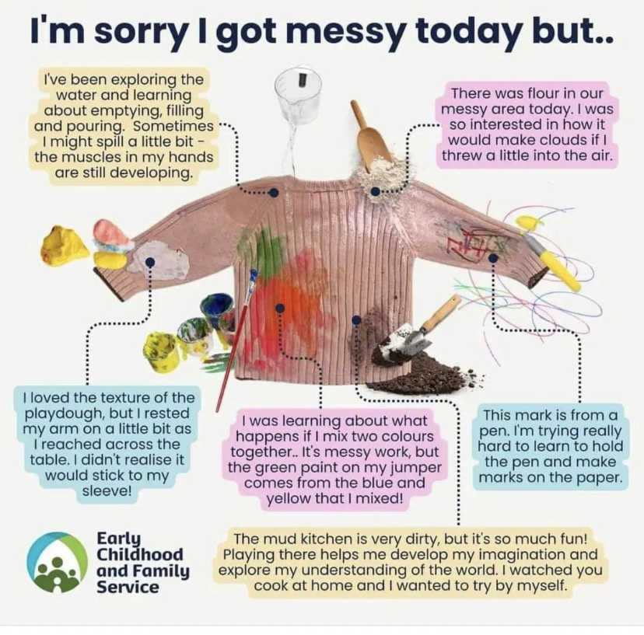
Outdoor Learning
We spend a lot of time in our outdoor area. We ask that every child has the following:
Wellington Boots: Send in a pair of labelled wellington boots.
Waterproof Trousers: Please send in a pair of waterproof trousers for outdoor learning. We ask these are labelled and sent in a labelled bag to store on their peg.
Please also send in a spare set of clothes and spare socks and underwear.
These can be put in the bag with the waterproof trousers.

Slide 18
Other information…
Water Bottles: We will provide your child with a water bottle that we will refill throughout the day and fill with fresh water every morning.
Cool milk: If you would like your child to have cool milk then please order it via the cool milk website. It is free until the week they turn 5, then you will need to reorder and pay on the cool milk website.
Lunches: School hot dinner menus are available on the school website, and parents can order via ParentPay. Alternatively, children can bring a packed lunch. Please remember our school is nut free!

Slide 19
We have several pupils and staff at Hanslope School who have a potentially life-threatening allergy to the following substances:
Ground nuts
Tree nuts
Coconut
Seeds (including sunflower and sesame)
Therefore, PLEASE DO NOT SEND any of these items in any packed lunches.
We also ask that you do not use products containing these substances on your child/children on school days.
Thank you for your co-operation in this manner.

Slide 20
Drop off & Pick Up
Your child starts full time on Wednesday 9th September. Gates open at 8.40am for Salcey playground. We will not be using the All Weather Pitch to begin with.
All children to be dropped off and picked up on Salcey playground in the mornings for at least the first three days.
The school day finishes at 3.10pm.
At home time, we will be releasing children from the sliding doors on Salcey Playground. We will not be using the all weather pitch to begin with.
We will let you know when we will be using the All Weather Pitch. This will be communicated in your child’s home/school book.

Slide 21
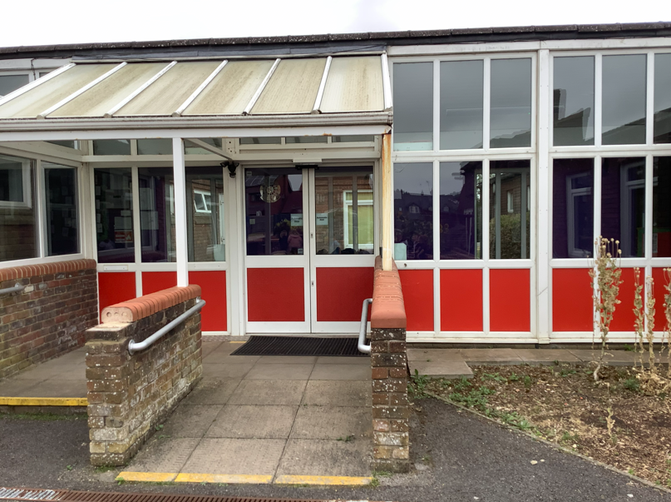

Slide 22
Classes
Will my child be in Maple class or Holly class?
When your children start with us, we will not put them straight into classes. This will allow us to get to know your children and who they are friends with.
Some children that are friends, do not always make good learning friends. They therefore may be in separate classes.
They will be mixing together for a week then we will place the children with a teacher.
We will send you the information once we have split them into two classes. This will be communicated via home/school books.
Please do not worry too much as we all work together in one large room!

Slide 23
Communication
  Staff Email Addresses: Available on the school’s website.
  Joanna.piacquadio@hanslope.milton-Keynes.sch.uk
  Tracey.byott@hanslope.milton-Keynes.sch.uk
  Absence: Please use the ParentMail APP or phone the office
  Urgent Messages: Please call the school office. (We don’t always check emails during the day)
  Non-Urgent Communication: Use the Home School Book.
  Weekly Newsletters: Keep up to date with school news.
  ParentMail: Our communication system for messages and updates.
  Subscribe to Our School Calendar: Available on the website.
  Menus, Policies, and Procedures: All available on the school website.
  Facebook page: Keep up to date with school news: https://www.facebook.com/groups/385370060554710/ ​
We look forward to working with you and your child/ren.

Slide 24
Before you Leave
Before you leave today, please ensure you have:
Signed up for a home/school visit
Checked which house your child is in so you can buy the correct coloured PE t-shirt.
Decided whether you would like your child to have hot dinners. If so, please do not forget to order before the summer holidays start.
Asked us any questions you may have.

Slide 25


Finally Your School Needs You

Slide 26
Questions
Please feel free to ask us any questions you may have.

