Slide 1
Phonics Workshop

Slide 2
Workshop aims
Explain what is phonics?
Show how we teach your child phonics, reading and writing.
Build your confidence in phonics
Share ideas to support your child at home

Slide 3
What is phonics?
Phonics is a method for teaching reading and writing.
It teaches the ability to hear, recognise and use the sounds within words.
Phonics is taught in a systematic synthetic way, and it is the key to children becoming fluent readers.
Synthetic phonics is the method of combining sounds to make words.
Phonics is about the links between letters and the sounds that they make.

Slide 4
Did you know?
There are 26 letters in the alphabet but there are 44 sounds and over 100 different ways of spelling them.
This is why English is one of the most complex languages to learn!

Slide 5
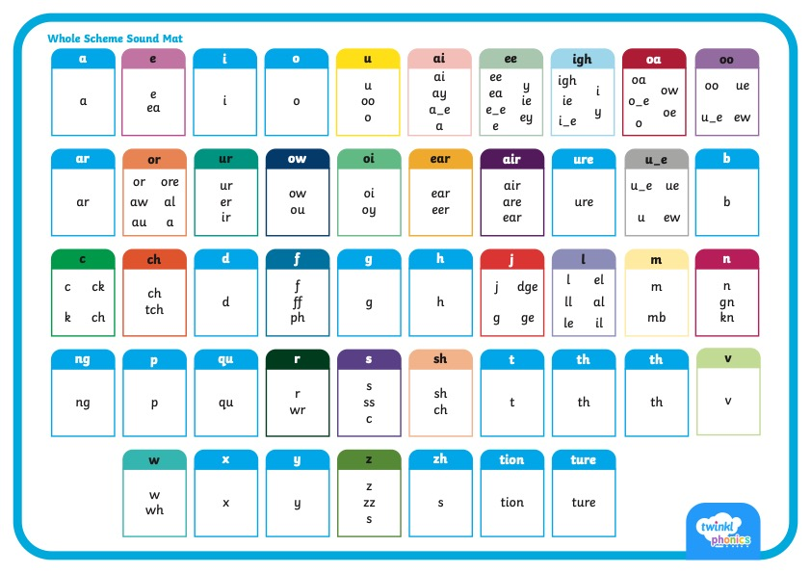

Slide 6
We don’t start alphabetically!
Your child will not learn the letter sound in alphabetical order. Many phonics schemes start with s a t p i n.
Teaching in this order means that your child can start to merge or ‘blend’ sounds together to read simple words almost immediately. Many more simple words can be made with these letters rather than abcdef.

Slide 7
Use letter sounds not names
Phonics is the prime approach to teaching your child to read.
This means they need to learn to match the written letter with the SOUND it makes so they can put these sounds together to read words.
You can’t do this by saying the letter names.

Slide 8
Use Pure Sounds
Avoid adding the /uh/ sound to the end of letter sounds and encourage your child to do the same.
By doing this you will produce the pure sound and your child will find it much easier to blend the sounds to read words.
For example, ‘sun’
SUH-U-NUH SSS-U-NNN

Slide 9
Phonics for reading
First children are taught to read letters, or groups of letters by saying the letter sounds. Encourage early readers to sound out words into their separate sounds and blend these sounds together to read.
They will need to spot when two or three letters are working together to make one sound too.
DIGRAPH
Two letters together that create one sound.
TRIGRAPH
Three letters together that create one sound.

Slide 10
Phonics for writing
When writing words, children are taught to reverse this process saying the word and then segmenting the sounds.
Segmenting is the opposite of blending.
We ‘sound talk’ the word and use our fingers to count how many sounds are in the word.
Cat - c-a-t. 3 sounds the first sound I make with my mouth is ‘c’.
Once we have ‘sound talked’ the word we write down the sounds we heard.

Slide 11
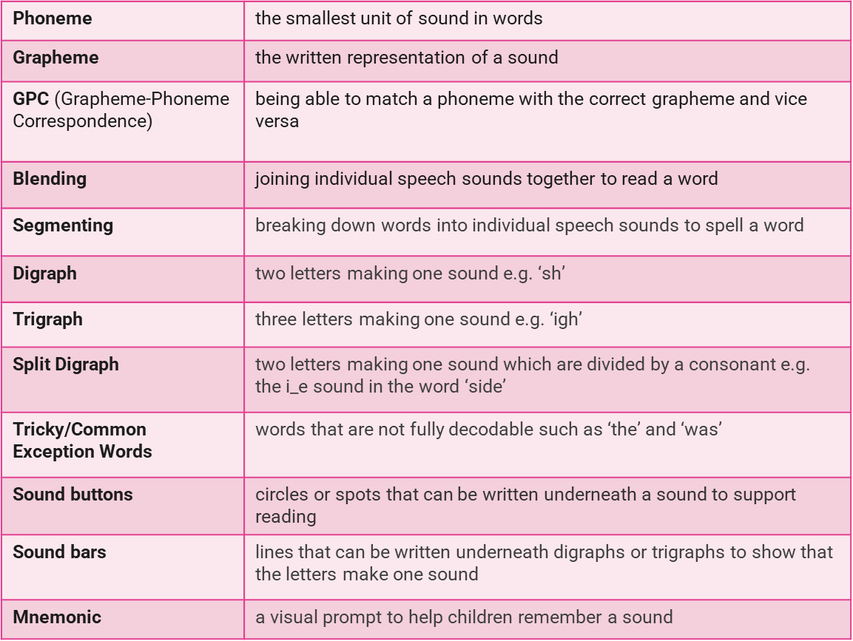
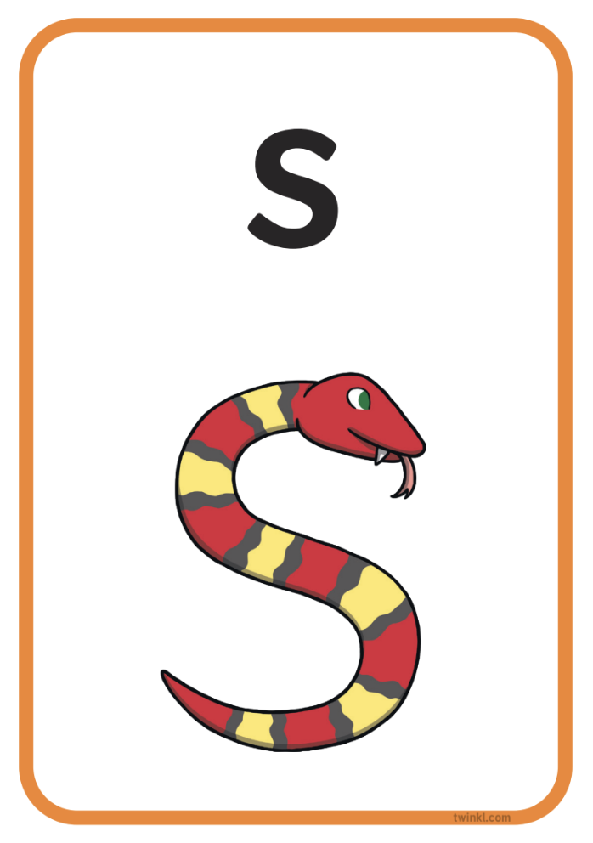

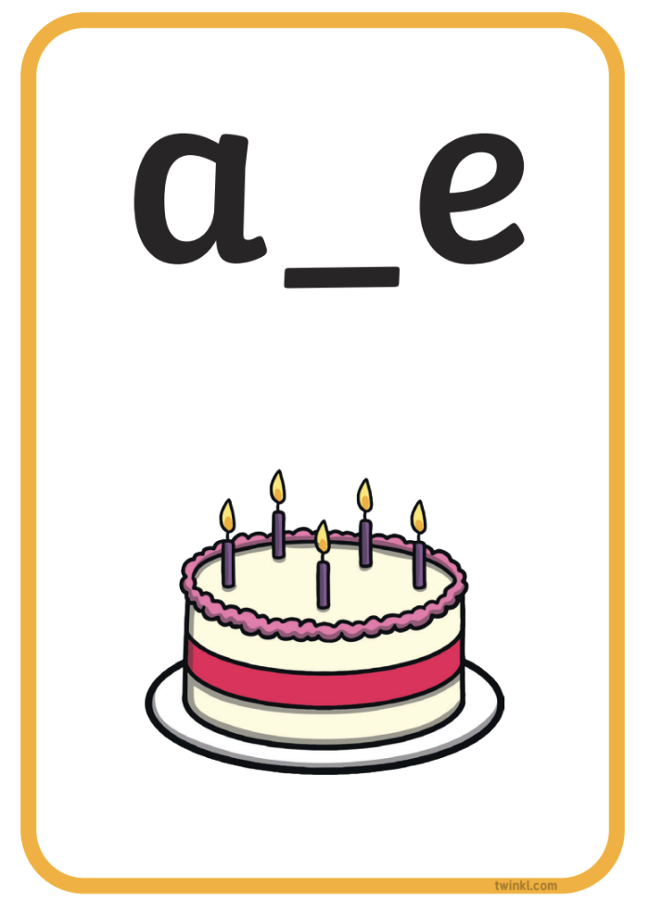

here is some of the terminology you might hear as your children begin to learn phonics.

Slide 12

At Hanslope Primary School, we use the Twinkl Phonics scheme.
This is split into 6 levels, from pre-school to Year 2.
Level 1 – takes place at Nursery/ Pre-school. In this phase children’s speaking and listening skills are developed. Phonics / letters should not be introduced at this stage
Twinkl have their own Twinkl Phonics on Youtube which tell you how to say the sounds correctly and give you the action the children use
https://www.youtube.com/watch?v=0SzkjubQ-Ok

Slide 13
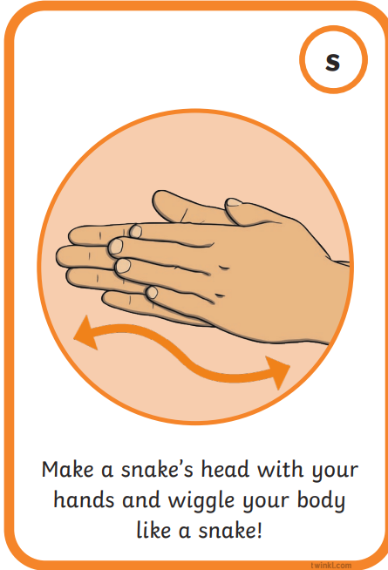
Sounds are taught using an action in level 2 and 3
Sounds and actions will be sent home in the sound bag once taught as a complete set.

Slide 14
Level 2
This phase is taught in the Reception class (Maple/Holly).
Children are taught 19 phonemes and graphemes.
By the end of Level 2 many children should be able to read some Vowel Consonant (VC) words e.g. at, in and some Consonant Vowel Consonant (CVC) words e.g. sat, pin.
Children will also begin to spell the words.

Slide 15
Level 2
Set 1: s, a, t, p
Set 2: i, n, m, d
Set 3: g, o, c, k
Set 4: ck, e, u, r
Set 5: h, b, f, ff, l, ll, ss

Slide 16
Children are also taught some tricky words or common exception words.
These are words that can not be segmented and blended. They just have to be learnt!
the, to, I, no, go, into
These will be sent home for you to practise with your child

Slide 17
Level 3
This phase is also taught in the Reception class (Maple/Holly).
Children are taught the next 25 phonemes and graphemes.
Most of these letters are digraphs two letters one sound. e.g. oa as in boat, coat (a vowel digraph) and sh as in ship, shop (a consonant digraph).
More tricky words!
he, she, we, me, be, was, you, they, all, are, my, her.

Slide 18
Level 3
Set 6: j, v, w, x
Set 7: y, z, zz, qu, ch
Consonant digraphs: sh, th, ng
Vowel digraphs: ai, ee, igh, oa, oo, ar, or, ur, ow, oi, ear
Final set: air, ure, er
Followed by a few weeks of consolidation!

Slide 19
Level 4 Reception/year 1
This phase consolidates all the children have learnt in the previous phases.
Children learn to blend and read words containing adjacent consonants e.g. stop, twin, grab.
More tricky words are learnt as well; said, have, like, so, do, some, come, were, there, little, one, when, out, what.

Slide 20
Level 5 Year 1
Children will be taught new graphemes.
Vowel digraphs: wh, ph, ay, ou, ie, ea, oy, ir, ue, aw, ew, oe, au.
Split digraphs: a_e, e_e, i_e, o_e, u_e.
They will also be taught alternative spellings for sounds and the rules of when to use them. Eg ai – ay.
When spelling words children learn to choose the appropriate graphemes to represent phonemes.
More tricky words!
oh, their, people, Mr, Mrs, looked,
called, asked, could.

Slide 21
Level 6 year 2
By this phase children should be able to read hundreds of words by;
Reading the words automatically
Decoding them quickly and silently because their sounding and blending routine is now well established
Decoding aloud
Spelling should be phonetically accurate although it may still be a little unconventional at times!
The focus in Level 6 is on learning spelling rules and patterns. They will revise all the sounds learned through reading and writing

Slide 22

READING MATTERS!
The ability to read is fundamental to learning and absolutely affects the chances children get in life. Teachers want ALL children in their care to succeed and the PARTNERSHIP between home and school is vital in ensuring success!

Slide 23
READ, READ, READ!
Whenever possible let your child see you reading for a variety of different purposes. This will really influence your child’s attitude to reading.
Reading for pleasure is a key predictor of later academic success.
Try to read the book sent home from school as often as possible too and PLEASE record in the homeschool book.

Slide 24
How you can help your child at home!
Work on listening skills, taking turns and encouraging your child to look at you when you are speaking..
Look for familiar sounds and words in the world around you. Such as, when in the supermarket, can your child find words on your shopping list or recognise letters on food packaging?
When outside, can they recognise letters on street names or on car number plates?
When in the house, can they recognise letters or words in magazines or letters you receive?

Slide 25
How you can help your child at home!
As they are introduced to a new sound, children are taught how to write it correctly. It would be great if you could model this at home.
It is really important that children learn to form the letters using the correct letter formation when writing.
Letter formation posters were given to you along with a whiteboard in the packs before they started school.

Slide 26
How you can help your child at home!
Try to read to and with your child every day.
Practise the new sounds and graphemes your child brings home using the Parent Information Sheets. Remember to use ‘pure’ sounds when pronouncing the sounds and model the correct letter formation as is taught in school.
Finally, remember to ask your child’s class teacher if you are unsure about any aspect of your child’s phonics learning. A consistent approach is important..

Slide 27

Sharing a book at home
Talk about the title, the pictures and the information on the front and back cover and ask what your child thinks the book might be about.
Look at the illustrations and talk about what they can see happening in the story. What is happening, why, what do you think …… is feeling ?
Look at inside the over, it shows the sounds and words that will be found in the book. Tricky words are found in red text.
Once you have looked at the whole book and discussed the story then tell your child that they are going to read the words to match the story.

Slide 28
Blending
Ask your child where they start reading.
Encourage them to put their fingers under the first letter and imagine pressing the sound button.
Say the sound.
Move to the next letter and say the sound.
Once all letters have been sounded out run finger under the word as they blend the word.
If your child gets stuck on a word encourage them to segment it by saying the letter sounds individually and then putting them together quickly to hear the word.
If they are still struggling support them by blending the sound yourself. They should find it easier at the beginning to blend words when you are saying the sounds.
c
a
t

Slide 29
When will we change the reading book?
We will change a book when you have signed the home school diary, to show that it has been shared.
We will move the children onto the next reading set once all the sounds from that set have been taught at school, in line with OFSTED requirements.

Slide 30
When will we change the reading book?
Worded books will be sent home once we have taught the sounds in set 1 , 2 and 3 – s,a,t,p,i,n,m,d,g,o,c,k.
Children need to be confident with reading sounds and blending simple VC and CVC words before bringing texts home.
Practise the sounds sent home along with the actions.
We will change the books 3 times a week at the start. This reduces to twice a week as the texts become longer.
Why do we do this?
Reading is not just about reading words it is all about comprehension. Fluent reading supports comprehension. For this to happen children need to re-read text so that they are not only focusing on decoding but also experiencing what fluency feels like. Fluency develops more in year 1 and into yr 2.

Slide 31
Thank you for listening!
We hope that you have a better understanding
of how we teach phonics, reading and writing at
Hanslope Primary School.
If you have any questions or need support please contact us, either face to face at pick up time or
by emailing
Tracey.byott@hanslope.milton-keynes.sch.uk
Or
Joanna.Piacquadio@hanslope.milton-keynes.sch.uk

