Slide 1


Slide 2
Dates and times:
Depart Hanslope: 10:00am Wednesday 29th April
Arrive back at Hanslope 15:30pm Friday 1st May
We will keep you informed via WhatsApp. Please ensure you have the school mobile phone number saved on your phone (07516199377).
For the coach, children will not need anything – lunch will be provided when we arrive

Slide 3
Who is going?
Mrs Curtis (Residential Leader, DSL, Year 4 Teacher and SENCo)
Mr Mistry (Year 4 Teacher)
Mrs Bull (LKS2 leader and Year 3 Teacher)
Mr Lawrence (Site Manager)

Slide 4


Where are we going?

Slide 5
Virtual Tour…
https://vimeo.com/106273922?fl=pl&fe=sh

Slide 6

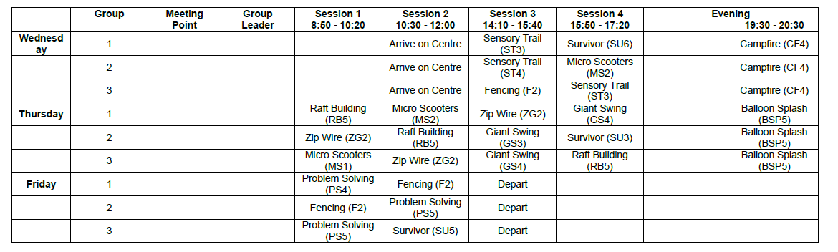
What will we be doing?

Slide 7
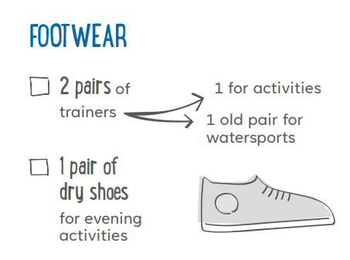
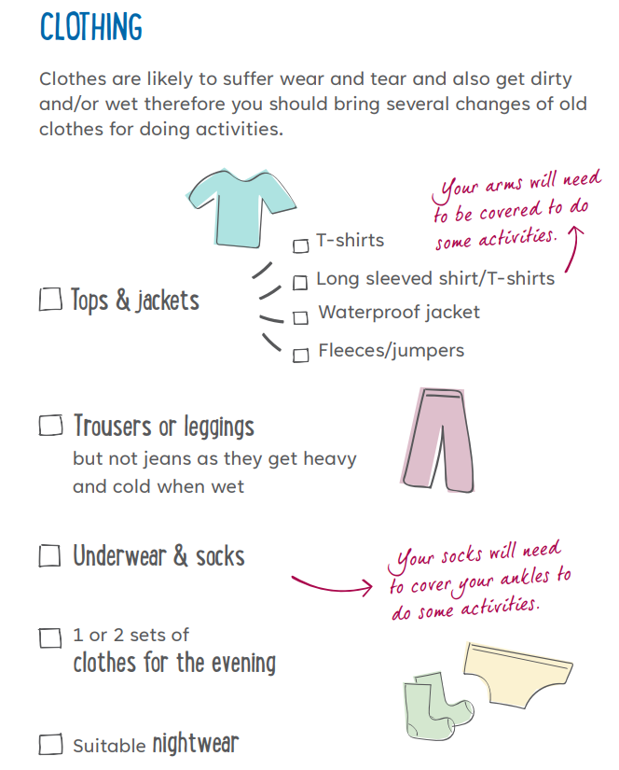
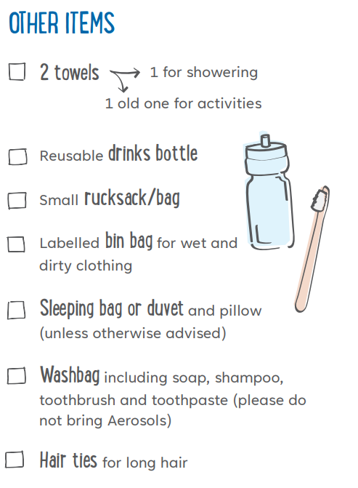

What will we need to pack?
DO NOT BRING ANY ELECTRONICS
Not needed.

Slide 8
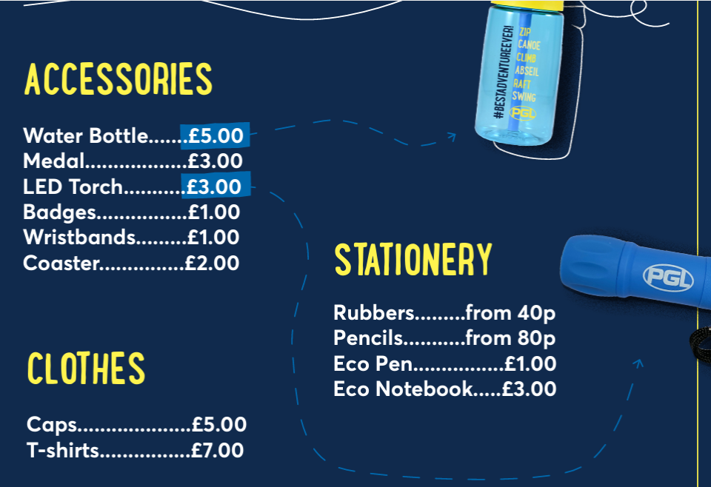

Money
We recommend the children bring no more than £10 cash for the shop which they need to keep safe in a purse until our allocated shop time.

Slide 9
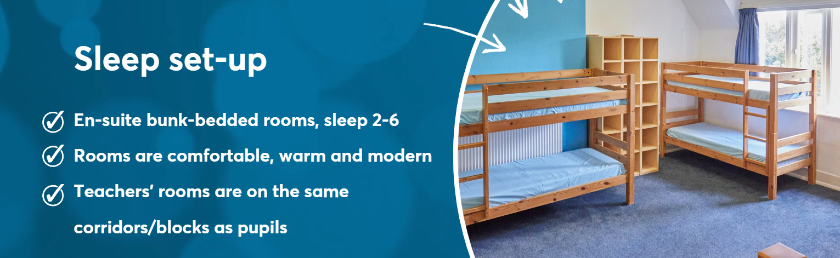
Where will we be sleeping?

Slide 10
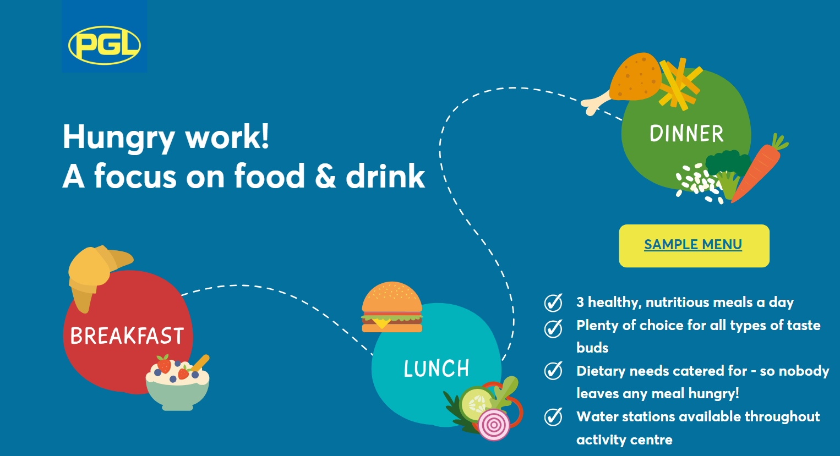
What will we be eating?

Slide 11

Safety and security

Slide 12
Medication
Monday 20th April
Please begin sending in the medication from Monday 20th April. It needs to be clearly labelled with the correct form and taken to the office.
Forms are at the front if you need one.
Fri. 24th Apr.
ALL Medication needs to be in by Friday 24th April so it can be checked and accounted for.

Slide 13

Any questions?

