Slide 1

Phonics workshop

Slide 2
Workshop aims:
Explore how phonics is taught at Hanslope
See progression throughout KS1
Share ideas to support your child at home
Phonics screener information

Slide 3
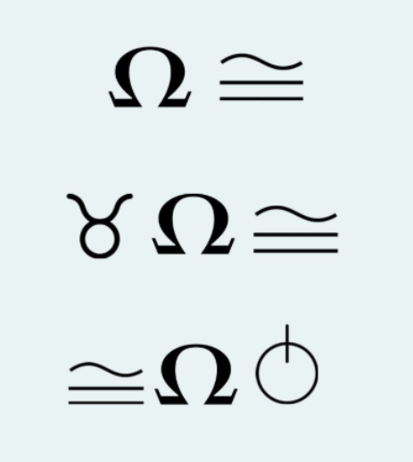
Can you read these symbols?

Slide 4
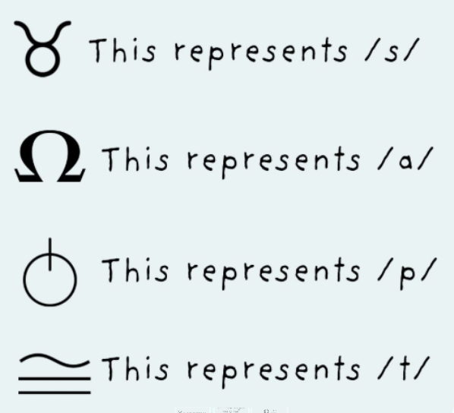
What about now?

Slide 5
What is phonics?
Phonics teaches children how letters and sounds work together to help them read and write.
Children learn to recognise sounds and blend them together to make words.
Phonics is taught systematically and helps children become confident, fluent readers.

Slide 6
Why phonics matters
There are 26 letters in the alphabet but there are 44 sounds and over 100 different ways of spelling them.
This is why English is one of the most complex languages to learn!
Phonics helps children to decode these unfamiliar words accurately.

Slide 7
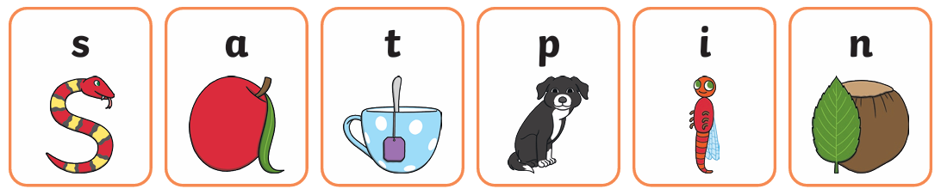
Teaching sounds
Phonics is not taught in alphabetical order.
Most phonics schemes often start with
s, a, t, p, i, n because these can be blended together to read lots of simple words quickly.

Slide 8
Pure sounds
Children need to learn the sound letters make rather than their letter names. Then they can blend the sounds together to read the words.
Use pure letter sounds without adding an ‘uh’ sound. This makes it easier for your child to blend the sounds together and read the word.
For example, ‘sun’
SUH-U-NUH SSS-U-NNN

Slide 9
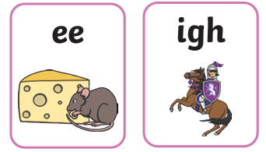
Blending for reading
First children are taught to say letter sounds, then blend the sounds together to read words.
They also learn that two or three letters can sometimes work together to make one sound.
DIGRAPH
Two letters together that create one sound.
TRIGRAPH
Three letters together that create one sound.

Slide 10
Segmenting for writing
For writing, children learn to segment words into their individual sounds, count the sounds, and then write the letters that represent them.
For example, if we were writing ‘sat’ we would sound out s-a-t and then write the word.

Slide 11
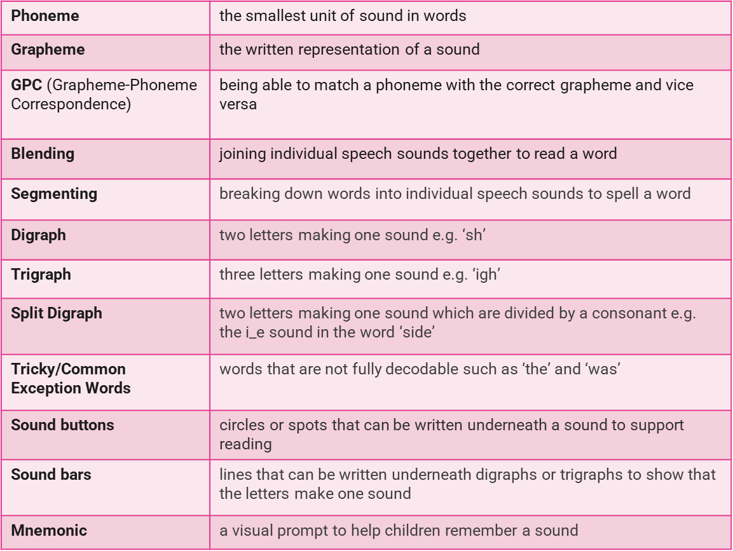
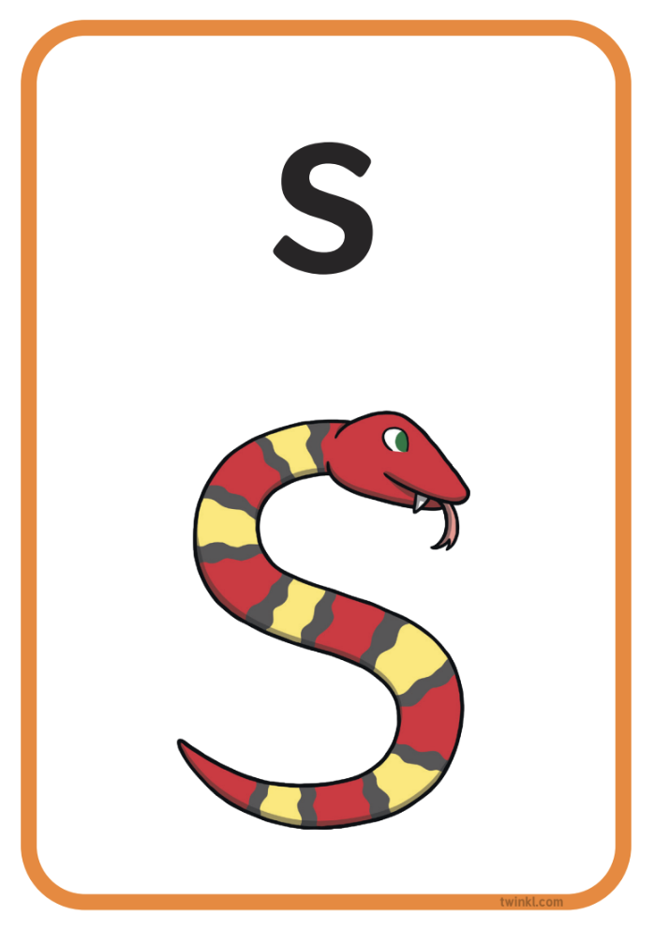
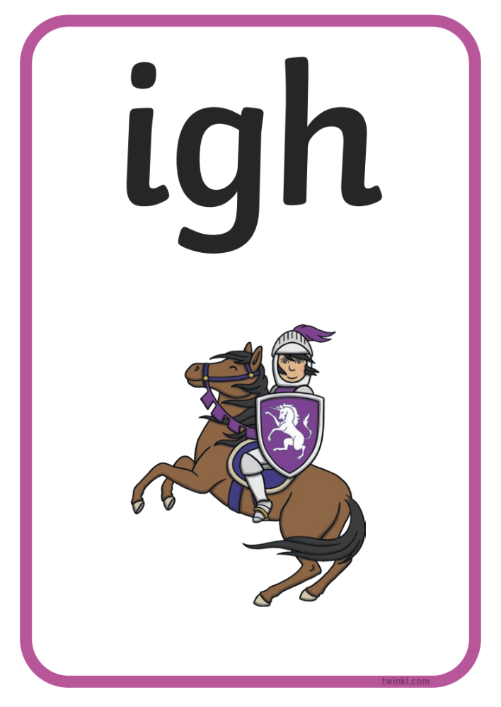
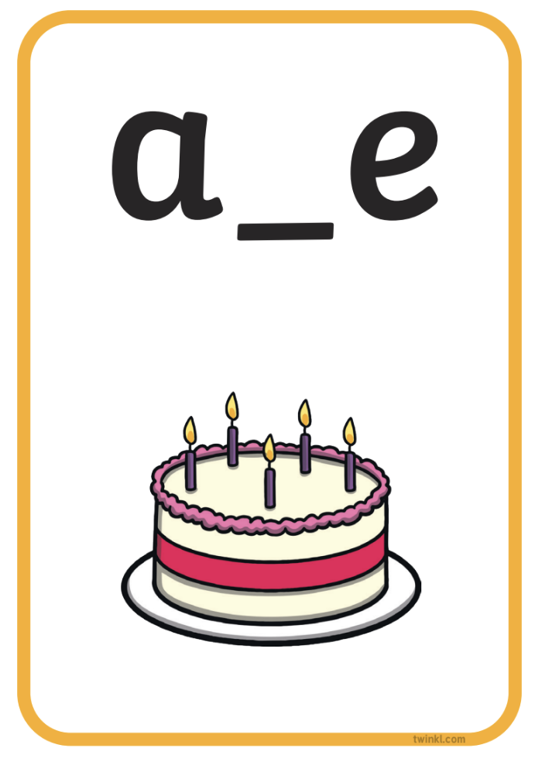

Key phonics vocabulary:

Slide 12
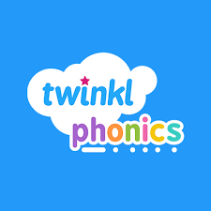
Twinkl Phonics
At Hanslope Primary School, we follow the Twinkl Phonics Programme.
The scheme has six levels from pre-school to Year 2.
In each year group, new sounds and words are introduced. Twinkl provides YouTube videos showing the correct sound and action at each level to support your child:
https://www.youtube.com/watch?v=0SzkjubQ-Ok

Slide 13
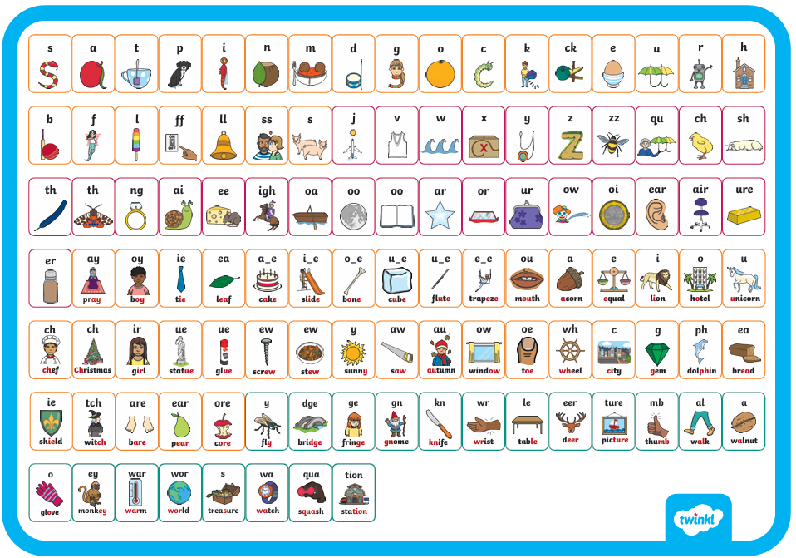
KS1 phonics scheme overview:

Slide 14
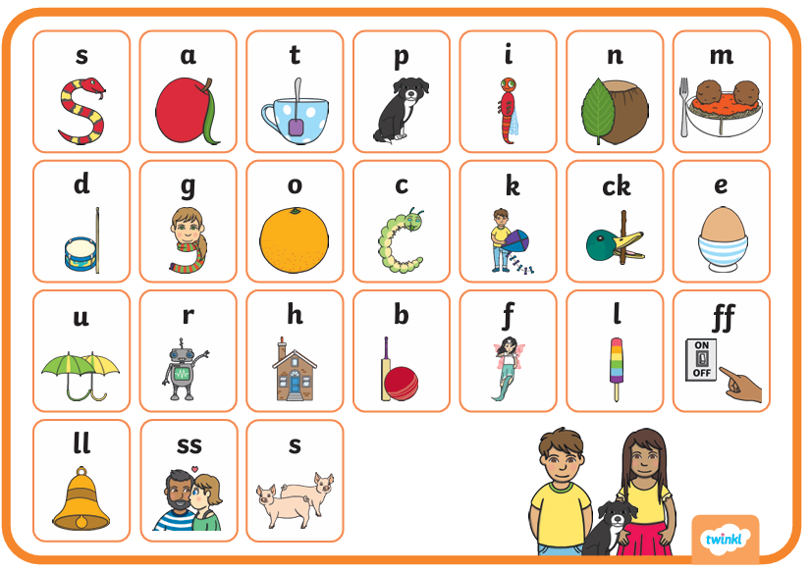
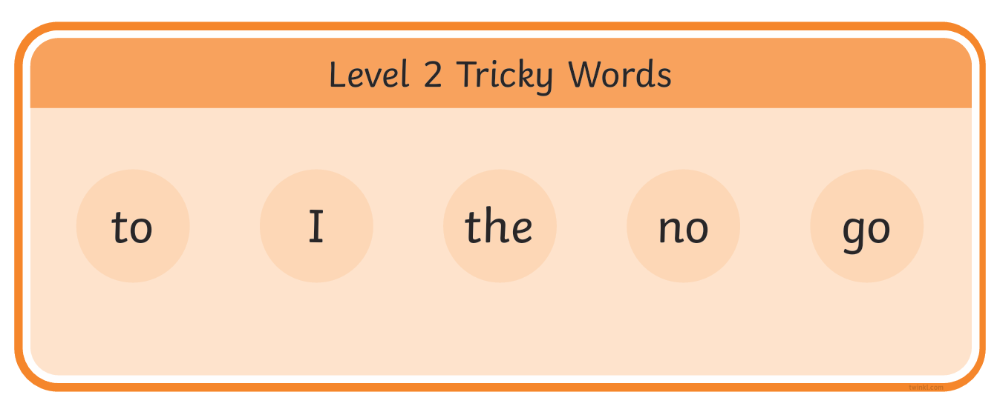
Level 2:
Level 2 is taught at the start of foundation (Maple and Holly class).
Children learn phonemes and graphemes and begin reading and spelling simple VC and CVC words, such as at, in, sat and pin.
Your child will also learn tricky words that cannot be sounded out and must be memorised:

Slide 15
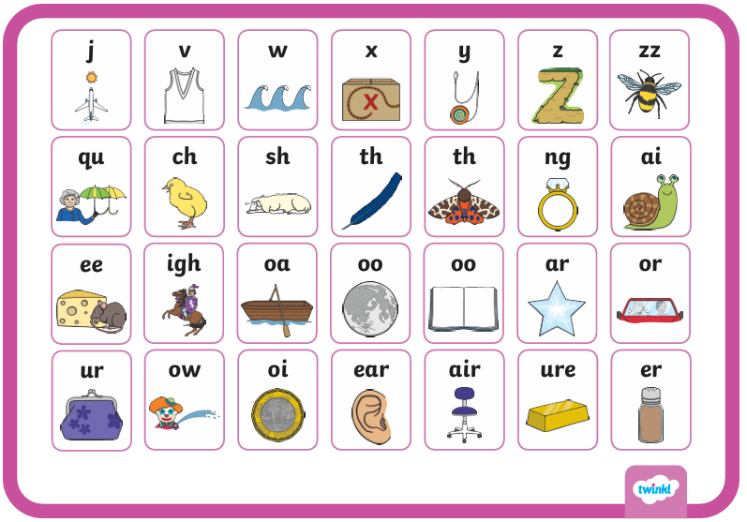
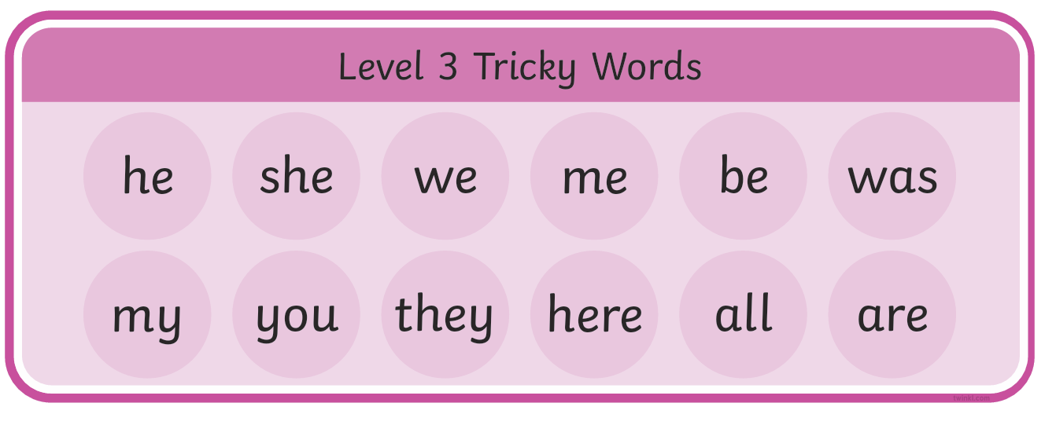
Level 3:
Level 3 is also taught in foundation (Maple and Holly class) and recapped at the start of Year 1.
Children learn more phonemes and graphemes, including digraphs (two letters making one sound) and trigraphs (three letters making one sound).
Your child will also learn more tricky words:

Slide 16
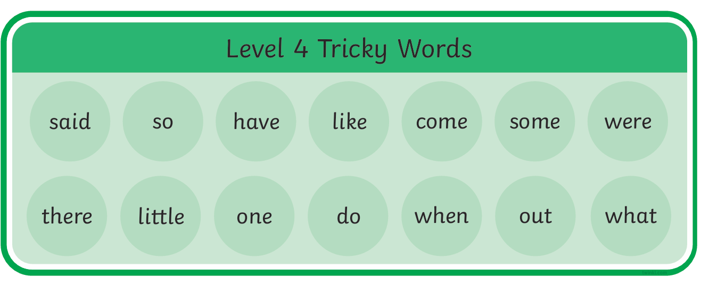
Level 4:
Level 4 is also taught in foundation (Maple and Holly class) and recapped at the start of Year 1.
Level 4 consolidates previous learning. Children practise blending and reading words with adjacent consonants, such as stop, twin and grab.
Your child will also learn more tricky words:

Slide 17
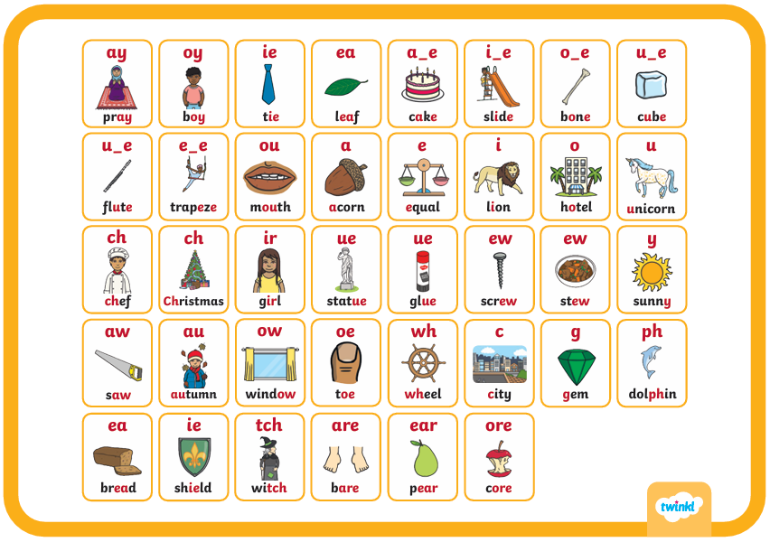
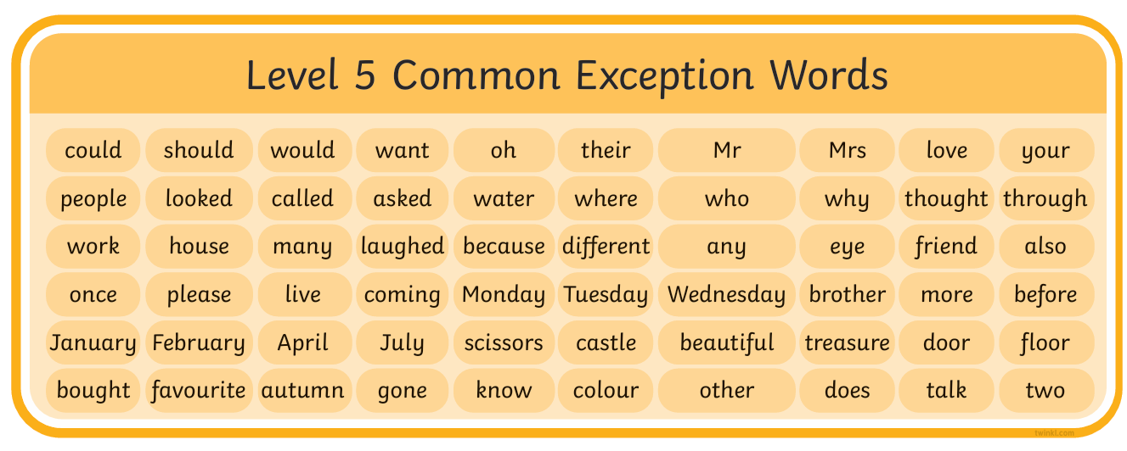
Level 5:
Level 5 is taught in Year 1 and introduces new graphemes, including vowel and split digraphs.
Children learn different ways to spell the same sounds and how to choose the correct spelling when writing words.
Your child will also learn more tricky words:

Slide 18
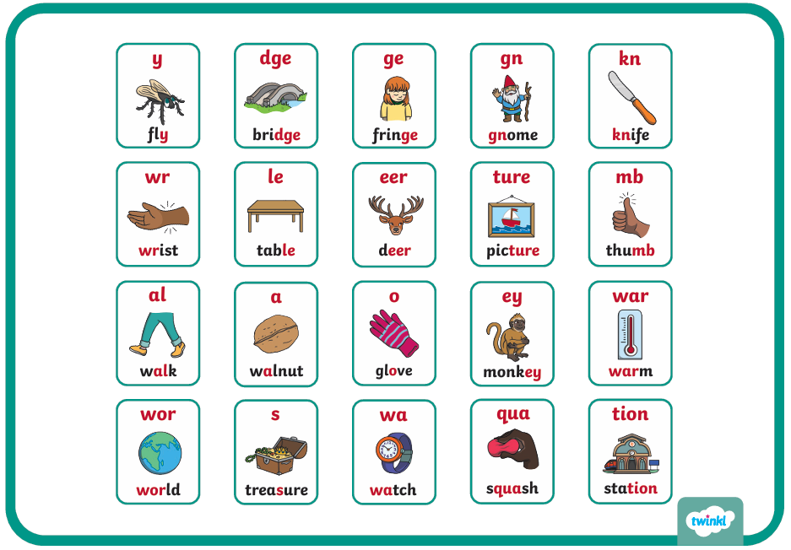
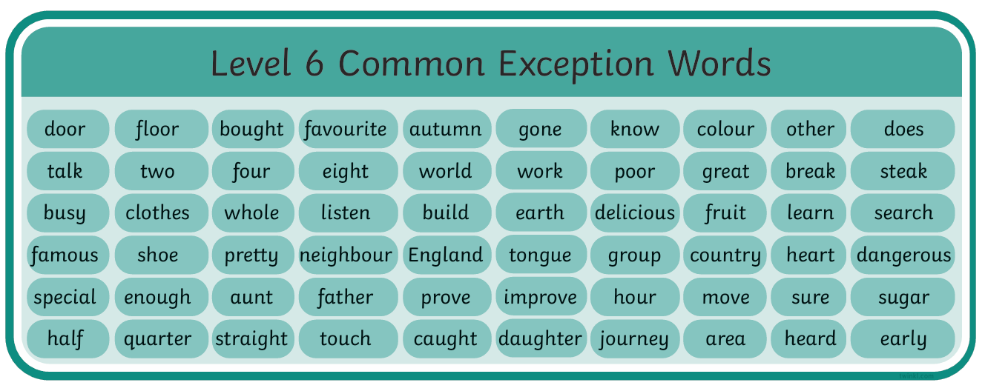
Level 6:
Level 6 is taught in Year 2 and focuses on developing fluent reading and accurate spelling.
Children should be able to read many words quickly and automatically, while learning spelling rules and patterns. They will also revise previously taught sounds.
Your child will also learn more tricky words:

Slide 19
Why reading matters
The ability to read is fundamental to learning and absolutely affects the chances children get in life. Teachers want all children in their care to succeed and the partnership between home and school is vital in ensuring success!
Try to read the book sent home from school as often as possible and please record in the homeschool book.
Reading for pleasure is also particularly important so giving your child lots of different opportunities to read and pushing that love of reading really helps!

Slide 20
Helping at home
Support your child’s phonics by:
Developing listening, turn-taking and speaking skills.
Helping them spot letters and familiar words in everyday places.
Practising new sounds and correct letter formation at home.
Reading every day and using the pure sounds taught at school.
Ask your child’s teacher if you are unsure about anything, so home and school use the same approach.

Slide 21
Helping at home
When reading together:
Talk about the book’s title, pictures and what your child thinks will happen.
Practise the sounds and tricky words before reading.
Encourage your child to sound out each letter, then blend the sounds together to read the word.
If they get stuck, help them segment the word into individual sounds and blend them together.
For tricky words in the book (usually highlighted in red), remind your child that we cannot sound out these words.

Slide 22

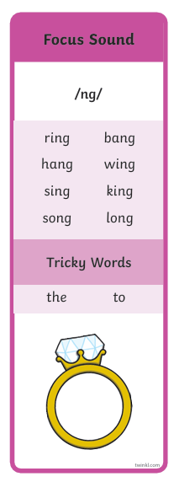
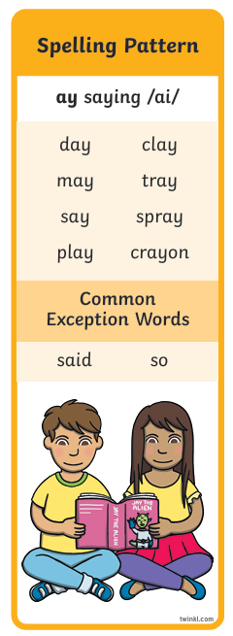
Helping at home
Your child will bring home a phonics book matched to the level they are learning in class. When the book has been read twice, we will change it for a new book.
There will also be a phonics bookmark stapled into the homeschool book. Please practice reading and writing the words with your child.
Your child’s class teacher may also send home extra work to support their phonics.

Slide 23
What is the phonics screening check?
A short, statutory assessment.
Taken by all Year 1 children in England.
Checks how well children can read words using phonics.
Conducted one-to-one with the class teacher.

Slide 24
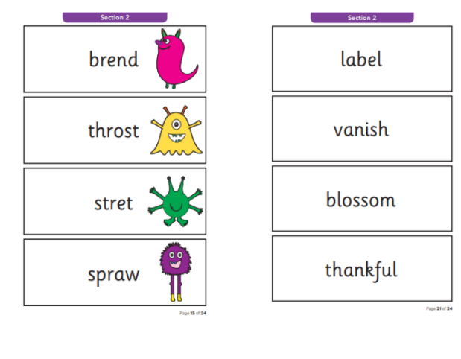
What does the check involve?
Children read 40 words
20 real words (e.g. ‘ship’)
20 ‘alien’ or nonsense words (e.g. ‘zog’)

Slide 25
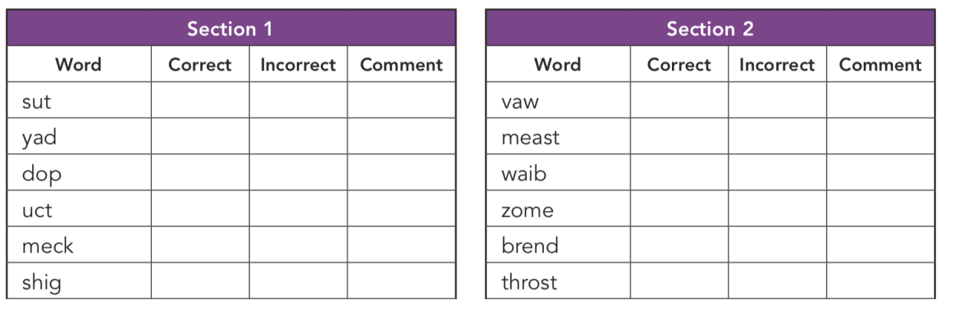
The check is divided into two sections:
Section 1 – simple word structures of three or four letters (20 words)
Section 2 – more complex word structures of five or six letters (20 words)

Slide 26
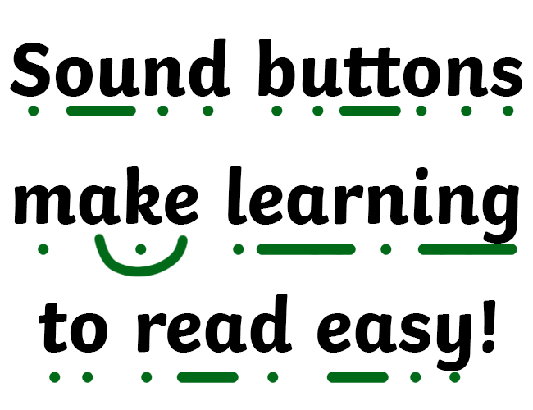

Slide 27
How are children supported?
A teacher known to the child will carry out the test.
Familiar format used in class beforehand.
No time pressure- most children take 4-9 minutes to complete.
Encouragement and praise throughout.

Slide 28
When does the check take place?
The check takes place w/b Monday 14th June.
Administered during the normal school day.
Children usually see it as a reading activity, not a test.

Slide 29
How is the check scored?
Each word read correctly scores 1 mark. Your child’s class teacher will mark the test.
The maximum score is 40.
The national pass mark is set each year and is usually 31/40.
Your child’s end of year report will inform you whether your child has passed or not.

Slide 30
What if my child does not pass?
Extra phonics support will be provided in Year 2.
Children will retake the check in Year 2.
Many children simply need more time to develop confidence.

Slide 31
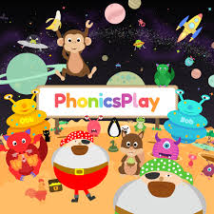
How can I support my child to pass the phonics screener?
Practise reading real and alien words at home.
Encourage your child to add sound buttons to the words to help recognise the sounds, especially split digraphs.
Nearer the time of the phonics screener, you will be given a phonics pack to support your child at home.
Make reading fun! Phonics play is a great website with games to get your child practising reading real and alien words.

Slide 32
Thank you for listening!
I hope you have a better understanding of how we teach phonics at Hanslope Primary School.
Please contact us if you have any questions or need support:
molly.peddie@hanslope.milton-keynes.sch.uk
Tracey.Byott@hanslope.milton-Keynes.sch.uk

