Slide 1

Spring Term 2

Slide 2

Freestyle: Starting from Monday 24th February
Basketball club:
When: Monday after school
Where: Salcey Playground
Timing: 3:15 to 4:15 or 3:15 – 5:15
What to wear/bring:
Hanslope school PE kit, drink, snack
Who for: Everyone
Collection: Salcey playground main doors

Slide 3

Freestyle: Starting from Tuesday 25th February
Dance club:
When: Tuesday after school
Where: Salcey Hall
Timing: 3:15 to 4:15 or 3:15 – 5:15
What to wear/bring:
Hanslope school PE kit, drink, snack
Who for: Everyone
Collection: Salcey playground main doors

Slide 4

Freestyle: Starting from Wednesday 26th February
Dodgeball club:
When: Wednesday after school
Where: Salcey Hall
Timing: 3:15 to 4:15 or 3:15 – 5:15
What to wear/bring:
Hanslope school PE kit, drink, snack
Who for: Everyone
Collection: Salcey playground main doors

Slide 5

Freestyle: Starting from Thursday 27th February
Gymnastics club:
When: Thursday after school
Where: Salcey Hall
Timing: 3:15 to 4:15 or 3:15 – 5:15
What to wear/bring:
Hanslope school PE kit, drink, snack
Who for: Everyone
Collection: Salcey playground main doors

Slide 6
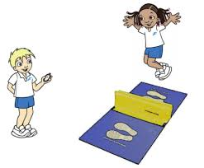
Indoor Athletics: starting from Monday 24th February
Indoor Athletics:
When: Monday after school
Where: Scots Pine/ All Weather Pitch
Timing: 3:15 to 4:15
Who for: Y3-6
Collection: Salcey playground
main doors

Slide 7

Football – starting from Thursday 27th February
Football club:
When: Thursday after school
Where: All weather pitch
Timing: 3:15 to 4:15
What to bring/wear:
Hanslope PE kit, snack, drink, (optional football boots/shin pads)
Who for: Y5/6 Girls
Collection: Salcey playground main doors

Slide 8

Art club – starting from Wednesday 26th February
Art club:
When: Wednesday after school
Where: Art room
Timing: 3:15 to 4:15
Who for: Y5/6
Collection: Salcey playground main doors

Slide 9
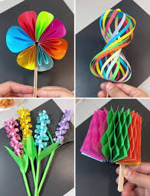
Lunchtime club: Starting Friday 28th January
Paper craft/mindfulness club:
When: Friday lunchtime
Where: Y4 Beech classroom
Timing: 12:30 - 1
Who for: Y3/4

Slide 10
To book:
Freestyle clubs:
https://freestylegroup.co.uk/event-list/term-time-clubs/
Other clubs:
Fill in the paper forms and send them back to your class teacher.
Any questions please email: l.goodwin@hanslope.milton-keynes.sch.uk

