Slide 1
Year 4 Knowledge Organisers Summer 2 2025

Slide 2
DT

Slide 3
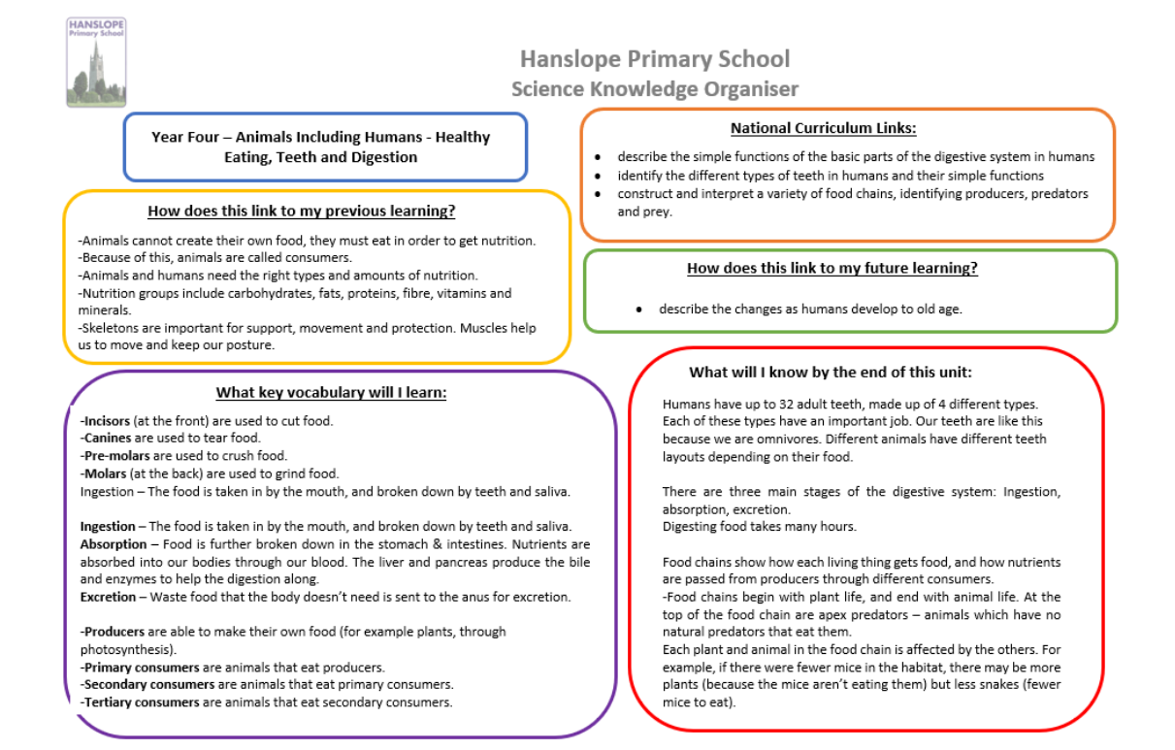
Science

Slide 4
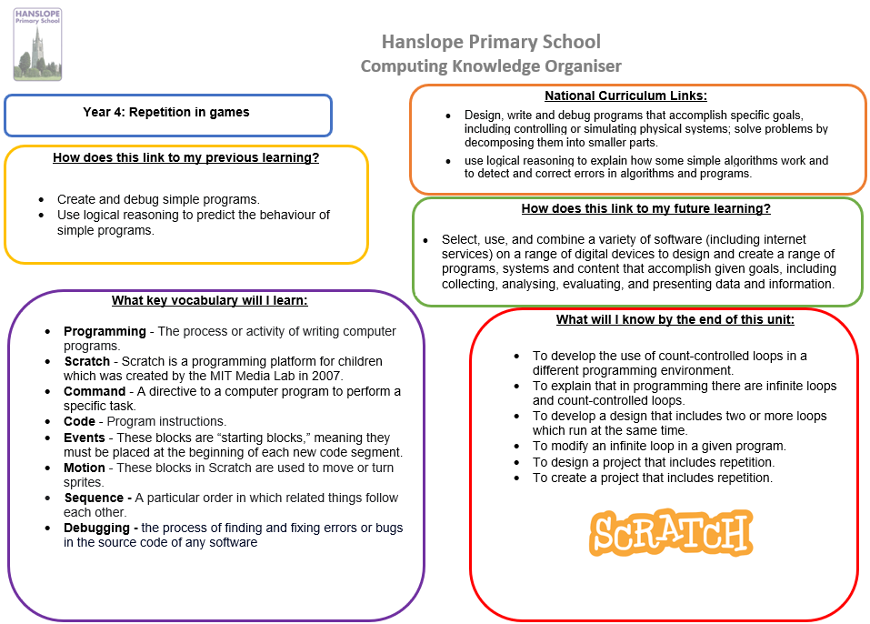
Computing

Slide 5
French

Slide 6
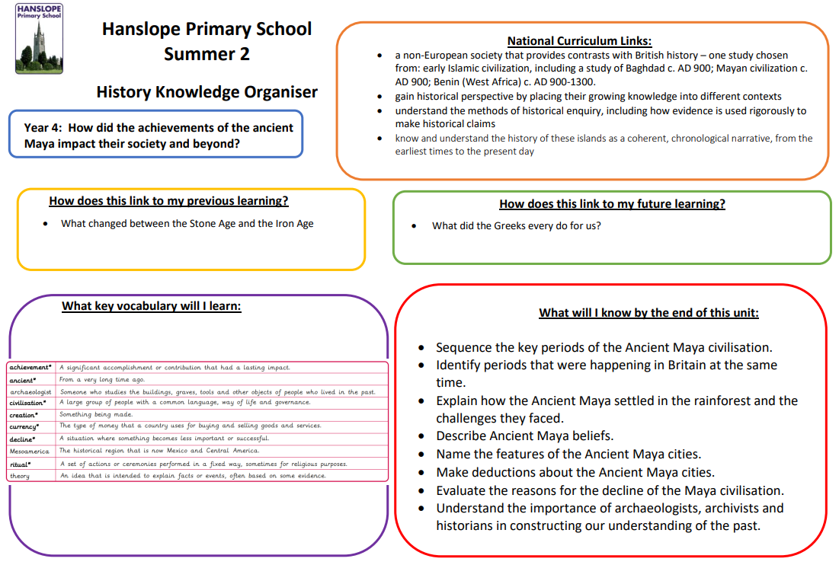
History

Slide 7
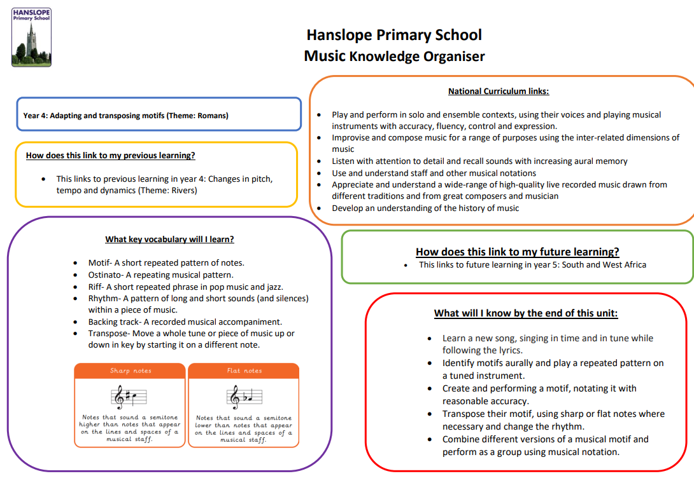
Music

Slide 8
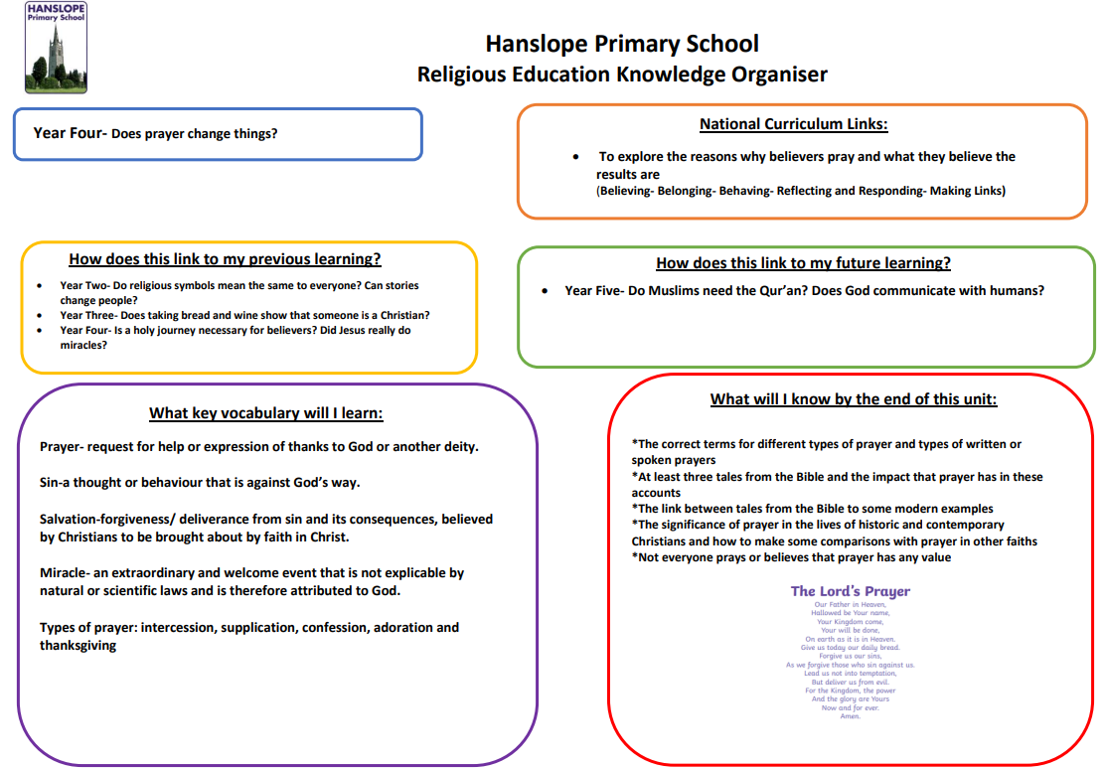
RE

Slide 9
PE

