Slide 1

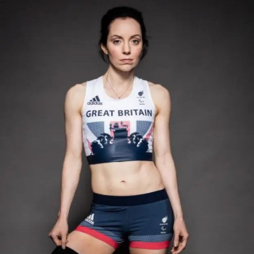
Tuesday, 30 December 2025
No Outsiders
Celebrating Everyone Just as They Are

Slide 2
Meet Stef Reid
Who Is Stef?
Stef Reid is a world champion athlete. She runs and jumps in the Paralympics for Great Britain.
What Are the Paralympics?
The Paralympics are big sports games for athletes who have different bodies, like those who use a wheelchair or have a prosthetic leg.
Stef has a prosthetic leg and still runs super fast!

Slide 3
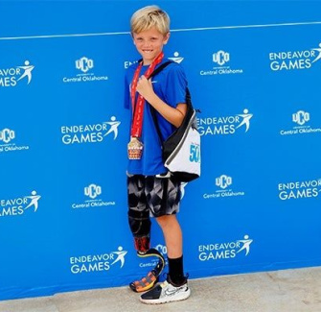
Stef’s Big Idea
Stef Wants Change
Stef wants shops like Nike, Adidas, and Puma to sell just one shoe.
She only needs one real shoe because her other leg has a blade.
But she has to buy two—why?
What do you think that feels like?

Slide 4
Why Two Shoes?
Shops’ Rules
Most shops only sell shoes in pairs.
It’s easier for them.
They think people always need two.
But that’s not true for everyone.
Stef’s Reality
Stef only wears one shoe.
She uses a special blade on her other leg.
She wastes money buying two.
She wants shops to be more fair.

Slide 5
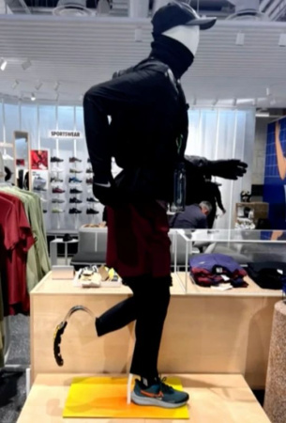
Bladed Mannequins
What’s a Mannequin?
A mannequin is a model in shops that shows clothes.
Some now have prosthetic legs!
Stef loves this—it shows people like her belong.

Slide 6
How Stef Felt as a Girl
Feeling Different
When Stef was little, she didn’t see anyone like her.
No toys, no models, no runners with blades.
She thought she didn’t fit in.
Now She Feels Proud
Now she sees mannequins with blades.
She feels seen and accepted.
She wants all children to feel this way.

Slide 7

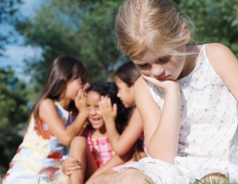
Discuss! 🤷‍♀️​ 💁‍♂️​ 💬​
Feeling Different and Belonging
How do you think Stef felt when she didn’t see anyone like her in shops? When have you felt different from other people?

Slide 8
Discuss! 🤷‍♀️​ 💁‍♂️​ 💬​
✅​
You might have said...
She might have felt sad and left out because nobody looked like her.
I felt different when I was the only one in my class who didn’t have a certain toy.
I felt a bit shy on my first day at a new club because I didn’t know anyone.

Slide 9
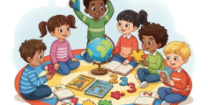

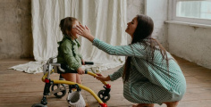
Why Shops Should Change
Inclusion
Selling one shoe says 'you belong here', just like everyone else.
Fairness
Get what you need, not forced to buy what you don't.
Respect
Respects differences, values all equally.

Slide 10
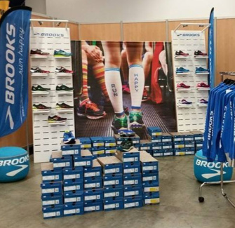
What Do Shops Sell?
Nike, Adidas, Puma
They sell sportswear—shoes, shirts, tracksuits.
They want people to feel strong and fast.
But do they treat everyone the same?
Stef says: show people like me, and sell what I need!

Slide 11
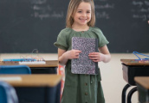
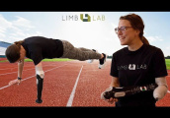

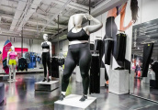
Stef’s Campaign Steps
1
2
3
4
Speak Up
Stef talks about her life and what she needs.
Show Pride
She wears her blade with confidence and joy.
Ask Shops
She asks big brands to sell single shoes.
Include All
She wants everyone to see themselves in shops.

Slide 12
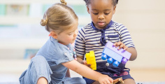


How We Can Help
Be Kind
Treat everyone the same, even if they look different.
Speak Up
If you see someone being left out, say something kind.
Celebrate All
Show that every kind of person is special and important.

Slide 13
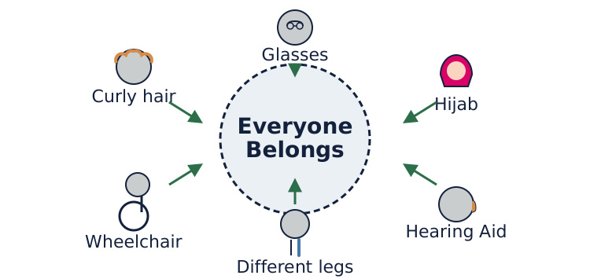
The Inclusion Circle

Slide 14
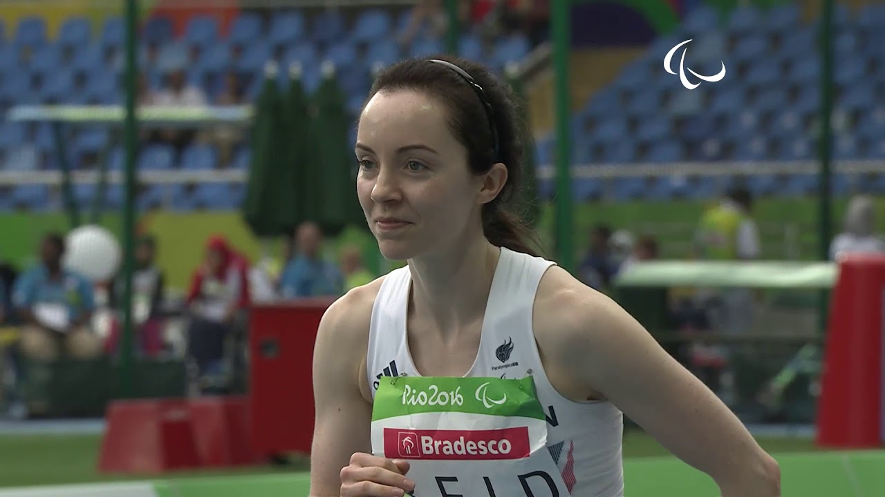
Watch Stef Jump!
▶

Slide 15
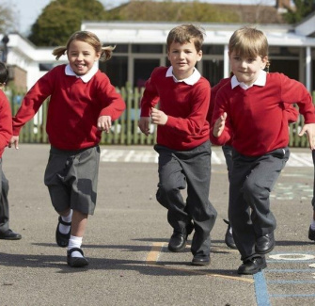
Differences Are Good
Our School Rule
We say: 'No Outsiders'. That means nobody is left out.
It doesn’t matter how you look, walk, talk, or move.
Everyone is welcome.
Being different is not wrong—it’s wonderful!

Slide 16
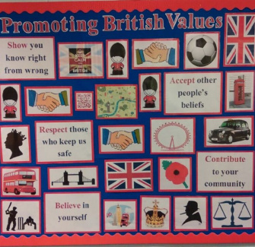
British Values
What Is a British Value?
One is Individual Liberty—we all have the right to be ourselves.
Another is Mutual Respect—we respect how others live.
Stef’s story is about both!
She’s free to run, and we respect her way of doing it.

Slide 17
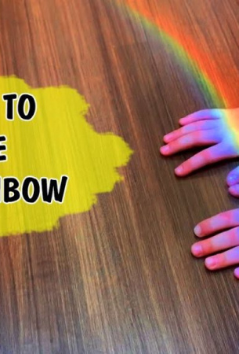
Everybody Belongs
We celebrate all kinds of people.
We listen to stories like Stef’s.
We make sure no one is left out.
That’s what 'No Outsiders' means.

