Slide 1

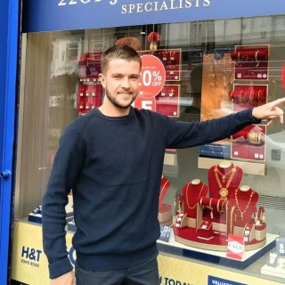
Tuesday, 30 December 2025
NO OUTSIDERS
Celebrating Everyone in Our Community

Slide 2

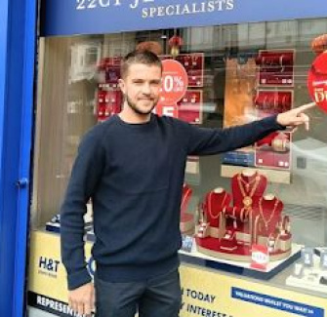
WHO IS IN OUR COMMUNITY?
Look and Think
What do you see?
Who is this man?
What is he doing?
This is David, a shopkeeper in Birmingham. He's pointing to a 'Happy Diwali' sign.
Every community has diverse people: shopkeepers, helpers, families—all are important!

Slide 3
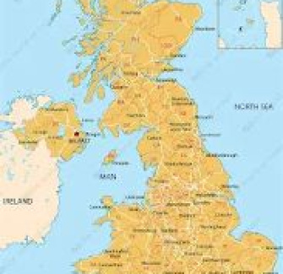
WHERE IS BIRMINGHAM?
A City Full of People
Birmingham, England, is home to over a million people. It's known for its incredible diversity, with residents from various backgrounds, speaking different languages, enjoying diverse foods, and celebrating unique traditions. Everyone belongs, regardless of their origin.

Slide 4
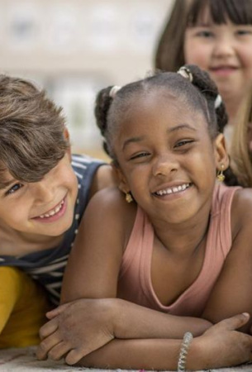
WHAT IS DIVERSITY?
Everyone Is Different
Diversity means we are all unique. No two people are exactly the same.
Some of us have curly hair. Some wear glasses. Some speak more than one language. Some celebrate Diwali, Eid, Christmas, or Hanukkah.
Being different is wonderful!

Slide 5
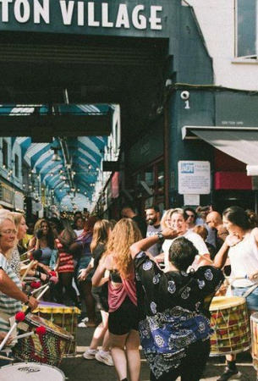
WHAT IS SUPER DIVERSITY?
Many Cultures in One Place
Super-diversity means diverse cultures coexist. Handsworth, Birmingham, exemplifies this with many languages, global foods, and celebrations, creating a vibrant, multicultural patchwork.

Slide 6
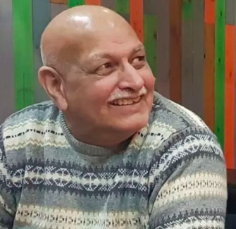
DAVID’S STORY
David, a white British shopkeeper in Handsworth, feels respected by all. Though Diwali isn't his, he displays a "Happy Diwali" sign, showing community care. Respect is kind.

Slide 7
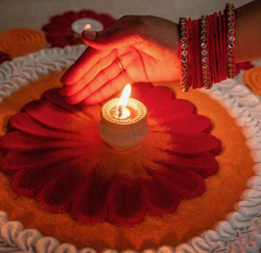
WHAT IS DIWALI?
Festival of Lights
Diwali is a special celebration for Hindu, Sikh, and Jain families. People light lamps, wear new clothes, share sweets, and spend time with family. David, who doesn't celebrate Diwali, shows kindness by displaying a Diwali sign, making others feel welcome.

Slide 8

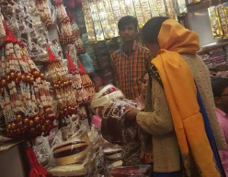
DISCUSS! 🤷‍♀️​ 💁‍♂️​ 💬​
Kindness Without Celebrating
Why do you think David put up the Diwali sign even if he doesn't celebrate it? How do you think this might make people in his community feel?

Slide 9
DISCUSS! 🤷‍♀️​ 💁‍♂️​ 💬​
✅​
You might have said...
He wanted everyone to feel welcome in his shop.
He wanted to show respect for people who do celebrate Diwali.
He wanted to make people happy and help them feel included.

Slide 10
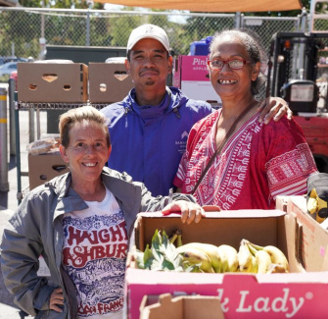
MEET BOB BALU
A Voice from the Community
Bob Balu also lives in Handsworth. He says: 'We’ve got Indians, Pakistanis, Vietnamese, Caribbean, white people — we're all passionate about recognising everyone.'
He loves the different foods and cultures. He says: 'We all eat.' That means everyone shares and enjoys each other’s traditions.

Slide 11
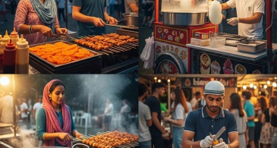
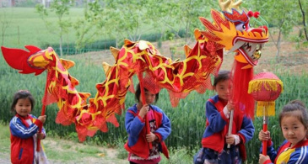
DIFFERENT CULTURES, ONE COMMUNITY
Foods We Share
Curries, roti, samosas, noodles, jerk chicken, fish & chips! We enjoy new foods together.
Celebrations We Share
Diwali, Eid, Christmas, Vaisakhi, Chinese New Year! We learn & join in.

Slide 12
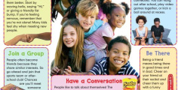
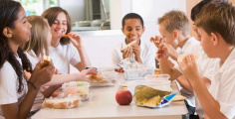
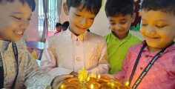
KIND ACTIONS IN OUR COMMUNITY
1
2
3
Say Hello
A simple 'hello' can make someone feel welcome.
Share Food
Trying a friend’s lunch helps us learn about their culture.
Celebrate Together
Joining in festivals shows we care about everyone.

Slide 13
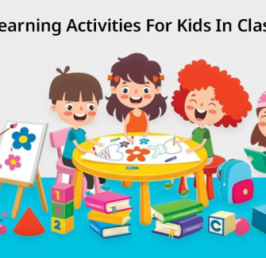
WHAT DOES 'UNIQUE' MEAN?
You Are One of a Kind
Everyone is unique — special and different in their own way.
You might have a unique laugh, a special talent, or a favourite game no one else plays.
Our differences make our class and community more interesting!

Slide 14
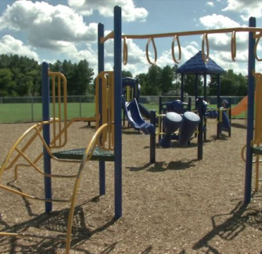
WHAT IS MULTICULTURAL?
Many Cultures Together
Multicultural means diverse cultures coexist.
In such communities, people speak different languages, wear varied clothes, eat diverse foods, and celebrate uniquely. This diversity is positive.
We learn from each other and foster kindness.

Slide 15
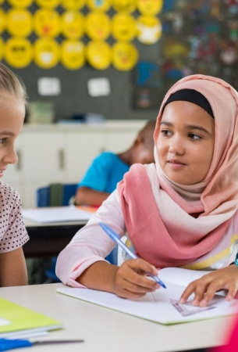
WHY RESPECT MATTERS
Being Kind to Everyone
David and Bob say people treat each other with respect.
Respect means listening, being kind, and not laughing at differences.
At school, we say: 'Treat others how you want to be treated.' That’s part of 'No Outsiders'.

Slide 16
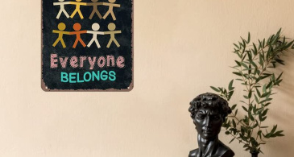
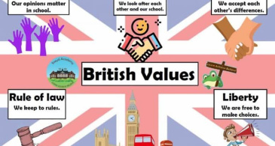
NO OUTSIDERS
Our School Rule Everyone belongs. All families, faiths, and backgrounds are welcome.
Our British Value
We follow mutual respect & tolerance of different faiths daily.

Slide 17
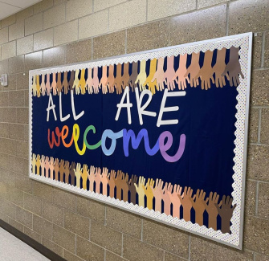
WHAT HAVE WE LEARNED?
Our Big Ideas
Everyone is unique. Diverse, multicultural communities thrive with kindness & respect. Celebrating differences makes our world brighter. Like David & Bob, we can make our school & community kinder.

Slide 18
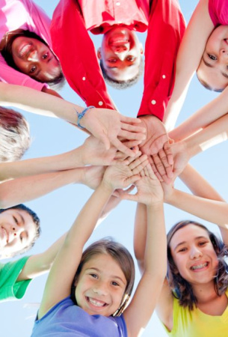
WE ALL BELONG
Together We Shine
In our class, in our school, in our country — no one is an outsider.
Every person has something important to share.
Let’s keep welcoming, learning, and caring — together.

