Slide 1

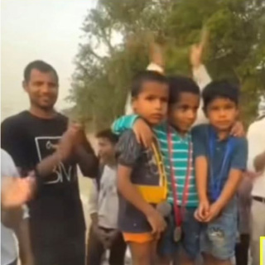
Tuesday, 30 December 2025
NO OUTSIDERS
Learning About Kindness, Fairness, and Inclusion

Slide 2

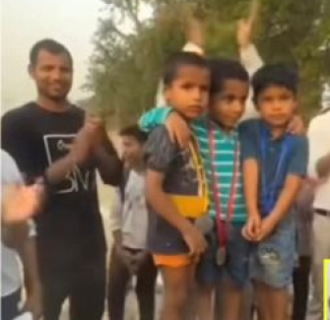
WHAT DO YOU SEE?
Look Closely
What can you see in this picture? Who is in it? What are they doing?
Talk Together
What do you think has just happened? Have they been racing? Who won?

Slide 3
A SPECIAL WINNER
The Boy in the Middle
This boy won first place in a race. He got a gold medal and stood on the top podium.
But He Did Something Different
Instead of standing alone, he asked the other boys to join him. Why do you think he did that?

Slide 4
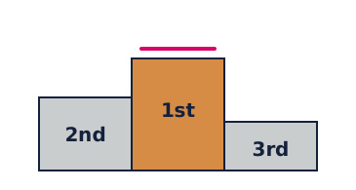
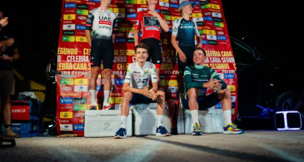
FIRST, SECOND, THIRD?
Race podium: First highest, second middle, third lowest.
But this time... All three stood on the top step! Winner shared his place.

Slide 5
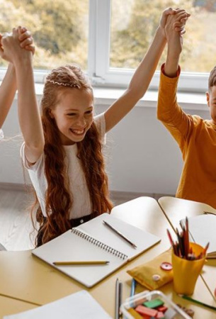
WHY SHARE THE TOP STEP?
1
Kindness
He wanted everyone to feel happy and included.
2
Team Spirit
Even in a race, we can still be friends.
3
Fairness
Everyone tried their best, so everyone deserved to celebrate.

Slide 6
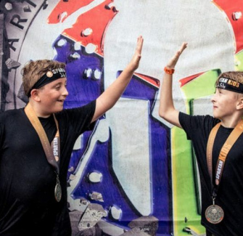
WHAT IS VICTORY?
Winning Isn’t Just Medals
Victory can mean trying your best, having fun, and making others feel good.
Sharing Joy
The boy showed that winning feels better when everyone can celebrate together.

Slide 7

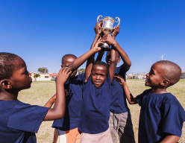
DISCUSS! 🤷‍♀️​ 💁‍♂️​ 💬​
When Sharing Feels Better
Have you ever shared a win with someone? How did it make you feel? Can you remember a time when being kind felt even happier than winning?

Slide 8
DISCUSS! 🤷‍♀️​ 💁‍♂️​ 💬​
✅​
You might have said...
I felt proud because everyone cheered together.
Being kind made me smile more than just winning by myself.
It felt nice to see my friends happy too.

Slide 9
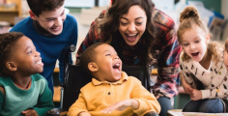
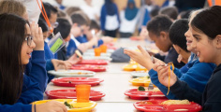
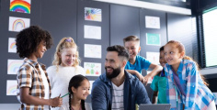
HOW HE MADE THEM FEEL
Included
He made sure no one felt left out.
Happy
Standing together made them all feel proud and joyful.
Respected
He showed that everyone’s effort mattered.

Slide 10
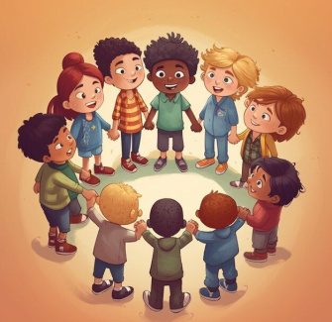
WHAT IS UNITY?
Unity Means Togetherness
Unity is when people work together and care for each other.
Like a Team
Even if we are different or competing, we can still stand together and support one another.

Slide 11
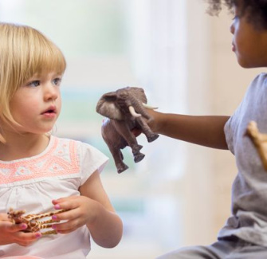
WHAT IS RESPECT?
Respect Is Kindness
Respect means treating others how we want to be treated.
We Show Respect By:
Listening to others
Being fair
Including everyone
The winner showed respect by sharing his moment.

Slide 12
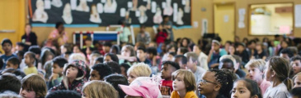
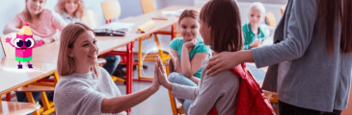
BRITISH VALUES
Unity
We stand together as a school and community.
Respect
We respect others even when we win or lose.

Slide 13
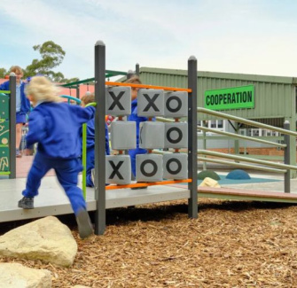
NO OUTSIDERS
Our School Promise
At our school, we make sure no one feels like an outsider.
Everyone Belongs
It doesn’t matter if you’re different – everyone is welcome, valued, and included.

Slide 14
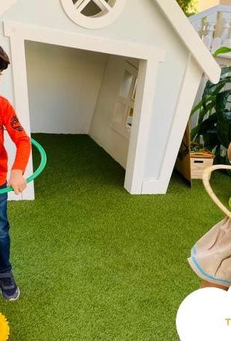
WAYS TO INCLUDE OTHERS
1
Invite In
Ask someone new to join your game.
2
Share Space
Let others use the equipment or sit with you.
3
Smile Often
A kind face makes others feel welcome.
4
Use Names
Calling someone by name shows you care.

Slide 15
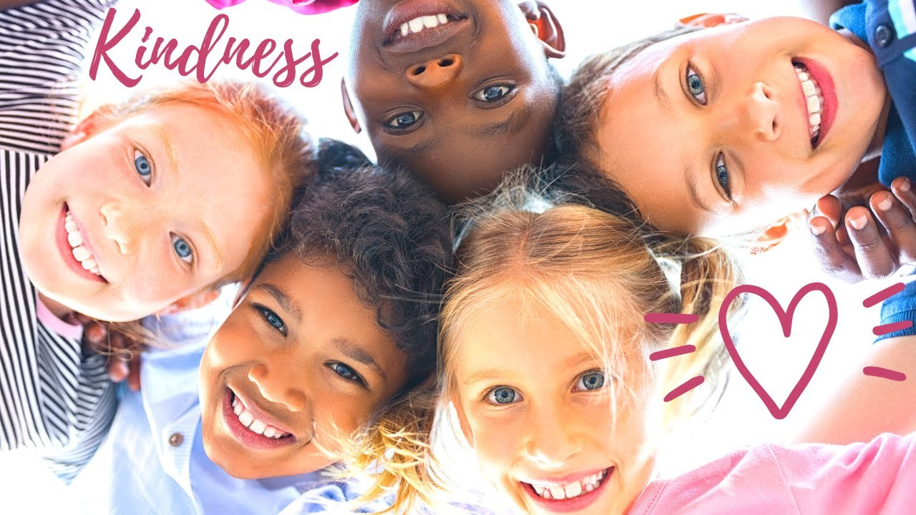
KINDNESS IN ACTION
▶

Slide 16
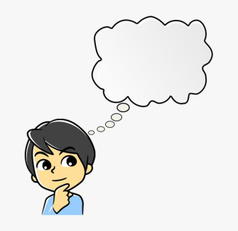
WHAT WOULD YOU DO?
Imagine This
You win a race. Your friends came second and third. Do you stand alone, or invite them up?
Think About It
How would they feel? How would you feel?

Slide 17
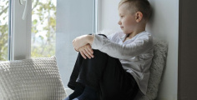
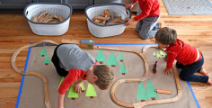
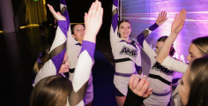
BEING A NO OUTSIDERS HERO
See Others
Notice who might feel left out.
Act Kindly
Do something to include them.
Celebrate Together
Make every win a group joy.

Slide 18
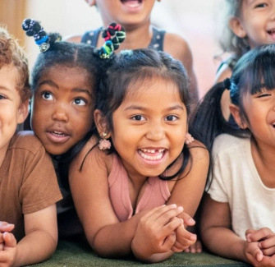
EVERYDAY CHAMPIONS
You Don’t Need a Medal
You can be a champion by being kind every day.
Small Actions, Big Difference
Sharing, smiling, and including others makes our school a happy place for everyone.

Slide 19

WE ALL BELONG
At our school, we celebrate kindness, unity, and respect. No one is an outsider. Together, we make a difference.

