Slide 1

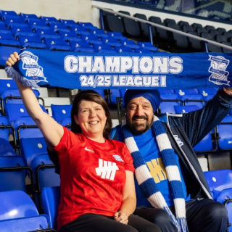
Tuesday, 30 December 2025
No Outsiders
A Story of Friendship, Football and Fairness

Slide 2
Who Are Mickey and Bill?
Two Good Friends
Mickey (brown skin) and Bill (white skin) were lifelong friends who loved watching Birmingham City play football.
Long Ago
Despite others' prejudice about their different skin colors, Bill stood by Mickey, saying, "Come with me — you’re my friend." They remained friends for life.

Slide 3
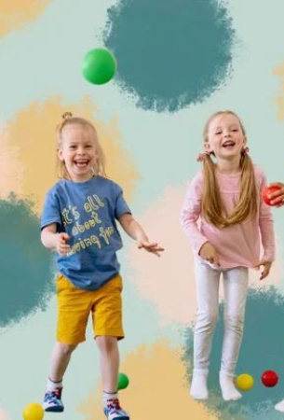
What Is Fairness?
Fair Means Equal
Treating everyone the same, regardless of appearance.
Everyone Belongs
Letting everyone join in—at school, at play, at football.
Like Bill Said
"Come with us—you're welcome." That's fairness.

Slide 4
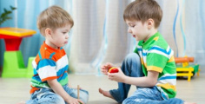
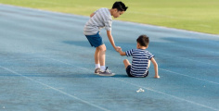
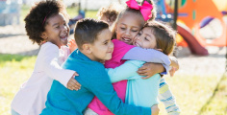
What Bill Showed Us
1
2
3
Kindness
Bill was kind to Mickey, even when others weren’t.
Bravery
He stood up for his friend when people said unkind things.
Friendship
Real friends care about each other, no matter what.

Slide 5
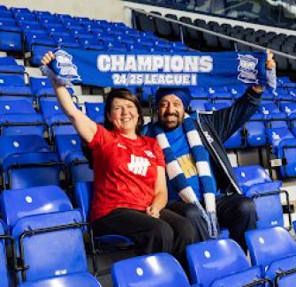
Caroline’s Memories
Bill’s Daughter
Caroline, Bill's daughter, grew up attending matches with her dad and Mickey.
Happy Times
Her dad would toss her in the air every time the team scored. She cherished these outings.
His Legacy
Caroline: "My dad taught us to treat everyone equally."

Slide 6
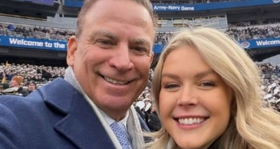
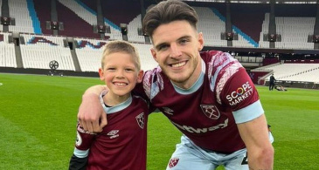
Family Is More Than Blood
Caroline Says
'Mickey reminds me of my Dad.' She sits with him at matches.
Mickey Says
'Caroline & her daughter are family. I love them.' Family is love & care, not just blood.

Slide 7
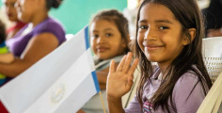

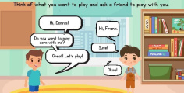
How Friendships Grow
Say Hello
Start with a smile or ‘hello’ — it’s easy and kind.
Play Together
Share toys, games or lunchtime fun.
Stand Up
If someone is left out, say: ‘Come and play with us!’

Slide 8
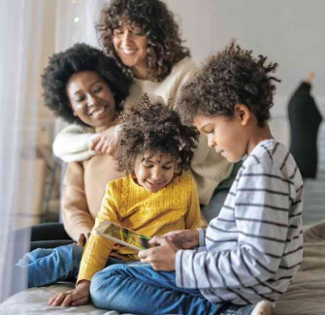
What Is a Family?
Not Just Parents and Siblings
A family is people who love and care for each other. It might be grandparents, friends, or someone who feels like a mum or dad. Mickey says Caroline and her daughter are his family — because they care for each other.
Love Makes a Family

Slide 9

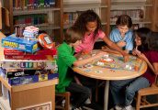
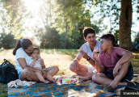

Families Come in All Forms
Small Families
Just one or two people — still full of love.
Foster Families
Caring adults who look after children with kindness.
Big Families
With lots of brothers, sisters, cousins or pets!
Chosen Families
Mickey & Caroline: friends like family.

Slide 10

Mickey’s New Mission
Bik and the Blues
Mickey & his son Bik founded 'Bik and the Blues' to make football welcoming for all, especially those with brown skin. Their goal: everyone feels happy, included, and proud at matches. Football is for everyone.

Slide 11
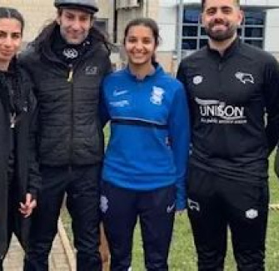
Riya Mannu’s Big Moment
A Special Player
Riya Mannu, first Punjabi girl to sign for Birmingham City, scored in her debut game!
Why It Matters
Her success inspires children, fostering pride and inclusion, showing them they can achieve great things too.

Slide 12
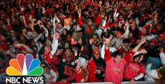
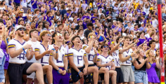

How Football Brings Us Together
Shared Joy
Team scores, everyone cheers with big smiles!
Singing Together
Fans sing songs side by side — no matter what they look like.
Kindness in Action
Helping someone find their seat or sharing a scarf.

Slide 13
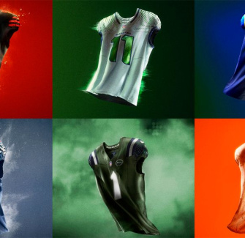
What If You Support a Different Team?
Still Friends
Love Birmingham City? Friend loves Aston Villa? No problem!
Respect
"I like my team, happy you like yours." Different isn't wrong. Celebrate what you love, still be kind.

Slide 14
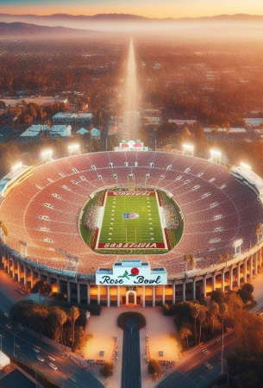
Lessons from Mickey and Caroline
5
Be Brave
Stand up for what’s right, even if others disagree.
6
Include All
Make sure no one feels left out — at school or in life.
7
Love Wins
Kindness and care build strong families and communities.

Slide 15
A Friendship Across Time
1980s
Growing Up
Caroline joins them, forming a bond like family.
2020s
New Hope
Mickey starts Bik and the Blues, welcomes fans.
1970s
Meeting Up
Bill & Mickey: Friends at football.
2015
Legacy
Bill passes away — but his kindness lives on.
2025
Breaking Barriers
Riya Mannu: Birmingham City debut goal.

Slide 16

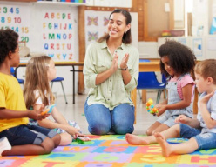
Discuss! 🤷‍♀️​ 💁‍♂️​ 💬​
Making Everyone Feel Welcome
Have you ever noticed someone being left out? What could you do to help them feel included? What does 'no outsiders' mean in our classroom?

Slide 17
Discuss! 🤷‍♀️​ 💁‍♂️​ 💬​
✅​
You might have said...
I could ask them to play with us so they are not lonely.
No outsiders means we include everyone, no matter what they look like.
It means everyone belongs and is treated with kindness.

Slide 18
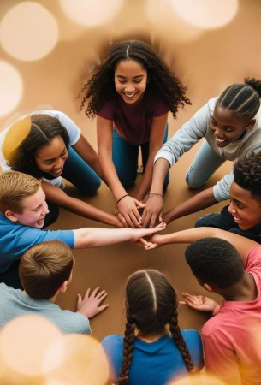
We Are All the Same Inside
Our Skin May Be Different
But our hearts are the same. We all want love, inclusion, and fair treatment.
No Outsiders
Means everyone is welcome in football, school, and life. Let's make kindness our superpower.

