Slide 1

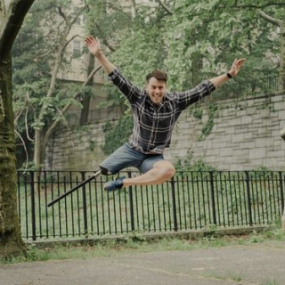
Tuesday, 30 December 2025
NO OUTSIDERS
Learning About Difference, Respect, and Inclusion

Slide 2

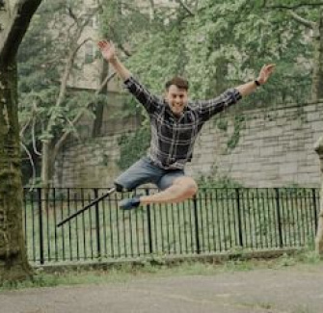
WHAT DO YOU SEE?
Look and Think
What do you notice about the man in the photo?
What do you think he likes to do?
He is smiling and jumping—how do you think he is feeling?

Slide 3
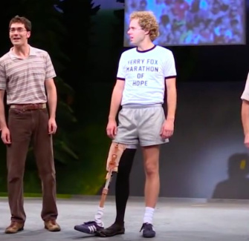
MEET EVAN RUGGIERO
A Dancer Like No Other
Evan Ruggiero is a professional dancer.
He has danced in big theatres around the world—even at the Oscars!
He was even nominated for 'Outstanding Actor' at a famous award show.

Slide 4
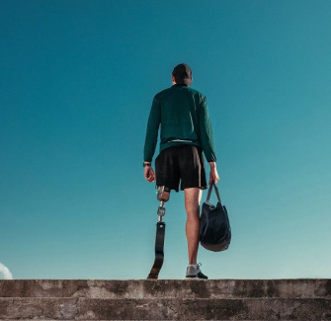
A BIG CHANGE
After an Illness
Evan had to have his right leg amputated when he was younger.
That means doctors had to remove his leg to keep him healthy.
At first, he felt self-conscious—that means he worried about what others might think.

Slide 5

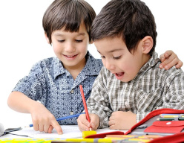
DISCUSS! 🤷‍♀️​ 💁‍♂️​ 💬​
Thinking About Feelings
Have you ever felt self-conscious or worried about being different? How can we show kindness to someone who feels that way?

Slide 6
DISCUSS! 🤷‍♀️​ 💁‍♂️​ 💬​
✅​
You might have said...
Yes, I felt self-conscious when I wore glasses for the first time.
I feel that way when everyone looks at me in class.
We can be kind by smiling at them or asking them to play with us.

Slide 7
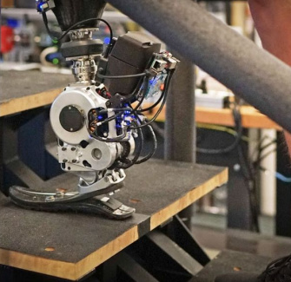
WHY DID PEOPLE LOOK?
People’s Reactions
Evan said some people would pull their children away when they saw him.
Why do you think they did that?
Does looking different mean someone is scary or not kind?

Slide 8
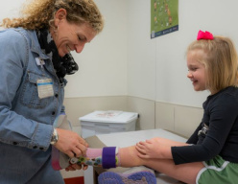
DISCUSS! 🤷‍♀️​ 💁‍♂️​ 💬​
Meeting Someone New
If you saw someone who has a prosthetic leg, what would you do? Would you say hello, ask a question, or look away? Why?

Slide 9
DISCUSS! 🤷‍♀️​ 💁‍♂️​ 💬​
✅​
You might have said...
I would say hello because everyone likes to be greeted.
I would ask them if they like dancing like Evan.
I might feel shy, but I would try not to look away so they feel included.

Slide 10
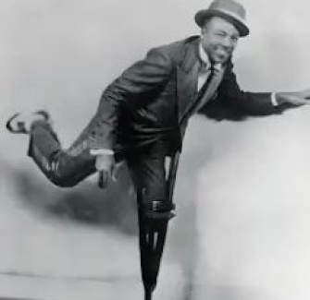
A DANCE HERO
Inspiration from the Past
Evan remembered Clayton Bates, a famous tap dancer from long ago.
Clayton lost his leg in an accident but danced on a wooden peg leg made by his uncle.
Evan grew up admiring him!

Slide 11
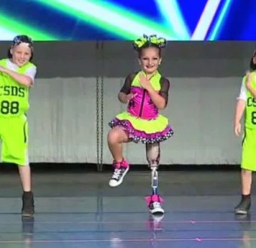
DANCING IN A NEW WAY
'I Dance Differently'
Evan says: 'Now I dance in a different way.'
Some people say his shoulders are hunched or his head is to one side.
But he says: 'That’s because I’m dancing on one leg!'
His dance is still beautiful and strong.

Slide 12
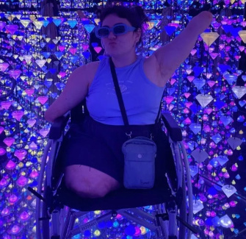
PROUD TO BE ME
'Loud and Proud'
Evan says attitudes have changed.
Now, people say: 'Hey, I’m an amputee — loud and proud!'
He wants the world to know: amputees are happy, strong, and living full lives.

Slide 13
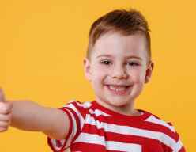
DISCUSS! 🤷‍♀️​ 💁‍♂️​ 💬​
What Makes You Proud?
What does the word proud mean? Can you feel proud of something that makes you different? What are you proud of?

Slide 14
DISCUSS! 🤷‍♀️​ 💁‍♂️​ 💬​
✅​
You might have said...
Proud means you feel happy about something you have done or something about you.
I can be proud of wearing glasses even though I look different.
I am proud that I can help my friends in class.

Slide 15
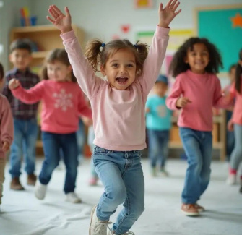
CAN YOU DANCE WITH ONE LEG?
Let’s Try!
Yes—you can dance with one leg!
Dancing is about moving your body in a way that feels good.
Balance, rhythm, and joy matter more than how many legs you have.

Slide 16
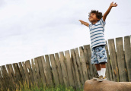
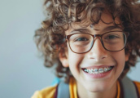
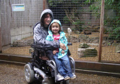
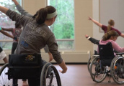
WHAT WE CAN LEARN
1
2
3
4
Be Brave
Evan danced through hardship. That's courage.
Stay Proud
Proud of who he is, despite looking different.
Be Kind
Don't stare or pull away. Say hello, be friendly.
Dance On
Amazing things, different ways.

Slide 17
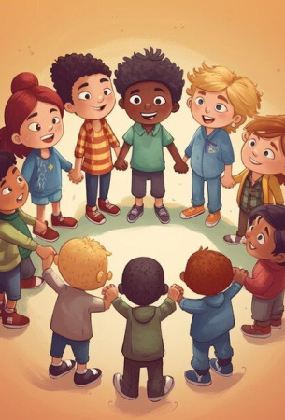
NO OUTSIDERS
Everyone Belongs
'No Outsiders' means no one should feel left out because they are different.
It doesn’t matter if you walk, hop, use a crutch, or dance on one leg—everyone has a place.

Slide 18
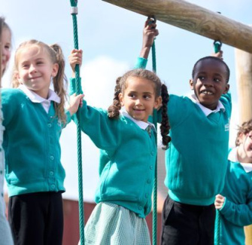
BRITISH VALUES
Mutual Respect and Tolerance
This story links to British Values.
We learn to respect people who are different.
We tolerate (accept and be kind to) everyone in our community.

Slide 19
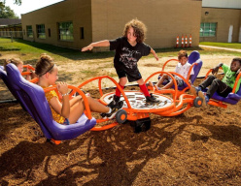
DISCUSS! 🤷‍♀️​ 💁‍♂️​ 💬​
Including Everyone at Playtime
Who is an outsider in your playground? How could you include them? What would Evan say to someone who feels left out?

Slide 20
DISCUSS! 🤷‍♀️​ 💁‍♂️​ 💬​
✅​
You might have said...
There’s a child who sometimes stands by themselves at playtime—maybe they feel like an outsider.
I can go over and ask them to join in our game so they feel included.
Evan would say, 'You’re amazing just as you are! Come dance with us.'

Slide 21
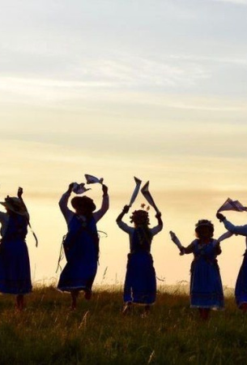
WE ARE ALL DIFFERENT, WE ARE ALL EQUAL
Final Thought
Our differences make the world more interesting.
Let’s celebrate them—with pride, kindness, and dance!

