Slide 1
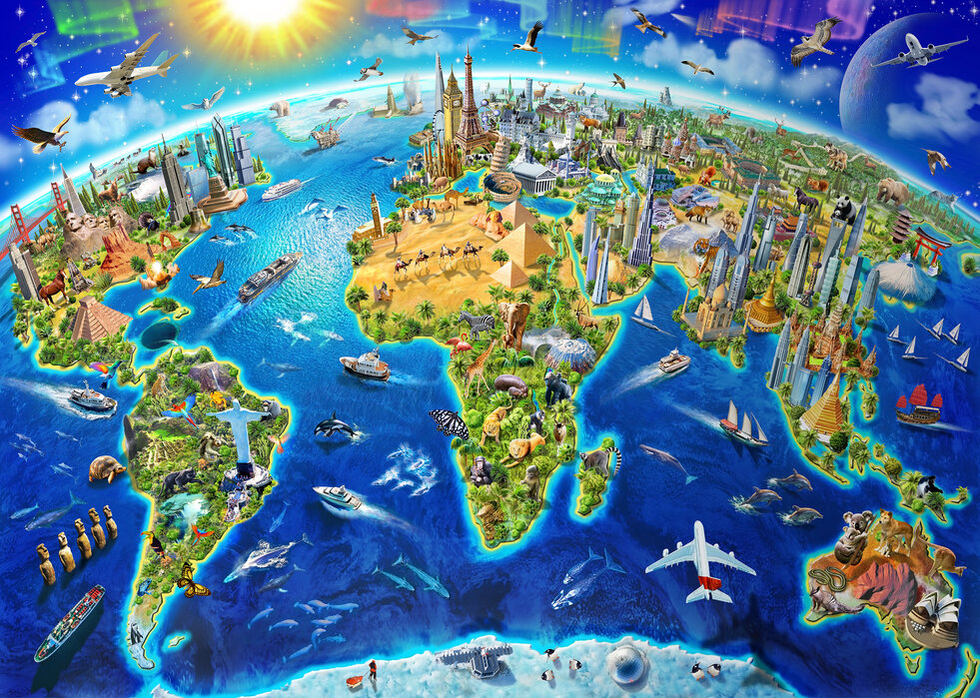



Beyond Harbury - Topic Web
Geography
Locations, continents, cities and countries
Geographical locations in Britain
Human and Physical geography of Britain and Harbury
World Geography – latitude, longitude, equator, tropics continents.
Geographical similarities and differences
Climate zones, river and mountains
Settlements, land use and trade links.
Natural resources.
Maps – atlas work, globes and digital
Compass references and grid references.
Comparisons of the United Kingdom and the wider world.
English
Texts: The Girl of Ink and Stars
Art
Memory Box Art
German
Eating Out
Performance Time
Science
Electricity
Evolution
Maths
Consolidation and problem solving
Music
Our School Production
Reflect, Rewind and Replay
PSHE
Relationships
Changing Me
Computing
Health Wellbeing and Lifestyle
Privacy Security and Copyright
RE
What is truth and where might it be found?
How can God bring freedom and Justice?
PE
Tag Rugby
Athletics
Football
Cricket
Values
Collaboration and Diversity
Inclusion and Justice

