Slide 1
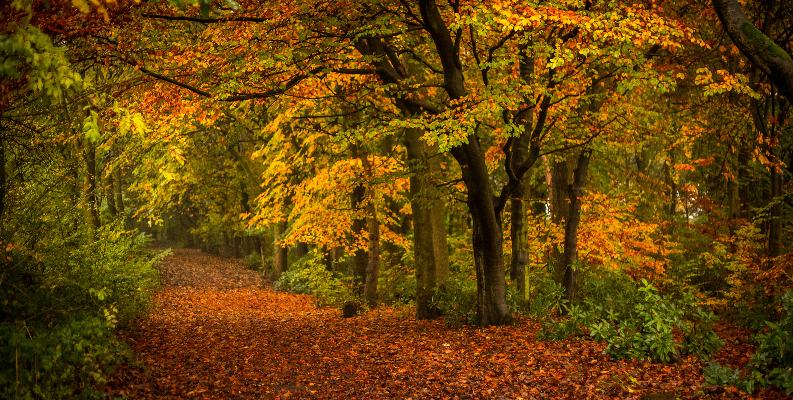
Hardwick Green Primary Academy
Reception Knowledge Organiser - Autumn 1
Key Texts
Here We Are
The Everywhere Bear
The Colour Monster
Beegu
Would You Rather?
Superpoop
Vocabulary
Family, household, parents, siblings, grandparents, different, diverse, seasons, Spring, Summer, Autumn, Winter, weather, country, town, community, school, Earth, planets, solar system, physical features, land, nature, equality, recycle, environment, reuse, costume, tradition, celebration
Key Knowledge
We all belong to a family and there are many diverse types of family.
There are 4 seasons in the year which usually have different weather.
We live in a town called Stockton-on-Tees which is in England. England is in the United Kingdom.
Black History Month is a special time of year when we celebrate the achievements and contributions of Black people throughout history.
I know how to keep my body safe and respect personal privacy.
We should recycle or reuse some materials to look after the environment..
Halloween is a fun celebration that happens on 31st October
Wider Curriculum & Experiences
Phonics – We will begin learning to read and write set 1 sounds in Read Write Inc and begin to read simple CVC words.
Maths – We will be subitising, counting, sorting, comparing and talking about measures and pattern.
Jigsaw – We will learning about expressing our emotions and how to be a kind friend.
Discovery RE – We will be answering the key question ‘What makes people special?’ and learn about Christianity and Judaism.
Understanding the World – we will learn about families, seasons, where we live, Black History Month, NSPCC Pants, recycling and Halloween.

