Slide 1

Year 1 Phonics Screening Check (PSC)

Slide 2
What is Phonics?
Phonics is how we teach children to read. Children begin to learn phonics (sounds) in Early Years - Nursery and Reception.
When children start school, they learn the letters which make each of the sounds and how these are used to read and spell words.
For this reason, the first sounds that children are taught are often ‘s’, ‘a’, ‘t’, ‘p’, ‘i’, ‘n’. These sounds can immediately be blended for reading to make simple CVC words (consonant, vowel, consonant) e.g. sat, pin.

Slide 3
What is the Phonics Screening Check (PSC)?
The Phonics Screening Check (PSC) is a short reading assessment.
It is a statutory assessment which has been designed to give teachers information about the progress the children are making with their phonics learning.

Slide 4
What is in the Phonics Screening Check?
The check contains 40 words.
Each child sits one to one with a teacher and reads each word aloud.
The list of words the children read is a combination of 20 real words and 20 pseudo words (nonsense/alien words).
Each child can take the assessment at their own pace- on average, it will take 10 minutes.

Slide 5
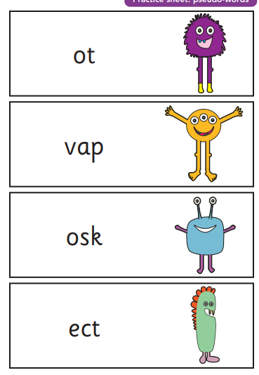
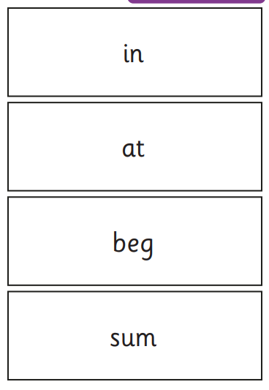
What will the children see?

Slide 6
When will I find out my child’s score?
By the end of the Summer Term, schools will report results of the check to parents and will confirm if children have met the standard threshold.

Slide 7
What happens if my child does not pass the PSC?
The screening check will identify children who have phonic decoding skills below the level expected for the end of Year 1 and who therefore need extra help and support.
Children who do not achieve the expected level will retake the test when they are in Year 2.
There will be additional interventions in place to support children who do not pass.

Slide 8
What can I do to help support my child?
Enjoy sharing and reading books as much as possible.
If your child is struggling to read a word, encourage them to ‘sound out’ and then blend the sounds together from left to right.
Talk about the meaning of unfamiliar words.
Ask your child’s teacher if you have any questions.

