Slide 1

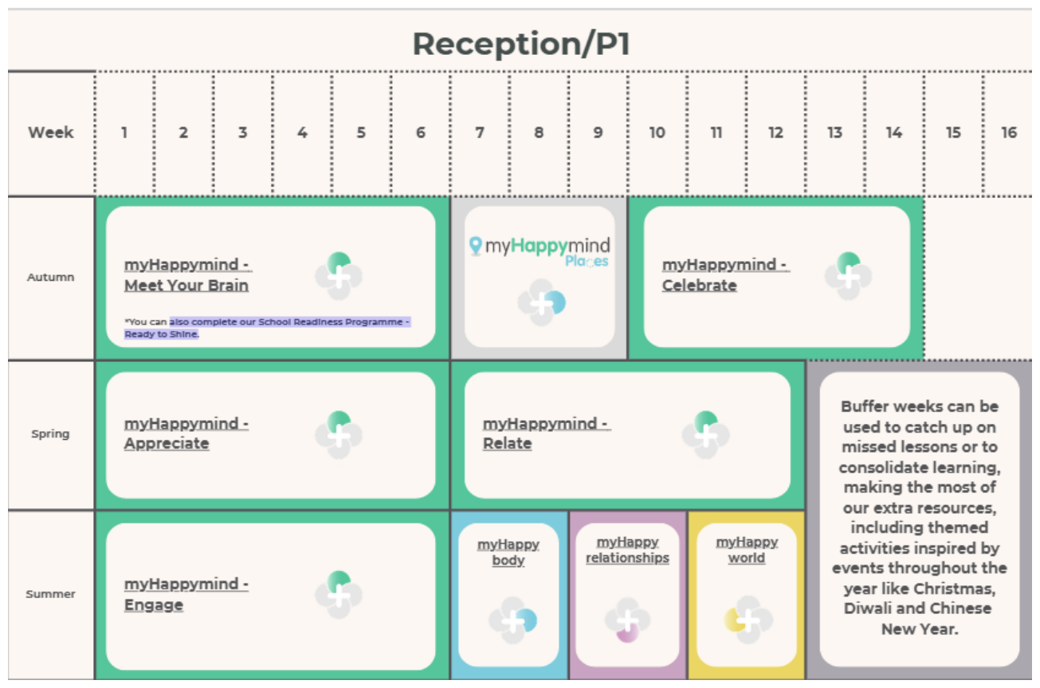
PSHE LONG-TERM PLAN
myHappymind Plus
Reception / P1
Progressive PSHE curriculum • Christian values • safeguarding • inclusion • life in modern Britain
Harper Bell SDA Primary School • Love, Learning and Laughter

Slide 2
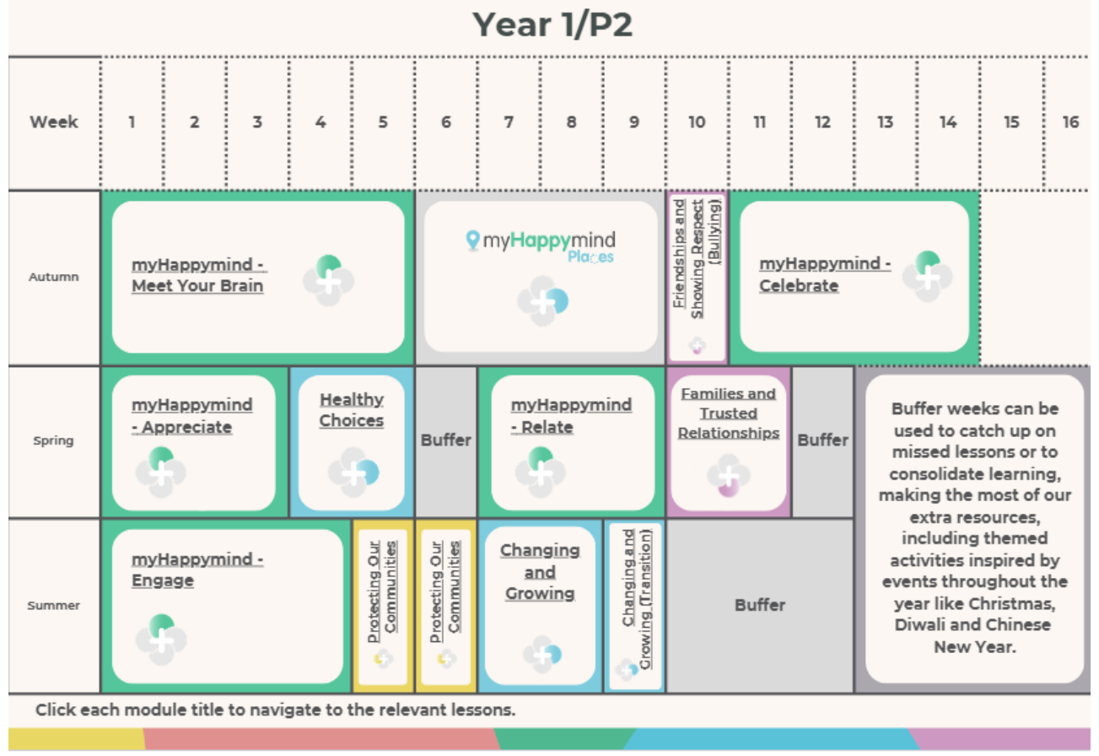
PSHE LONG-TERM PLAN
myHappymind Plus
Year 1 / P2
Progressive PSHE curriculum • Christian values • safeguarding • inclusion • life in modern Britain
Harper Bell SDA Primary School • Love, Learning and Laughter

Slide 3
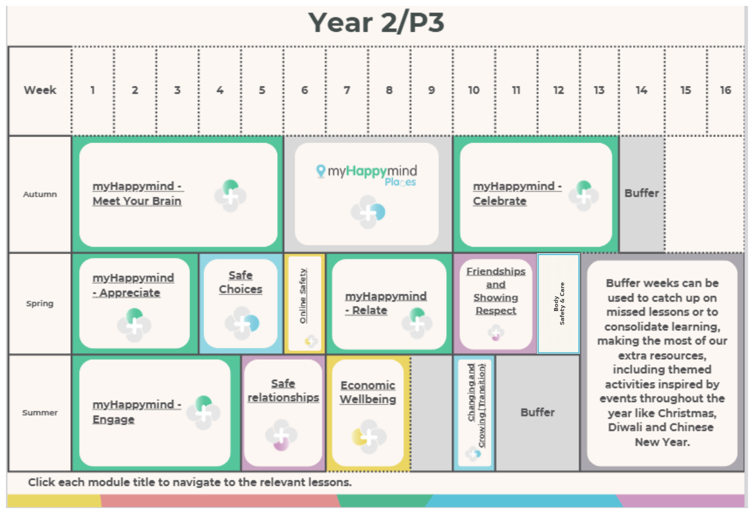
PSHE LONG-TERM PLAN
myHappymind Plus
Year 2 / P3
Progressive PSHE curriculum • Christian values • safeguarding • inclusion • life in modern Britain
Harper Bell SDA Primary School • Love, Learning and Laughter

Slide 4
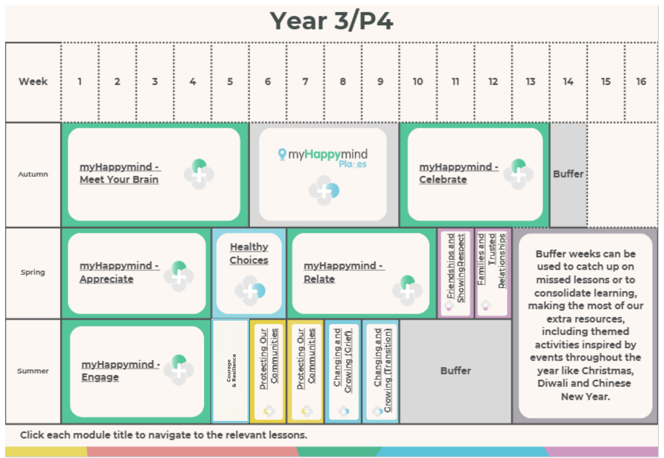
PSHE LONG-TERM PLAN
myHappymind Plus
Year 3 / P4
Progressive PSHE curriculum • Christian values • safeguarding • inclusion • life in modern Britain
Harper Bell SDA Primary School • Love, Learning and Laughter

Slide 5
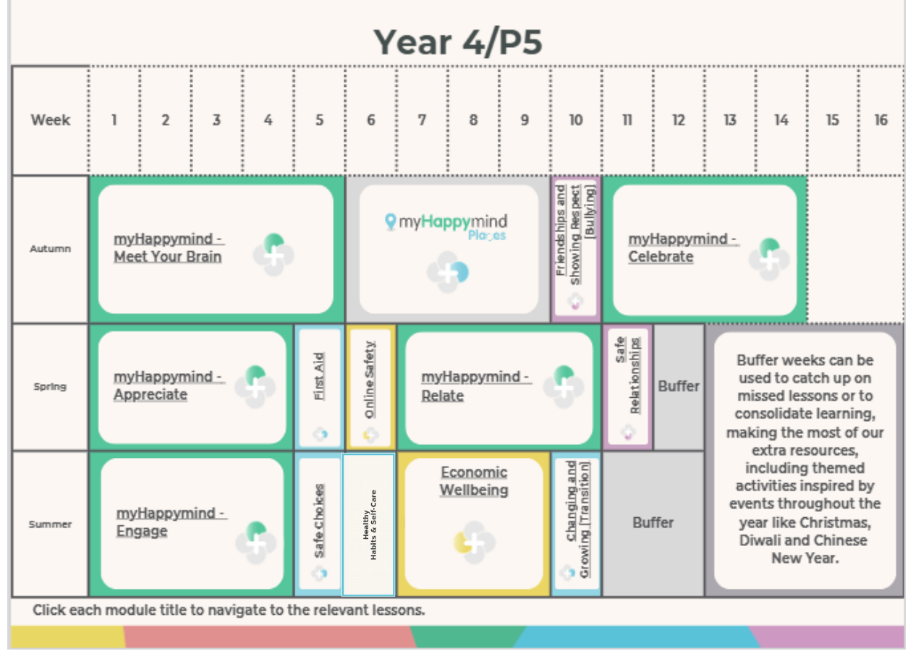
PSHE LONG-TERM PLAN
myHappymind Plus
Year 4 / P5
Progressive PSHE curriculum • Christian values • safeguarding • inclusion • life in modern Britain
Harper Bell SDA Primary School • Love, Learning and Laughter

Slide 6
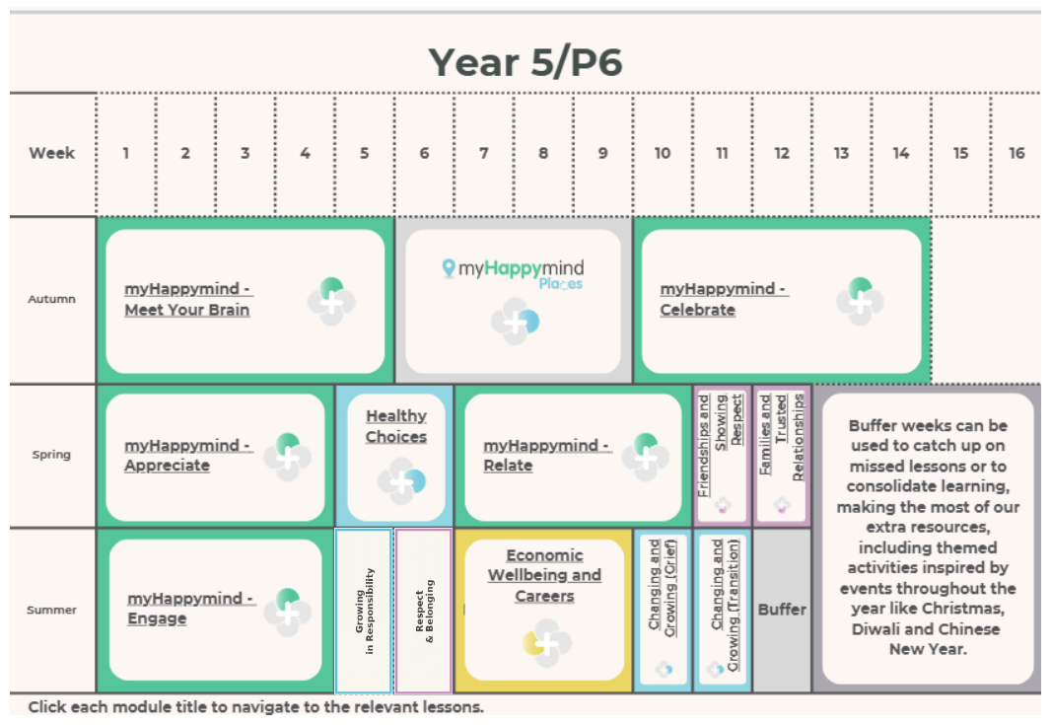
PSHE LONG-TERM PLAN
myHappymind Plus
Year 5 / P6
Progressive PSHE curriculum • Christian values • safeguarding • inclusion • life in modern Britain
Harper Bell SDA Primary School • Love, Learning and Laughter

Slide 7
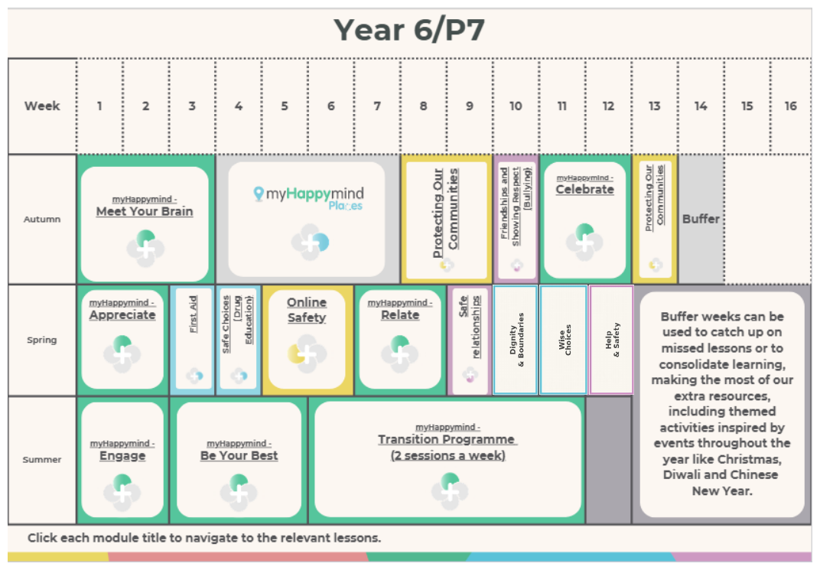
PSHE LONG-TERM PLAN
myHappymind Plus
Year 6 / P7
Progressive PSHE curriculum • Christian values • safeguarding • inclusion • life in modern Britain
Harper Bell SDA Primary School • Love, Learning and Laughter

