Slide 1


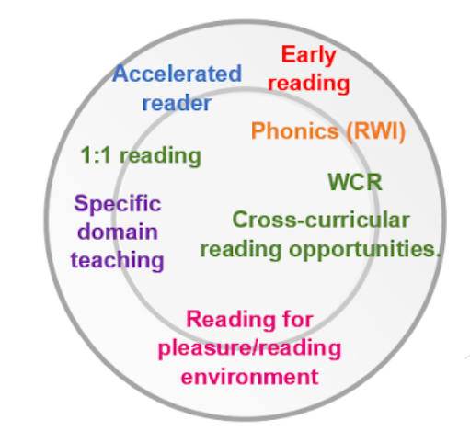
Harper Bell Seventh Day Adventist: Approach To Reading
Intent
At Harper Bell, we inspire a lifelong love of reading through a progressive, ambitious and responsive curriculum. High-quality texts act as both windows and mirrors: reflecting pupils’ identities and experiences while opening up new cultures, ideas and perspectives. Reading builds fluency, vocabulary, comprehension and knowledge, enabling pupils to access the full curriculum and become curious, confident readers.
Implementation
● Phonics & Early Reading: Little Wandle provides a systematic, cumulative route to secure decoding and fluency. Rapid Keep-up and targeted support address gaps promptly.
● Independent Reading: Accelerated Reader and STAR Reading support appropriate challenge, monitor progress and guide book choice. Pupils read regularly with adults, with additional practice for those who need it most.
● Reading Culture: ERIC, story time and Reading for Pleasure are protected parts of the school day. Pupils read widely, discuss books and develop independence, stamina and positive reading identities.
Impact
● Progress: Ongoing checks for understanding, STAR Reading and termly assessments identify what pupils know and what needs teaching next.
● Outcomes: Pupils become increasingly accurate, fluent and thoughtful readers who use rich vocabulary, discuss texts confidently and read successfully across the curriculum.
● Responsive Support: Assessment identifies pupils and groups requiring additional teaching. Rapid Keep-up, targeted intervention and 1:1 reading close gaps while maintaining high expectations.
Subject Knowledge, Skills and Vocabulary
Our reading curriculum builds knowledge and skill cumulatively from EYFS to Year 6. Pupils develop:
● Decoding and fluency – secure early reading through Little Wandle, progressing to accuracy, automaticity, pace, phrasing and expression.
● Comprehension and analysis – retrieval, inference, prediction, explanation and summarising are developed through rich, increasingly complex texts.
● Vocabulary and language knowledge – explicit vocabulary teaching and wide reading deepen language and background knowledge.
● Literary understanding – diverse authors, genres and themes provide windows into others’ lives and mirrors of pupils’ own identities and heritage.
● Oracy and reasoning – structured discussion, book talk and performance reading develop expression, reasoning and confidence.
● Progression and independence – knowledge is revisited and deepened; responsive teaching and purposeful practice support every pupil to read with increasing independence and enjoyment.

Slide 2

Harper Bell Seventh Day Adventist: Approach To Reading
Inclusion
At Harper Bell, reading underpins equitable access to the full curriculum for every pupil. Every pupil is entitled to become a confident, fluent reader and to experience the pleasure of books. Teachers use frequent checks for understanding to identify barriers early and adapt teaching without lowering ambition. Pupils with SEND, EAL or disadvantage receive precise scaffolding, repeated modelling, accessible texts and targeted practice. Where decoding gaps remain, Little Wandle Rapid Keep-up and additional 1:1 reading provide timely support. Assessment identifies next steps and ensures pupils increasingly access ambitious texts and the wider curriculum independently.

