Slide 1

WELCOME TO HLPS PTA

Slide 2



WELCOME TO HARROW LODGE PRIMARY SCHOOL PTA
Who are the PTA?
Chairpersons: Kelly Lawson
Treasurer: Jason Cordery
Secretary: Gemma Plewa
The PTA is a registered charity.
The PTA is made up of a committee (Chair-person, Treasurer and Secretary) and Members (Parents).
What We Do
Fundraise through fun activities and events
Buy resources to benefit the children
Organise exciting trips and activities for children and families
Sell our school uniform
Notes:
QuickStarter has created an outline to help you get started on your presentation. Some slides include information here in the notes to provide additional topics for you to research.

Slide 3
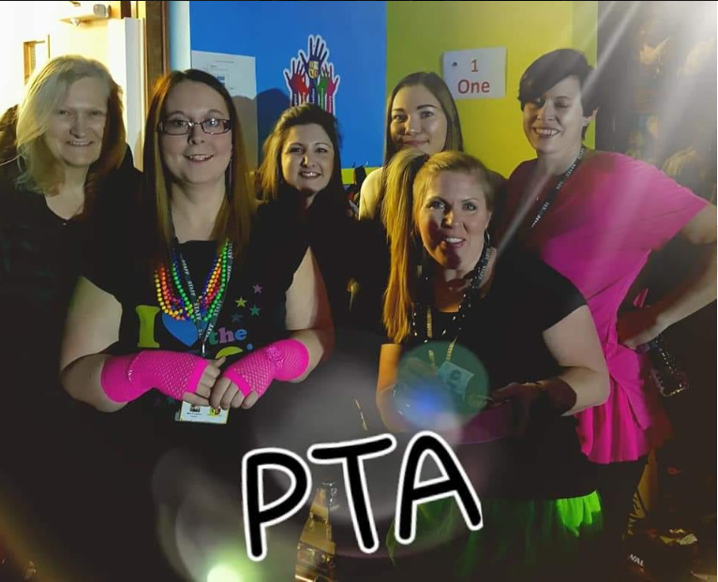
Our Events
The PTA runs events for the school community throughout the year, including:
Theatre Trips
Children’s Discos
Mothers Day and Fathers Day Gift Stalls
Pamper Evenings
Themed Family Disco Nights
Film Nights
Summer Carnival
Fireworks Night
Open Air Cinema Evenings
Seasonal Raffles
Easter Egg Hunt
Christmas Bazaar
Breakfast with Santa
Santa’s Grotto

Slide 4

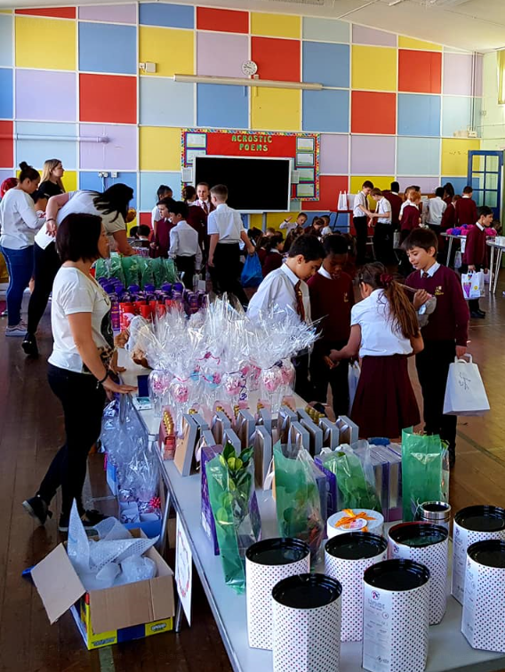
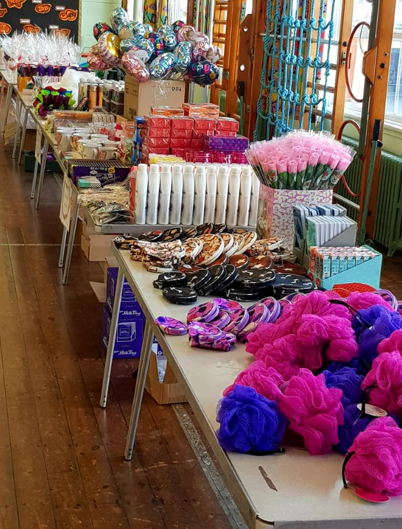
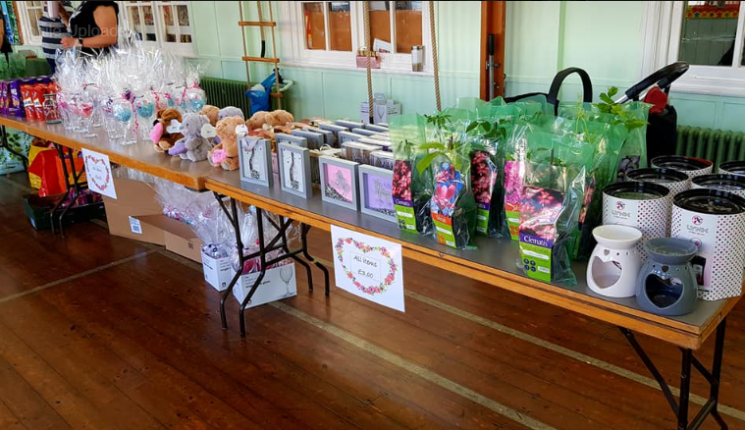
MOTHERS DAY AND FATHERS DAY STALLS

Slide 5
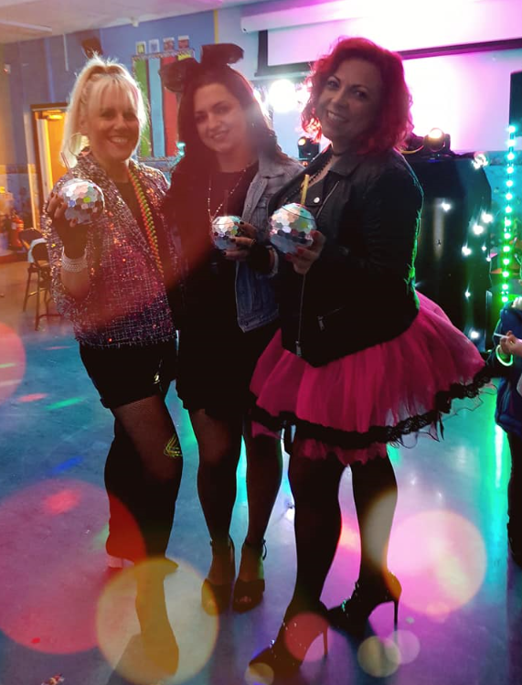
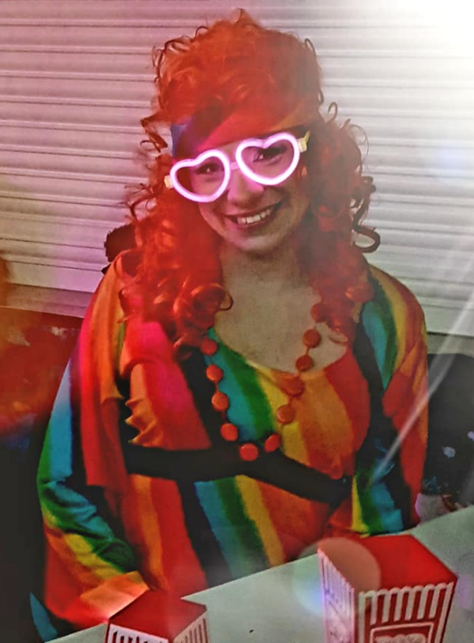
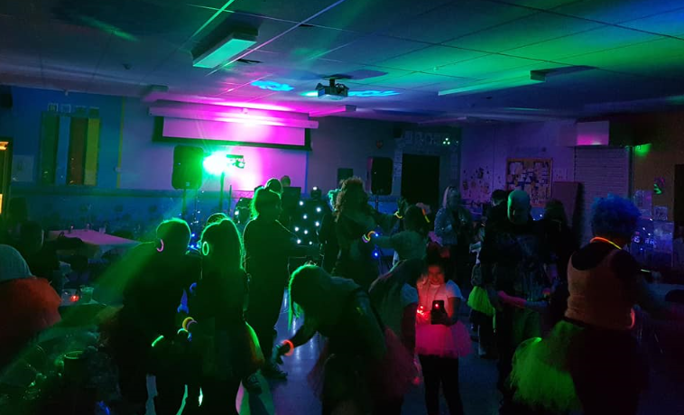
80’S – THEMED FAMILY DISCO NIGHT

Slide 6
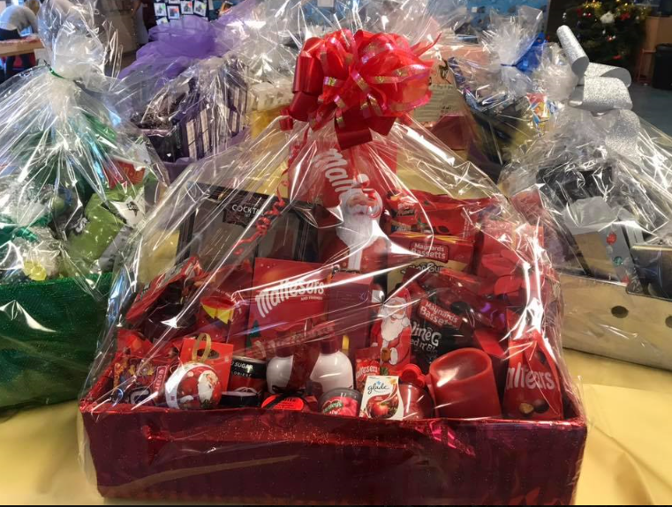
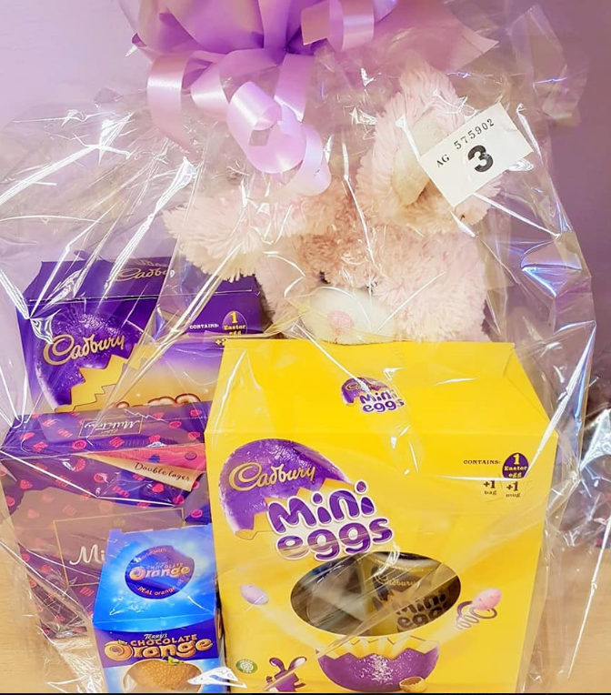
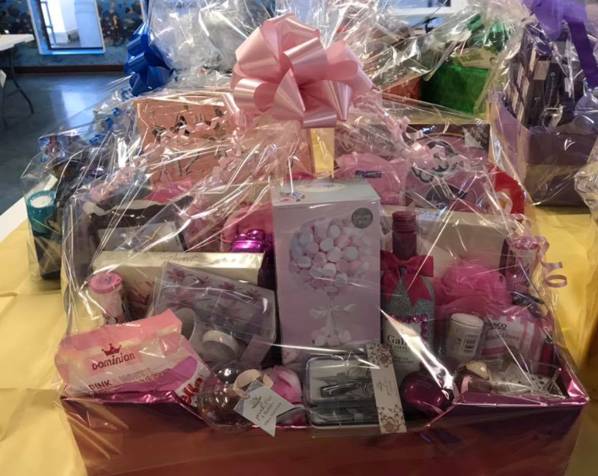
SEASONAL RAFFLES

Slide 7











Slide 8


PTA Fundraising Activities

Slide 9

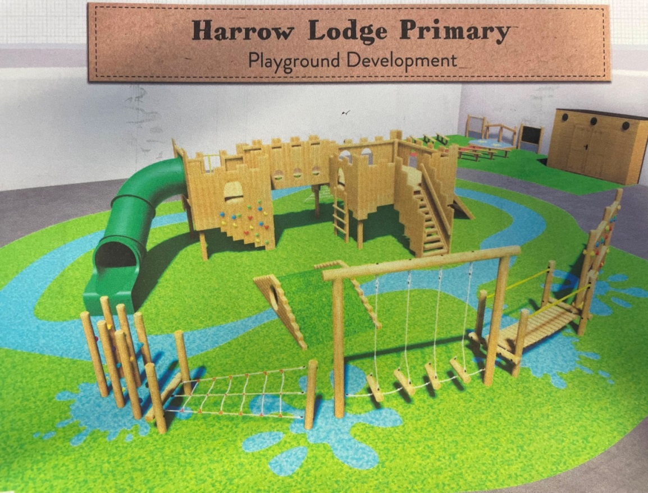
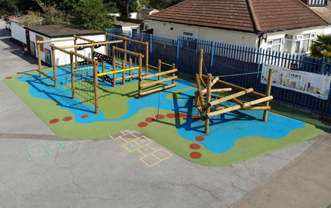


PTA Achievements

Slide 10

Social Media and Contact
FOLLOW US:
on Facebook & Instagram
to receive the latest news on our events
and fundraising activities.
CONTACT US:
harrowlodgeprimarypta@gmail.com
ORDER WITH US:
www.pta-events.co.uk/harrowlodgeprimarypta

Slide 11
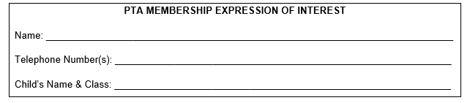
JOIN US!
The PTA wholly relies on volunteers from the school community who give up their time to support its fundraising activities.
Please consider joining our friendly bunch of PTA volunteers! We are always happy to welcome new faces and hear new ideas!
Even something simple such as baking a cake for our cake stall, helping to sell ice-creams in the sunshine or hosting a stall at one of our school fetes is always greatly appreciated, especially by the children.
If you would like to be involved in our PTA activities, please provide your details here.
Notes:
QuickStarter has created an outline to help you get started on your presentation. Some slides include information here in the notes to provide additional topics for you to research.

