Slide 1


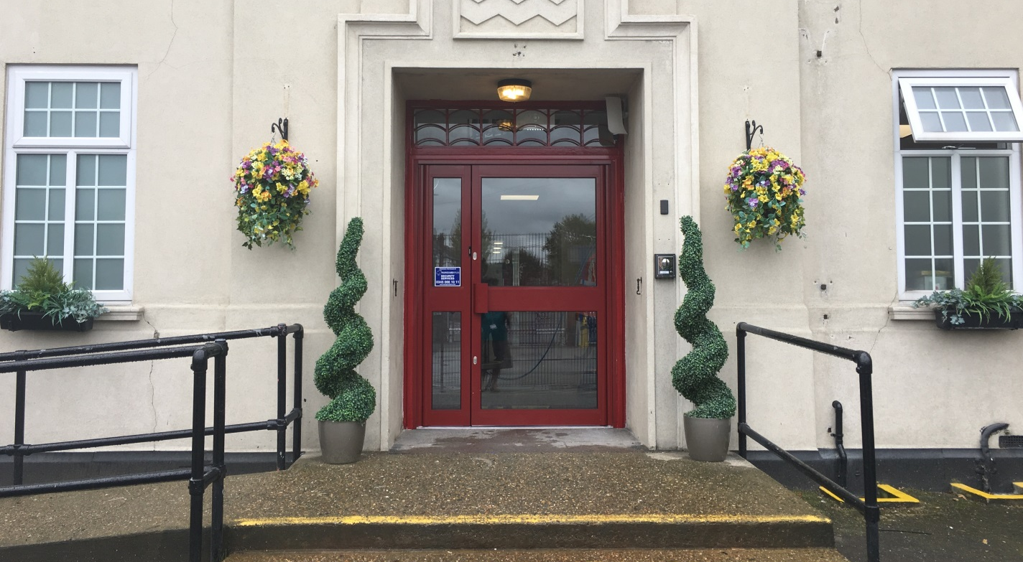


Welcome to Harrow Lodge Primary School

Slide 2

ROLE | NAME
HEAD TEACHER | Mrs Lynette Searle
DEPUTY HEAD TEACHER | Ms Michelle Clarke
ASSISTANT HEAD TEACHER & SAFEGUARDING LEAD | Mrs Lorraine Waddington
SENDCo | Mrs Sarah Boyes
PASTORAL & BEHAVIOUR | Mrs Andrea Petrie
CLASS TEACHERS | Miss Goodwin & Mrs Harding
ASSISTANT PRACTITIONERS | Mrs Jayne Swain Mrs Claire Welch
PARTNERSHIP LEARNING MULTI-ACADEMY TRUST
CEO | MR ROGER LEIGHTON

Slide 3

Our school runs on 2 principles
Core Values
Rules
Respect
Empathy
Aspiration
Confidence
Honesty
Be Kind
Be Respectful
Be Hardworking
Be Safe

Slide 4


Verbal Praise
House Points
Stickers
Star of the Week
Activity Equipment
Attendance Rewards
Presentation Cup
Handwriting Cup
Postcards Home
Achievement Badges

Slide 5

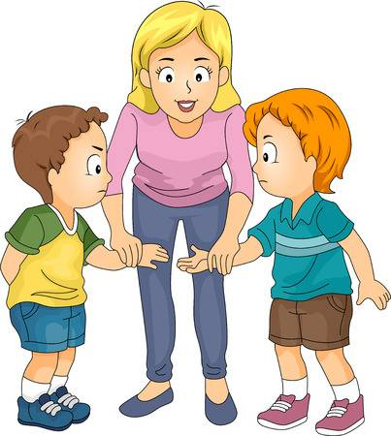

We are a Restorative School

Slide 6
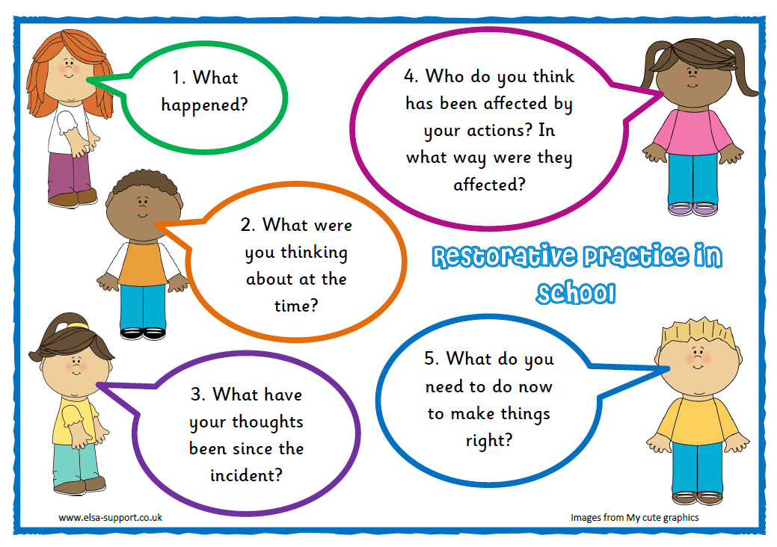

Slide 7

Home School Partnership
Stay & Learn – Remembrance – Nativities
Special event picnics – Fetes
Assemblies – Sports Days
Parent Council – PTA

Slide 8
EYFS Results
2019
2019
GOOD LEVEL OF DEVELOPMENT
HARROW LODGE PRIMARY =
NATIONAL LAST YEAR =
2% either side of National is
considered to be in line
71%
72%
1 %

Slide 9
YEAR 1 PHONICS SCREENING
HARROW LODGE PRIMARY =
NATIONAL LAST YEAR =
Harrow Lodge achieved higher
than most schools by 13%
95 %
82 %
13 %

Slide 10
YEAR 2 PHONICS SCREENING
HARROW LODGE PRIMARY =
NATIONAL LAST YEAR =
Harrow Lodge achieved higher
than most schools by 6%
97 %
91 %
6 %

Slide 11
KS1 RESULTS
SUBJECT | Harrow Lodge Primary | National
READING | 78 % | 75 %
WRITING | 77 % | 69 %
MATHS | 83 % | 76 %
COMBINED | 73 % | 65 %

Slide 12
CLUBS - £3.50
Football – Club & School Teams
Dodge-ball, Multi-sports, Gymnastics
Karate
Performing Arts & Choir, Recorder
Mindfulness
Arts & Crafts
Cookery
Quiz Club

Slide 13



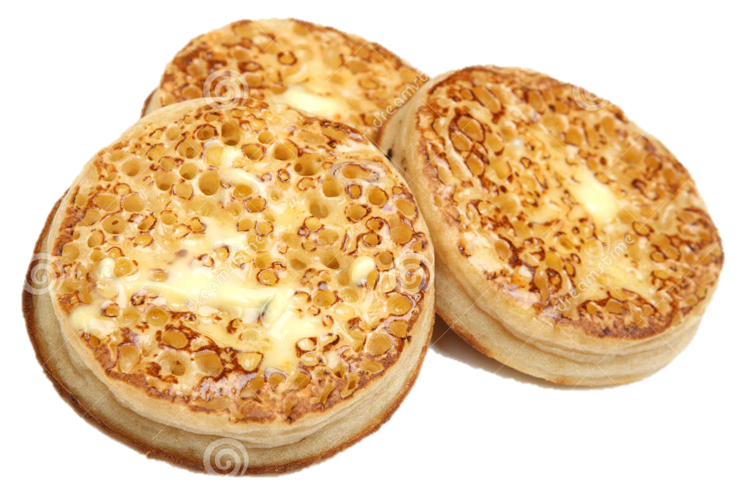
Start Time: 7:30 am
Cereal Bars & Fruit only after 8:15 am
Cost: £3.00 per session
Booking Required

Slide 14
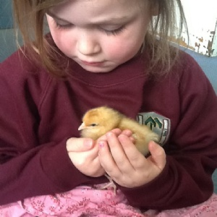
Wider-Curriculum Opportunities
Chicks
Marsh Farm Visit
Reptile Experience
Guinea-pig pets
Fire-fighters, ambulance, police
British values week
Culture Week
World Festivals eg Chinese New Year etc

Slide 15
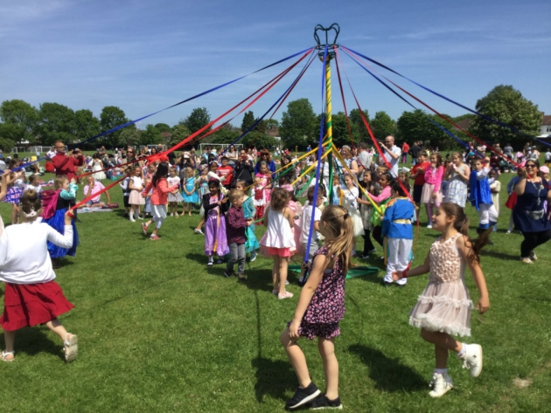
British Values Week

Slide 16
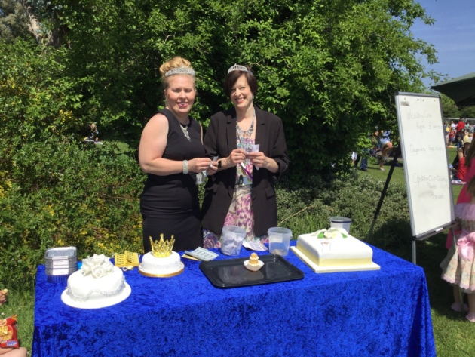
Prince & Princess Day

Slide 17
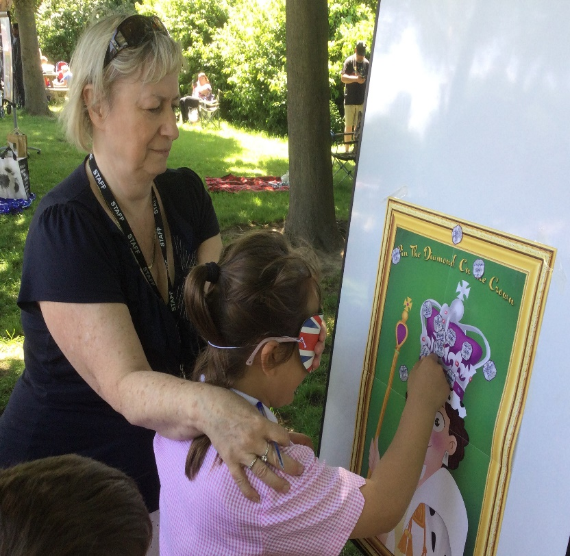
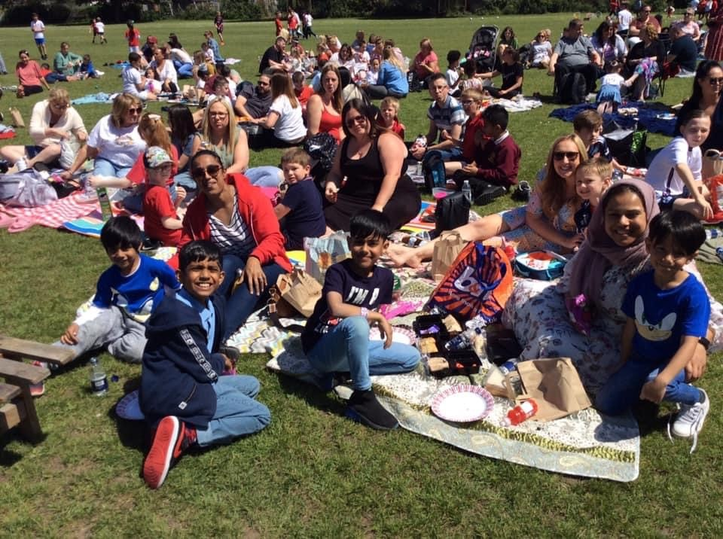
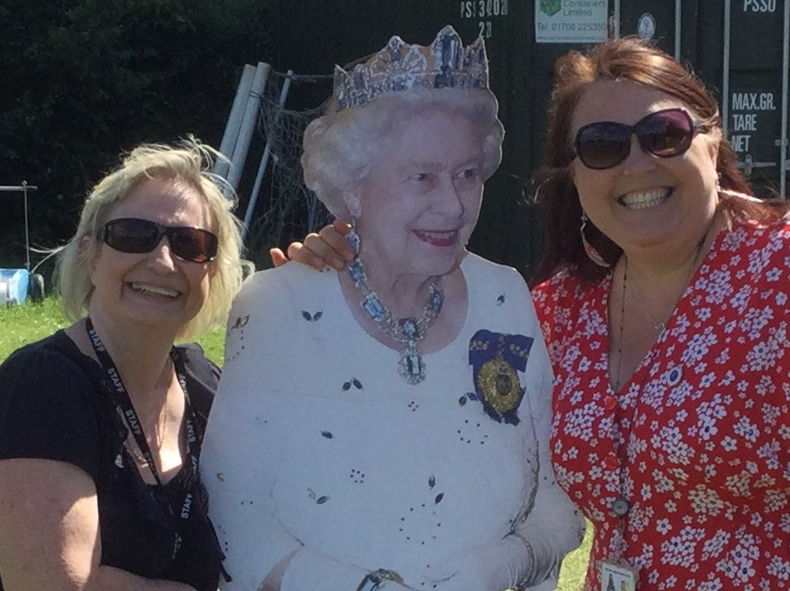
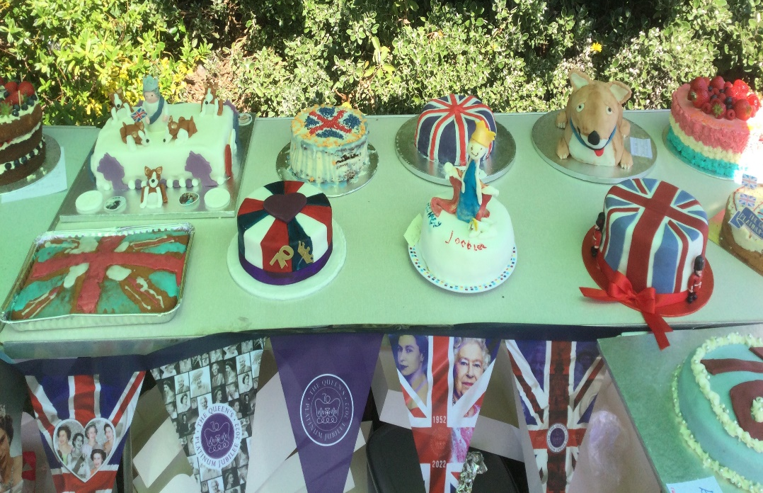

Platinum Jubilee Celebrations

Slide 18
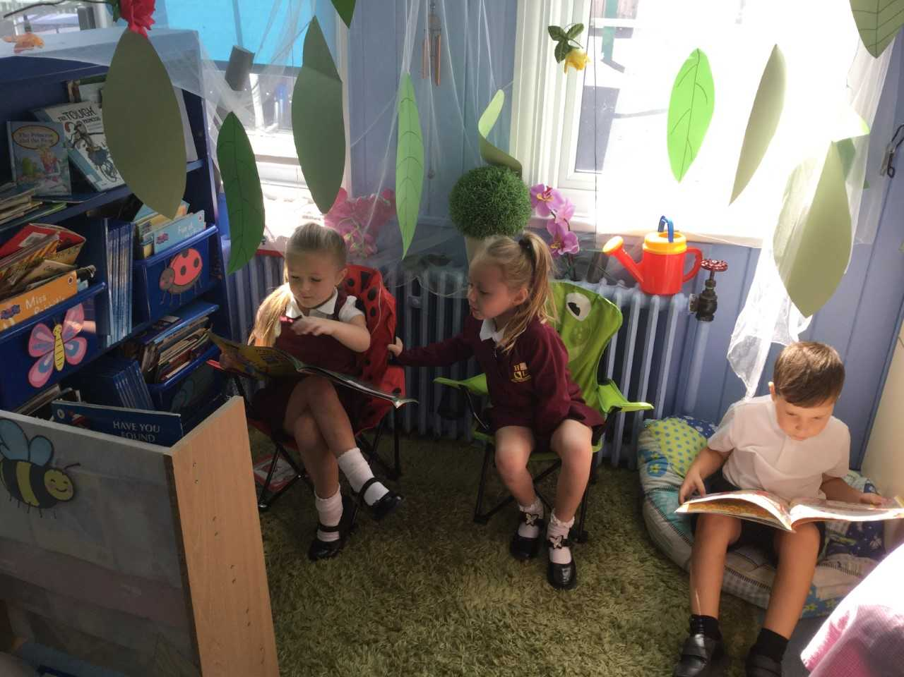
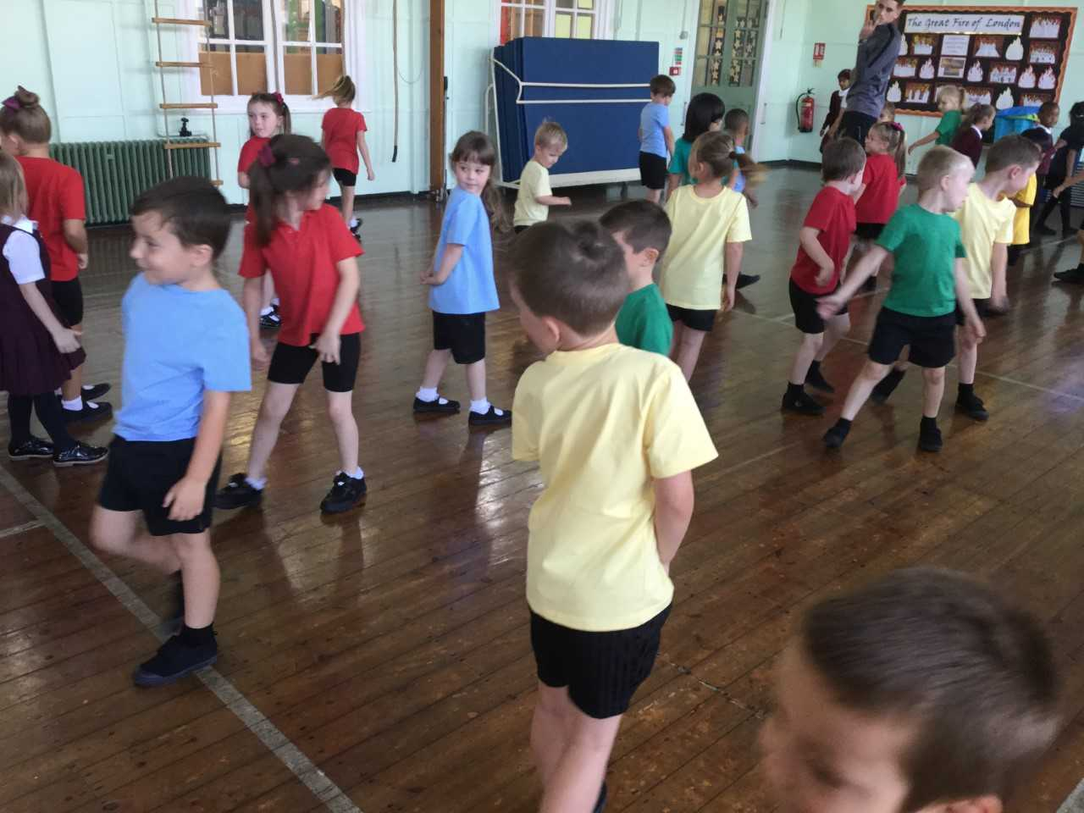
Life at Harrow Lodge

Slide 19
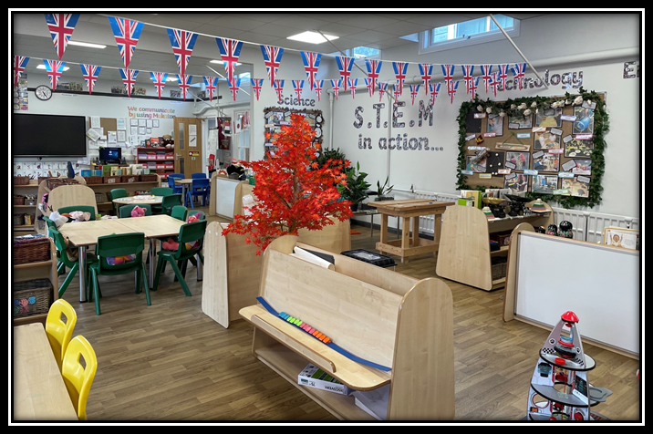
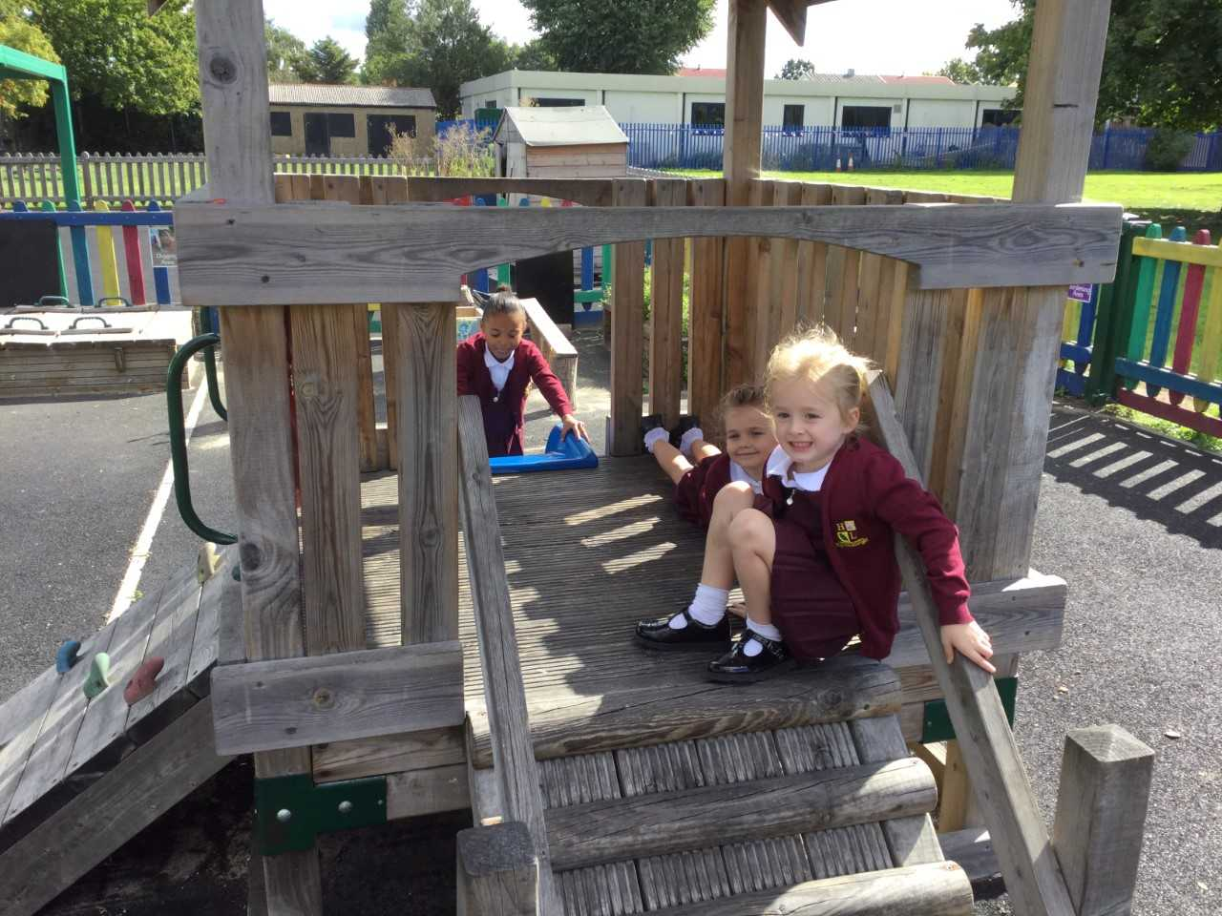
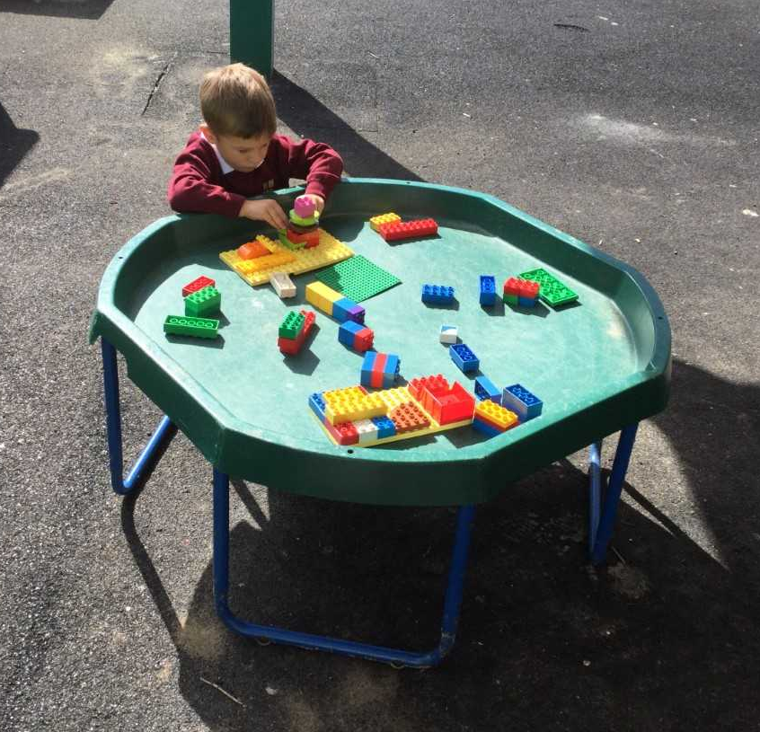
EYFS

Slide 20
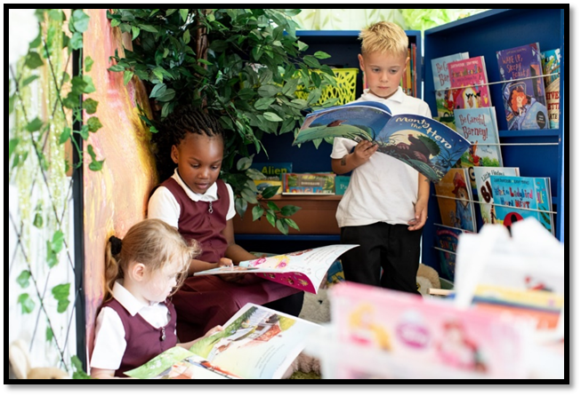
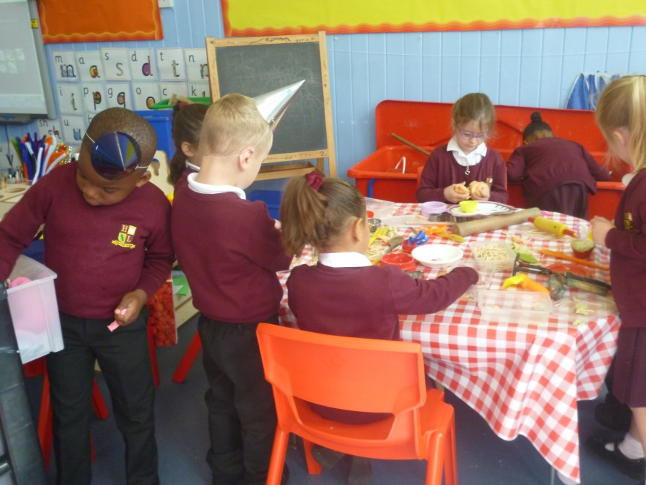
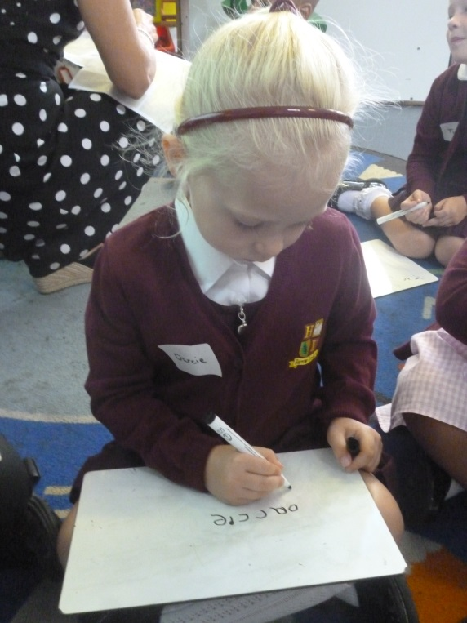
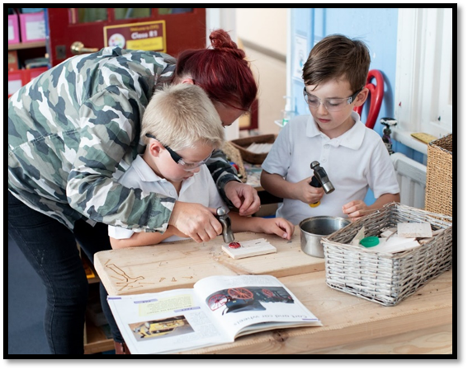

Slide 21
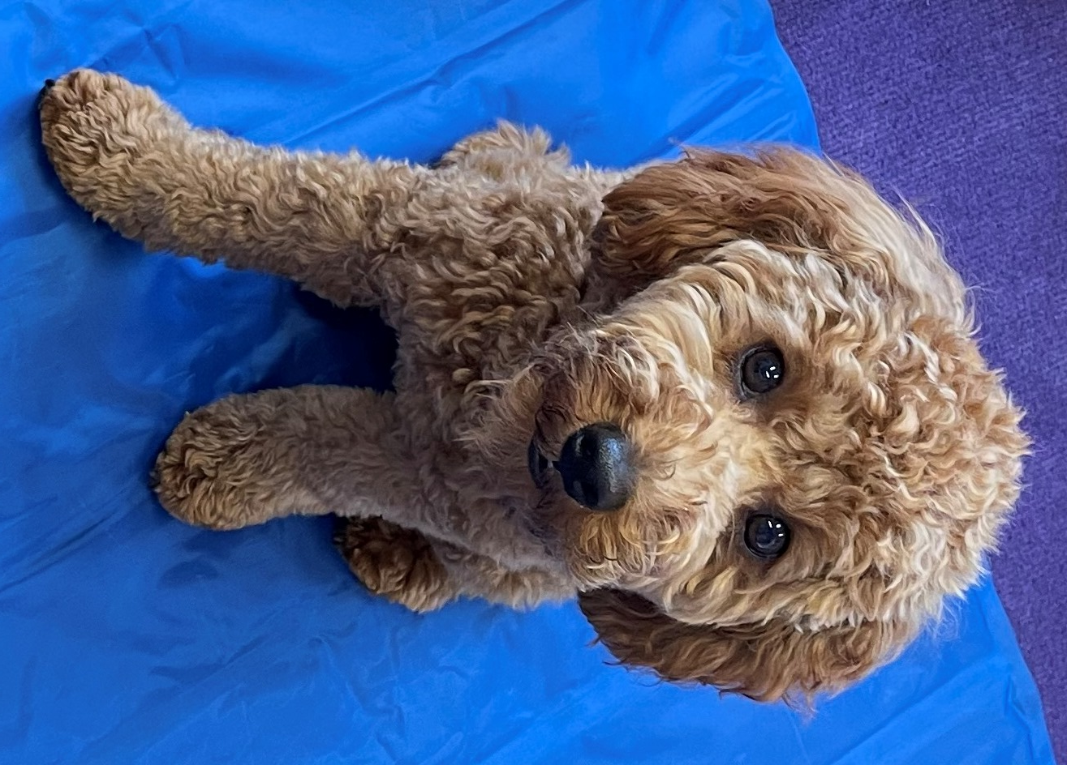
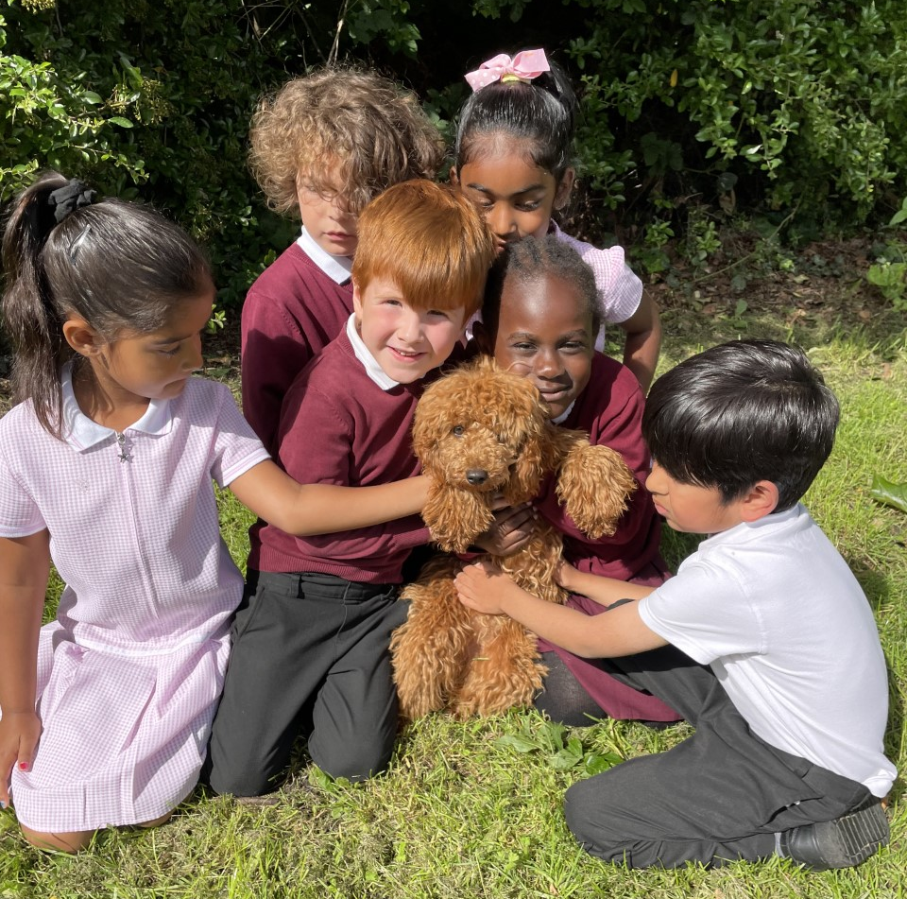
We have a School Dog!
Meet… Nala

Slide 22
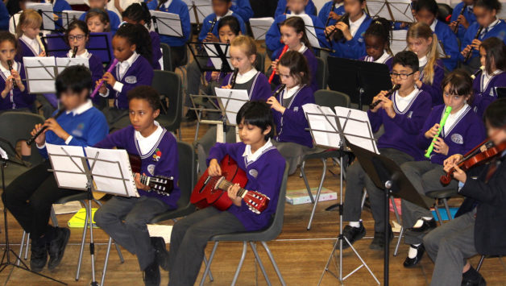


Learning an instrument
Piano
Guitar
Violin
Drums

Slide 23
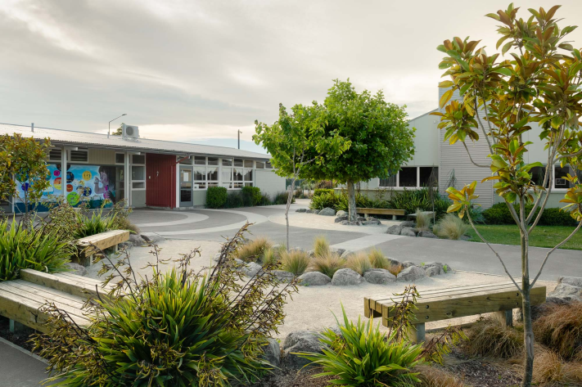
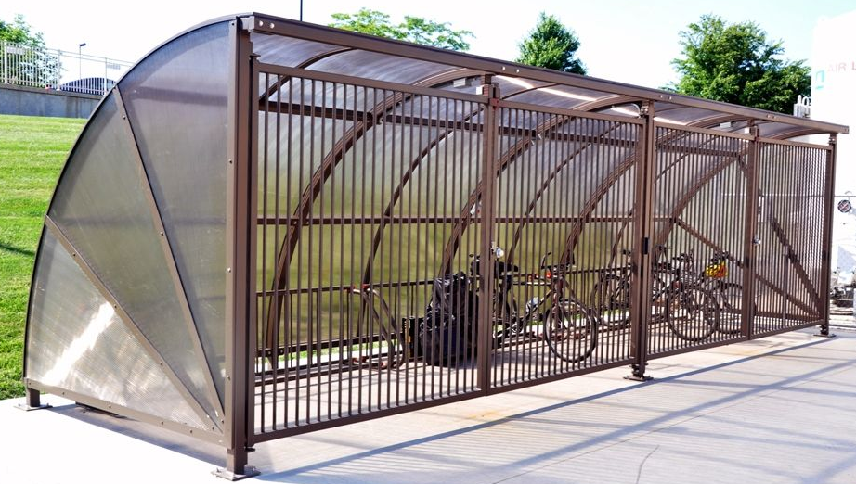
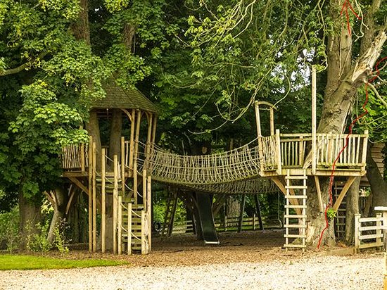
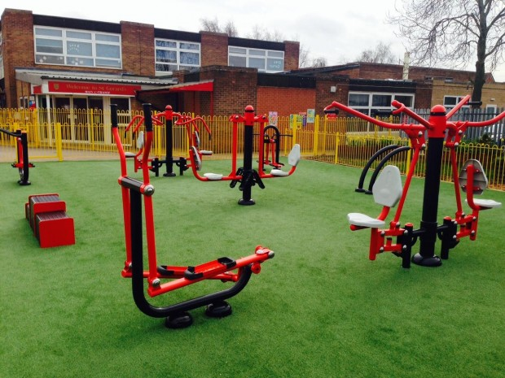
Future Projects
Playground Improvements

Slide 24
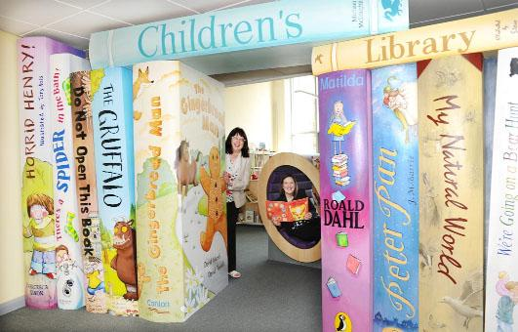
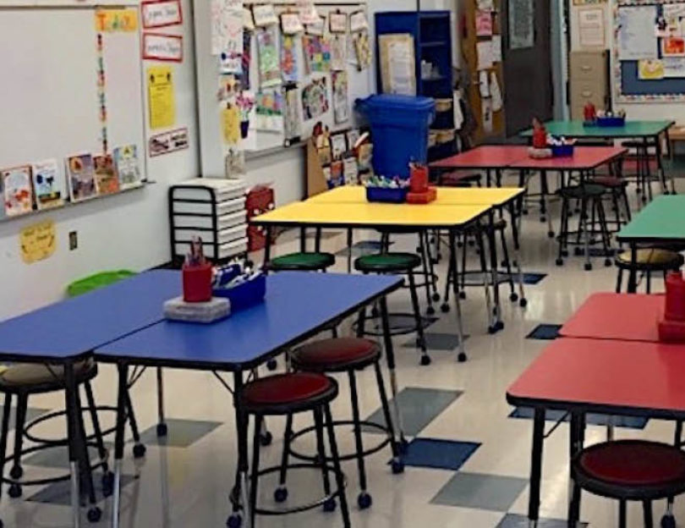

Art Room

