Slide 1
Year 6
2026-2027
How to have a happy and successful year in Year 6

Slide 2

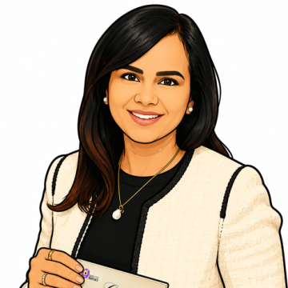



Miss Howard 6A Mrs Matharu 6B Miss Harrison 6C Mrs Kerr LA Miss O’Driscoll LA
Meet the staff

Slide 3
∗ Attendance
∗ Punctuality
∗ Homework
∗ Uniform
∗ Attitude
∗ Behaviour
Expectations

Slide 4
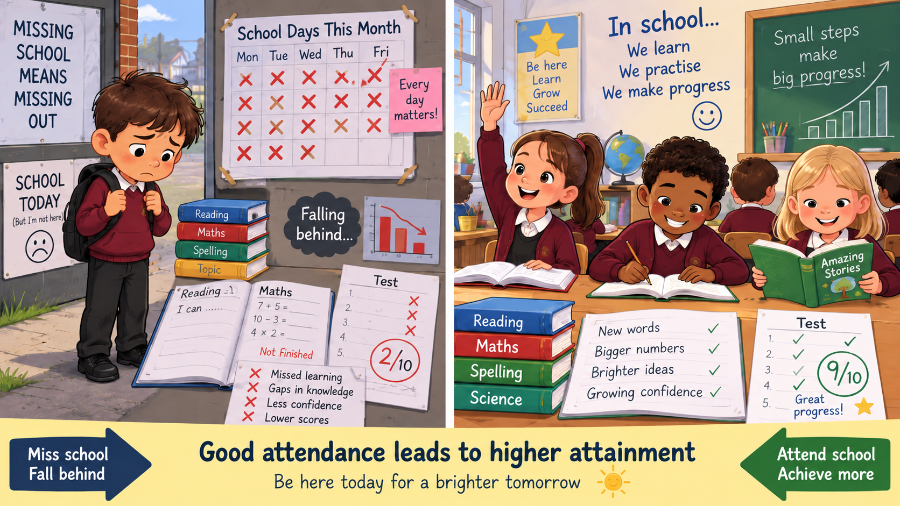
Attendance and Punctuality

Slide 5
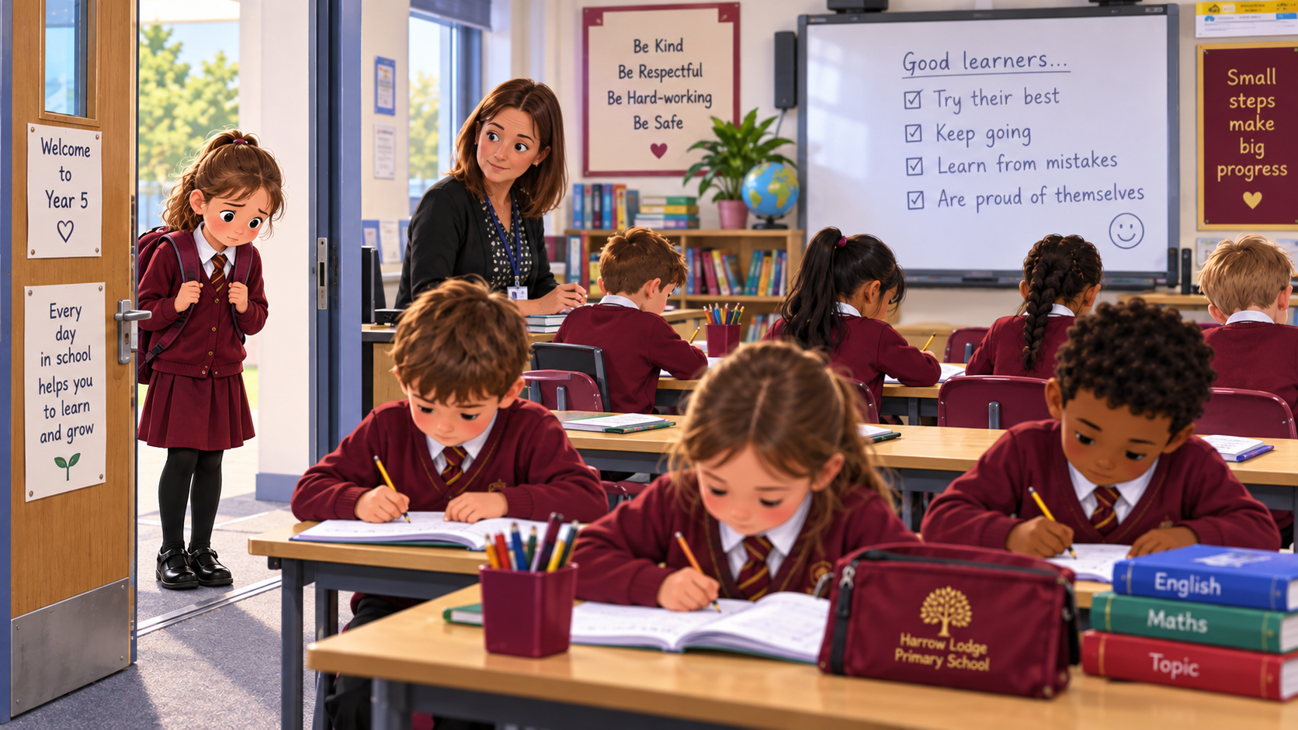

Slide 6

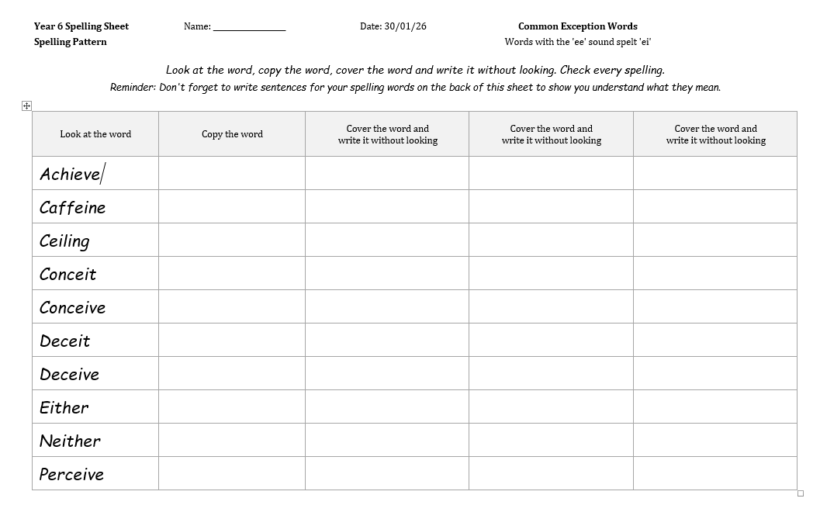

Reading Book in school every day – reading can happen at any time
CGP books should in school everyday, as they will be used throughout the week.
Homework

Slide 7


Books and Spellings set on Friday to be given in the following Wednesday.
Doodle Maths & TTRS
You will find your child’s logins in their reading records.
LBQ (Learning By Questions)
Expectation is to complete revision from this platform at home too.
Homework

Slide 8
Written parental permission form must be submitted to the office this year for walking home alone.
Brick phone only. Must be named.
In ruck sacks when on site.
Given in to teacher.
Smart phones will be confiscated and must be collected from the school office by a parent.
Extra letter for permission to walk home after any school clubs.
Children walking home alone

Slide 9
Uniform
Still really important – they are the role models for the whole school
Polo shirt – no tie but after half term must be shirt and tie.
Hair accessories – only maroon or black
Black trousers – NEVER leggings.
ALWAYS black shoes.
Plain black trainers for PE – no branding.
Plain black or dark blue or maroon coats.
Plain maroon hats or caps – no branding.
No earrings except plastic studs.
No nail varnish, gel nails or make-up.
MUST have jumper or cardigan with a logo.
NO HOODIES
PE Uniform
Gold T- shirt.
• Black shorts
• Plimsolls or plain black trainers
• Tracksuit- Burgundy sweatshirt – no logo
and black tracksuit bottoms (No leggings)

Slide 10
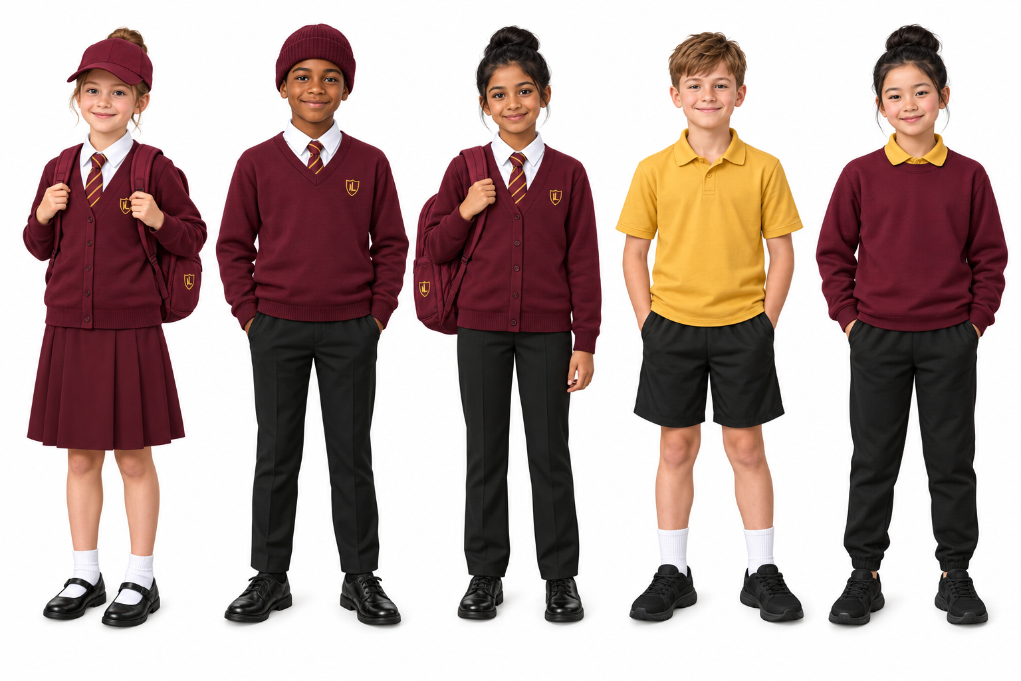

Slide 11
Y6 – Wednesday Morning
Please ensure that children arrive at school wearing their PE kits on their PE day.
On days when children have after sporting school clubs they will expected to wear their normal school uniform and change into their sports clothing after school.
Some children will be continuing swimming lessons in Year 6- a separate list will follow.
PE

Slide 12
∗Coat (plain black, navy or maroon)
∗Hat – Harrow Lodge or maroon or black only
∗School bag – Harrow Lodge
∗Lunch bag (if packed lunch) – clearly labelled
∗Clearly labelled water bottle – NO JUICE
Please ensure that the children do not bring any other items to school, such as toys or pencil cases, as they will be confiscated and you will need to collect them from the office.
What children will need

Slide 13
Attitude & Behaviour
Role Model Behaviour
In class – resilience and a growth mindset
Homework and Doodle & TTRS – all are compulsory
Below 90% Attendance – will lose prefect roles and any school team membership
Lunchtime is usually the problematic time – please talk to your children
End of year records go to secondary schools of choice but they always ask us for a report on each child.

Slide 14
10th May 2027, SATs tests on the following papers:
• Spelling, punctuation and grammar (SPAG) (2 papers)
• Maths (3 papers)
• Reading comprehension (1 paper)
Their writing will be independently assessed by teachers and may be externally assessed as well.
A SATs information meeting will be held during the year.
Practice papers will take place throughout the year to reinforce test conditions, celebrate learning and to ensure your child is confident and resilient.
KS2 SATS

Slide 15
The best way to contact us, should you have any queries or concerns, is via email. Please understand that we may not be able to respond immediately, as we will be teaching, but all emails will be responded to within 48 hours. If you need to contact us more urgently, please telephone the office.
jmatharu@harrowlodgeprimary.com
nhoward@harrowlodgeprimary.com lharrison@harrowlodgeprimary.com
Parent-Teacher Contact

Slide 16

Any Questions?

