Slide 1

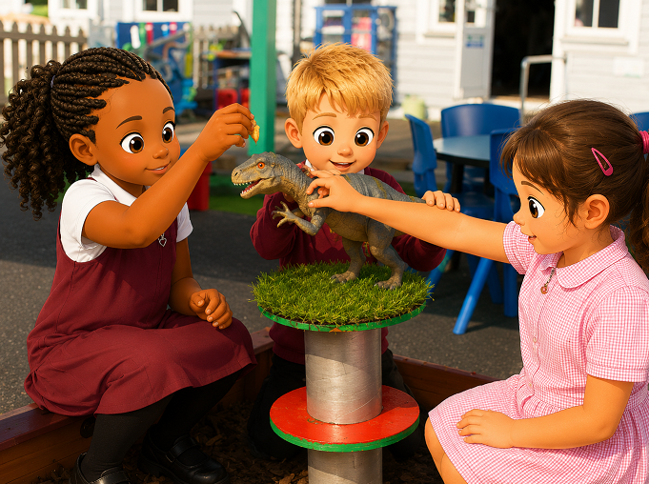
Welcome to KS1
SG
We hope you have had a lovely summer and we are looking forward to lots of exciting times ahead with your children!

Slide 2
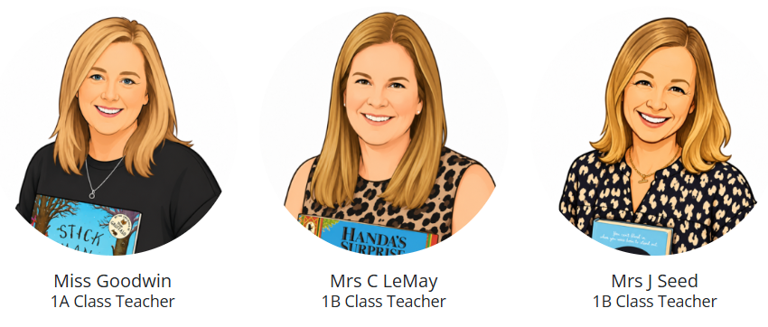




The KS1 Team
SG
Year 1
Year 2
Mrs Galvin

Slide 3
Attendance and
Punctuality
SG
Attendance and achievement go hand in hand.
Poor attendance can result in under achievement, difficulty in making or keeping friends, and loss of a child's confidence.
Please make every effort to ensure that your child arrives at school on time each day at 8.40am.

Slide 4


Reading Books
JS
Daily reading with your child is essential and will benefit their development in all areas. Each time you read with your child, please enter your initials or make a small comment in their reading diary.
Books will be changed when they are finished. Children are expected to place their finished books, with their diary, in a tray for changing. Books will only be changed if the diary has been signed by an adult.

Slide 5
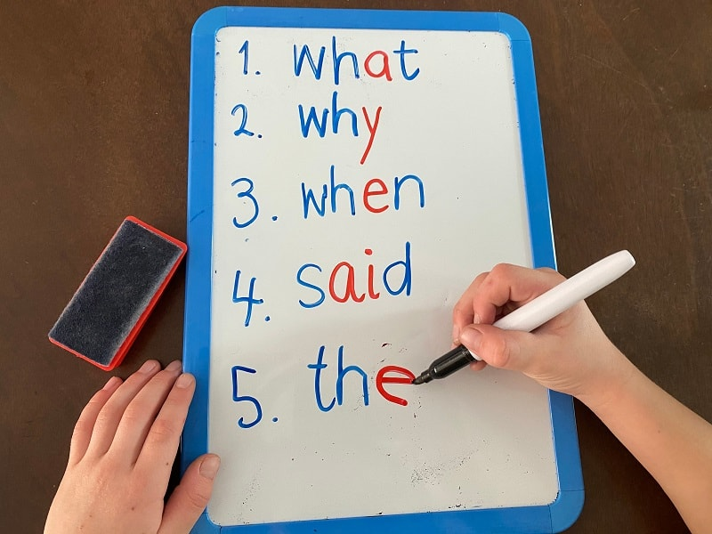
Spellings
JS
Spellings are given to children weekly on Friday.
Spellings are practised throughout the week and tested on Friday.
Here are some strategies for learning spellings:
      Look, say, cover, write
      Identify spelling patterns
      Practise daily – Little but often

Slide 6

Homework
JS
Reading (daily)
Spellings (weekly)
Doodle Maths (daily online)
Times Tables Rock Stars (Year 2)
Grammar (weekly)
Half-termly topic homework project
Year 1 will also be using Seesaw to set homework and communicate with parents

Slide 7

Behaviour Expectations
The children will work with the teacher to create a set of class rules and class expectations.
However, the school’s Core Values are at the heart of the children’s learning
The school’s main rules for behaviour are:
  Be Kind
  Be Respectful
  Be Hard Working
  Be Safe

Slide 8


Behaviour Chart
EO
The children start on green every week and have the opportunity to move through Bronze, Silver and Gold which will earn them house points for their team.
Children who achieve Gold will receive a certificate from their class teacher each time. After reaching Gold 5 times, they will receive an Achievers Badge and a Reward Card from the Head Teacher.
There is also a Yellow and a Red area on the chart for rare occasions when children need to reflect on their behaviour.
As well as the main class behaviour chart, the children may also be rewarded or be given targets more personal to their individual needs by their class teacher.

Slide 9
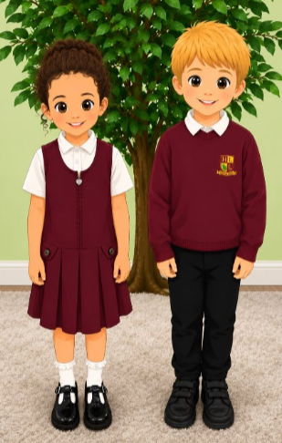
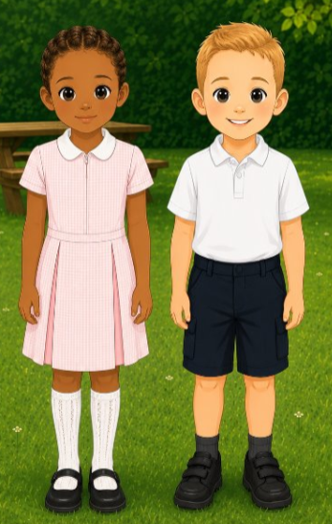
Uniform
EO
Please ensure your child wears the correct uniform.
Earrings must be removed for school.
Long hair should be tied back.
Trainers are only worn for PE
It is the child’s own responsibility to look after their clothes.
Please label every item of clothing

Slide 10

PE
EO
Year 1 PE is every Wednesday for both classes.
Year 2 PE is every Tuesday for both classes.
Children must come in to school wearing their PE kit on the day they have PE.
PE Kit
Gold polo shirt
Plain black shorts
Plain black tracksuit bottoms (no leggings)
School PE sweatshirt
Plain black trainers/plimsoles

Slide 11
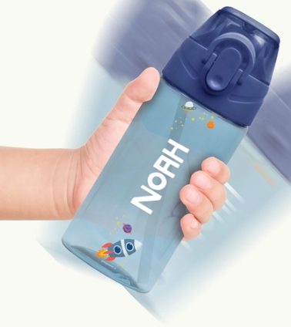
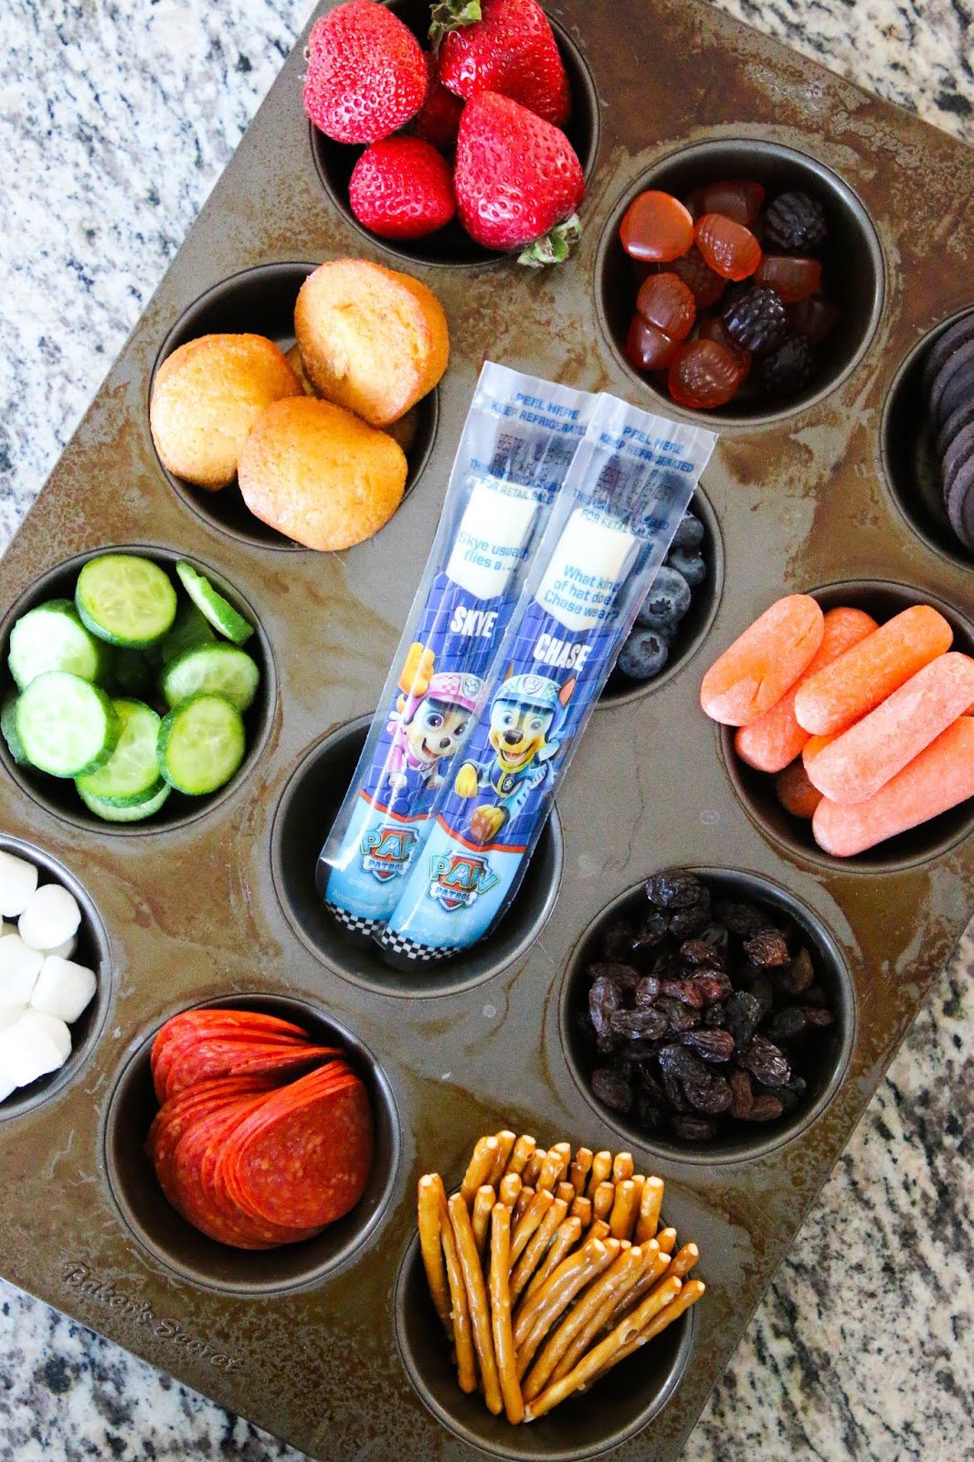
Water & SNaCK
SM
Please send your child in with a named clear water bottle. This must only contain water. Bottles can be refilled in the classroom
Classes do have plastic cups but we would prefer bottles please.
Children can bring one small healthy snack each day for break time. Fruit will also be available in class.

Slide 12

General
SM
Please send a letter in if your child is going to be collected by another adult or call the school office. We will not allow a child to leave with anyone else unless we have been informed.
Please do not allow the children to bring in toys or pencil cases/stationery from home. Everything will be provided in class.
If you have any issues or questions please feel free to email the class teacher on the following email addresses:
year1@harrowlodgeprimary.com year2@harrowlodgeprimary.com
A member of staff will aim respond to your email within 48 hours.

Slide 13
Thankyou
SM
Any Questions?

