Slide 1

Year 5 Expectations
WELCOME BACK!
Notes:
Before we start, you’ll receive two Year 3 newsletters today. One gives you more detailed information about the Autumn Term, including what the children will be learning, uniform and other practical information. The second summarises the Year 3 expectations that we’ll be talking through today. We’ll give you hard copies this evening, and they’ll also be sent through ParentMail, so please don’t feel you need to remember everything I say

Slide 2



Welcome to our Year 5 Team
Ms Mikayla & Ms Hayward
5B - Mrs Byrne
5A - Mrs Plewa

Slide 3
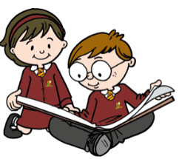

Year 5 Expectations
Why expectations help your child to succeed
Moving into Year 5 is a big step for children as they begin Upper Key Stage 2 and are encouraged to become more independent and responsible for their own learning and belongings.
Clear routines help children know what to do and what is expected of them. This helps them to be confident and achieve their very best.
In Year 5 we expect the children to be responsible for their own learning and conduct.
In order to achieve their best they will need to take pride in their work and try to produce their best at all times.
Team work makes the dream work – so they need to be kind and supportive to each other. The children should engage in their lessons fully to get the most out of them so we expect them to contribute to discussions with peers and adults.

Slide 4
Year 5 Expectations
Every Day Matters:
Being in school regularly helps children feel settled and confident.
All of their learning builds from one lesson to the next so missing any time at school can mean missing important chunks of their learning, which can make it harder for children to keep up when they return.
We completely understand that children are sometimes unwell and need to be at home. When they are well, regular attendance and arriving on time gives them the best possible start.
    Good attendance = Good achievement
    Punctuality - It is vital so your child does not miss vital learning
    Your child should arrive at school in time to be sitting at the desk by 8:50 am

Slide 5





Year 5 Expectations
Homework:
In Year 5, children will use a mixture of books, online programmes and activities to support their learning at home. Look out for:
Doodle Maths – This should be done daily to keep them in the green
TT Rock Stars – building speed and confidence with times tables
Spellings – practising the words and patterns we are learning in school
Grammar/reading/maths homework books We will check these together and go through strategies.
Reading Record – regular reading at home, with a short comment or signature
We encourage children to have a go independently wherever possible — it doesn’t need to be perfect! If something is proving particularly difficult, please let us know rather than it becoming a source of worry at home.

Slide 6

Year 5 Expectations
Maths at home: Ten minutes a day.
Doodle Maths: It has been proven that the children who do their Doodle Learning regularly make better improvements in Maths.
Times tables: Times tables are the key to most Mathematics, so knowing these and having quick recall will help your child in all areas of maths. Children are encouraged to practise regularly on TT Rock Stars and join in with our class, school and national tournaments. A few minutes, often, makes a real difference.
Notes:
We’re not expecting children to sit down and spend ages learning tables every evening. Five or ten minutes regularly is much more useful. By the end of Year 3, we want the 2s, 5s and 10s to be really secure and children becoming increasingly fluent with their 3s, 4s and 8s. TT Rock Stars is a great way of making that practice more enjoyable, particularly when we have tournaments running.”
Knowing their tables quickly frees children up to concentrate on the maths problem itself rather than having to work out every multiplication fact from scratch.

Slide 7


Year 5 Expectations
Reading at home: little and often
Around 10–15 minutes each day can make a real difference. Little and often is much more valuable than one long reading session each week.
Your child must bring their reading book and reading
record to school every day, as they will be reading their
books in class during the day.
Reading together should be fun. You might chat about a new word, a character’s actions, what might happen next, or simply what your child liked or disliked about the book.
Any books your child reads should be recorded in their record books.
You should encourage your child to sign their own record book.

Slide 8
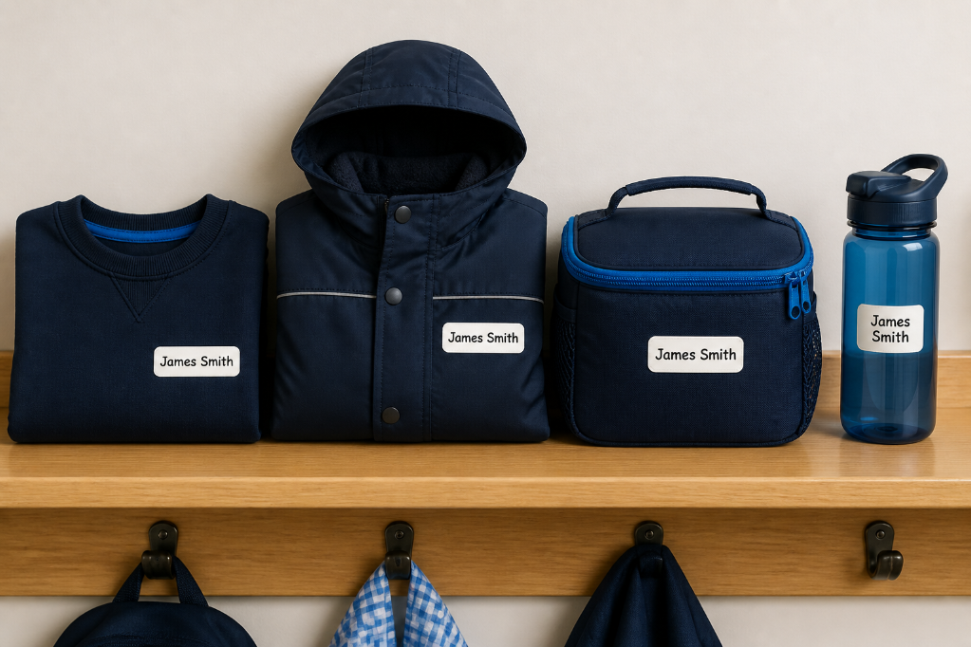
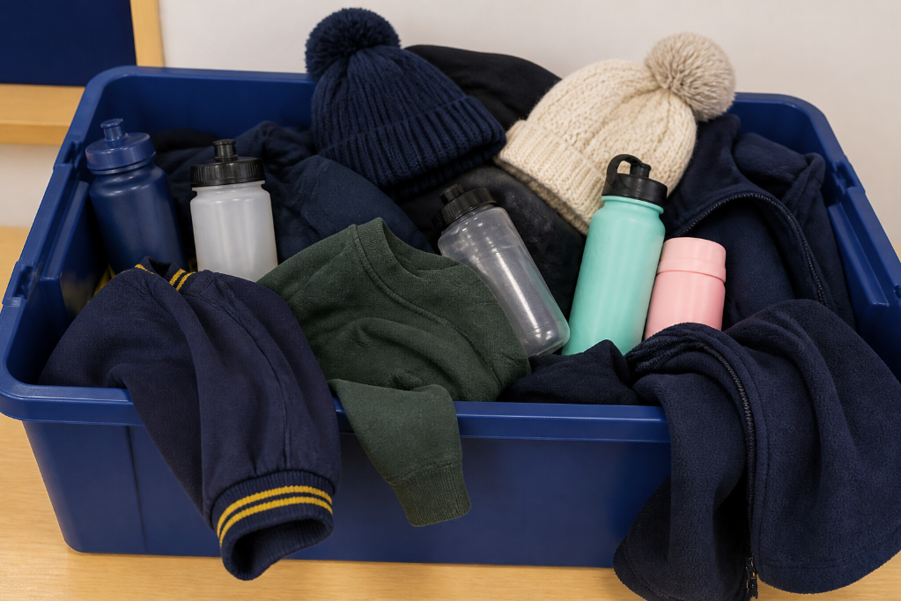
Year 5 Expectations
Labelled uniform or lost property? It only takes a minute to label everything with a sharpie or iron on labels.
Labelled belongings
No labels
Names on your things help you find them fast and keep you organised.
Without labels, things can get mixed up and end up in lost property.

Slide 9
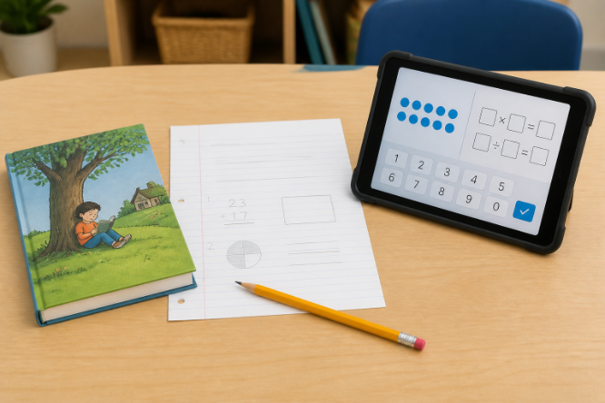
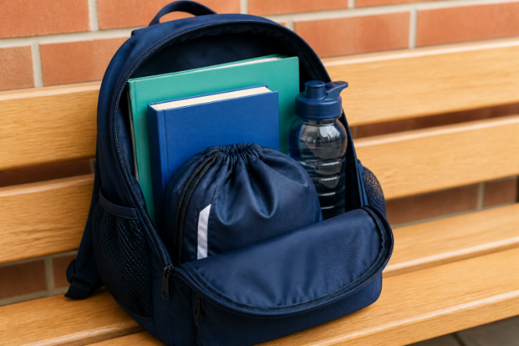
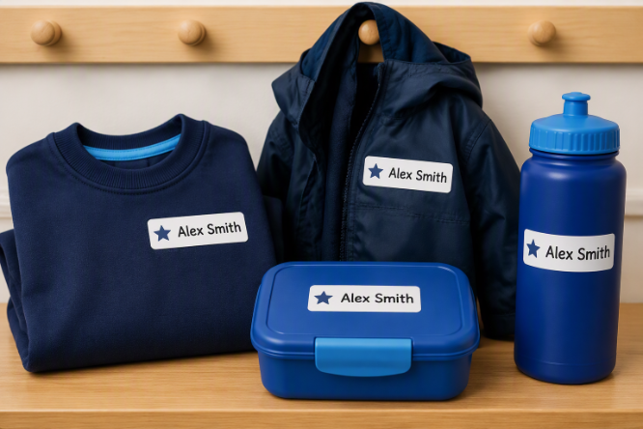
Year 5 Expectations
So, what does independence actually look like for a Year 5 child?
Learn at home
Bring the right things
Look after their things
Learn at home – being responsible for their own homework, reading and online learning.
Bring the right things – remembering books, homework and water bottles (see Newsletter).
Look after their things – taking responsibility for labelled belongings

Slide 10
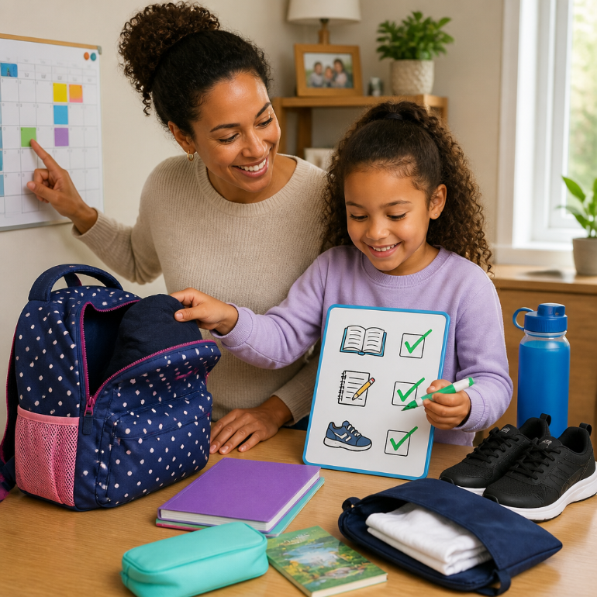
Year 5 Expectations
How can you be more independent in Year 5?
How can your child show independence in Year 5 at home and at school?
A strong answer your child might say ...
“I can pack my bag the night before and check that my reading book and homework are inside.
I can set out my uniform the night before and check all labels are still in place. This helps me be responsible.”

Slide 11
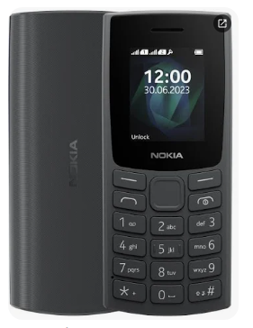
Year 5 Expectations
Walking home alone and mobile phones.
Now they are getting older and more independent, children in Year 5 can walk home alone but we must have the parent consent form signed before we can allow this. A separate consent statement is needed for permission to walk home alone after a school club.
Only children that are walking to or from school alone can bring in a mobile phone. This must be the brick type and not a smart phone with internet access.
Most importantly, the phone MUST be labelled with your child’s name.

Slide 12
Year 5 Expectations
Swimming.
The children will having swimming lessons in Year 5 on a Tuesday.
5A will start their lessons straight away.
5B will start their swimming lessons in February 2027.
Please double check that your child has the correct swimming kit when it is their turn to go. They will also need a school swimming bag, a swimming hat, goggles (optional), a towel and, most importantly, their underwear for when they get dressed to come home! (Most children wear the swimming kit to school)

Slide 13
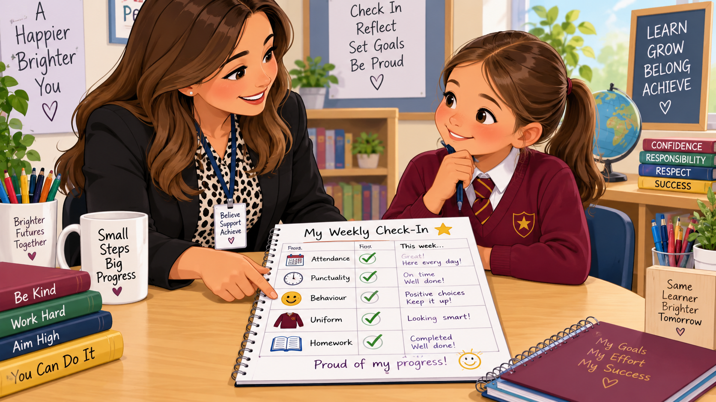
Year 5 Expectations
Weekly Meetings
Every week, Ms Clarke will meet each child and discuss how well they are meeting school expectations. She will cover the following topics:
Attendance
Punctuality
Homework Completion
Uniform infringements
Behaviour infringements
– a slip
These meetings will help children take greater responsibility for their own learning, choices and success.

Slide 14


Year 5 Expectations
Thank you for helping us to help your child achieve the best they can by working together and helping them become responsible for themselves.
Any Questions?

