Slide 1
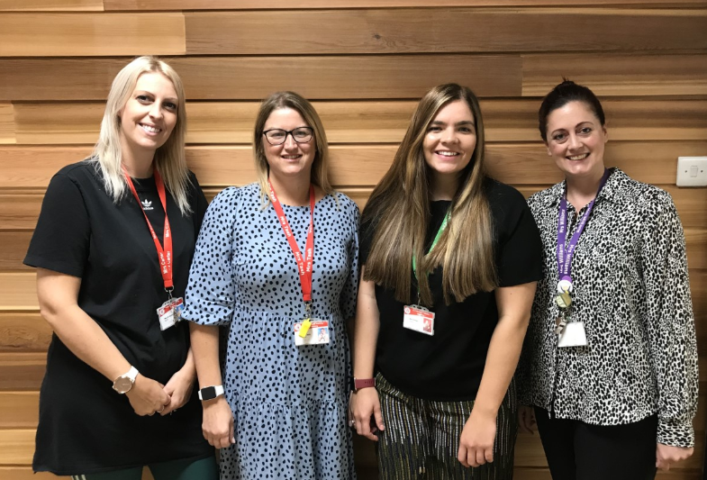

Welcome to Year 2

Slide 2
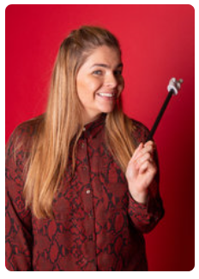
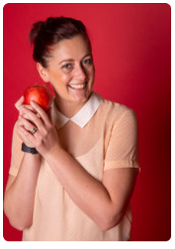
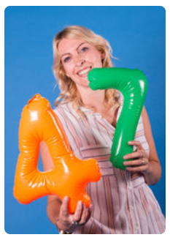
Your new teacher is Miss Duncan.
You are in 2ED in Year 2
The teaching assistants in your class are Mrs Williams and Mrs Carter.

Slide 3
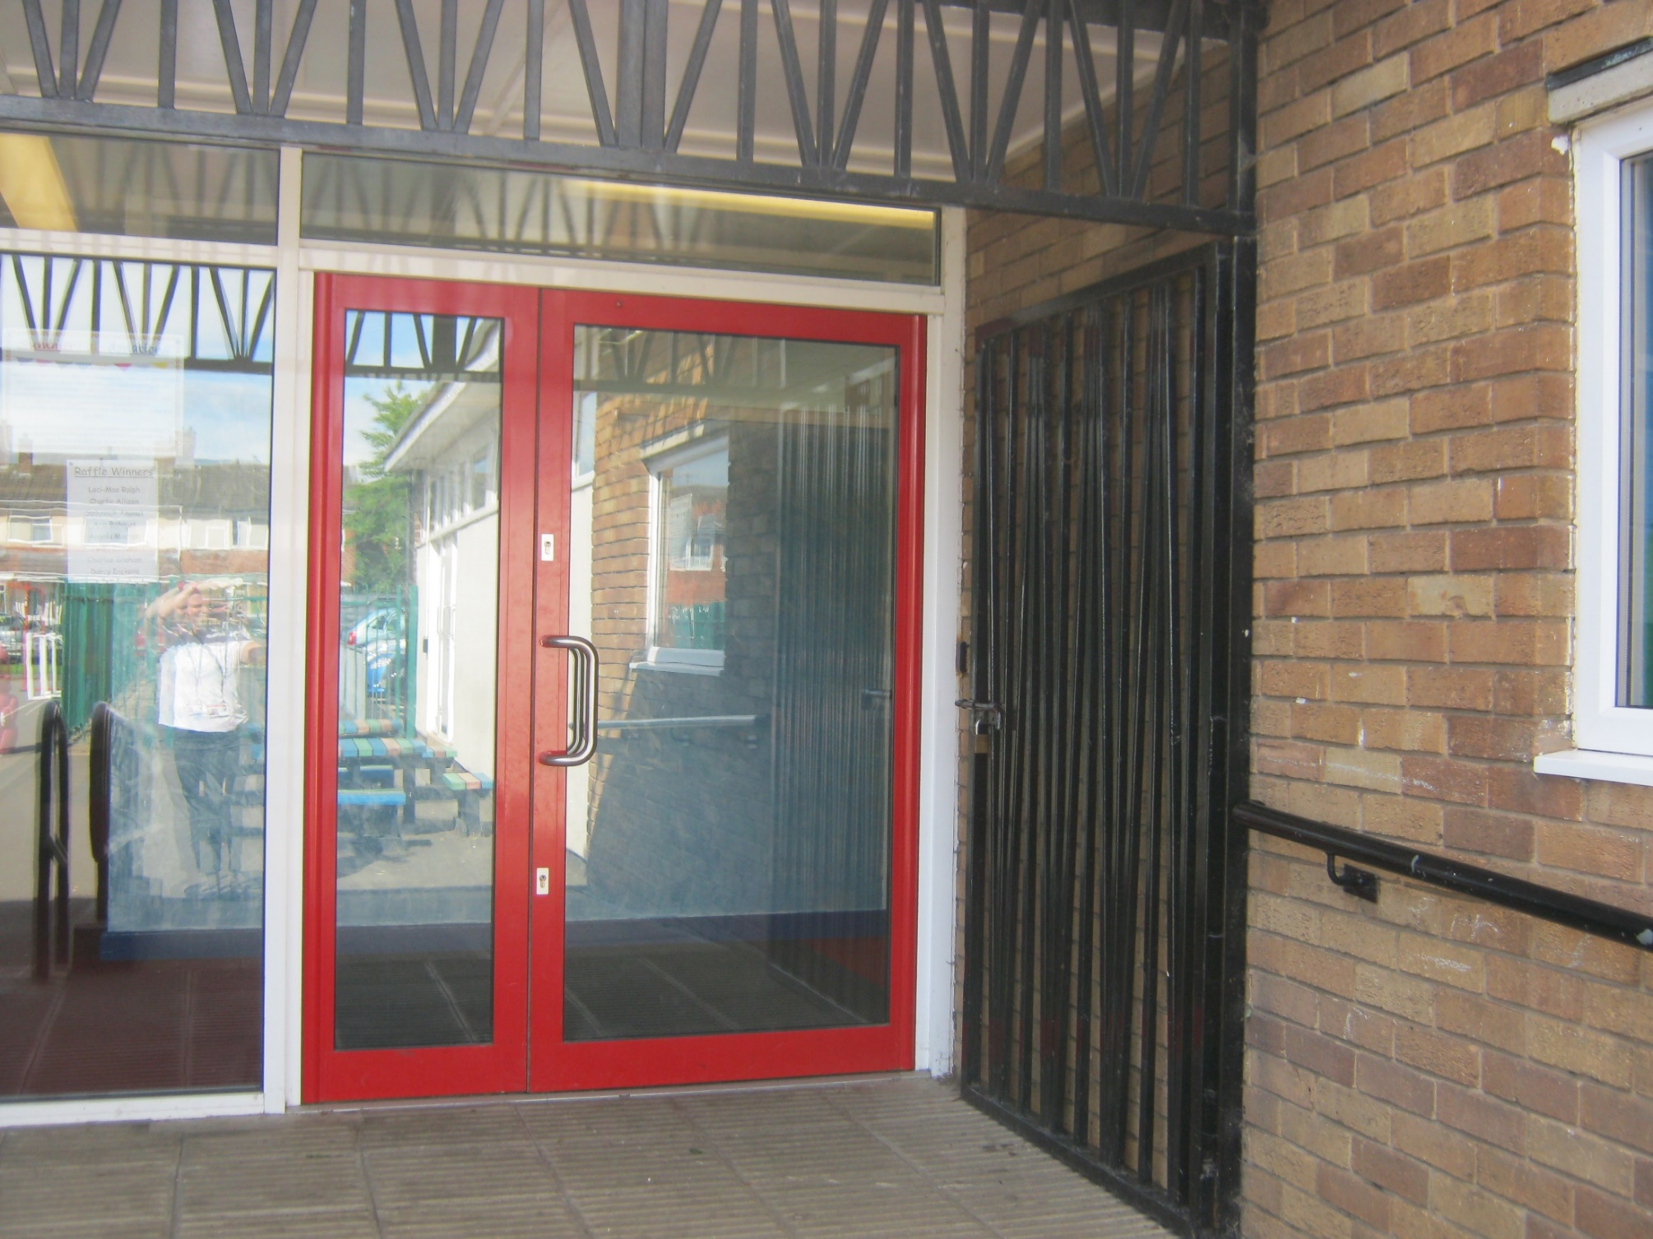
School starts at 8:45am
This is the door you will go into school.
There will be an adult from your new year group to help you get to the classroom.

Slide 4
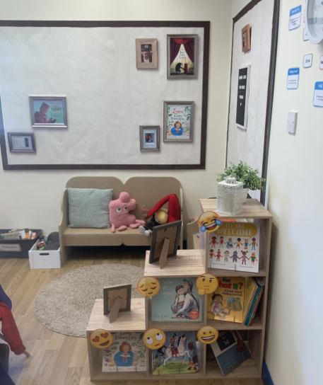
Our wonderful reading area.
Welcome to your new reading area. We put our favourite authors and books on this wall to celebrate the fun we have had reading them.

Slide 5







Everyday we do…
Notes:
You could add extra information around English……this half term we will be focusing on…
Maths this half term will be……..
The class reader will be……..

Slide 6
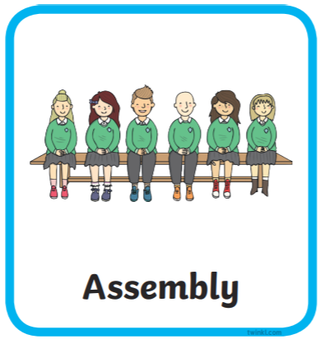






Here are subjects and activities we will do each week in the first term.

Slide 7

Our topics when you come back are …
Our history question for the term is “Pirate or explorer? – Francis Drake and James Cook
Science and Design Technology
In Science we will be looking at animals including humans.
In DT we will be looking at food and nutrition.

Slide 8
You will go home at 3.10pm from this door.

