Slide 1
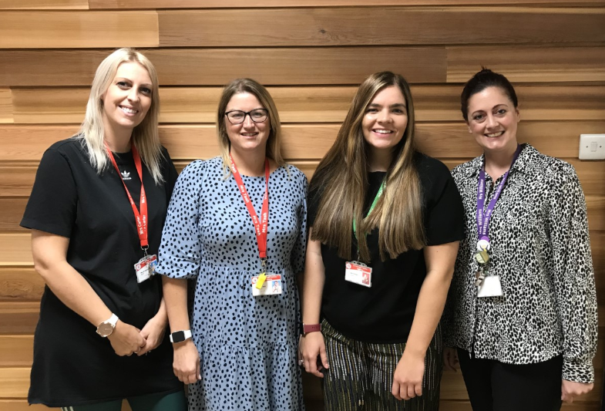

Welcome to Year 2

Slide 2
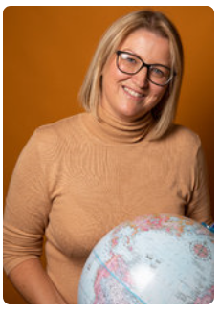
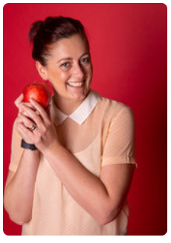
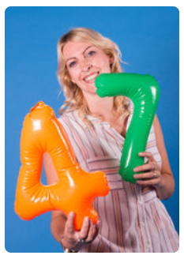
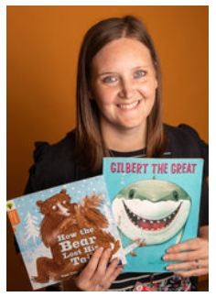
Your new teacher is Mrs Tash.
You are in 2RT in Year 2
The teaching assistants in your class are Mrs Williams, Mrs Carter and Mrs Hellson

Slide 3
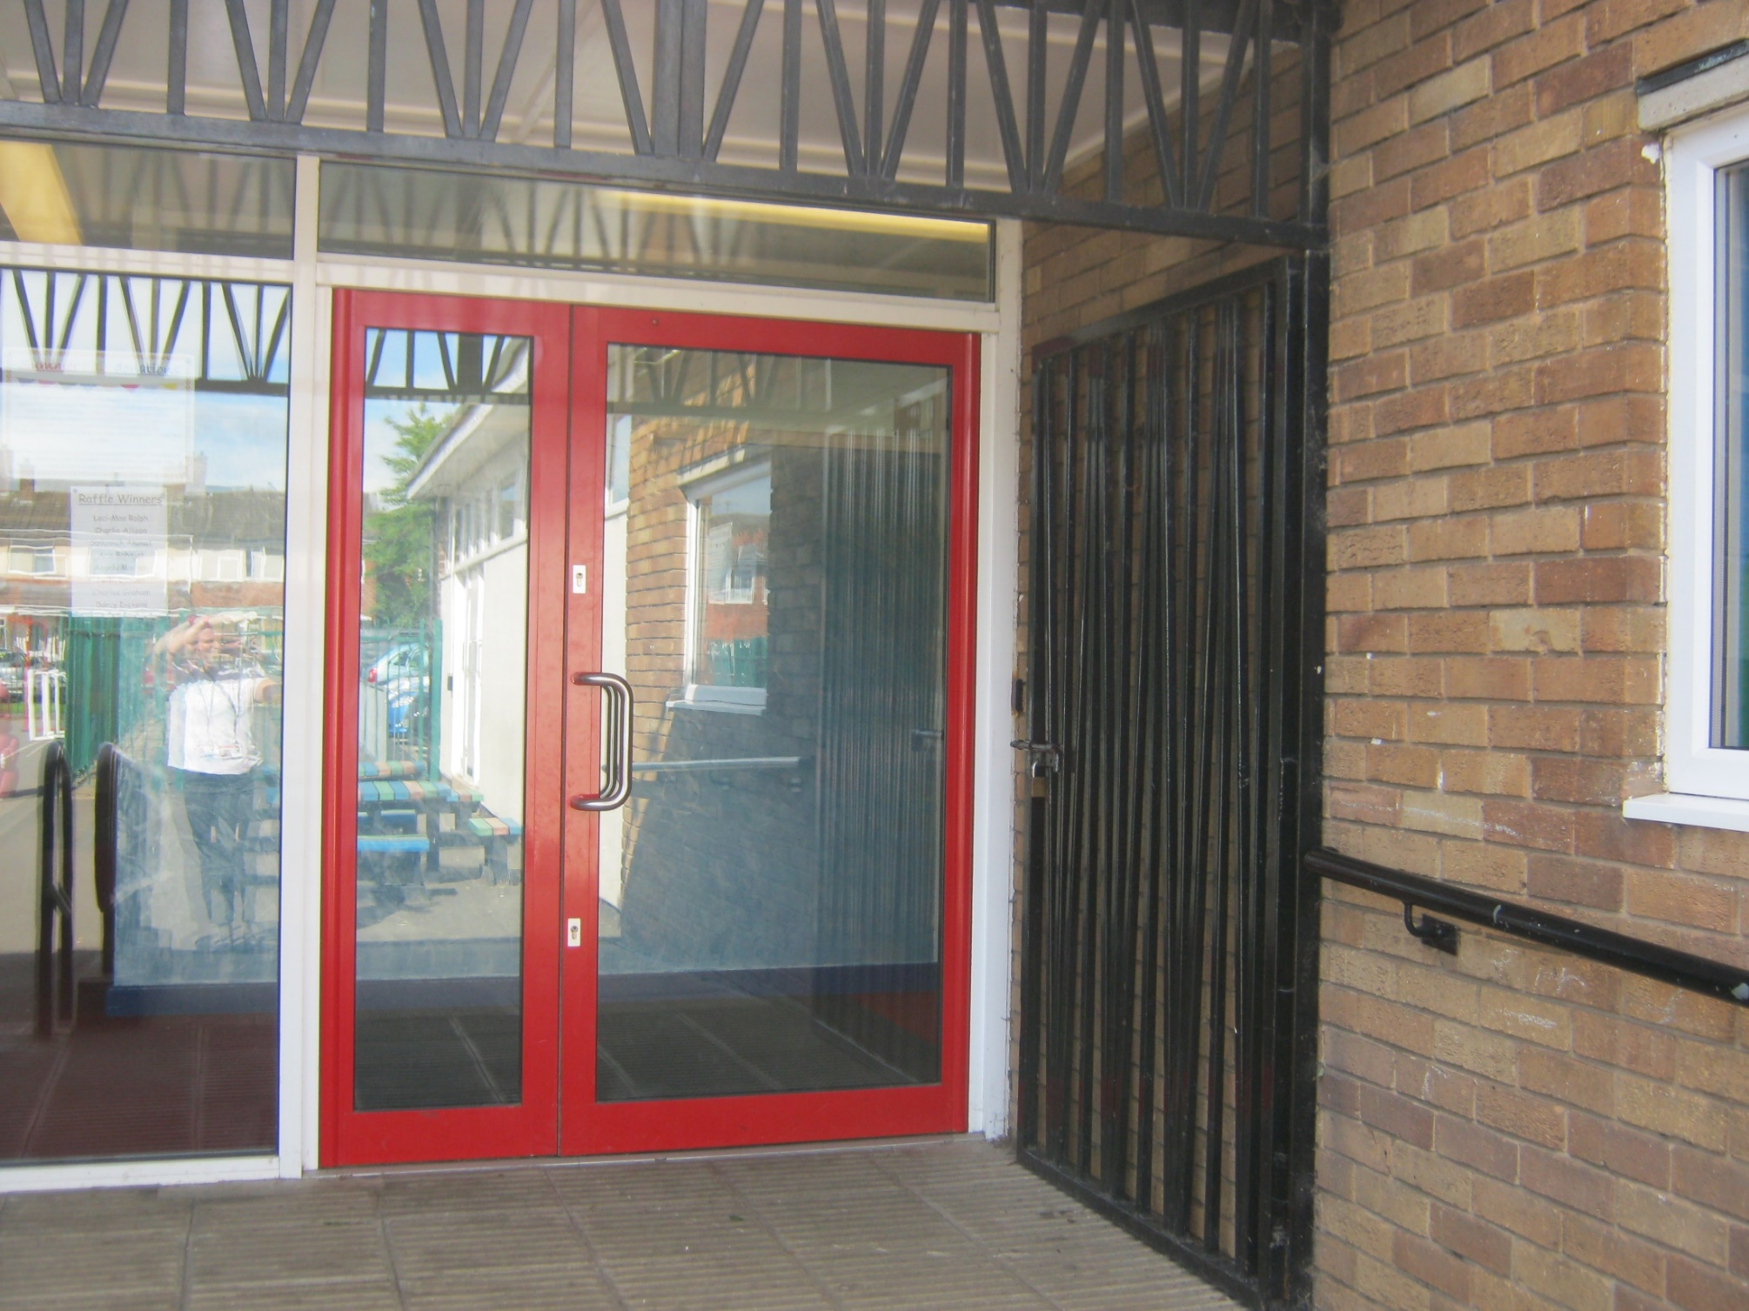
School starts at 8:45am
This is the door you will go into school.
There will be an adult from your new year group to help you get to the classroom.

Slide 4
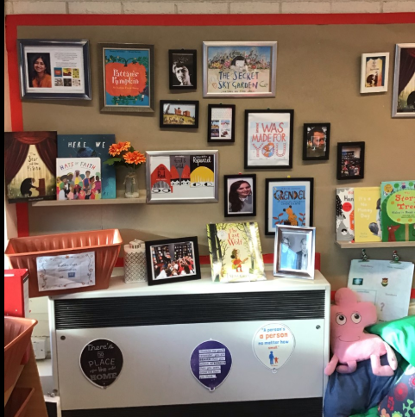
This is our beautiful reading area.
Do you love our wall of fame?

Slide 5
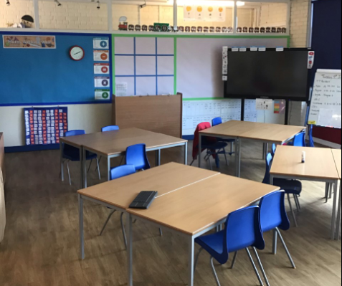
This is your classroom
This will look different once we are all back in September.

Slide 6

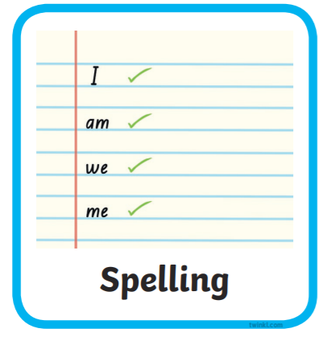


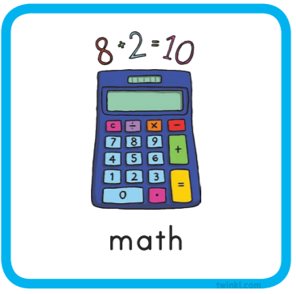


Everyday we do…
Notes:
You could add extra information around English……this half term we will be focusing on…
Maths this half term will be……..
The class reader will be……..

Slide 7
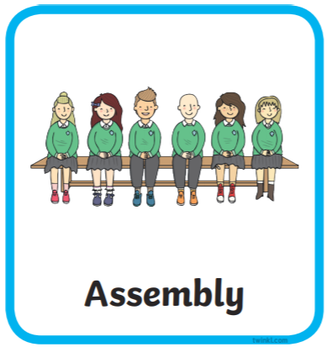



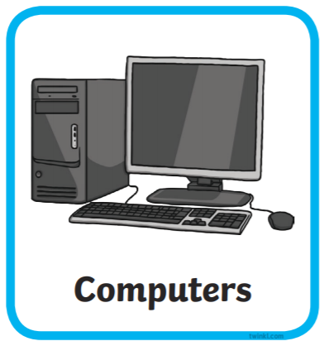

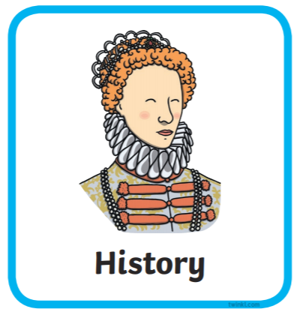
Here are subjects and activities we will do each week in the first term.

Slide 8

Our topics when you come back are …
Our history question for the term is “Pirate or explorer? – Francis Drake and James Cook
Science and Design Technology
In Science we will be looking at animals including humans.
In DT we will be looking at food and nutrition.

Slide 9
You will go home at 3.10pm from this door.

