Slide 1
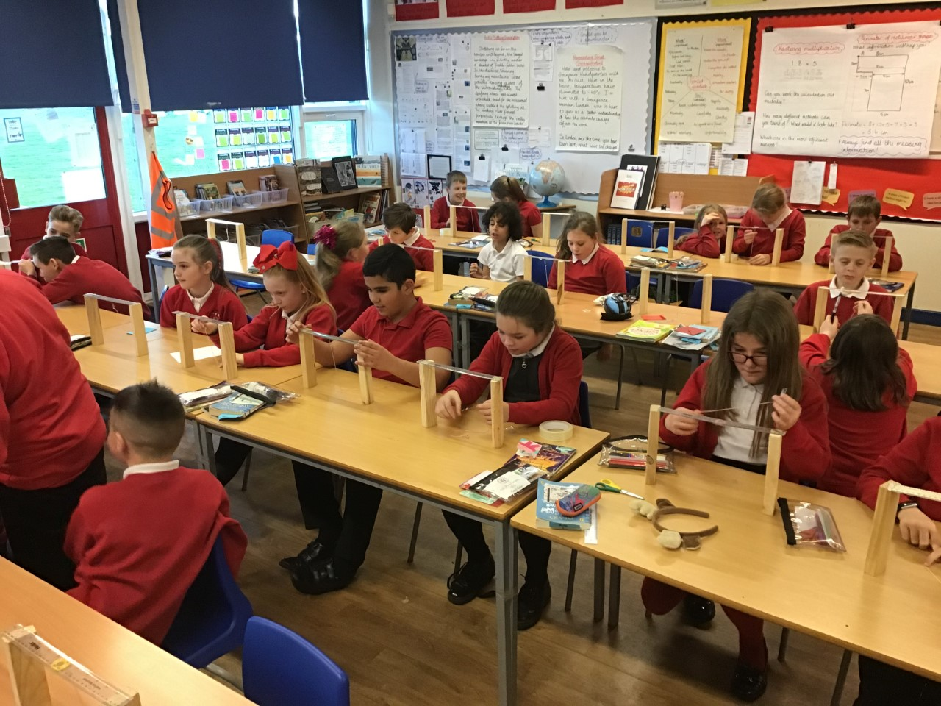

Welcome to 5JG

Slide 2
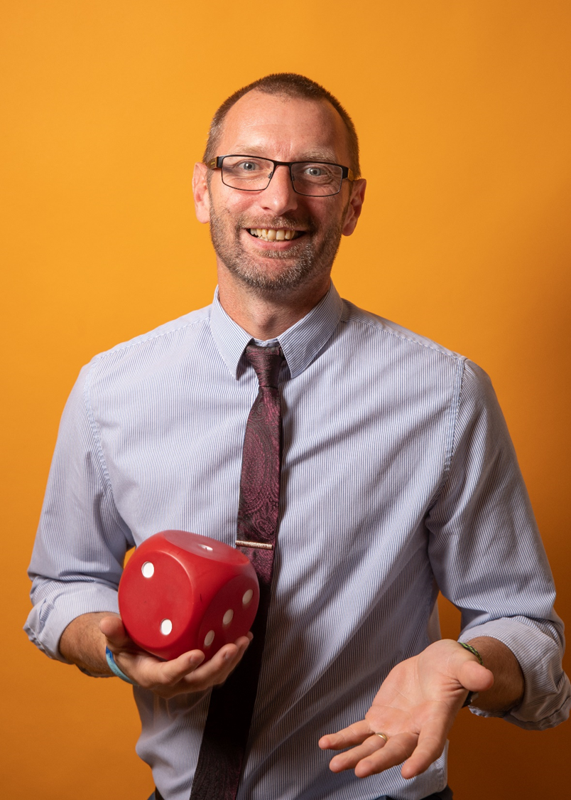

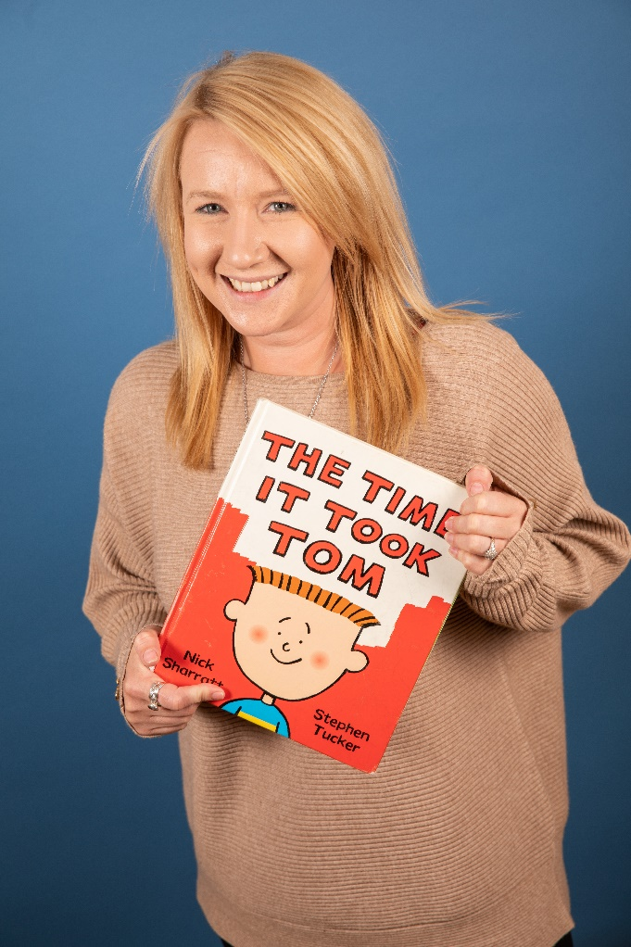
Your new teacher is Mr Galt
You are in 5JG in Year 5
The teaching assistants are Miss Shaw and Miss Lansell

Slide 3
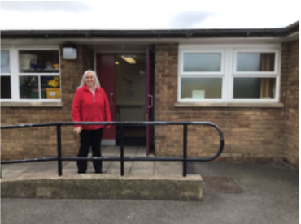
School starts at 8:45am
This is the door you will go into school.
There will be an adult from your new year group to help you get to the classroom.
You will also leave using this door at 3:15pm.
If there are any changes due to COVID-19 we will inform you before September.

Slide 4

This is your classroom
This is a photograph of the classroom when it was ‘normal’ with all the children in! We are doing a Science experiment here. At the moment, the classroom looks a little different to this. Do you recognise anyone in the photo? The tables and chairs will be a bit different when you come.

Slide 5
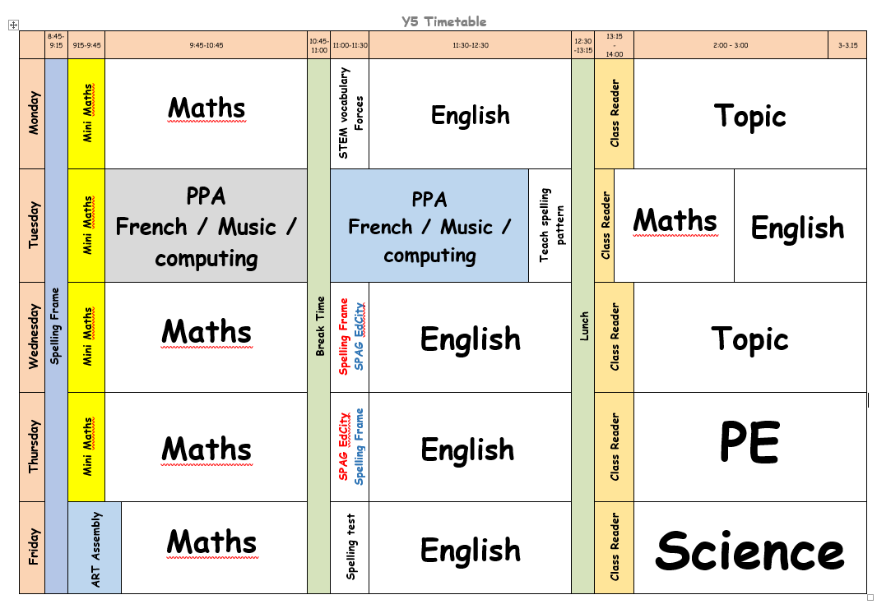
This is how your week will look in year 5

Slide 6
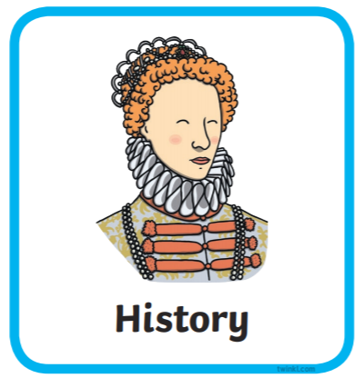

Our topics when you come back are …
Our history question for the term is “What were the risks to a poor family in Victorian Britain?”
Our science will focus on investigating materials and their properties.

