Slide 1
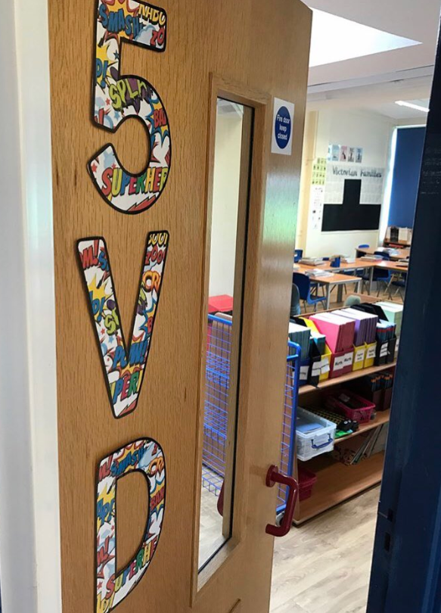

Welcome to 5VD

Slide 2
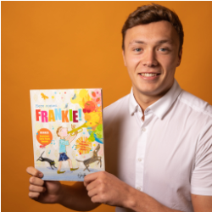
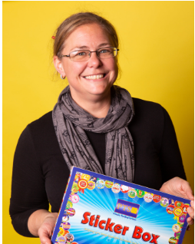
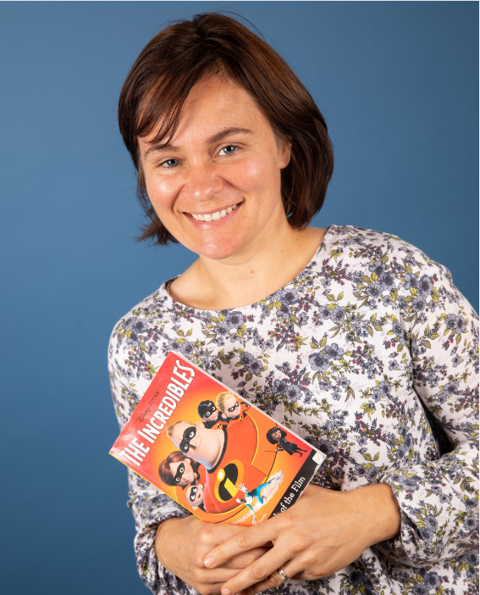
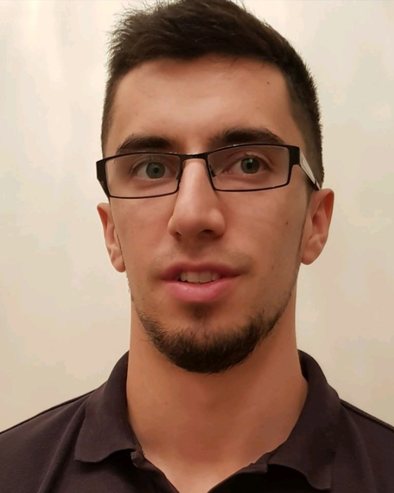
Your new teacher is Mr Dawson
You are in 5VD in Year 5
The teaching assistants in your class are Miss Dickinson, Ms Shotton and Mr Dobson

Slide 3
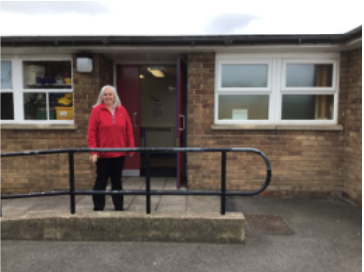
School starts at 8:45am
This is the door you will go into school.
There will be an adult from your new year group to help you get to the classroom.
You will also leave using this door at 3:15pm.
If there are any changes due to COVID-19 we will inform you before September.

Slide 4
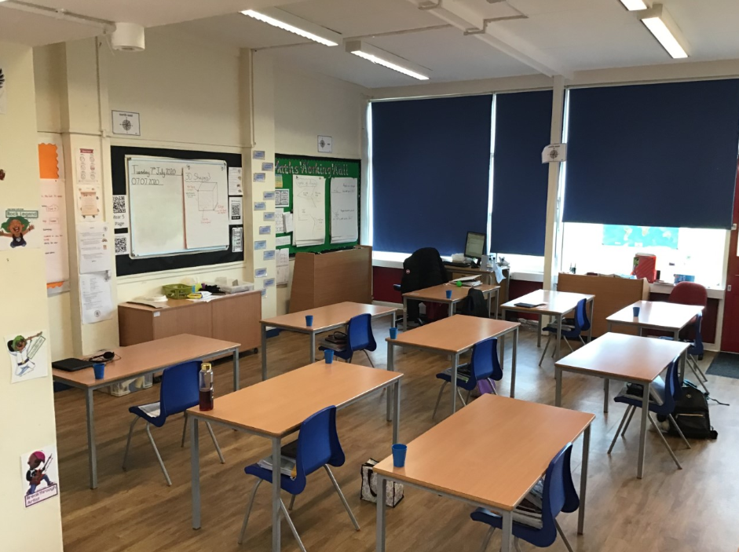
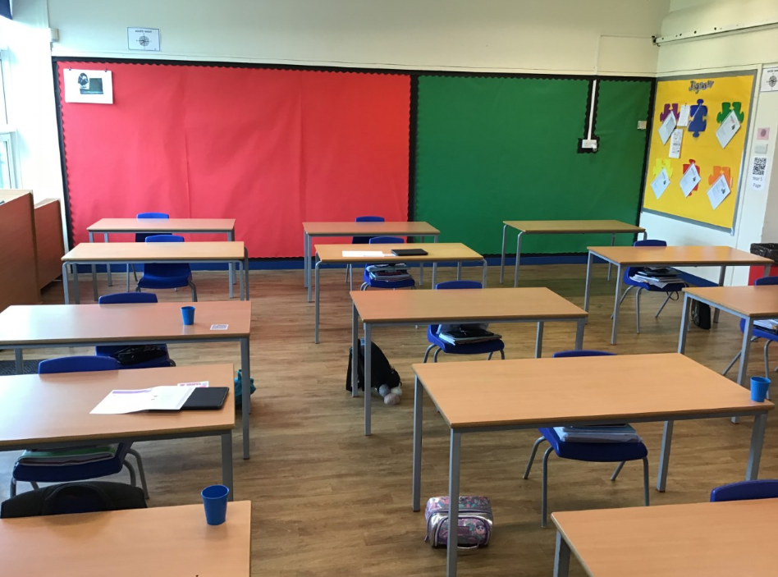
This is your classroom
The class room will look a little different in September as we will be adding more tables and chairs.

Slide 5
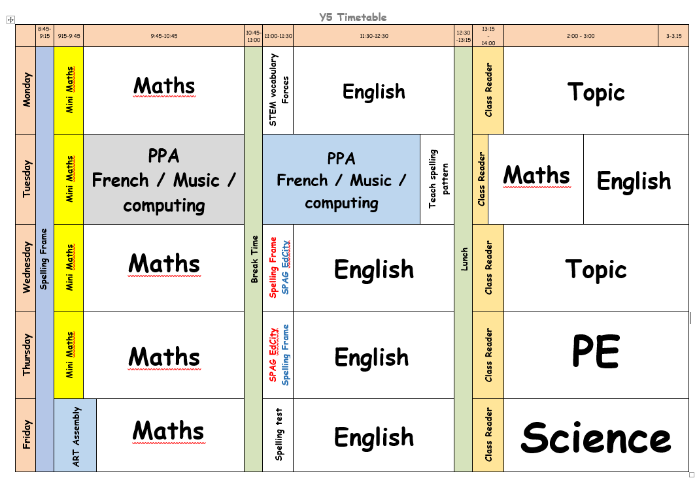
This is how your week will look in year 5

Slide 6
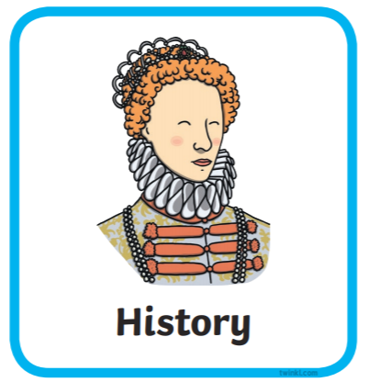

Our topics when you come back are …
Our history question for the term is “What were the risks to a poor family in Victorian Britain?”
Our science will focus on investigating materials and their properties.

