Slide 1
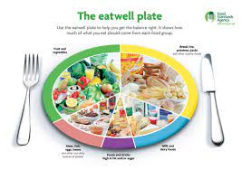
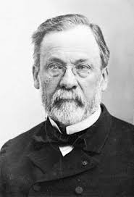
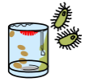
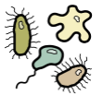

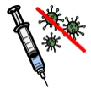

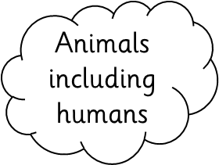


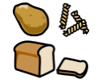





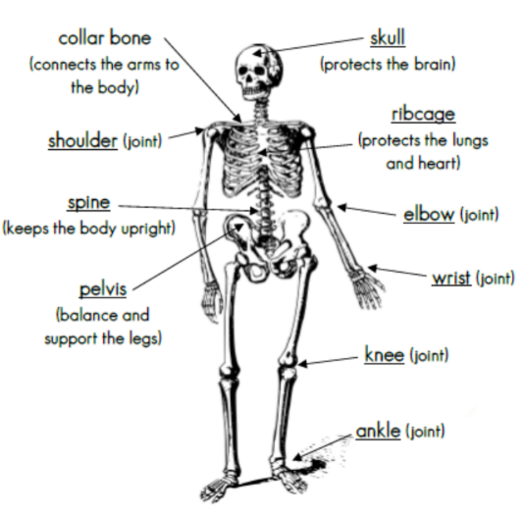






Louis Pasteur
bacteria
germs
pasteurisation
vaccinations
Food groups
Muscles
skeletal muscles
smooth
muscles
cardiac
muscles
Nutrition
carbohydrates
The Skeletal
System
protein
fats
Types of Skeleton
Fruit and vegetables
endoskeleton
exoskeleton
hydrostatic skeleton
dairy
fibre
water

