Slide 1
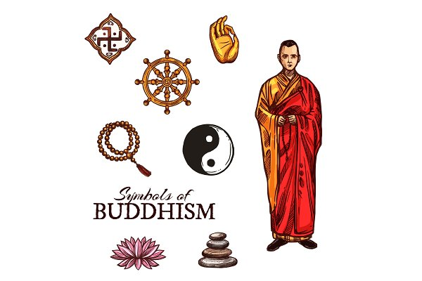
Buddhism
What is Buddhism?
What are the core Buddhist beliefs?

Slide 2







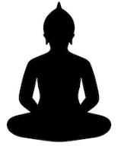


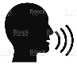
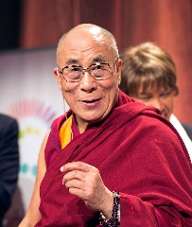



Gautama
483BC
Founder of Buddhism
Gautama
Teachings - foundations Buddhism
3rd Century BC
Ashoka the Great
Buddism a State Religion
Origins of Buddhism
Viewpoint
Meditation
thoughtfulness
Good karma = rebirth easier life
The Circle of Life
Eightfold Path
Mindfulness
Speech
Karma
Buddhism
Good lives = good karma
Effort
Action
Livelihood
Dalai Lama
Leading monk
Reincarnation of previous Dalai Lama
Present:
Lhamo Thondup (1935 -)
Next in line born at exactly same time of death
Tulku: Someone continually reborn

Slide 3
Buddhism
Dalai Lama

