Slide 1
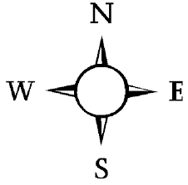
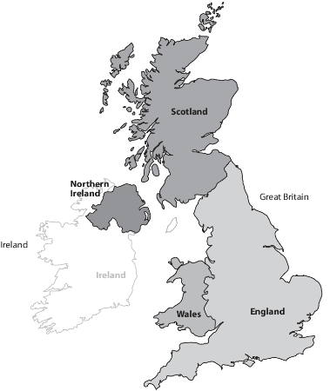
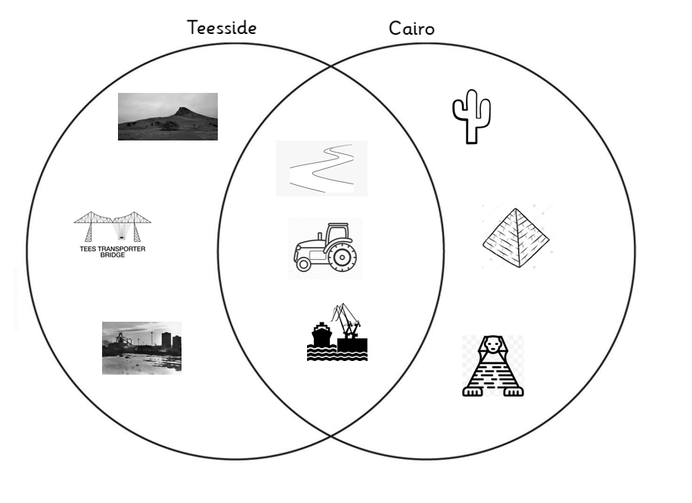
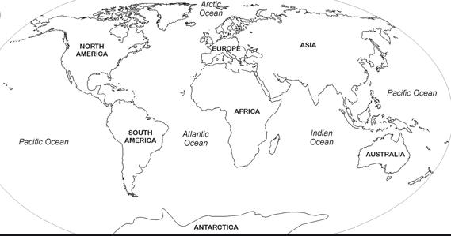
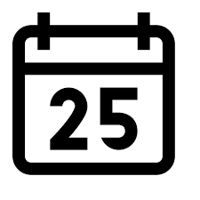
United Kingdom
Y2 – How is Teesside different to Cairo?
Scotland
Edinburgh
Northern Ireland
Belfast
North Sea
England
London
Irish Sea
A distinctive hill in
North Yorkshire.
Desert land
Wales
Cardiff
English channel
River
Seas are smaller than oceans and are usually located where the land and ocean meet.
Provides an important
Crossing.
The Pyramids of Giza.
Tomb of the Pharaohs.
Land used for farming
Where ships can load and unload goods.
Manufacture of goods.
The Great Sphinx was
built to guard the
important areas.
Cairo is the capital city of Egypt
Egypt is a country
in the continent of Africa.
The River Nile is the longest river in the world.
Oceans and seas are vast amounts of water on the Earth’s surface.

