Slide 1
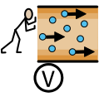
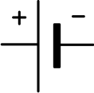
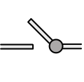
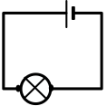

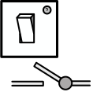


Week 1
Week 2
.
Week 3
I can name all of the components in a circuit.
I can recognise & draw the symbol (including + & - sides) for wire, bulb, buzzer, motor & switch to create a simple circuit diagram
I can use circuit symbols to represent components in a simple circuit diagram.
I know what will happen if I add more cells to a circuit.
Week 6
Week 5
Week 4
.
I can design a circuit to enable nonverbal communication.
I can explain how a switch is used in a simple circuit.
I know what will happen if I add more bulbs/buzzers/motors to a circuit.

