Slide 1


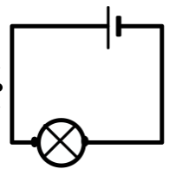

Week 1
I know what electricity is and know the difference between mains and battery.
Week 2
Week 3
.
I can name the basic parts of a circuit.
I can build a simple circuit.
I know that electricity can be dangerous if it is not used safely.
Week 6
Week 5
I know which materials are conductors, and which materials are insulators?
Week 4
I know which materials are conductors, and which materials are insulators?
Looking to the future and working with electricity.

