Slide 1
RSHE in Primary Schools: A Guide for Parents
Supporting parents in understanding primary school education
Notes:
---

Slide 2
RSHE in Primary Schools – Parent Information
Notes:
---
This slide references information from the following file: https://enquirelearningtrust.sharepoint.com/sites/HarrowGateStaff/Shared%20Documents/Staff%20Shared/Subjects%20%26%20Curriculum/PSHE/PSHE%2025-2026/Meeting%20info%20shared%20June%2026/parents-guide-to-rshe-in-primary-schools-2026.pdf
Introduction to RSHE, What is RSHE?, Why RSHE is Important, What Children Learn, Healthy Me and Relationships, Changing Me and Puberty, Sex Education in Primary Schools, Your Rights as Parents, Common Questions from Parents, Supporting Your Child at Home, Key Messages and Conclusion

Slide 3

Introduction to RSHE
Purpose of RSHE
  RSHE supports children's wellbeing, safety, and personal development through age-appropriate education.
Parental Role
  Parents remain the primary educators and partners in reinforcing values like kindness and safety.
Focus of RSHE in Primary Schools
  Emphasis is on relationships, health, and personal safety rather than explicit content, delivered in a careful sequence.
Clarifying Misunderstandings
  RSHE complements home conversations and reassures parents about the nature and timing of lessons.
Notes:
---
This slide references information from the following file: https://enquirelearningtrust.sharepoint.com/sites/HarrowGateStaff/Shared%20Documents/Staff%20Shared/Subjects%20%26%20Curriculum/PSHE/PSHE%2025-2026/Meeting%20info%20shared%20June%2026/parents-guide-to-rshe-in-primary-schools-2026.pdf
This presentation is designed to help parents and carers understand Relationships, Sex and Health Education (RSHE) in primary schools and how it supports children’s wellbeing, safety, and personal development. RSHE is delivered through the wider PSHE (Personal, Social, Health and Economic) education curriculum and reflects statutory guidance from the Department for Education. While many parents may remember learning similar themes at school under different names, RSHE has been clarified and strengthened in recent years to ensure all children receive consistent, age-appropriate education that prepares them for modern life. The focus is not on encouraging children to grow up too quickly, but on giving them the knowledge, language, and confidence they need to understand themselves and the world around them.
For parents, it is completely natural to want reassurance about what is being taught, when it is taught, and why it is considered important. This introduction sets the context for the rest of the presentation by explaining that parents remain the most influential educators in a child’s life. Schools work in partnership with families, reinforcing values such as kindness, respect, safety, and responsibility. RSHE lessons are designed to complement conversations at home, not replace them, and schools recognise that families may approach topics in different ways based on their beliefs and experiences.
The presentation also aims to clarify common misunderstandings about RSHE. In primary schools, the emphasis is on relationships, health, and personal safety, rather than explicit sexual content. Teaching is carefully sequenced so that children receive the right information at the right time, helping them feel secure and confident rather than confused or anxious. By the end of this presentation, parents should feel clearer about the purpose of RSHE, reassured about its age-appropriate nature, and confident about how they can support their child’s learning both in school and at home.

Slide 4
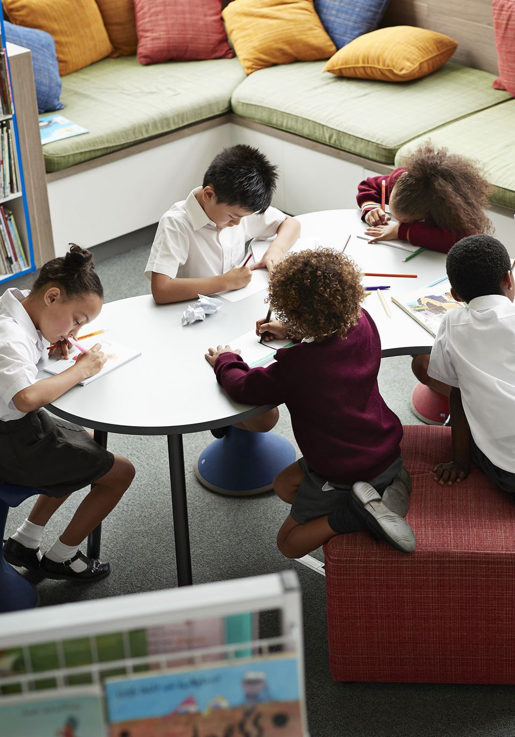
What is RSHE?
Purpose and Scope
  RSHE is a mandatory curriculum focusing on healthy relationships and physical and mental health for primary students.
Age-Appropriate Content
  RSHE covers friendships, families, feelings, safety, and body changes, introduced gradually with age.
Delivery and Safeguarding
  Delivered using structured programs by trained teachers to create safe, inclusive spaces supporting children's wellbeing.
Parental Reassurance
  RSHE supports wellbeing without undermining family values, helping parents understand its supportive role.
Notes:
---
This slide references information from the following file: https://enquirelearningtrust.sharepoint.com/sites/HarrowGateStaff/Shared%20Documents/Staff%20Shared/Subjects%20%26%20Curriculum/PSHE/PSHE%2025-2026/Meeting%20info%20shared%20June%2026/parents-guide-to-rshe-in-primary-schools-2026.pdf
Relationships, Sex and Health Education (RSHE) is a compulsory part of the primary school curriculum in England and is delivered through PSHE education. Relationships Education and Health Education have been statutory since 2020, meaning all primary schools are required by law to teach them. RSHE focuses on helping children understand healthy relationships, both with others and with themselves, and how to look after their physical and mental health. It also supports children in developing the social and emotional skills they need to thrive at school, at home, and in the wider community.
In primary schools, RSHE is not about teaching children about sexual activity. Instead, it concentrates on themes such as friendships, families, feelings, personal boundaries, and staying safe. Health Education includes learning about healthy lifestyles, hygiene, exercise, sleep, mental wellbeing, and how bodies change as children grow. These topics are introduced gradually and revisited as children move through the school, allowing their understanding to deepen in line with their age and maturity.
RSHE is delivered in a structured and planned way, often using a recognised programme such as Jigsaw, which organises learning into clear themes across the year. This ensures consistency, progression, and sensitivity. Teachers are trained to deliver lessons in a calm, factual, and inclusive manner, creating a safe environment where children feel able to ask questions and share thoughts. Importantly, RSHE supports safeguarding by giving children the language and confidence to talk about worries, recognise unsafe situations, and know who they can turn to for help. For parents, understanding what RSHE is – and what it is not – can provide reassurance that the curriculum is designed to support children’s wellbeing, not undermine family values.

Slide 5
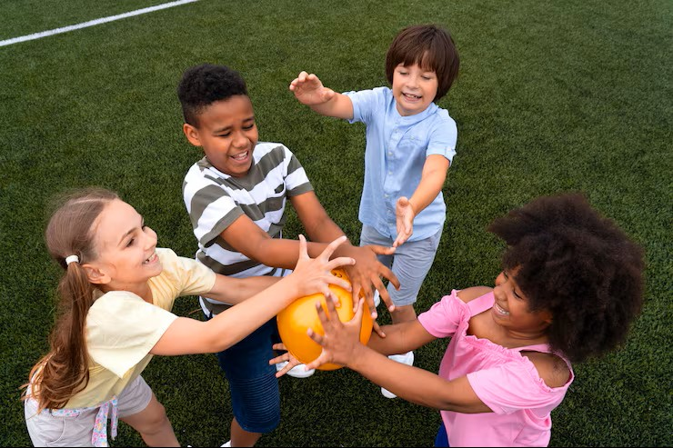
Why RSHE is Important
Safety and Personal Boundaries
  RSHE helps children learn about personal boundaries and recognise unsafe situations to stay safe and seek help when needed.
Healthy Friendships and Behaviour
  Children develop kindness, conflict resolution skills, and understanding of good friendships, supporting emotional wellbeing.
Physical and Mental Health
  RSHE promotes healthy eating, exercise, sleep, and emotional regulation to improve overall physical and mental health.
Future Preparedness and Online Safety
  Children learn resilience, managing emotions, and responsible behaviour online to prepare for future challenges.
Notes:
---
This slide references information from the following file: https://enquirelearningtrust.sharepoint.com/sites/HarrowGateStaff/Shared%20Documents/Staff%20Shared/Subjects%20%26%20Curriculum/PSHE/PSHE%2025-2026/Meeting%20info%20shared%20June%2026/parents-guide-to-rshe-in-primary-schools-2026.pdf
Children today are growing up in a complex and fast-changing world, both offline and online. RSHE plays a vital role in equipping them with the knowledge and skills they need to navigate this world safely and confidently. One of the key reasons RSHE is important is that it helps children stay safe. Through learning about personal boundaries, trusted adults, and recognising unsafe situations, children are better prepared to protect themselves and to seek help when they need it.
RSHE also supports the development of healthy friendships and positive behaviour. Children learn how to be kind, how to resolve disagreements, and how to recognise what makes a good friend. These skills are essential not only for school life but for long-term emotional wellbeing. In addition, RSHE promotes both physical and mental health. Lessons on healthy eating, exercise, sleep, and emotional regulation help children understand how their choices affect their bodies and minds.
Another important aspect of RSHE is preparing children for the future. By learning about change, resilience, and managing emotions, children are better equipped to cope with challenges as they grow older. RSHE also addresses online safety, helping children understand that not everything they see online is true or kind, and teaching them how to behave responsibly in digital spaces. Overall, RSHE is about giving children a strong foundation for life. It supports their development now and helps prepare them for adolescence and adulthood, while reinforcing values of respect, empathy, and responsibility that benefit the whole school community.

Slide 6
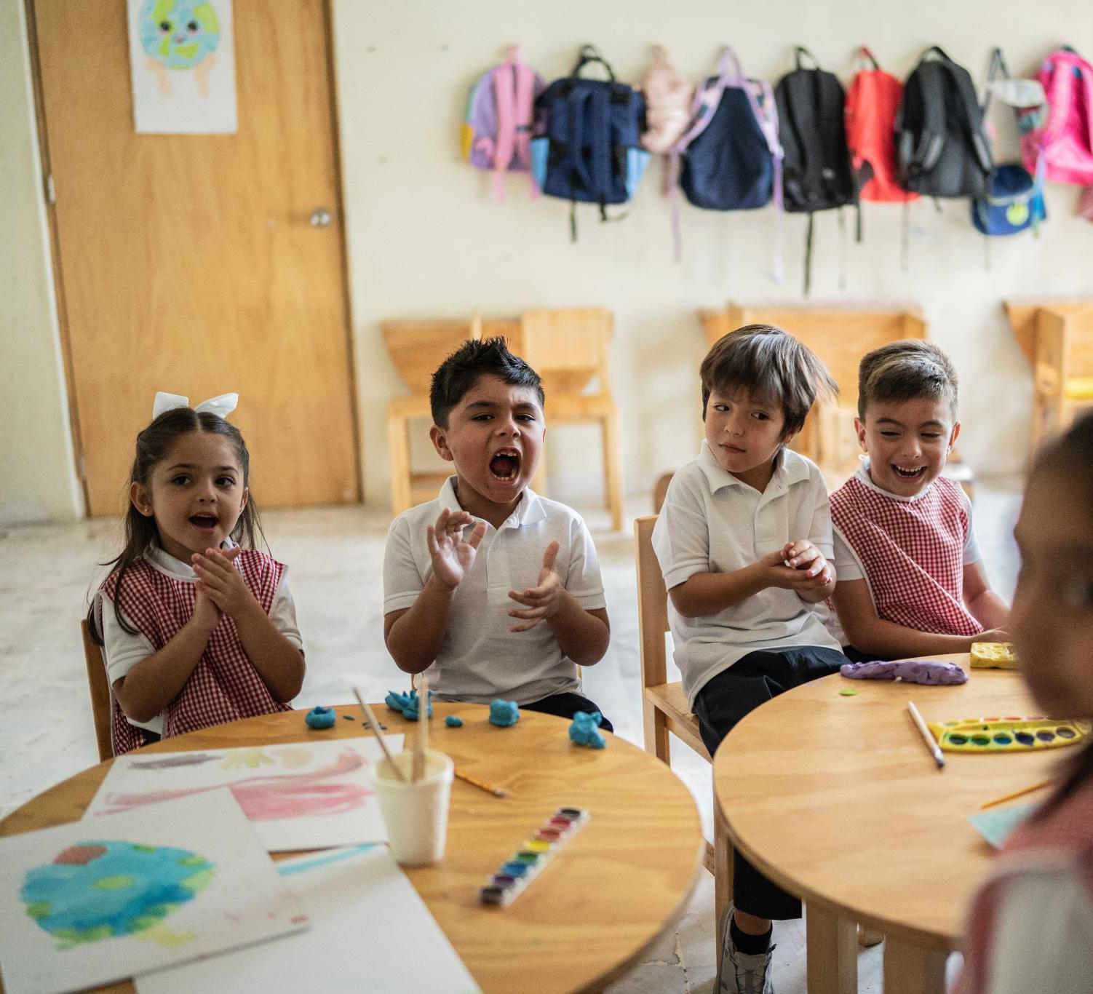
What Children Learn
Structured RSHE Themes
  Primary schools use structured programmes like Jigsaw to teach RSHE through clear, age-appropriate themes.
Personal and Social Growth
  Themes like Being Me in My World and Celebrating Difference teach children about identity, community, and respect.
Aspirations and Wellbeing
  Dreams and Goals plus Healthy Me themes encourage resilience, physical and mental health awareness.
Relationships and Change
  Relationships and Changing Me themes help children build positive connections and understand growth and puberty.
Notes:
---
This slide references information from the following file: https://enquirelearningtrust.sharepoint.com/sites/HarrowGateStaff/Shared%20Documents/Staff%20Shared/Subjects%20%26%20Curriculum/PSHE/PSHE%2025-2026/Meeting%20info%20shared%20June%2026/parents-guide-to-rshe-in-primary-schools-2026.pdf
In many primary schools, RSHE is taught through a structured programme that divides learning into clear themes across the school year. Using the Jigsaw approach as an example, children explore six main areas: Being Me in My World, Celebrating Difference, Dreams and Goals, Healthy Me, Relationships, and Changing Me. Each theme is revisited every year, with content adapted to be appropriate for the children’s age and stage of development.
Being Me in My World focuses on helping children understand themselves as individuals and as part of a community. They learn about rules, rights, responsibilities, and how to make their classroom a safe and welcoming place. Celebrating Difference teaches children that everyone is unique and that differences should be respected. This includes learning about different types of families and understanding why bullying is harmful.
Dreams and Goals encourages children to think about aspirations, perseverance, and resilience. They learn that success can look different for different people and that setbacks are a normal part of learning. Healthy Me covers physical and mental health, including safety and wellbeing. Relationships focuses on building positive, respectful connections with others, while Changing Me helps children understand growth, change, and, as they get older, puberty. Together, these themes ensure a balanced and comprehensive approach to RSHE.

Slide 7
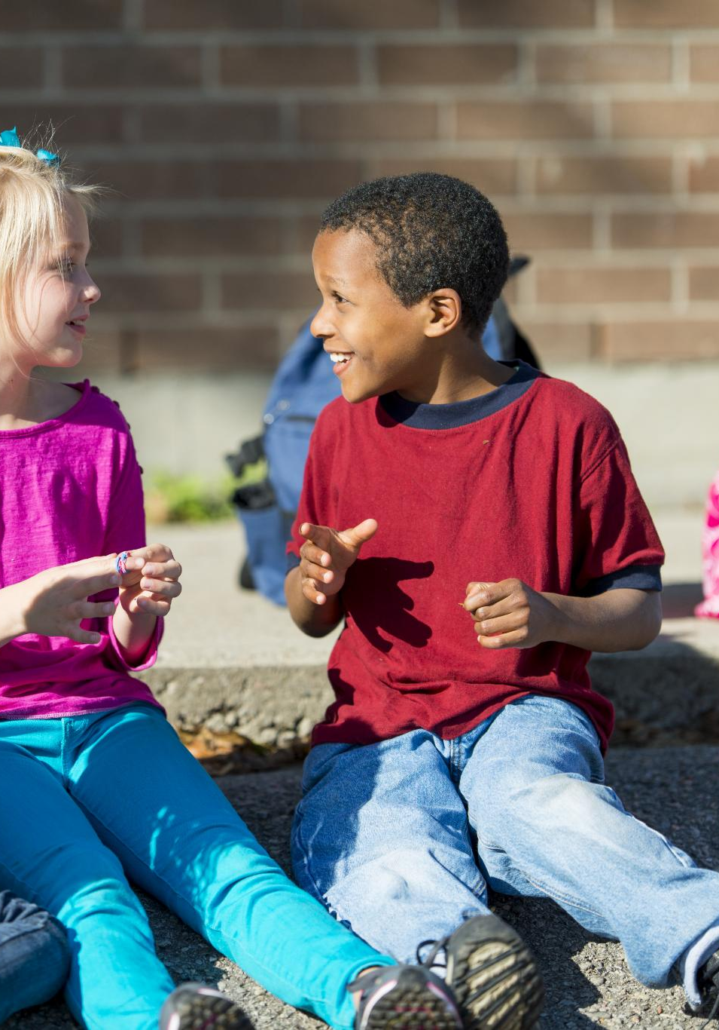
Healthy Me and Relationships
Healthy Me Habits
  Children learn to care for their bodies and minds through healthy eating, exercise, sleep, and hygiene practices.
Emotional Awareness and Safety
  Children develop skills to manage stress, recognise emotions, and understand safety in various environments including online.
Positive Relationships
  Children explore friendships, family bonds, kindness, empathy, and respect for personal boundaries.
Recognising Healthy Relationships
  Children learn to identify healthy versus unhealthy relationships, promoting their right to safety and respect.
Notes:
---
This slide references information from the following file: https://enquirelearningtrust.sharepoint.com/sites/HarrowGateStaff/Shared%20Documents/Staff%20Shared/Subjects%20%26%20Curriculum/PSHE/PSHE%2025-2026/Meeting%20info%20shared%20June%2026/parents-guide-to-rshe-in-primary-schools-2026.pdf
The Healthy Me and Relationships themes are central to helping children develop lifelong habits and social skills. In Healthy Me, children learn about how to look after their bodies and minds. This includes understanding the importance of healthy eating, regular physical activity, sufficient sleep, and good hygiene. As children get older, they also learn about managing stress, recognising emotions, and knowing when and how to ask for help. Safety education is an important part of this theme, covering topics such as road safety, water safety, fire safety, and online safety.
The Relationships theme focuses on how children interact with others and how they feel about themselves. Children learn about friendships, family relationships, and respectful behaviour. They are encouraged to recognise their own feelings and to understand that other people may feel differently. Lessons explore concepts such as kindness, empathy, cooperation, and respect for personal boundaries.
As children progress through primary school, they also learn to recognise the difference between healthy and unhealthy relationships. This knowledge supports safeguarding and helps children understand that they have the right to feel safe and respected. Together, Healthy Me and Relationships provide children with a strong foundation for wellbeing, helping them develop confidence, self-awareness, and positive social skills that will support them throughout their lives.

Slide 8
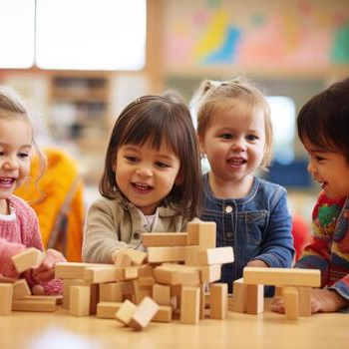
Changing Me and Puberty
Understanding Normal Change
  Children learn that change is natural through growth, life cycles, and correct naming of body parts from an early age.
Age-Appropriate Puberty Education
  Puberty is taught sensitively, building knowledge year by year with boys and girls learning together to foster empathy.
Health Education and Preparation
  Puberty is part of compulsory Health Education to prepare children, ensuring they feel informed and reassured before changes.
Emotional and Social Changes
  Changing Me also covers emotional changes, friendships, and transitions helping children develop coping strategies and confidence.
Notes:
---
This slide references information from the following file: https://enquirelearningtrust.sharepoint.com/sites/HarrowGateStaff/Shared%20Documents/Staff%20Shared/Subjects%20%26%20Curriculum/PSHE/PSHE%2025-2026/Meeting%20info%20shared%20June%2026/parents-guide-to-rshe-in-primary-schools-2026.pdf
The Changing Me theme helps children understand that change is a normal and natural part of life. In the early years and younger classes, this focuses on simple concepts such as growth, life cycles, and naming body parts correctly. As children move into upper primary, learning gradually develops to include an understanding of puberty and the physical and emotional changes that occur during this time.
Puberty is taught in an age-appropriate and sensitive way, building knowledge year by year rather than delivering all information at once. Boys and girls usually learn together, which helps build empathy and reduces embarrassment or stigma. Using correct terminology is an important part of this teaching, as it supports clear communication and safeguarding.
It is important for parents to understand that learning about puberty is part of Health Education, not Sex Education. This means it is compulsory and children cannot be withdrawn from these lessons. The aim is to ensure children are prepared before changes happen, so they feel informed and reassured rather than frightened or confused. In addition to physical changes, Changing Me also addresses emotional changes, changing friendships, and transitions such as moving class or school. This holistic approach helps children develop coping strategies and confidence in managing change.

Slide 9

Sex Education in Primary Schools
Scope of Sex Education
  Sex education in primary schools focuses on conception and birth, not on broader topics like puberty or relationships.
Parental Rights and Withdrawal
  Parents have the legal right to withdraw their children from sex education lessons about conception if they choose to do so.
Communication and Support
  Clear communication between schools and parents ensures informed decisions and appropriate support for children.
Notes:
---
This slide references information from the following file: https://enquirelearningtrust.sharepoint.com/sites/HarrowGateStaff/Shared%20Documents/Staff%20Shared/Subjects%20%26%20Curriculum/PSHE/PSHE%2025-2026/Meeting%20info%20shared%20June%2026/parents-guide-to-rshe-in-primary-schools-2026.pdf
Sex Education in primary schools is often a source of concern for parents, so it is important to clarify what is and is not taught. Teaching about how babies are conceived is not compulsory in primary schools, although the government recommends that some age-appropriate content may be included in Years 5 and 6. If a school chooses to teach this content, parents have the legal right to withdraw their child from these specific lessons.
Sex Education in this context refers specifically to conception and birth, not to broader topics such as relationships, feelings, or puberty. These wider topics are covered under Relationships Education and Health Education, which are compulsory. Schools are required to inform parents in advance if Sex Education lessons will be taught and to explain the content and withdrawal process clearly.
Many schools choose to include limited Sex Education content because it can help children understand basic biological facts and answer questions they may already have in a factual and sensitive way. However, the decision to withdraw is respected, and schools work with parents to ensure children are supported appropriately. Clear communication between school and home is key to ensuring parents feel informed and confident about what their child is learning.

Slide 10
Your Rights as Parents
What your child learns | Required by law? | Can I withdraw my child?
Relationships Education | Yes | No
Health Education (including puberty) | Yes | No
Sex Education (conception and birth) | Recommended, not required | Yes
Science (life cycles, reproduction) | Yes | No
Notes:
---
This slide references information from the following file: https://enquirelearningtrust.sharepoint.com/sites/HarrowGateStaff/Shared%20Documents/Staff%20Shared/Subjects%20%26%20Curriculum/PSHE/PSHE%2025-2026/Meeting%20info%20shared%20June%2026/parents-guide-to-rshe-in-primary-schools-2026.pdf
Parents and carers have clear rights and responsibilities when it comes to RSHE. Understanding these rights can help build trust and partnership between families and schools. Relationships Education and Health Education, including puberty, are required by law, and parents cannot withdraw their children from these lessons. This ensures that all children receive essential information related to safety, wellbeing, and health.
Sex Education, meaning teaching about conception and birth, is recommended but not compulsory in primary schools. If this content is taught, parents have the right to withdraw their child. In addition, parents cannot withdraw children from the science curriculum, which includes learning about life cycles and reproduction in plants and animals, and in some schools, humans.
Schools are expected to be transparent and to work collaboratively with parents. This includes allowing parents to view curriculum materials, discussing lesson content, and offering opportunities to ask questions or raise concerns. By understanding their rights, parents can feel more confident engaging with the school and supporting their child’s learning in a way that aligns with both educational requirements and family values.

Slide 11

Common Questions from Parents
Age-Appropriate Learning
  RSHE content is tailored to different ages, gradually introduced and revisited to suit children's development stages.
Inclusion and Family Diversity
  Teaching emphasizes respect for diverse family structures and promotes inclusion without focusing on sexual behaviour.
Sensitive Question Handling
  Teachers are trained to respond sensitively to children’s questions and communicate with parents when needed.
Adaptations for SEND
  RSHE is adapted to meet the specific needs of children with special educational needs and disabilities.
Notes:
---
This slide references information from the following file: https://enquirelearningtrust.sharepoint.com/sites/HarrowGateStaff/Shared%20Documents/Staff%20Shared/Subjects%20%26%20Curriculum/PSHE/PSHE%2025-2026/Meeting%20info%20shared%20June%2026/parents-guide-to-rshe-in-primary-schools-2026.pdf
Many parents have similar questions or concerns about RSHE, and schools aim to address these openly and honestly. A common question is whether children are too young for this learning. RSHE content is carefully designed to be age appropriate, meaning a Reception child’s learning looks very different from that of a Year 6 pupil. Information is introduced gradually and revisited over time.
Parents also often ask about teaching related to different family structures or same-sex relationships. Children learn that families come in many forms and that all loving families deserve respect. This teaching is about inclusion and respect, not about sexual behaviour. Questions about gender stereotypes are addressed by encouraging children to see themselves and others as individuals, free from limiting expectations.
Teachers are trained to handle children’s questions sensitively. If a question goes beyond the planned content, children may be encouraged to talk to their parents at home, and schools will inform parents when appropriate. RSHE is also adapted to meet the needs of children with SEND. Overall, schools aim to respect family beliefs while ensuring children receive factual, safeguarding-focused education.

Slide 12

Supporting Your Child at Home
Open Communication Importance
  Open communication helps children feel safe and confident discussing bodies, feelings, and relationships.
Honest and Simple Answers
  Answering questions honestly builds trust and models curiosity by exploring answers together.
Using Correct Terminology
  Using correct terms for body parts supports clear communication and reduces embarrassment.
Partnership with Schools
  Parents and schools working together reinforce respect,, and kindness for consistent guidance. safety
Notes:
---
This slide references information from the following file: https://enquirelearningtrust.sharepoint.com/sites/HarrowGateStaff/Shared%20Documents/Staff%20Shared/Subjects%20%26%20Curriculum/PSHE/PSHE%2025-2026/Meeting%20info%20shared%20June%2026/parents-guide-to-rshe-in-primary-schools-2026.pdf
Parents play a crucial role in supporting RSHE learning, and the most important thing they can do is keep communication open. Children who feel able to talk to their parents about bodies, feelings, and relationships are safer and more confident. Everyday moments, such as watching television or discussing school events, can provide natural opportunities for conversation.
Answering questions honestly and simply helps build trust. It is okay not to have all the answers straight away, and parents can model curiosity by suggesting they find out together. Using correct terminology for body parts supports clear communication and reduces embarrassment or shame. Listening carefully and reassuring children that their questions are welcome encourages them to keep talking.
Schools encourage parents to see themselves as partners in RSHE. By reinforcing messages of respect, safety, and kindness at home, parents help ensure children receive consistent guidance. If parents have concerns or want more information, schools welcome discussion and engagement. Working together helps create a supportive environment in which children can thrive.

Slide 13

Key Messages and Conclusion
Purpose of RSHE
  RSHE supports children's safety, health, and emotional wellbeing in primary schools.
Education Requirements
  Relationships and Health Education are mandatory; puberty education is compulsory and prepares children early.
Parental Rights and Sensitivity
  Sex Education on conception is recommended but optional, with parental withdrawal rights respected.
Partnership for Success
  Parents are primary educators; collaboration with schools ensures confident, informed children.
Notes:
---
This slide references information from the following file: https://enquirelearningtrust.sharepoint.com/sites/HarrowGateStaff/Shared%20Documents/Staff%20Shared/Subjects%20%26%20Curriculum/PSHE/PSHE%2025-2026/Meeting%20info%20shared%20June%2026/parents-guide-to-rshe-in-primary-schools-2026.pdf
In summary, RSHE in primary schools is designed to support children’s safety, health, and emotional wellbeing. Relationships Education and Health Education are required by law and provide children with essential knowledge and skills. Puberty education is a compulsory part of Health Education and is taught before children need the information, helping them feel prepared and reassured.
Sex Education, specifically teaching about conception and birth, is recommended but not compulsory, and parents have the right to withdraw their child from these lessons if they choose. All RSHE content is age appropriate, carefully planned, and delivered sensitively. Schools aim to respect all families and to teach children that families come in many forms, all of which are valued.
Perhaps the most important message is that parents remain their child’s first and most influential teachers. The conversations children have at home matter greatly. By working in partnership, schools and families can ensure children grow up informed, confident, and respectful, with the skills they need to navigate life safely and successfully.

