Slide 1
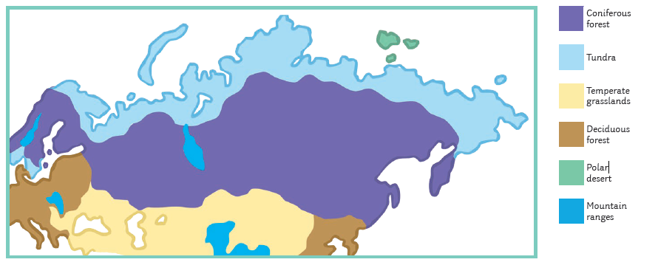



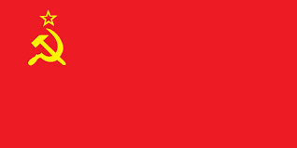
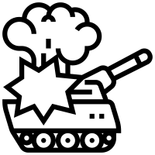


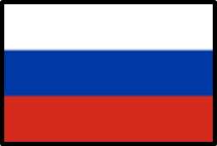

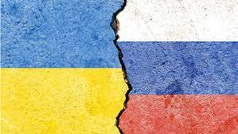
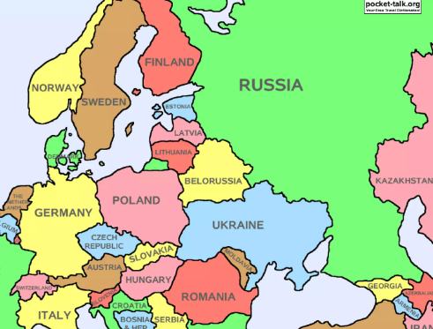

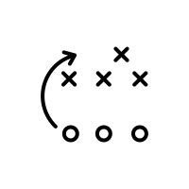
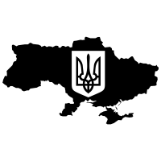
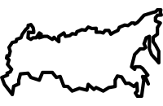

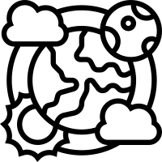




Russian civilians were unhappy with the Government 1917
Overthrew Tsars and formed a new elected government
A communist group called the Bolsheviks seized power.
Union of Soviet Socialist Republics (U.S.S.R.)
Russian Revolution
Ukraine’s Revolution
of Dignity 2014
Biomes
Russia has a variety of Biomes- Mountain ranges, tundra, temperate forest, Steppe, taiga.
Conflict in
Eastern Europe
Russia holds power
over Eastern
European countries
February 2015 –
Minsk II Agreement
Current Affairs
On-going conflict effecting
Trade, economy and life
across the globe.
Russia
2021 - Russian troops surrounded Ukrainian borders
(Putin’s orders)
2022 – Russian troops invade Ukraine
The Facts
Spans 11 time zones and 2 continents.
Shores on 3 oceans (Atlantic, Pacific and Arctic Oceans)
Home to the largest number of ecosystems worldwide.
Most people live in the West -population 143 million
World’s largest country – one tenth of all land on Earth.
Russia is made up of many different biomes and climates.
9th largest economy in the world.
Leading producer of natural gas, oil and metals.

