Slide 1
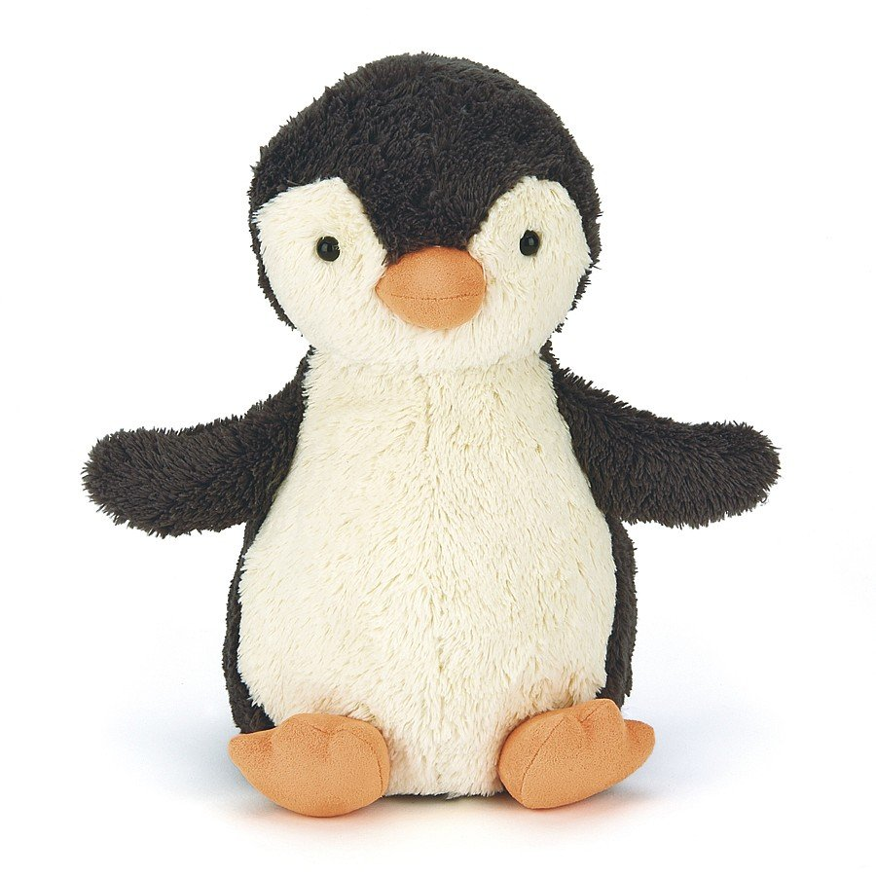

Welcome to Reception

Slide 2
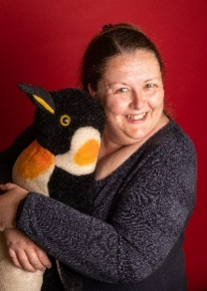
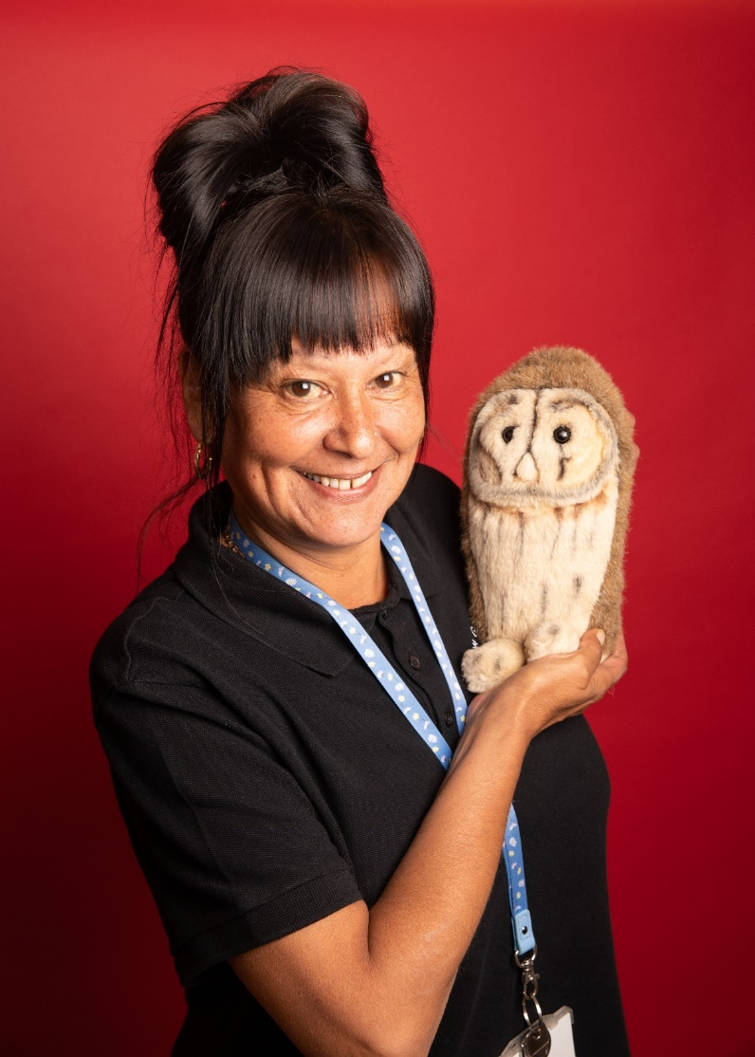
Your new teacher is Miss Clough.
You are in Penguins class in Reception
The teaching assistant in your class is Mrs Edwards.

Slide 3
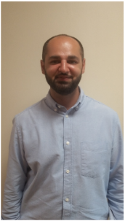
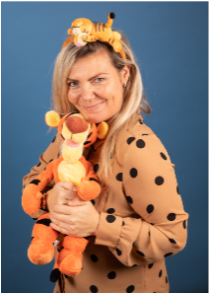
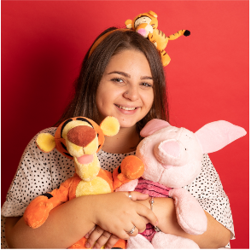
Other adults your child will see everyday in Reception.
Mr Majeed
Bee’s class teacher
Miss Owens
Teaching Assistant
Miss Hughes
Teaching Assistant

Slide 4
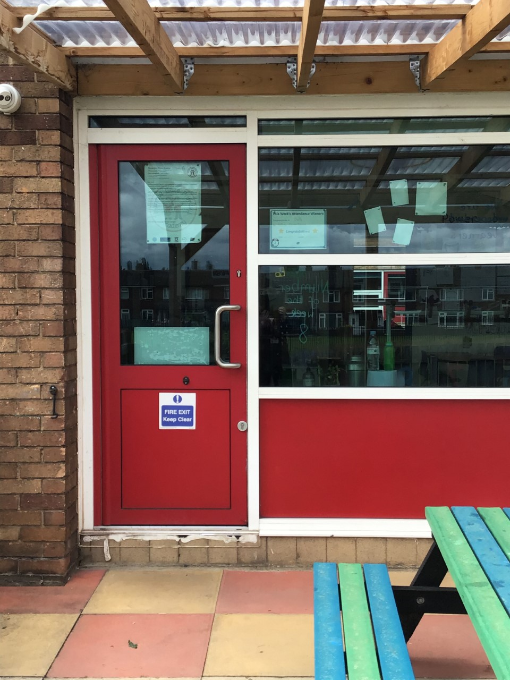
School starts at 8:45am
This is the door you will go into school.
There will be an adult from your new year group to help you get to the classroom.

Slide 5
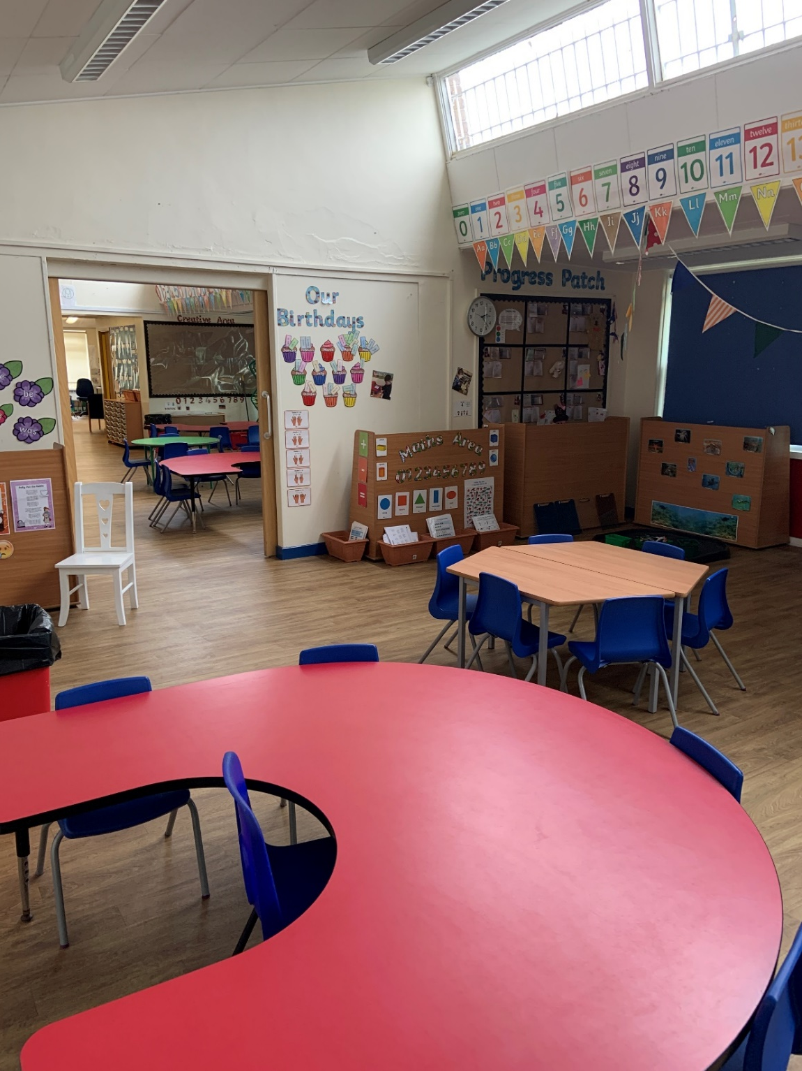
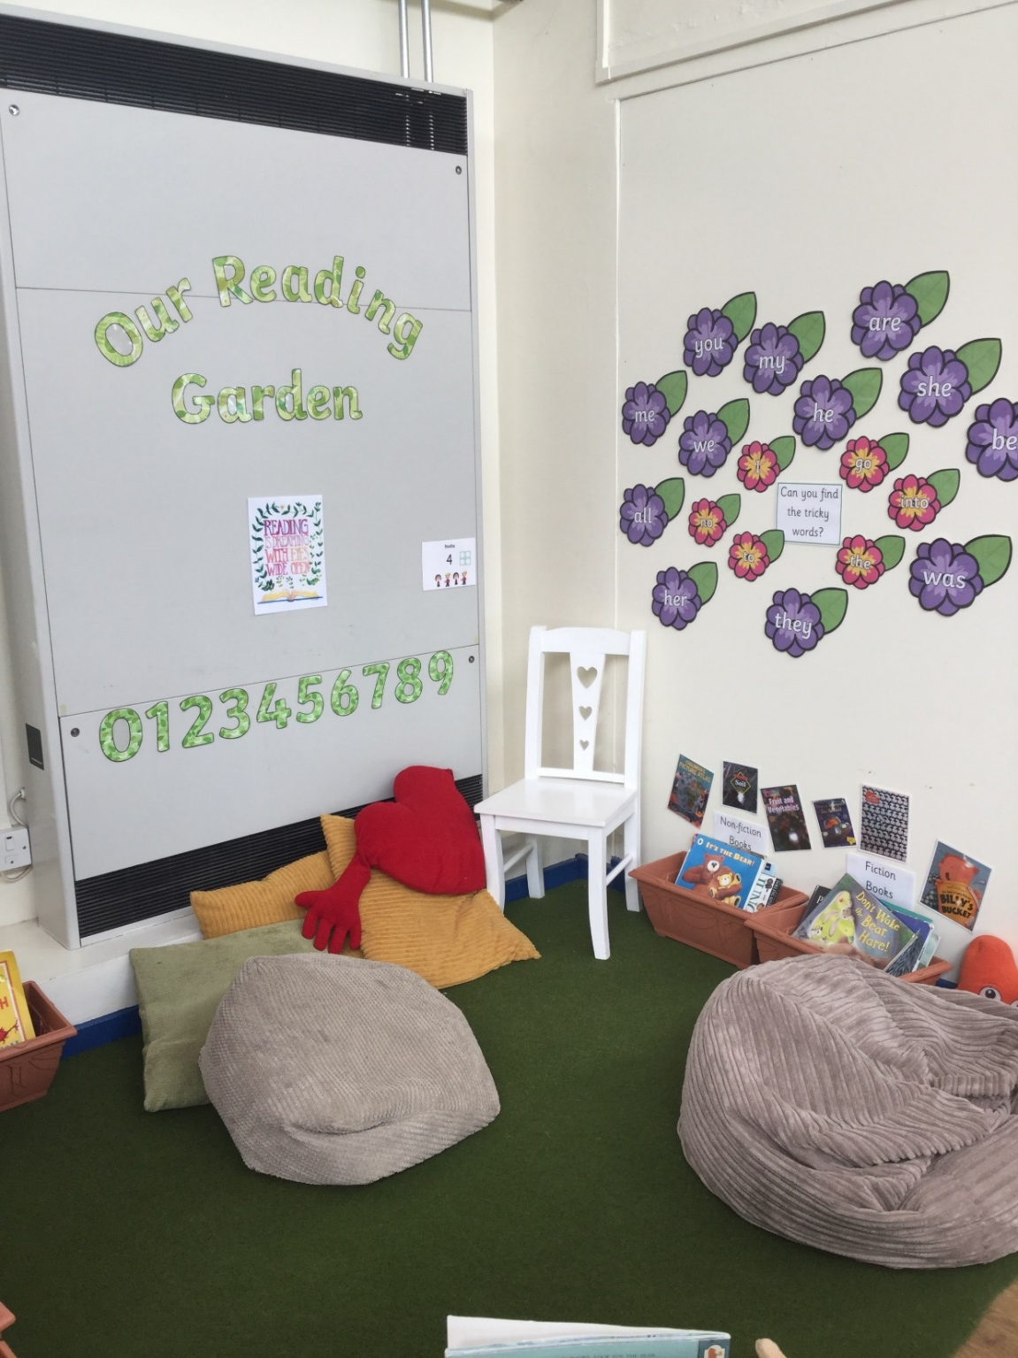
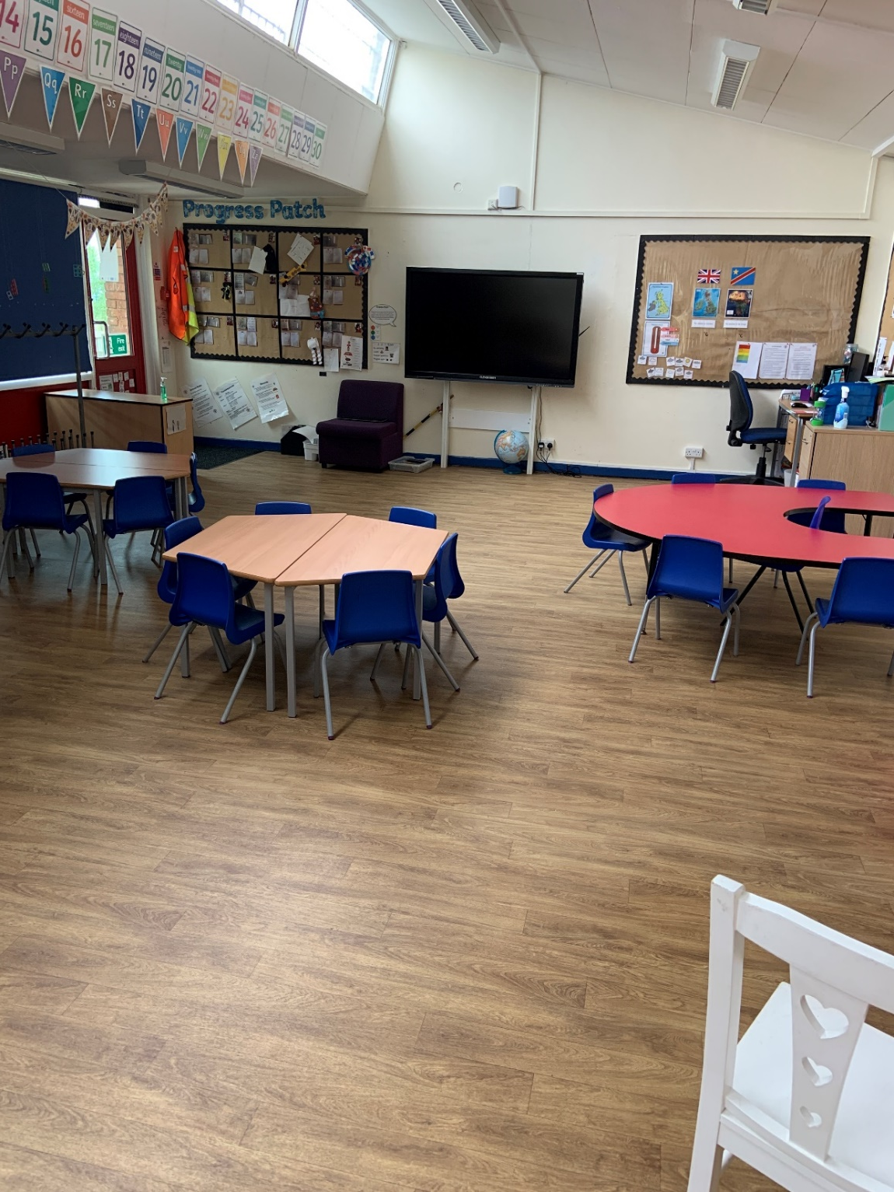
This is your classroom
Your classroom may look a little different to this in September.

Slide 6
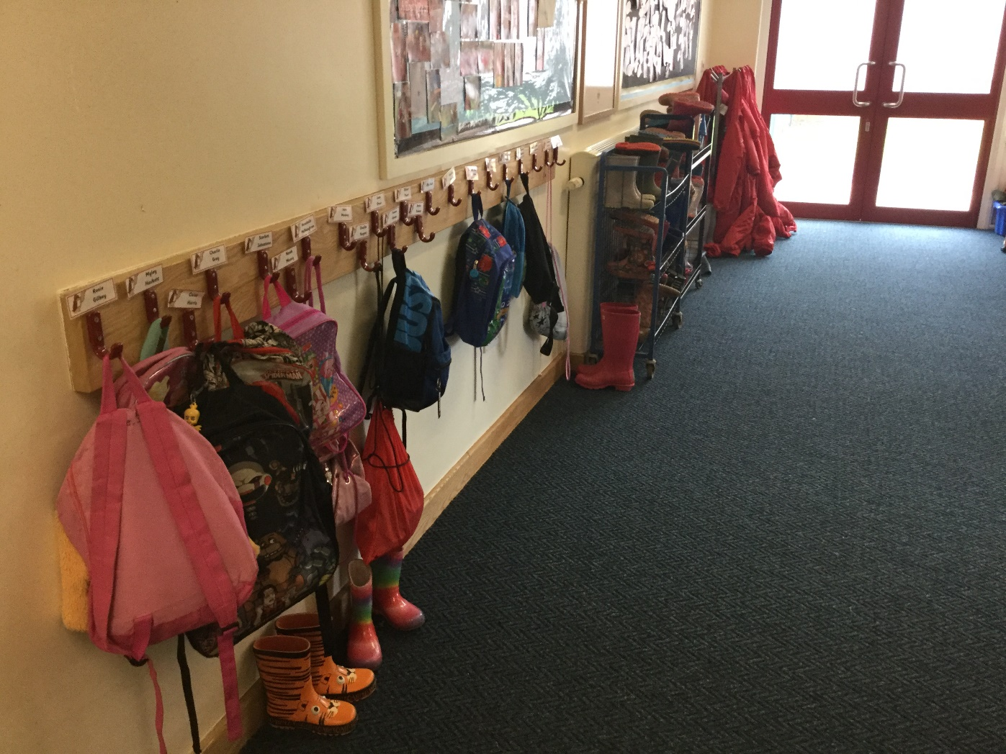
You will hang your coat here.

Slide 7
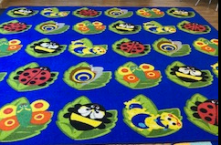
This is your carpet.

Slide 8
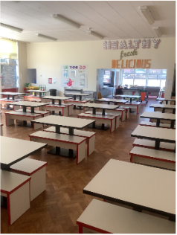
This is where we eat our lunch.

Slide 9
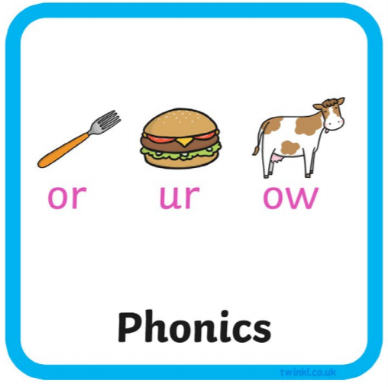



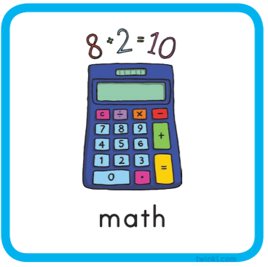



Everyday we do…
Notes:
You could add extra information around English……this half term we will be focusing on…
Maths this half term will be……..
The class reader will be……..

Slide 10



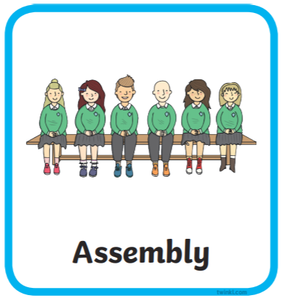

Here are subjects and activities we will do each week in the first term.

Slide 11
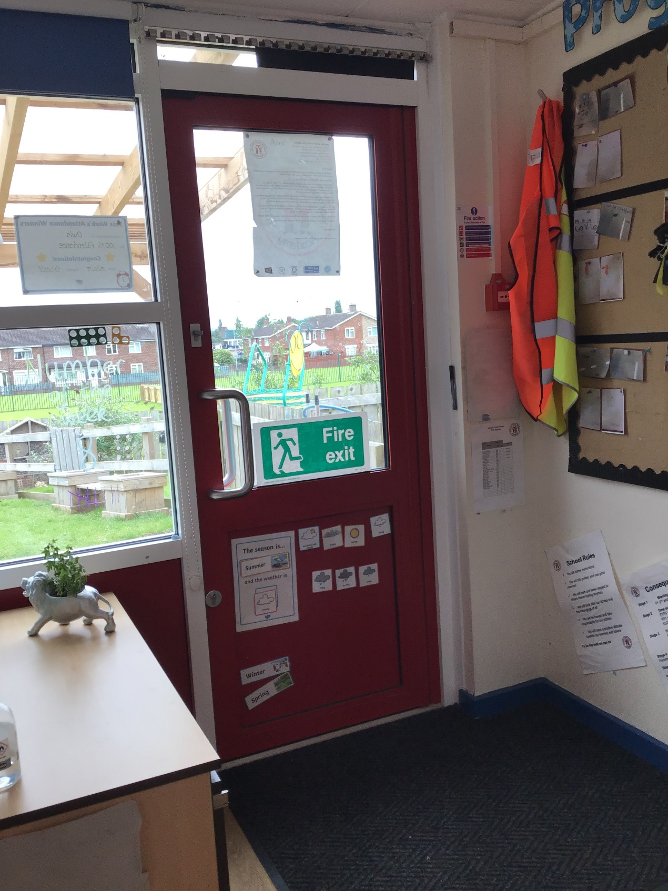
You will go home at 3.00pm from this door.

Slide 12
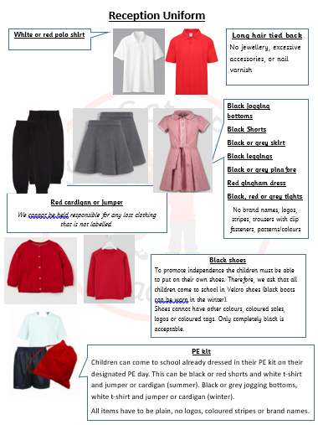
Other information
Our PE days are on a Friday
afternoon and all children are
expected to come to school in their
school PE kit.

