Slide 1
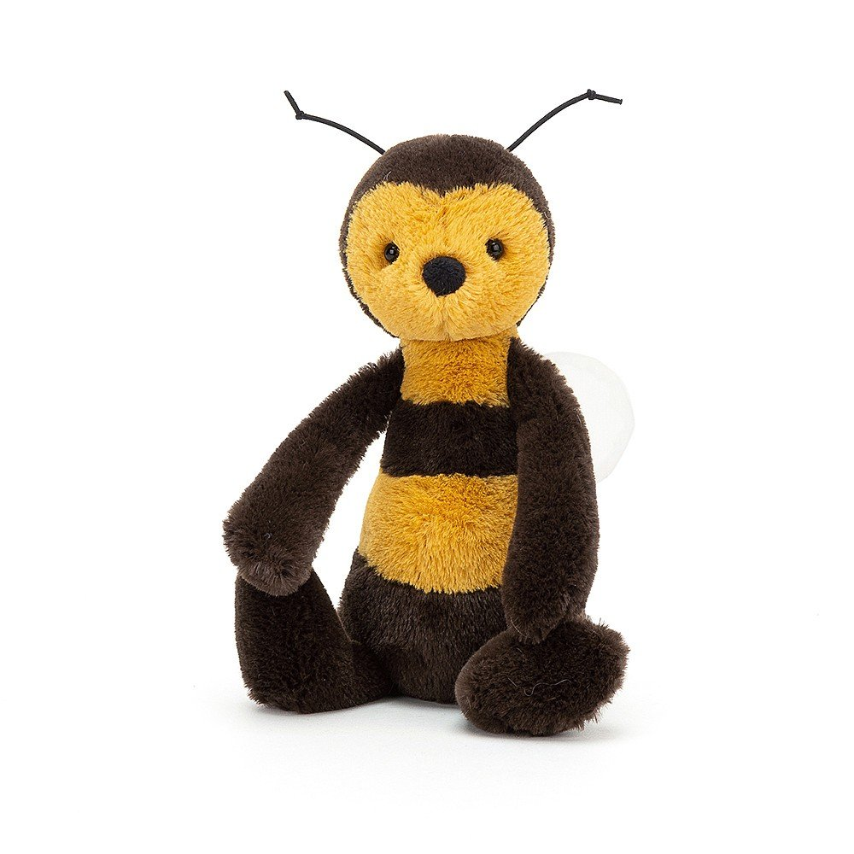

Welcome to Reception

Slide 2
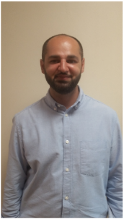
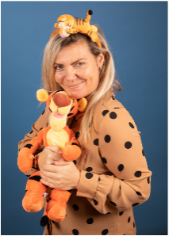
Your new teacher is Mr Majeed.
You are in Bees in Reception
The teaching assistant in your class is Miss Owens.

Slide 3
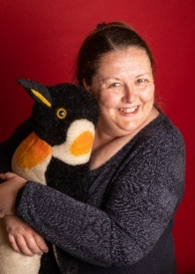
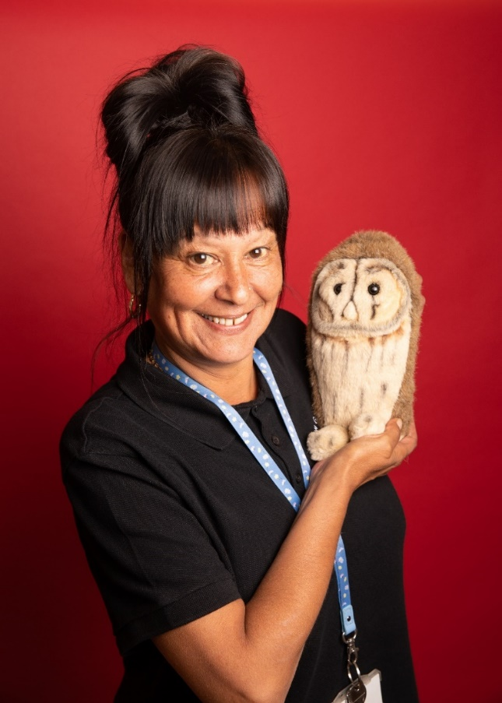
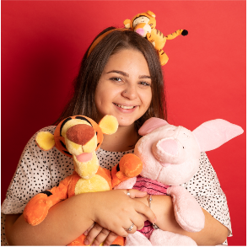
Other adults your child will see everyday in Reception.
Miss Clough
Penguins class teacher
Mrs Edwards
Teaching Assistant
Miss Hughes
Teaching Assistant

Slide 4
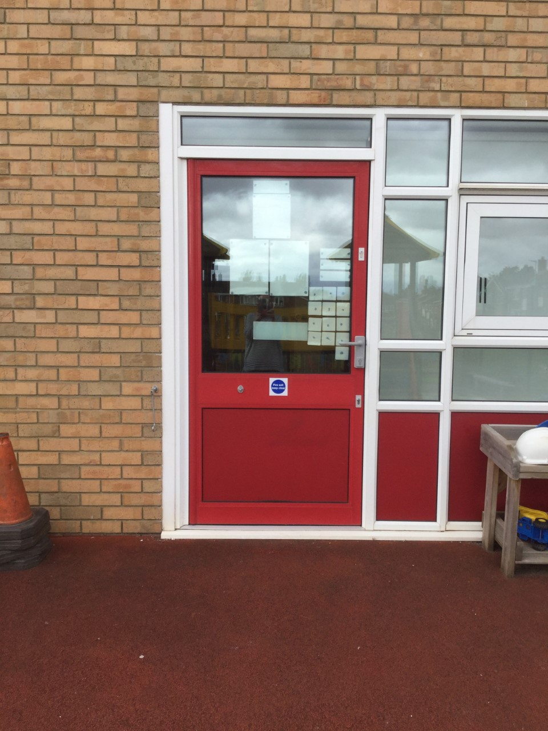
School starts at 8:45am
This is the door you will go into school.
There will be an adult from your new year group to help you get to the classroom.

Slide 5
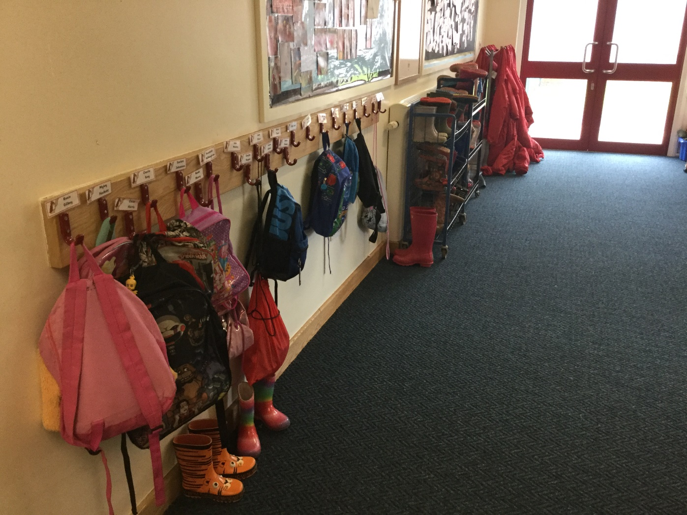
You will hang your coat here.

Slide 6
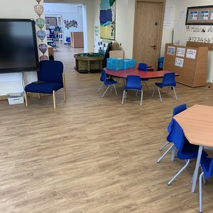
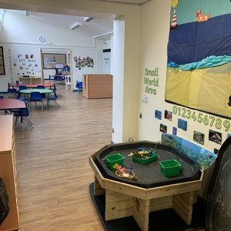
This is your classroom.

Slide 7
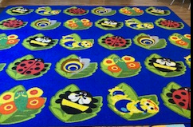
This is your carpet.

Slide 8
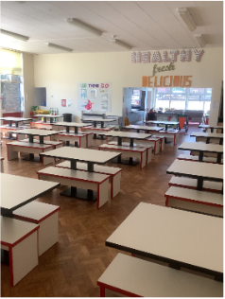
This is where we eat our lunch.

Slide 9
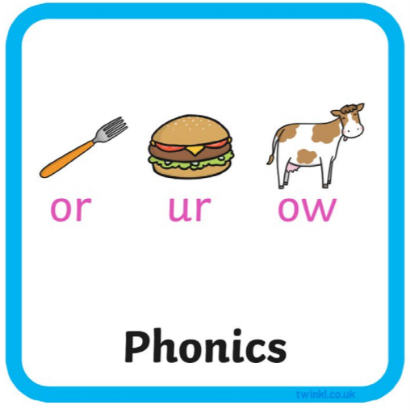



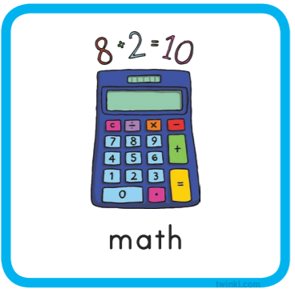



Everyday we do…
Notes:
You could add extra information around English……this half term we will be focusing on…
Maths this half term will be……..
The class reader will be……..

Slide 10



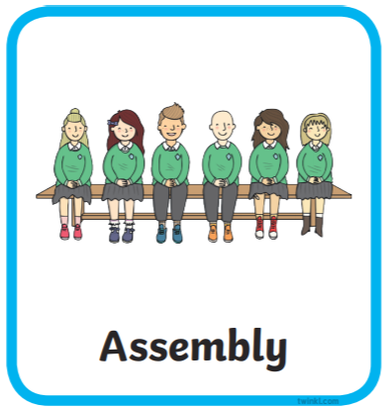

Here are subjects and activities we will do each week in the first term.

Slide 11

You will go home at 3.00pm from this door.

Slide 12
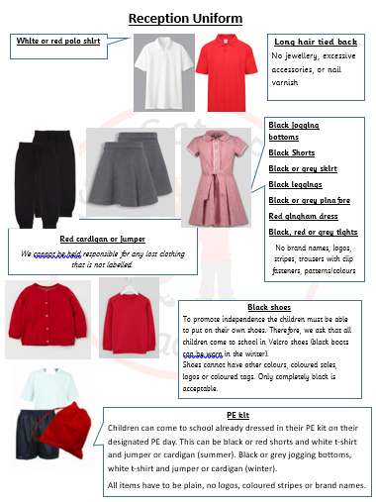
Other information
Our PE days are on a Friday
afternoon and all children are
expected to come to school in their
school PE kit.

