Slide 1
Twitch
Vocabulary Organiser
Word / Phrase | Definition / Meaning | Homonym
canal | A man-made watercourse constructed for some purpose. | canal a tubular duct in a plant or animal
Tag Cut | Tag Cut is a 500 metre section of disused canal in the Cromwell Bottom Nature Reserve.
reserve | A tract of land, usually having some particular biological or ecological value or interest. | reserve "a place was reserved for her in the front row"
weir | A barrier or dam to restrain water.
convict | A person guilty of an offence which makes him liable to legal punishment
outwit | To get the better of a person.
loot | Goods esp. articles of considerable value that are taken.
alkaline | The pH scale measures how acidic or basic something is, on a scale of 0-14
foliage | The leaves (of a plant or tree) collectively; leafage
coppiced | Coppicing is a traditional method of woodland management which exploits the capacity of many species of trees to put out new shoots from their stump or roots if cut down
rivulets | A small stream of water.
staccato | Staccato is a form of musical articulation
reverberations | Reverberation, in acoustics, is a persistence of sound after it is produced

Slide 2
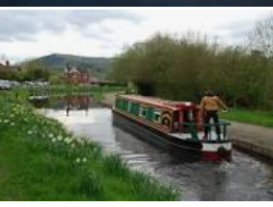
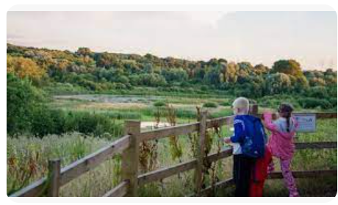
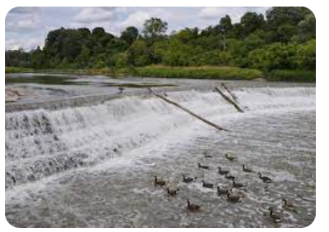
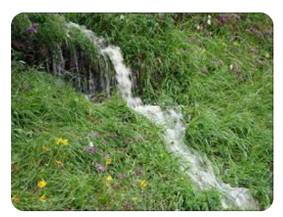
canal
reserve
weir
rivulets

