Slide 1
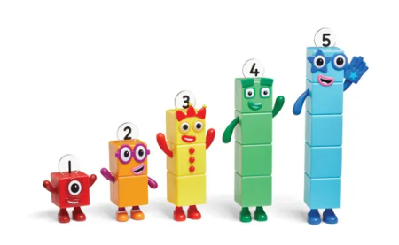
Reception Learning for Autumn 1
Our book sequence for this half term is
Jabari Tries by Gaia Cornwall
The endearing father-child dynamic of Jabari Jumps is
re-created in this sequel in which Jabari is determined to invent a
machine all by himself that will fly right across his back garden. He consults books, finds out about inventors and inventions and makes careful plans but he just can’t quite make it work. Then his dad suggests that partnering with his little sister Nika might help and together they produce a feat of engineering. Advice from dad about dealing with feelings of frustration plays an important part too.
This book will support the children with learning and talking about self-regulation, perseverance and managing feelings.
I Am Me!
Our theme for this half term is I Am Me!
This book is perfect for exploring how to create and develop a sense of self with children, as well as awareness of the feelings of others around them. We will spend time looking at how we manage emotions of our own as well as how we can help others.
To support with this theme, we would like you to send in photos (via Dojo is fine) of your family to be used in class discussions.
Maths
The children will build on previous experiences of number from their home and nursery environments, and further develop their subitising and counting skills. They will explore the composition of numbers within 5. They will begin to compare sets of objects and use the language of comparison.
Subitising is recognising and knowing how many there are without counting. You can support your child’s subitising skills by asking how many fingers you are holding up, or how many plates are on the table for example.
As part of Mastering Number, we will introduce the Number Blocks through our maths sessions.
You can watch the episodes at home:
https://www.bbc.co.uk/iplayer/episodes/b08bzfnh/numberblocks
Vocabulary we will hear and begin to use
Autumn | The season between summer and winter when the weather becomes cooler, and the leaves fall off the trees.
Family | Who we are related to and who we live with.
Inventor | Someone who designs or creates something for the first time.
Engineer | A person who designs, builds or looks after machines.
Feelings | Something that we feel inside. Our emotions and feelings can change depending on what is happening around us.
Phonics
The children will begin Little Wandle phonics sessions – Phase 2. We will introduce graphemes (letters) and phonemes (sounds of letters) each day. Look out for videos on Dojo of the children modelling how we say each phoneme!
Please look at the Little Wandle Parent’s Page for support and guidance. https://www.littlewandlelettersandsounds.org.uk/resources/for-parents/
Any questions. Feel free to ask!

Slide 2
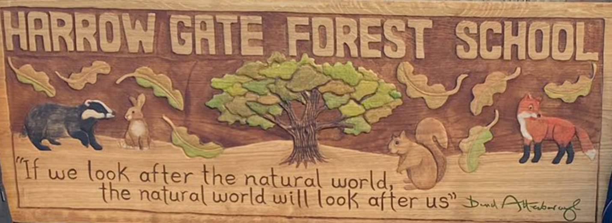
Reception Learning for Autumn 1
Forest School sessions offer the opportunity for children to become completely immersed in the natural environment, develop their physical, problem-solving and communication skills.
Forest School will take place every Tuesday.
Please ensure that your child wears comfortable and appropriate clothing on this day. Children’s legs and arms must be covered so long sleeves and trousers or leggings are a must. We will provide children with waterproof suits. We have some spare wellies, but not enough for everyone, so if your child has a pair at home, we would appreciate you sending them in. Children can leave wellies at school as these are use daily.
It is important that they are prepared for all weathers as we will always be going outside.
PE
The children are taking part in Balance Bike lessons every Thursday.
Please can we remind parents and carers to put your child’s name in their jumpers and cardigans as this makes it easier- Thank you.

