Slide 1
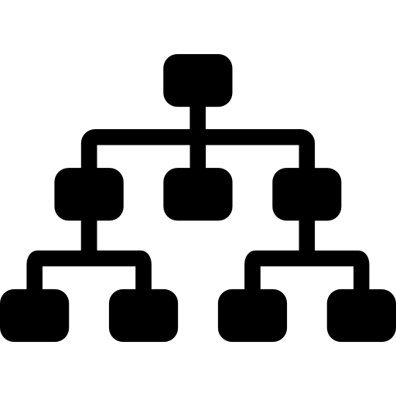
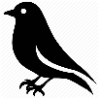
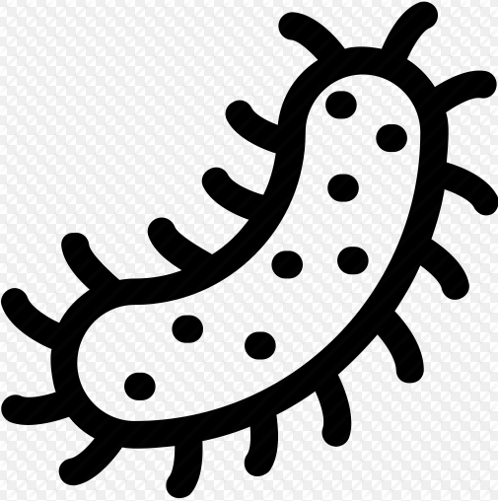
uses a hierarchical system
Amphibians
Fish
Mammals
uses an accepted universal biological language
make everyday life easier
Reptiles
Birds
groups organisms based on shared characteristics or features
helps us make sense of the world
can only be seen using
a microscope
HOW DOES IT WORK?
Some animals and plants are microorganisms
sorts living things into groups
without them the world would be chaos
VERTEBRATES
ANIMALS
MICRO-ORGANISMS
Fungi
(e.g. mould)
CLASSIFICATION
OF LIVING
THINGS
INVERTEBRATES
Bacteria
(single celled)
PLANTS
Non - Vascular
(has no true roots)
Vascular
(has roots)
Virus (unusual micro-organism,
infectious agents that replicate inside cells)
Has Seeds
No Seeds
Porifera
Annelids
Arthropods
mosses
Flowering
Non- Flowering
ferns
Echinoderms
Molluscs
Cnidarians

