Slide 1
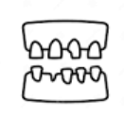
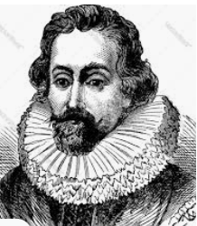
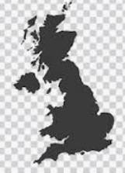
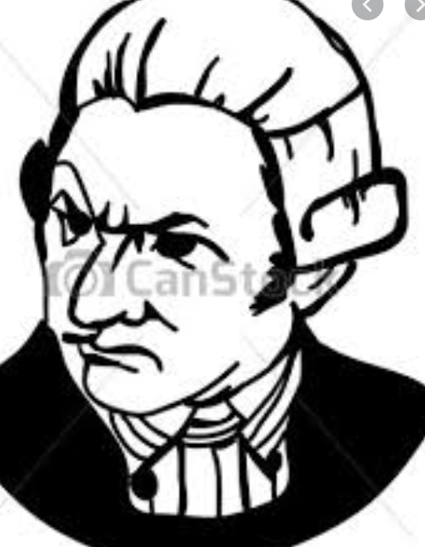
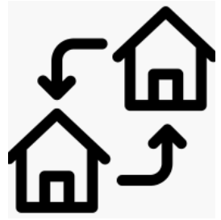
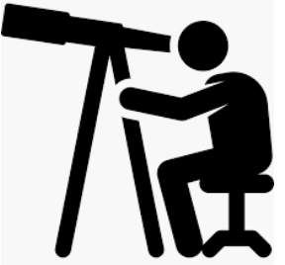
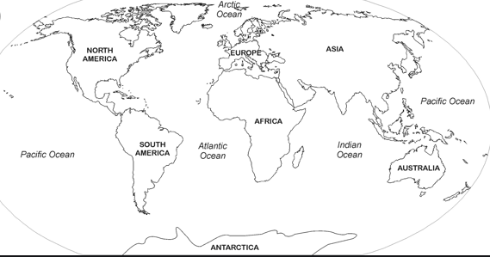
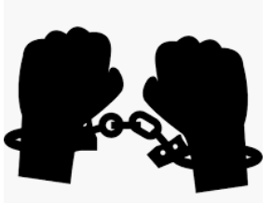
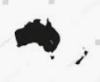
Francis Drake
James Cook
Scurvy
disease
Vitamin C
1540-1544
Francis Drake was born.
1577
Queen Elizabeth asked Drake to sail around the world
1580
Returned to England
1596
Francis Drake died in Panama
.
1728
James Cook was born in Marton.
1736
He moved to Great Ayton
1746
Worked in Whitby.
1755
James Cook joins the Navy
1768 –
1771
First Expedition
1772-
1775
Second Expedition
1776 –
1779
Final Expedition
James Cook was killed by natives in Hawaii
James Cook
Francis Drake
Best known for exploring the South Pacific
First Englishman to sail around the world.
Captained a ship called The Judith.
At 18 he took on apprenticeship with the Royal Navy at the start of a war
Sailed to Africa and captured
people to sell into slavery.
Cook was given command of a cat-collier ship named The Endeavor.
He was a privateer and attacked many enemy ships.
Transit of Venus
First voyage to observe Venus and landed in New Zealand and Austrailia..
Sailed to South America and plundered the Spanish.
.
Third voyage he landed in Hawaii and angered the natives. Captain Cook was killed in Hawaii.
Queen knighted him Sir Francis Drake..

Slide 2
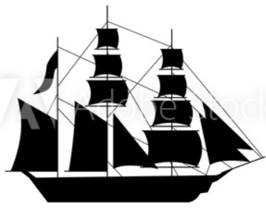
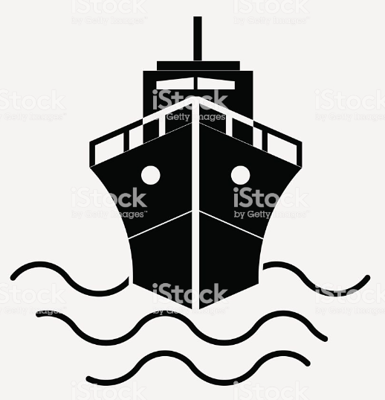
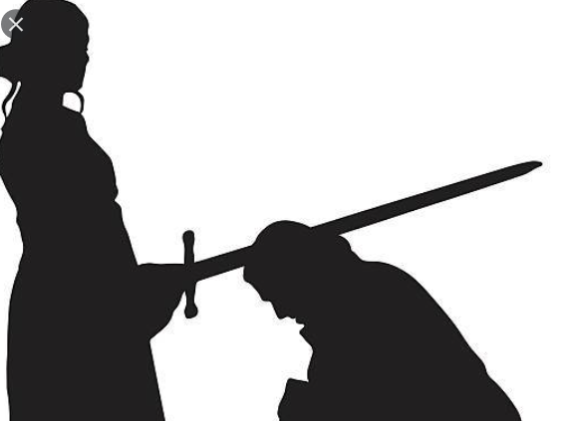
Vocabulary Organiser- History
Fleet | A group of ships.
Battle | A fight between armed forces.
Voyage | Is a long journey involving travel by sea.
Commander | A person who has authority.
Invasion | Invading a country with an armed force.
Navy | A countries armed services that conduct military operations at sea.
Explorer | To travel around a place to find out what is is like.
Privateer | an armed ship owned and crewed by private individuals holding a government commission and authorized for use in war
Pirate | A person who attacks or robs ships at sea.
Occupation | the work a person does to earn a living; profession.
Expedition | A journey undertaken by a group of people with a particular purpose.
Plunder | Steal goods from a place or a person.
Knighted | A knighthood is a title that is given to a man by a British king or queen for his achievements or his service to his country.
Merchant | A merchant is a company or individual who sells a service or goods.
Surveying | The act of looking, seeing or orbserving.
Navigating | To plan and direct the course of a ship, aircraft, or other form of transport, especially by using instruments or maps.
Natives | Someone who is born in a particular country.

Slide 3
Cat - collier | A ship designed to carry coal.
Hygiene | Keeping yourself clean to stop the spread of germs.
Scurvy | a disease caused by a deficiency of vitamin C
Astronomers | Astronomers are scientists who study the universe, stars and planets.
Maori tribe | The Maori People are an indigenous community of New Zealand. This means they were the orginial owners and caretakers of this region.
Coral reef | A ridge of rock in the sea formed by the growth and deposit of coral.
Malaria | Malaria is a serious tropical disease spread by mosquitoes.
Capture | To be taken into one’s possession or taken by force
Slave | A person who is the legal property of someone and is forced to obey them.
Ransom | A sum of money demanded or paid for the release of a captive

