Slide 1
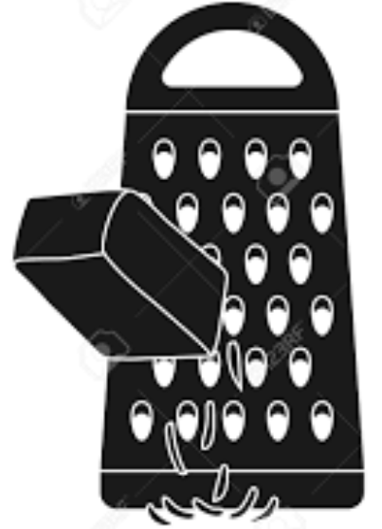
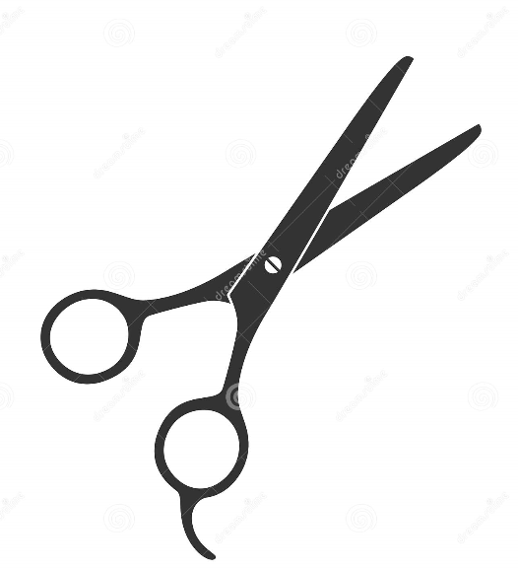
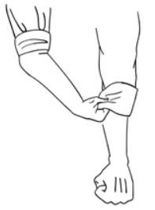
Tools
Hygiene rules
Remove jewellery
Peeler
Grater
Scissors
Knife
Juicer
Tie hair back
Food
Roll up sleeves
Techniques
Put on apron
Wash hands
Peeling
Claw
Bridge
cut
grating
Cover any cuts

Slide 2
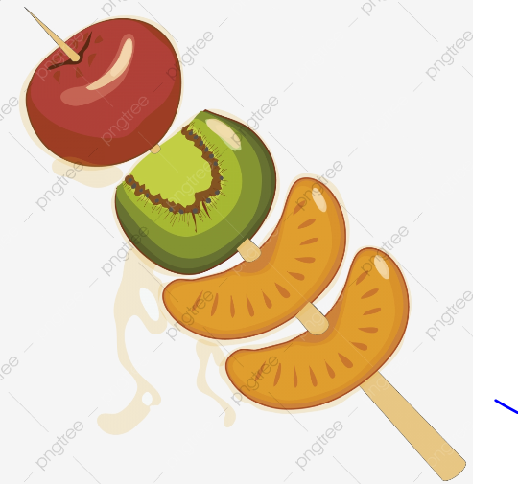
Vocabulary Organiser- Design Technology
Fruit | A plant or tree’s edible seed with envelope.
Vegetable | Plant used for food
Nutrients | All the things in food that the body needs to remain healthy
Pith | The soft white lining inside fruit such as oranges
Salad | A cold dish of fresh and/or cooked vegetables or fruit
Sensory evaluation | Subjective testing of foods where senses are used to evaluate qualities such as appearance, smell, taste, texture (mouth feel)
Kebab | Cooked and/or fresh ingredients on a skewer
Apron | A protective garment worn over the front of one's clothes and tied at the back.
Grater | An object covered with holes edged by slightly raised cutting edges, used for grating cheese and other foods.
Peeler | A sharp object used for removing the skin from fruit and vegetables.
Juicer | A tool used to squeeze the juice from certain fruits.

