Slide 1
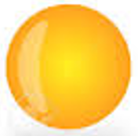
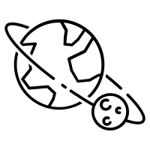
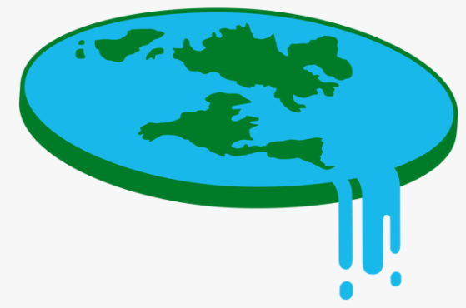
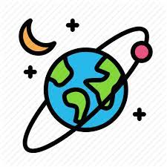
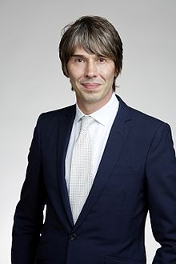
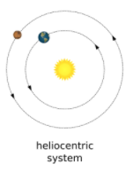
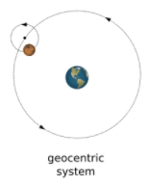
Sun
Mercury
Venus
Earth
Mars
Jupiter
Saturn
Uranus
Neptune
Planets of Solar System
Moon orbits the Earth
Flat Earth
V
Historical beliefs
Spherical Earth
Movement
Earth and Space
V
Earth rotates and orbits the Sun
Professor Brian Cox
(1968 – present)

Slide 2
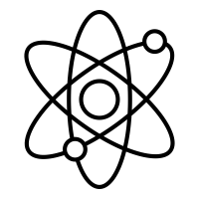
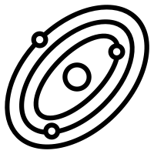
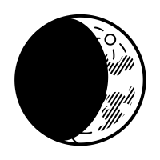
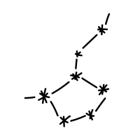
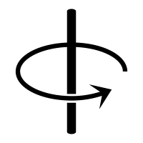
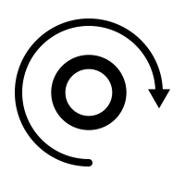
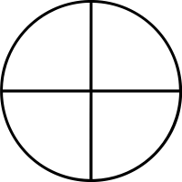
 | Physics | Physics is the study of energy and matter in space and time and how they are related to each other.
 | Earth | Earth is the third planet from the Sun. It is the only planet known to have life on it. The Earth formed around 4.5 billion years ago.
 | Solar system | The collection of eight planets and their Moons in orbit round the sun.
 | orbit | The regularly repeated elliptical course of an object or spacecraft around a star or planet.
 | spherical Body | An object in orbit around the Sun that is large enough to have its self-gravity pull itself into a round (or near spherical) shape.
 | moon Phases | The changing portions of the Moon that are visible during the 27-day cycle.
 | celestial body | Any natural body outside of the Earth's atmosphere (e.g. the Moon, Sun or any other planet).
 | axis | An imaginary straight line passing through the North Pole, the centre of the Earth, and the South Pole. The Earth rotates around this axis.
 | rotation | The circular movement of an object about a point in space.
 | geocentric | People used to believe that the earth was the centre of the solar system and that the sun, and all the other planets, orbited it.
 | heliocentric | Over hundreds of years, scientists began to understand that the sun was at the centre of the universe. They realised that all the planets actually orbited the sun not the earth.
 | gravity | A force which tries to pull two objects toward each other. Gravity is what holds the planets in orbit around the Sun and what keeps the Moon in orbit around Earth.
 | gravitational pull | The closer you are to an object, the stronger its gravitational pull is. Gravity is what gives you weight
E
S

