Slide 2
Aim
I can plant seeds and bulbs and suggest how to care for them.
I can set up a test and make a prediction.
Success Criteria
I can follow instructions to plant a seed and a bulb.
I can suggest how to care for a plant so it grows well.
I can set up a simple test to show what plants need to grow well.
I can predict which plants will grow well and which will not.

Slide 3
We have been learning about…
Plants

Slide 4
Seeds and Bulbs
The first stage in the life cycle of most plants is a seed.
Seeds come in all shapes and sizes. Every plant has a different seed.

Slide 5
Seeds and Bulbs
Every single seed has the beginnings of a new plant inside it, along with a little store of food to help it grow.
When the conditions are right, the seed soaks up water and swells, and the tiny new plant bursts out of its shell. This is called germination.
Embryo:
The tiny root and shoot which will grow into the adult plant.
Food Store:
A store of food for the young plant to use until it has grown enough to make its own food.
Seed Coat:
A tough outer covering.

Slide 6
Seeds and Bulbs: Germination
Click the button below to find out more about germination.

Slide 7
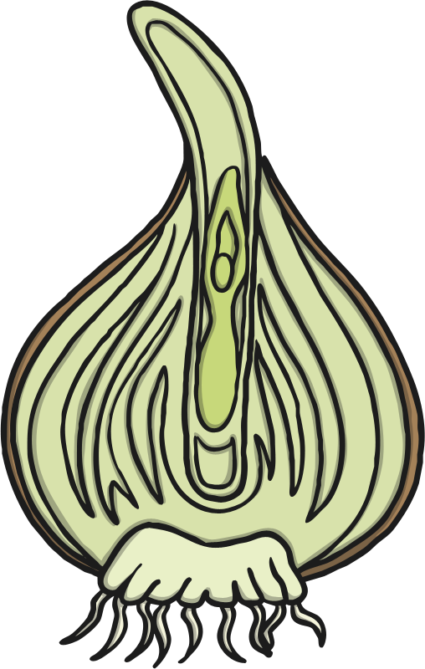
Seeds and Bulbs
Some plants grow first from a seed, and then develop a bulb that helps them to grow back year after year.
A bulb lets the plant rest underground over the winter when it is too cold, then grow back later in the year when conditions are right.
Flower Bud:
Future flower stored inside the bulb for protection.
Tunic:
A papery outer covering.
Scales:
Thick leaves that store the food.
Roots
Stem

Slide 8
Seeds and Bulbs
Here are some common plants that grow from bulbs.
Lilies
Daffodils
Allium
Snowdrops
Tulips

Slide 9
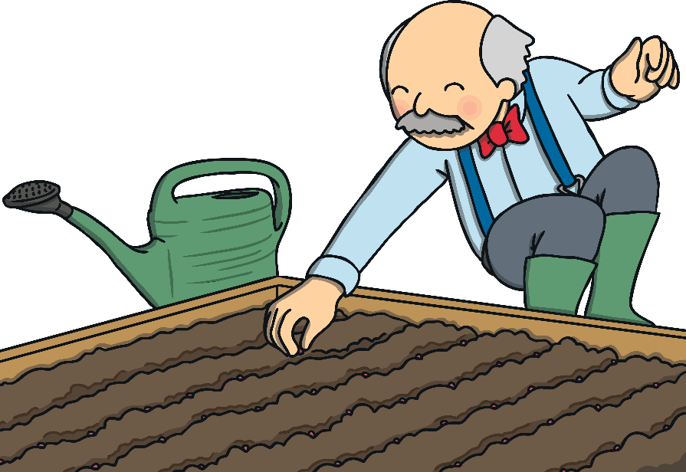
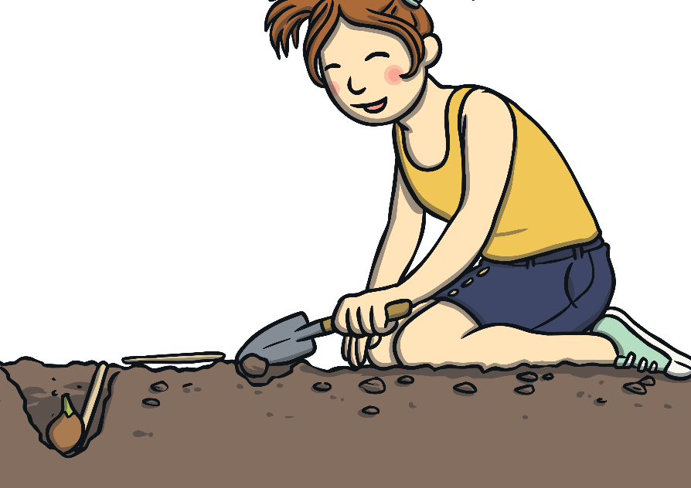
Seeds and Bulbs
We are going to plant a seed and a bulb each, so we can compare how they grow.
Comparing means looking closely to see what is similar and what is different.

Slide 10
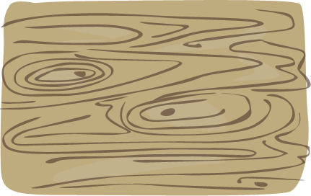
What Do Plants Need to Grow?
Seeds and bulbs need to wait for conditions to be just right before seeds can germinate and bulbs can sprout new growth.
What do you think that our plants will need so they can sprout and grow well?
How can we find out if you are right?

