Slide 1
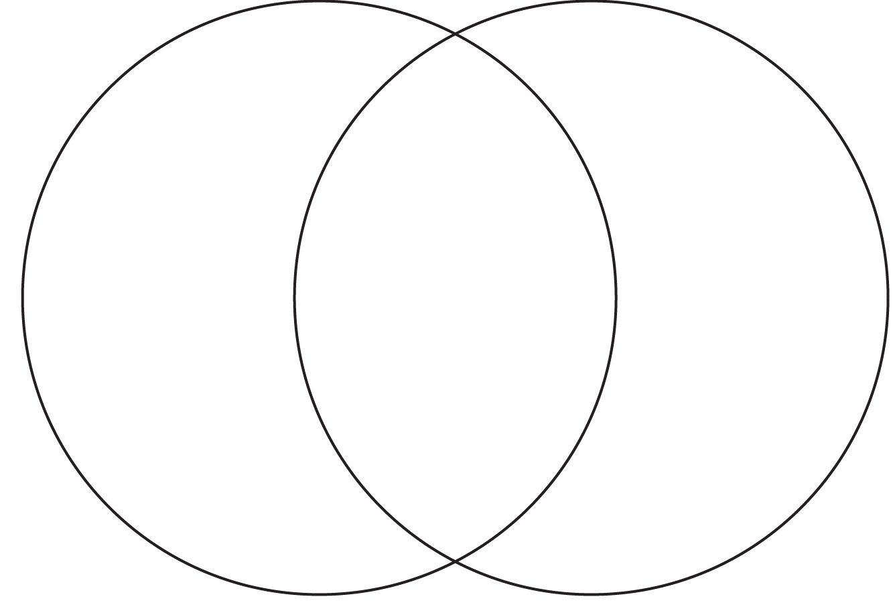
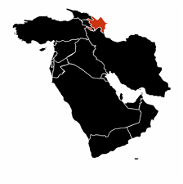
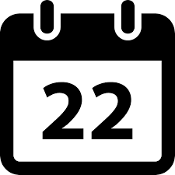
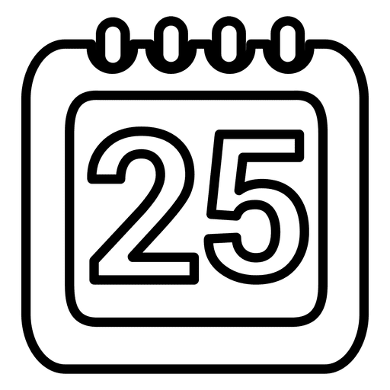
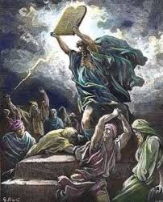
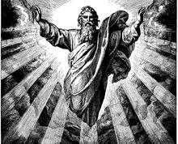
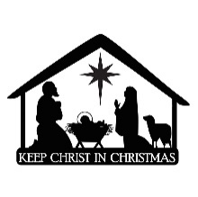
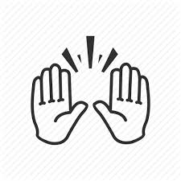
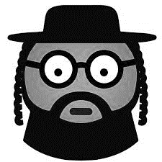
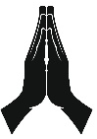
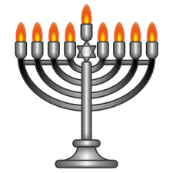
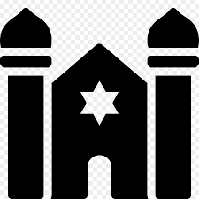
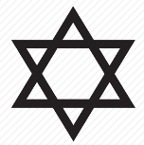
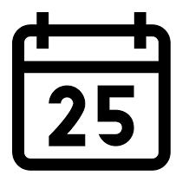
Y2 – How are Christmas and Hanukkah similar and different?
Judaism
Hanukkah
Christmas
Christianity
Began over 3500 years ago in Middle East
Largest religion in the world
Celebrated on 22nd December but can vary
Celebrated on 25th December
Founders are Abraham and Moses
Focuses on the life and teachings of Jesus Christ
Most important
religious text
Jesus Christ is the son of God
Yaweh
Only one God
Marks the birth of
Jesus Christ
During Hanukkah Jewish people celebrate victory
Jesus taught his disciples the ‘Lord’s Prayer’
kippah
The New Testament
Rabbis
The Old Testament
Jesus taught people to love God and show kindness to others
Hanukkah (festival of light) 8 days
Worship in churches
and cathedrals
Religious sign of Judaism
Worship in temples
called synagogues
Jesus was crucified on a cross
10 commandments
Founders are Jesus and his disciples

