Slide 1
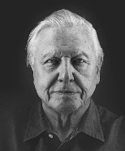
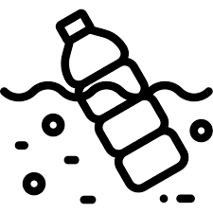
flower
leaves
stem
roots
Classification Key
David Attenborough
male part
stamen
Plants
Born 8th
May 1926
female part
carpel
nutrients
Endangered species
Human impact
air
room to grow
light
water

