Slide 1
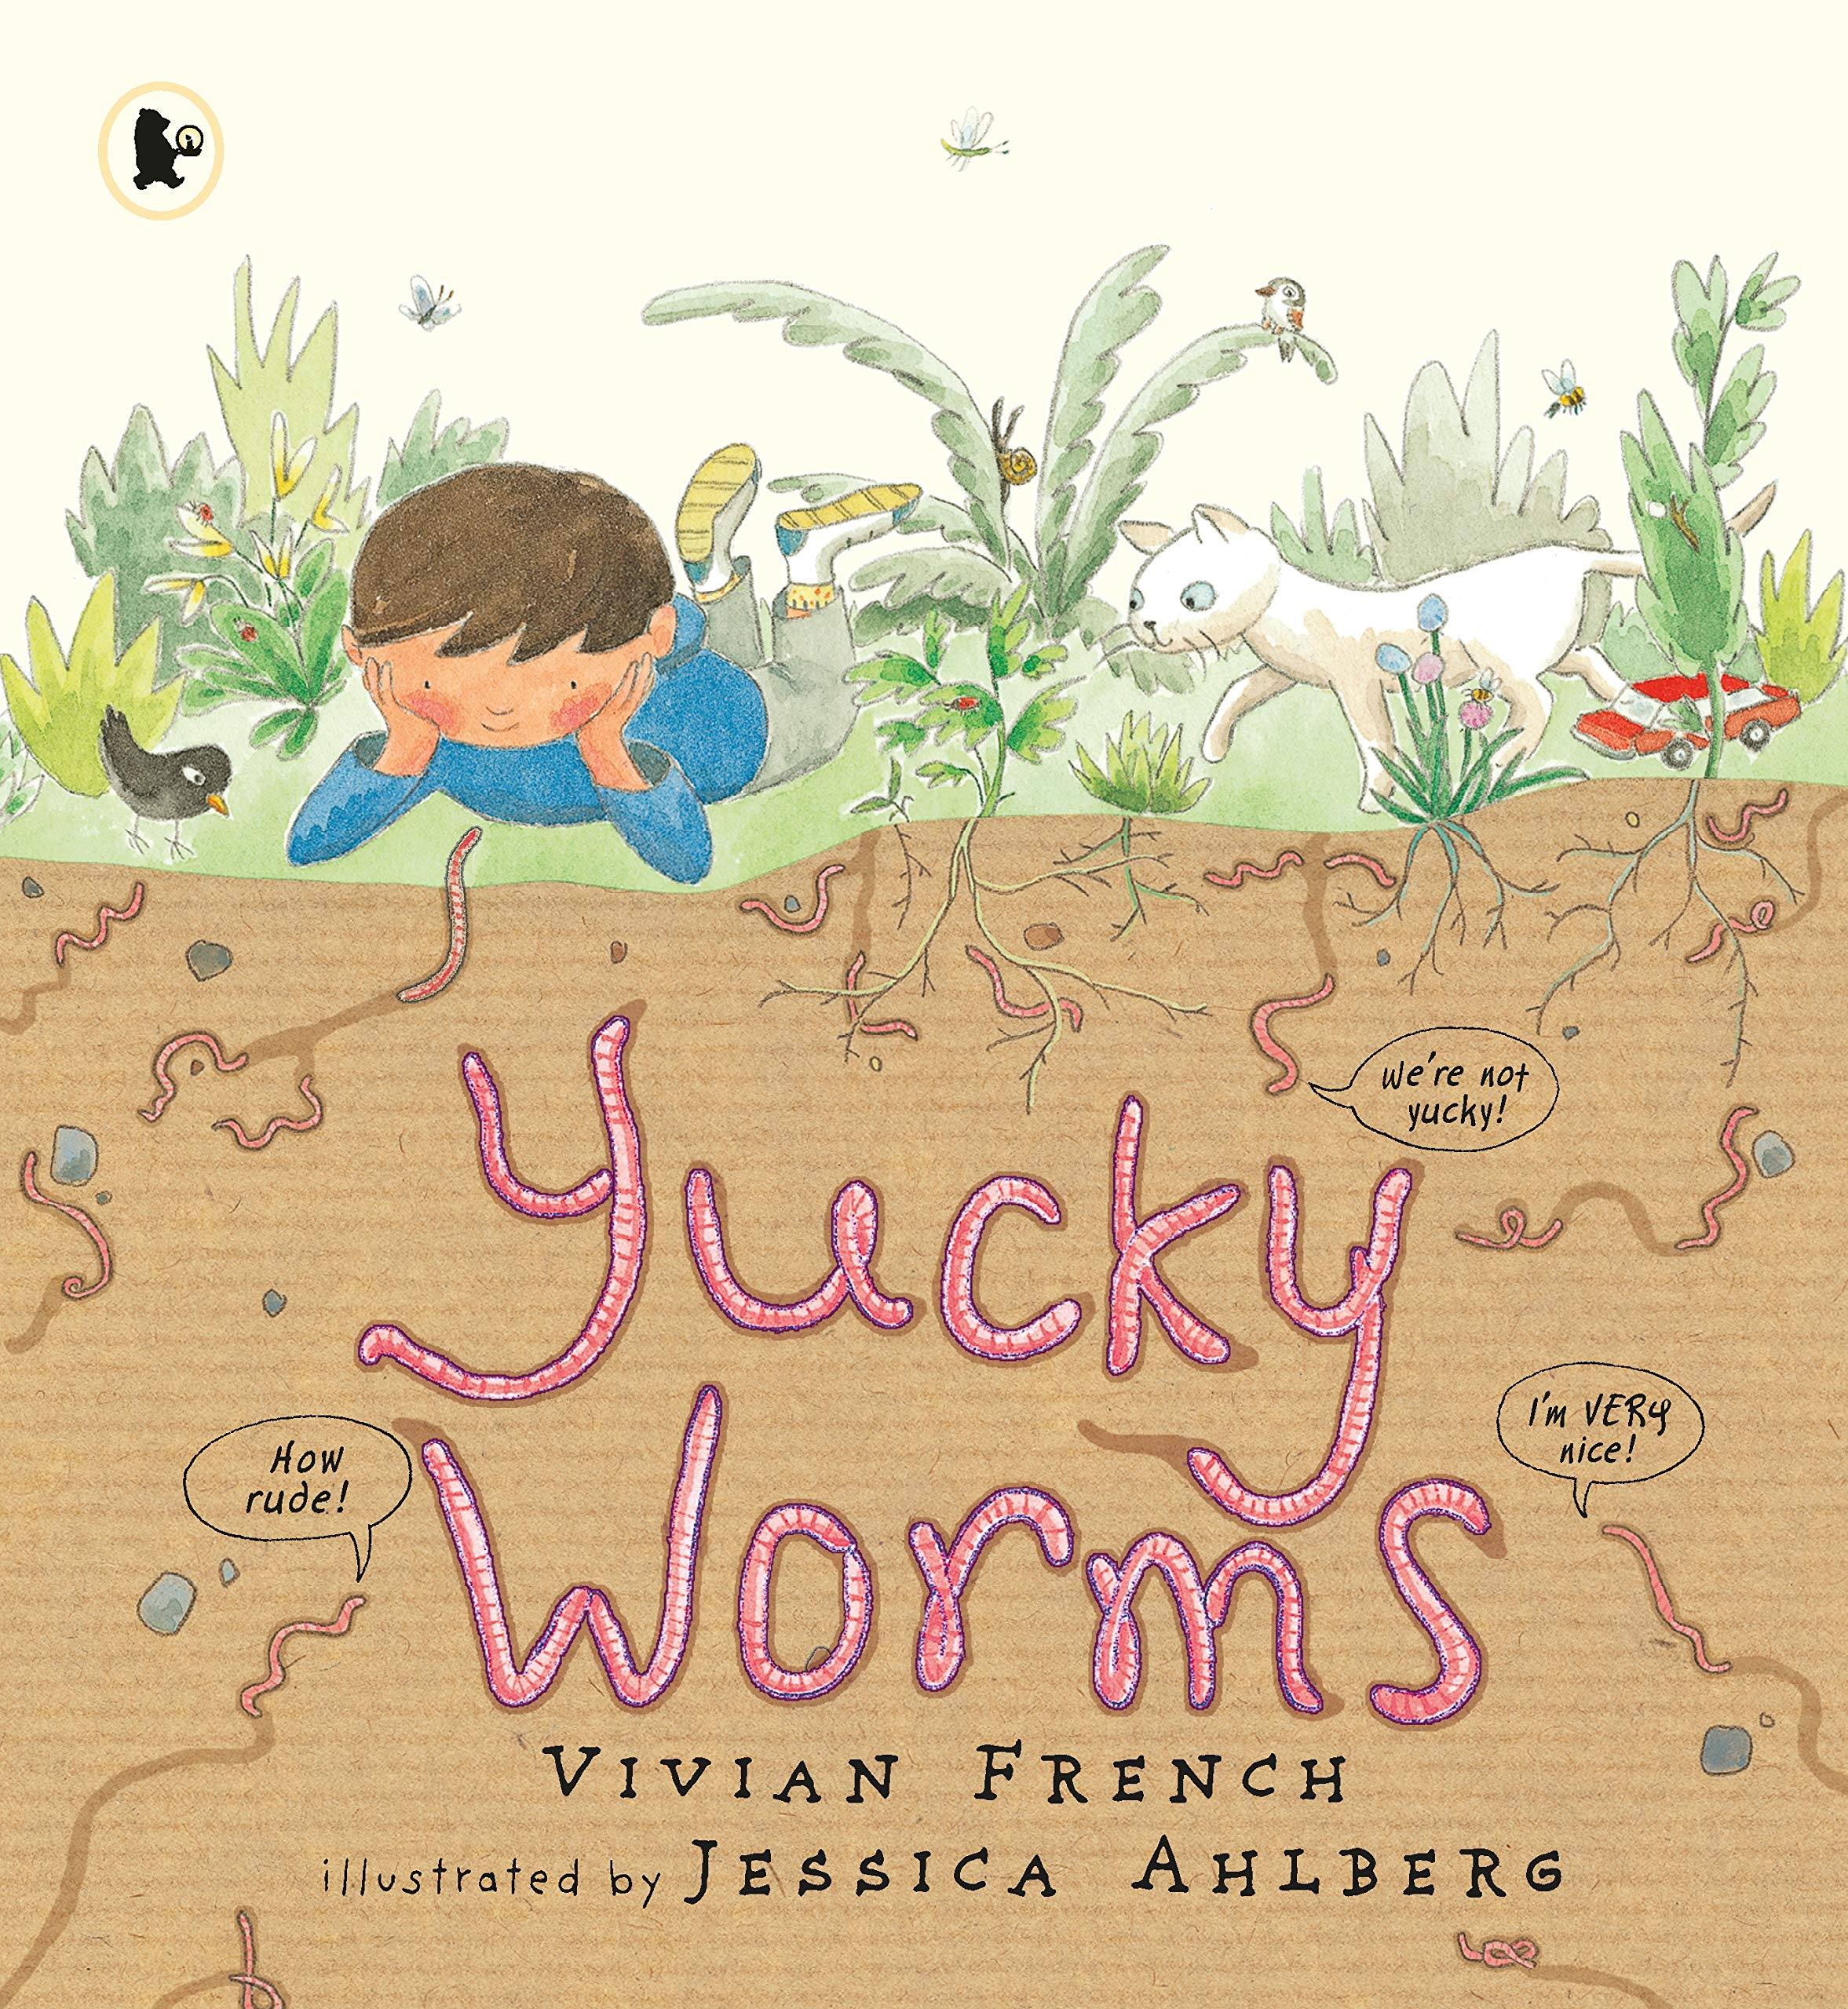
Hearing synonyms throughout the story will allow your child to experience and use newly acquired vocabulary.
Daisies Learning for Spring 2
Maths
Counting –
We will be practising counting beyond 10 and matching number names to the items we count.
We will be talking about the different ways the number 10 can be made.
Numerical patterns
We will be counting objects accurately to 10 using one to one correspondence identifying when objects have the same, less that or more than.
We will be loosing at the composition of numbers and how numbers are made.
We will be comparing quantities of objects/numbers.
Shape
We will be using shape names and positional language.
We will be comparing size, weight and capacity.
We will be looking at 3D shapes names and some of their basic properties.
We will be extending our knowledge of repeating patterns.
Additional learning:
We will continue to have a number of the week. Can you join in with the challenges set on dojo and send us a picture?
We will continue to set activities using Maths Seeds. Please log on to Maths Seeds with your child to complete any set activities.
Our book sequence for this half term is
Yucky Worms by Vivian French.
This term we will be using the story to find out how we can help our environment We will be looking closely at the environment around us and how we can take care of it, this will include plants, animals and insects. We will be looking to attract more insects and creatures to our garden by developing our planting areas.
How does your garden grow?
Our theme for this half term is How does your garden grow? We will be investigating the life cycles of creatures, different features in our environment and what we can do to help the environment. We will do this by researching and investigating different creatures, their habitats and their life cycle.
Synonyms Using synonyms will help to expand your child’s vocabulary and allow them to experience new language! While reading the Yucky Worms book I will expose the children to new words. Home challenge, see if you can use synonyms while talking to your child.
Book language | Synonym | Book language | Synonym
Slimy | Mucous | Stomach | Belly
Slithery | Slippery | Weird | Strange
Wiggly | Squirming | Recycle | Convert
Throw it away | Rejected | Goodness | Nourishment
Horrified | Shocked, Aghast | Strong | Robust, stable
Disappeared | Retreated | Spread | Dispersed
Vanished | Faded, disappeared | Loosen | Break up
Look at | Investigate | Stretch | Expand
Tunnel | Burrow | Dangerous | Deadly
Asked | Enquired | Tough | Hard
Earth | Ground, soil | Asked | Interrogated
Rotting | Decomposing, decaying | Pretend | Trick them
Dead | Deceased | Chewing | Nibbling
Grind | Pulverize | Promised | Agreed
A while | Sometime | Stamped | Trodden, tramped
Vibrations | Quakes, trembles | Thump | Thud, bang
Hungry | Ravenous | Danger | Warning
Dug | Plunged | Washed | Cleaned
Clean | Spotless | Rustling noise | Stirring
Bristles | Stubble | Seedlings | Sprout, small plant
Thought | Idea, intention | Friends | Chums, mates
Good idea | Theory
Vocabulary we will hear and begin to use.
Insect | Is a small animal that has six legs. Most insects have wings. Ants, flies, butterflies and beetles are all insects.
Pest | Are insects or small animals which damage crops or food supplies.
Beneficial | Something that helps people or improves their lives.
Environment | Everything that is around us.
Phonics
Phase 3 phonics will be taught daily in Spring 2. Your child will learn the following:
ai ow
ee oi
igh ear
oa air
oo er
oo words with double letters.
ar longer words
or
ur
The children will then progress onto phase 4 which involves the process of learning to read and write longer words.

Slide 2
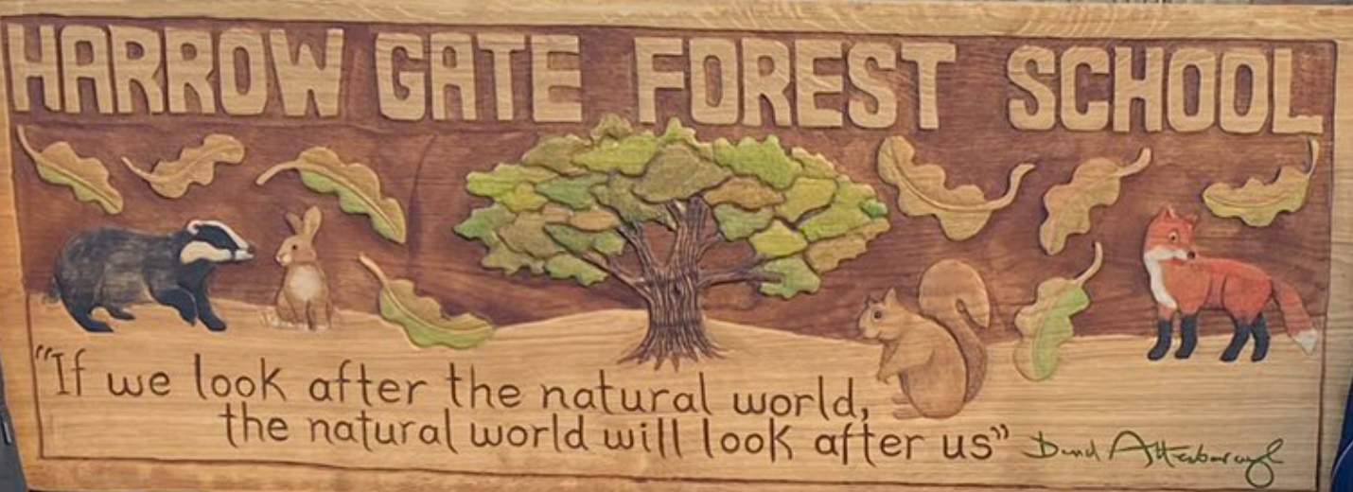
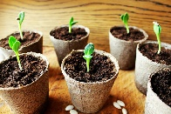
Daisies Learning for Spring 2
Welcome back to Reception!
We hope you have had relaxing and fun time with your families over the Holidays and are excited and ready for the new term ahead.
We are really looking forward to having you back in school.
If you have any questions or concerns, please do not hesitate to talk to a member of the reception team on the door or message via Class Dojo.
EBooks
Your child will be set a new reading book on Collins eBooks. Your child's details were sent out to you last term. It is so important that you are reading at home with your child as much as possible. As a school we can accessed reports to see who has accessed the books and how long a child has spent reading the book. Please read frequently with your child at home.
If you have any issues accessing the eBooks, please let a staff member know.
Forest School sessions offer the opportunity for children to become completely immersed in the natural environment, develop their physical, problem-solving and communication skills.
Forest School will take place every Friday.
Please ensure that your child wears comfortable and appropriate clothing on this day. Children’s legs and arms must be covered so long sleeves and trousers or leggings are a must. We will provide children with waterproof suits. We have some spare wellies, but not enough for everyone, so if your child has a pair at home, we would appreciate you sending them in. Children can leave wellies at school as these are use daily.
It is important that they are prepared for all weathers as we will always be going outside.
Home Learning
Show and Tell
‘Show and Tell’ is a fun speaking and listening activity. Children can bring in an item from home that they would like to show to the group and tell us about. The children take turns to show and describe their items to the group. The rest of the group also has the opportunity to ask questions. This helps the children to practise their speaking and listening skills and also develops their self-confidence when speaking to a group.
Your child will come home with a bag to bring their show and tell item into school in. You will receive a letter with more information about this activity. Each child will be given a different day to bring in their item into school.
Your child will be planting seeds in school and discussing the life cycle of a plant. They will be then taking the plants home to care for the seed and watch it grow. We would love for your child to care for the plant and send us updates on dojo.
PE
Children are to come to school in their PE kits on Mondays and Tuesdays.
Please can we remind parents and carers to put your child’s name in their jumpers and cardigans as this makes it easier- Thank you.

