Slide 1
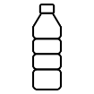
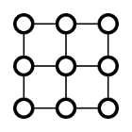
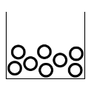
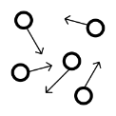
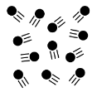
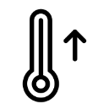
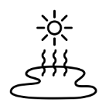
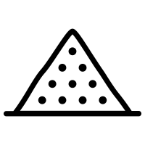
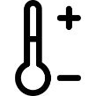
doesn’t take the shape of a container
takes the shape of a container
can be squashed
fixed shape
fixed volume
solid
can be held
no fixed shape
can be poured
fixed volume
liquid
difficult to hold
no fixed shape
gas
often invisible
water temperature rises
sun and heat
evaporation
States of Matter
The Water Cycle
water vapour rising
Chemistry
precipitation
water temperature falls
condensation
melting
condensation
carbon dioxide
water vapour
oxygen
air
Solid, Liquid or Gas?
wood
ice cube
glass
matter
changes of state
everything is made
of matter
matter can change shape depending on its temperature
coffee
water
shower gel
freezing
evaporation

