Slide 1
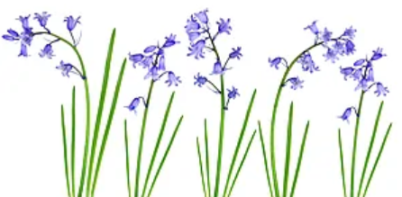
Bluebells Learning for Summer 1
Maths
This term, we will explore and investigate measurement; capacity, height, length and weight.
This will link in with our under the sea topic by using buckets to fill and empty, discuss size of objects and creatures and our own height.
Number rhymes will continue to play a key part in our learning too!
Rhymes you can sing at home to support our learning:
One, Two, Three, Four, Five. Once I Caught a Fish Alive https://www.youtube.com/watch?v=9ir_l7qTiZ4
Five Little Speckled Frogs https://www.youtube.com/watch?v=8VCpa4blanQ
Five Little Ducks
https://www.youtube.com/watch?v=pZw9veQ76fo
How Many Fingers?
https://www.youtube.com/watch?v=xNw1SSz18Gg
Home learning ideas:
Can you spot any numbers with your child on your way home from nursery? Can you ask them to count how many plates you need for tea? If your child is helping to wash up or with shopping, discuss when something is full, empty, heavy, light etc.
We would love you to take part in counting activities at home too! Please send any photos on Class Dojo.
Our book sequence for this half term is
Billy’s Bucket by Kes Gray and Garry Parsons.
Billy wants a bucket for his birthday. At first, his parents try and persuade him to have a more conventional present but eventually they take him to Buckets “R” Us to select his gift from a huge array. Once he fills his bucket with water, Billy claims he can see all the wonders of the ocean deeps and his parents humour him. However, when they ignore his instructions not to borrow his bucket, something amazing happens.
Our theme for this half term is Commotion in the Ocean.
We will be learning about sea-life and land animals, different countries in the world and talk about the differences we see; explore different undersea animals and their features. Use and explore new language from the illustrations such as fins, flippers, scales, coral, tusks etc. as well as that in the text such as sardine, barracuda, shoal, herring, stingray.
The children will also explore birthday celebrations, just like Billy, discussing their own experiences.
Earth Week is from 22nd – 26th April We are looking at how we can help our planet in different ways.
We are always investigating the outdoor environment, looking for signs of the season and weather. We are so excited to see our daffodils and tulips in full bloom as well as some shoots from seeds we have planted.
In Forest School, we will continue to observe the life cycle of a frog; hopefully we have tadpoles! And in nursery we are observing the life cycle of a butterfly!
Phonics
Phase One phonics is taught throughout the year in nursery. Phase One activities concentrate on developing children’s speaking and listening skills,
phonological awareness and oral blending and segmenting. These activities are intended
to be used as part of a broad and rich language curriculum that has speaking and listening
at its centre, links language with physical and practical experiences, and provides an
environment rich in print and abundant in opportunities to engage with books. Phase One
activities pave the way for children to make a good start in reading and writing.
Aspect 4 – Rhythm and Rhyme
This aspect aims to develop children’s appreciation and experiences of rhythm and rhyme in speech. Activities include rhyming stories, rhyming bingo, clapping out the syllables in words and odd one out.
Aspect 5 – Alliteration
The focus is on initial sounds of words, with activities including I Spy type games and matching objects that begin with the same sound.
Home learning ideas:
Play a game of I Spy with my little eye, something/someone beginning with…
Sing nursery rhymes and read stories together.
Vocabulary we will hear and begin to use.
Spring | The season after winter and before summer. Flowers and leaves on trees will begin to grow and some animals have their babies in spring.
Earth | The planet we live on.
Blossom | Flowers on a tree or bush.
Pond | A small area of fresh water for insects, fish, frogs to live.
Chrysalis | The form a caterpillar takes before emerging from the cocoon as a butterfly.
Sea-life | Animals and plants that live in the ocean.
Shoot | The stem of the plant, beginning to grow about the ground.
Frogspawn, Tadpoles | Eggs laid by female frogs, which then hatch into tadpoles.
Soil | A layer of earth. Soil is important in helping plants to grow.

Slide 2
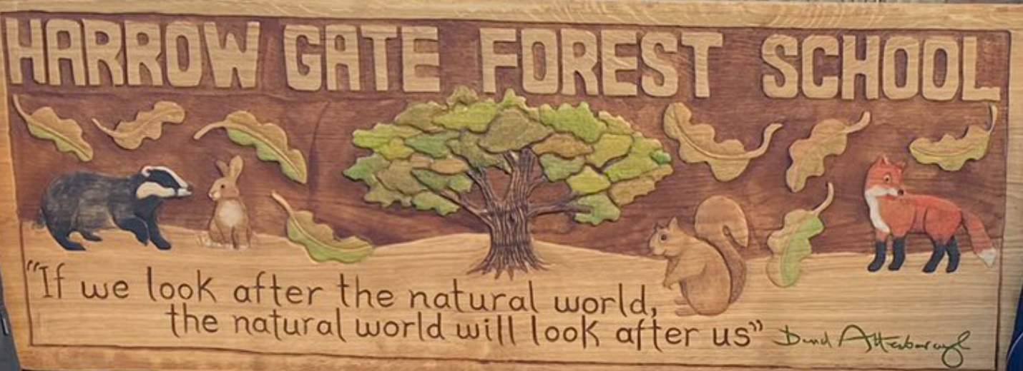
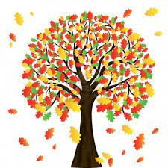
Bluebells Learning for Summer 1
Welcome back to nursery everyone!
We hope you have had a lovely break for half term.
We are really looking forward to the next exciting half term!
If you have any questions or concerns, please do not hesitate to talk to a member of the nursery team on the door or message via Class Dojo.
Home Learning
Are your sunflower seeds beginning to grow? We would love to see them, so please share photos on Class Dojo!
Are you planning a trip to the seaside? If so, what different objects can you find?
Go on a spring nature walk! What can you see? Try and name the flowers, animals or habitats, such as pond, river etc with your child.
We would love to see what you do together! Please send in a photo on Dojo and your child can share it with the rest of the class.
Forest School sessions offer the opportunity for children to become completely immersed in the natural environment, develop their physical, problem-solving and communication skills.
Forest School will take place every week.
Children attending full days will take part in both morning
and afternoon sessions.
Please ensure that your child wears comfortable and appropriate clothing to nursery. Children’s legs and arms must be covered so long sleeves and trousers or leggings are a must in Forest School. We will provide children with waterproof suits. We have some spare wellies, but not enough for everyone, so if your child has a pair at home, we would appreciate you sending them in.
It is important that they are prepared for all weathers as we will always be going outside.
Please can we remind parents and carers to put your child’s name in their jumpers and cardigans. Thank you.

